Slide 1

Sourcing from Africa – Opportunities & Challenges
Panel Discussion
Strategic Advisors
for the Global Economy
April 2011
Notes:
1

Slide 2
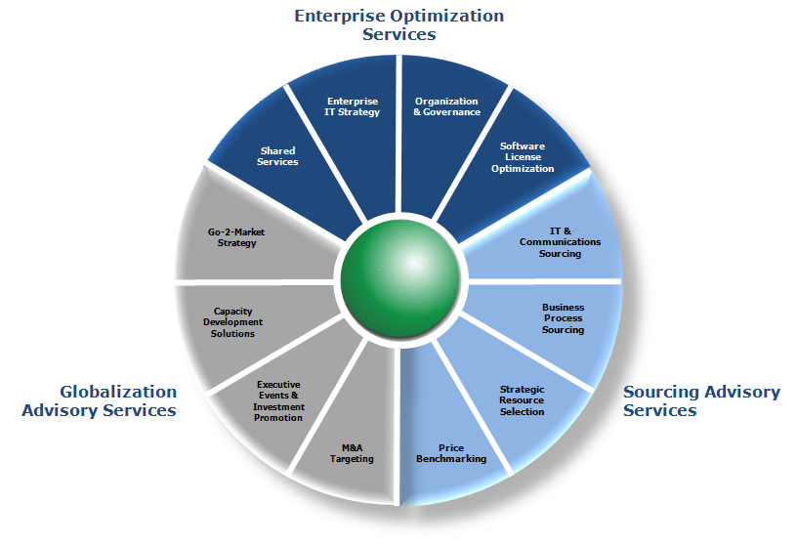
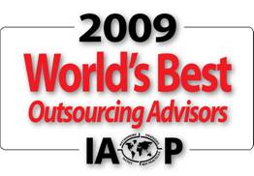
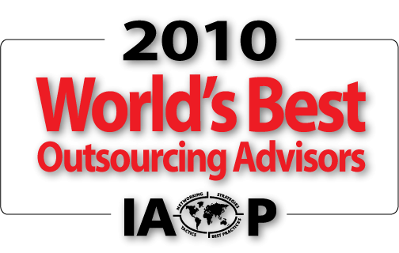

About Avasant
Within Avasant’s primary disciplines: Enterprise Optimization, Sourcing Advisory and Globalization Advisory; are comprehensive solutions sets which have been hailed across the industry in recent years
IAOP World’s Best - Avasant has also been the recipient of several awards for excellence in Management Consulting and Sourcing Advisory. Avasant has been designated among the “World’s Best Outsourcing Advisors” by the International Association of Outsourcing Professionals (IAOP) in 2009, 2010 and for 2011.

Slide 3
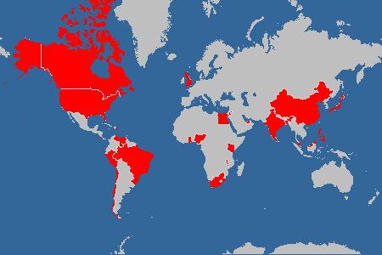
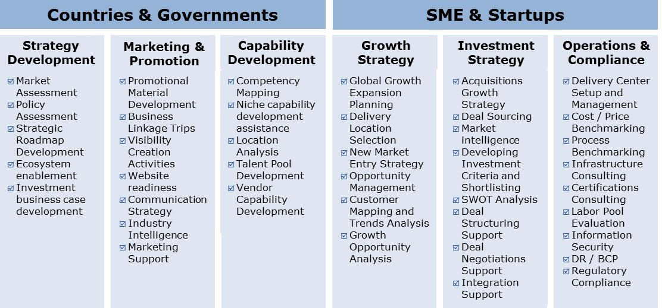
Avasant Global Services Footprint

Slide 4
Many factors are impacting Globalization today…
Cloud Computing
SaaS
Adoption of cloud computing and SaaS are revolutionizing the way services are delivered
Pay Per Use Model
Outcome Based Pricing
Political & Regulatory Environment
Political compulsions make governments take decision that can adversely affect outsourcing potential
Cost Rationalizations
Cost Pressure
Slow economic recovery is putting a lot of
pressure on organizations to cut costs
Lower Capex /
Rapid deployment
Re-engineering
Market Growth
Saturation of developed markets compared to strong growth in emerging markets
Global Footprint
Explore Emerging Markets that meets challenges, provides benefits & market differentiation
Cost Benefits
Skill Benefits
Market Access

Slide 5
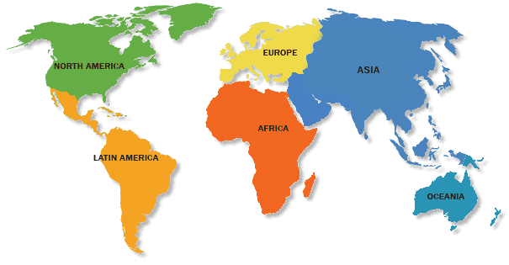
Leading to evolution of Globalization…
Globalization is being pursued now for gaining strategic market access
Lets take example of the call centre industry:
Market Access
Competitive Advantage
Skill Availability
Skill Availability
1.0 Call Centers moved from Ireland to Australia to India in search of lower costs.
2.0 Realizing that skills are critical factor lead to call centers moving to Philippines to take advantage of skills in voice processes.
3.0 Globalization is now seen as a tool for competitive advantage. Increasing trend of moving centers to region such as Africa where market potential is rising
Cost Arbitrage
Cost Arbitrage
Cost Arbitrage
Globalization 1.0
Globalization 2.0
Globalization 3.0

Slide 6
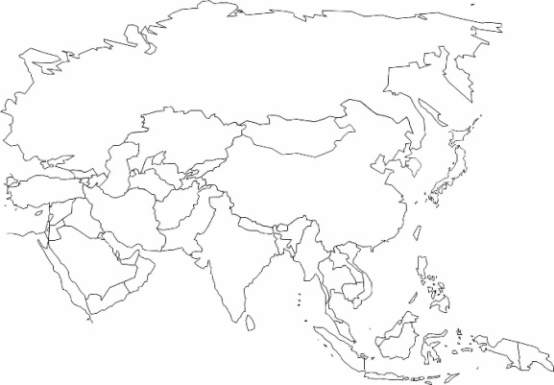
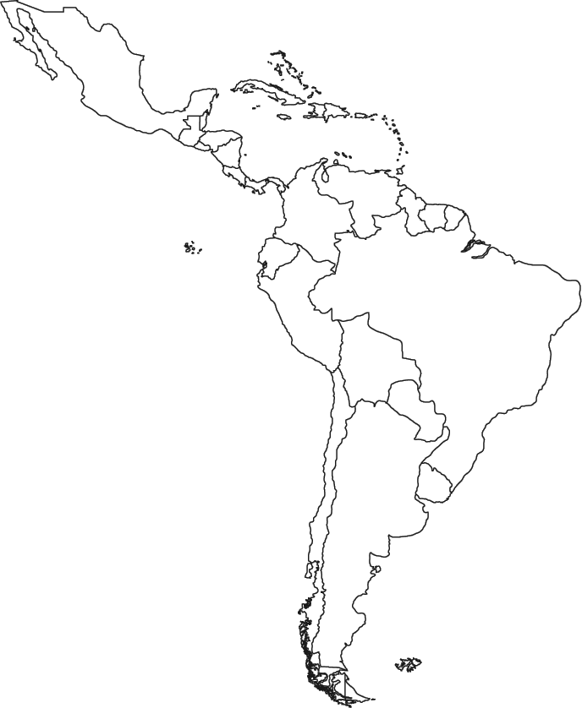
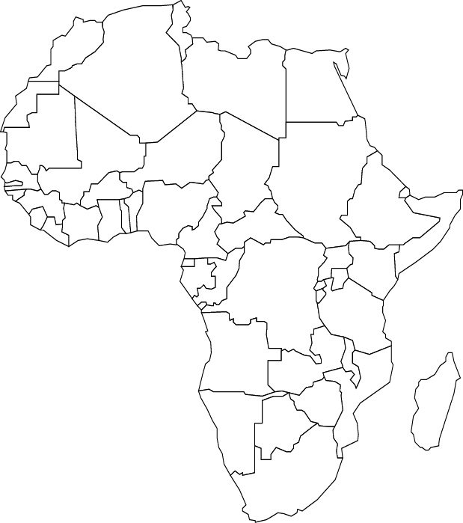
Each sourcing region has its own characteristic and are at different phases of growth cycle..
Mature locations such as India, China
Presence of most global corporations
Abundant talent pool
Proactive government
Incentives on their way out
Rising costs makes it unsuitable for low end operations
Explored locations such as Mexico, Chile
Strong in Non English support
Presence of most global corporations
Ideal for specific requirements and skills
Talent availability high in certain pockets
Unable to provide scale matching India / China
Availability of IT skills
Emerging locations such as Egypt, SA, Ghana
The most unexplored markets
Fast growing region – huge domestic market potential
Untapped talent pool
Incentives and red carpet from governments
Stability in political environment is a challenge in certain locations
Scale up issues and availability of IT skills

Slide 7

Emergence of Africa: Opportunities Galore

Slide 8
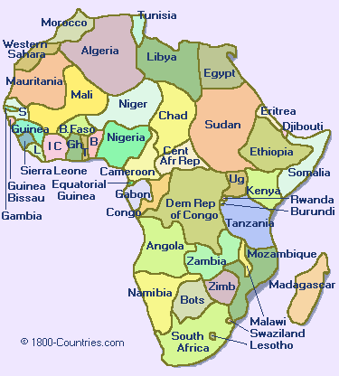
Africa – The Next Billion
50+ Countries with a population of over 1 billion
In last 5 years cellular market grew 5000% (400mn+ Telecom Subscribers); internet grew 630%
Fastest growing ICT market worldwide – 50% Growth YOY largely dominated by mobile telephony
According to IDC estimates, Africa's IT market is expected to be over $22 billion in 2010
Africa needs over $90 billion per year to build the infrastructure to support growth and meet development goals (World Bank estimates)
ICT & High-tech business on the agenda of many African governments which is seen as a catalyst for development
Africa presents Global Businesses with immense opportunity

Slide 9
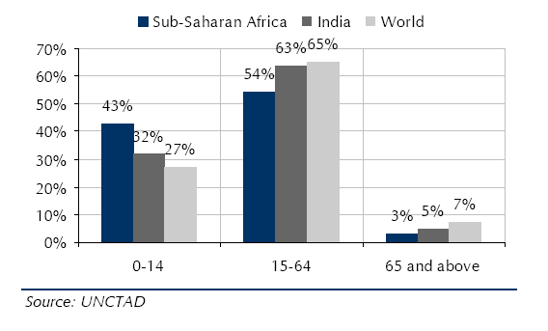
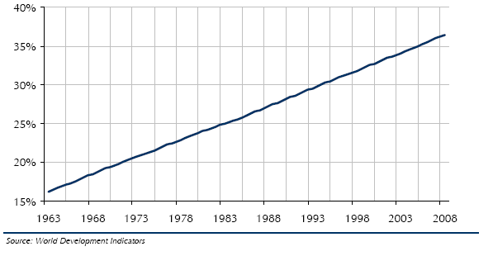
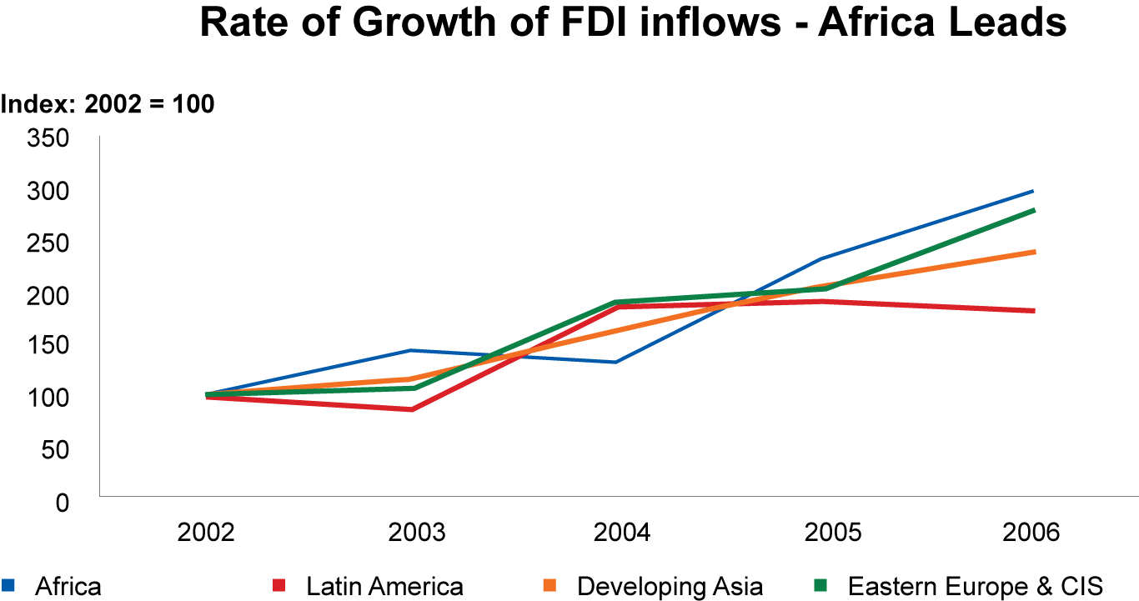
Africa is steadily climbing on most indictors
Declining Infant Mortality
40%+ population in Africa are in the 0-14-year age group, and seeing increasing healthcare facilities, reducing infant mortality rates and improving life expectancy
At ~36.4%, the urbanization in sub-Saharan Africa exceeds that of India’s 29.5%
Higher Urbanization
FDI Flows into Africa are Now Growing Faster than into any other Emerging Market Region
Favored Investment Destination
7 African countries have per capita GDP bigger than China.
Notes:
1Libya
2Mauritius
3South Africa
4Botswana
5Namibia
6Angola
7Algeria

Slide 10
Rapidly changing factors in the continent are bringing masses into mainstream economy
Positive Govt. Actions
Increased spending targeted towards poverty alleviation and social growth
WB, EU, AfDB providing over $70 bn of aid
Targeted action focusing governance and education
ICT seen as a key driver to achieve Millennium Development Goals (2015)
Increasing
Democracy
Economic Liberalization
Positive Leadership
Robust Economic Growth
Favorable investment climate
Rising Stock Markets
Stronger Currencies
Falling Interest Rates
Improved Optimism
Decreasing
Corruption
Violence
Political instability
Huge needs in areas of e-Governance, Education, Security, Healthcare and across private sectors are driving demand for ICT in Africa

Slide 11
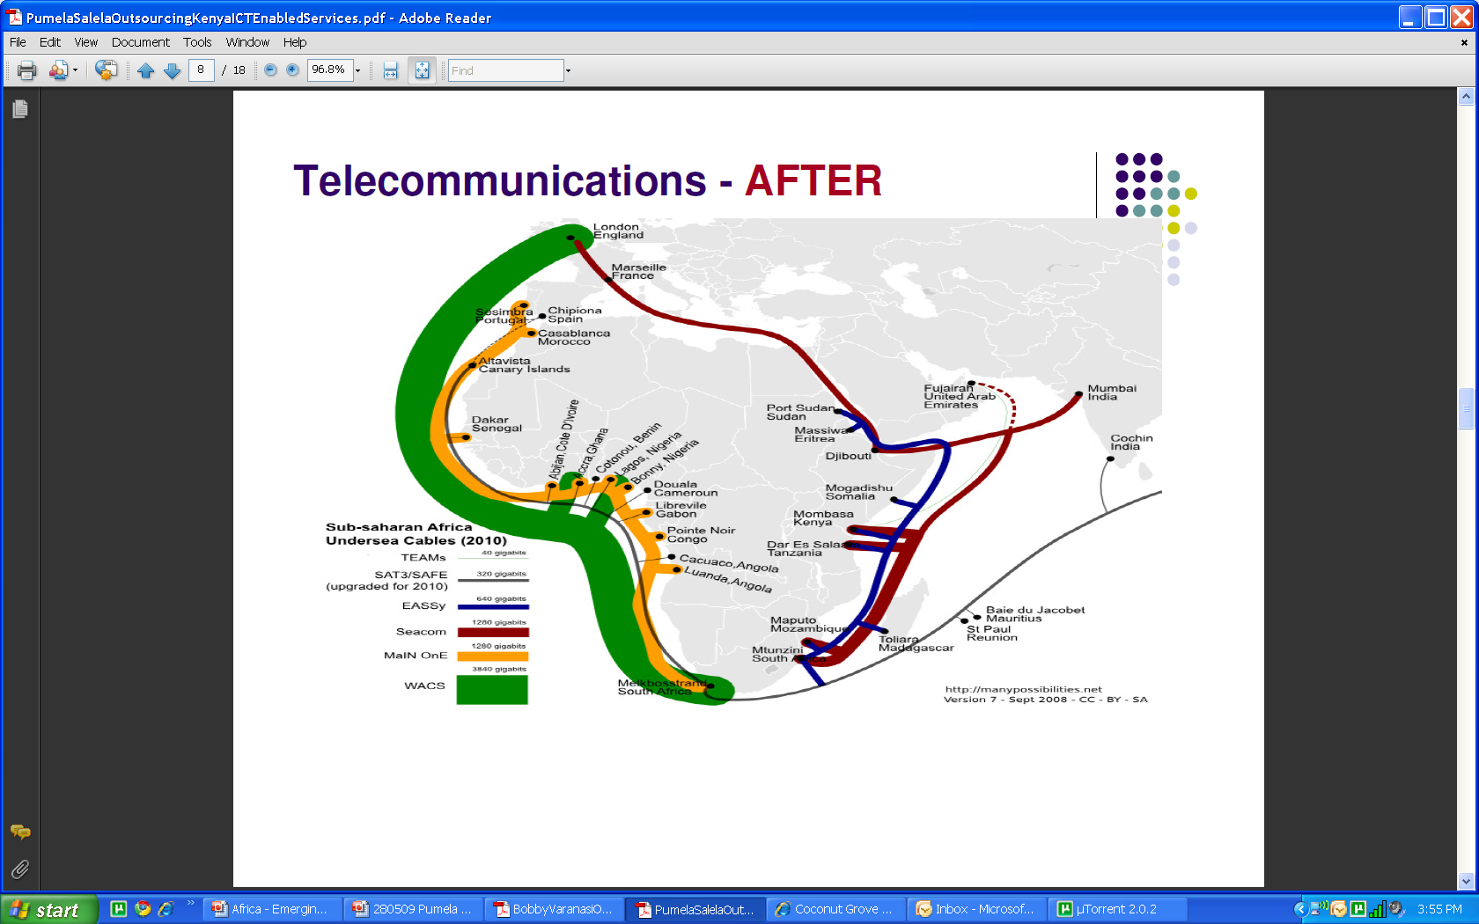
And governments have realized the importance of telecommunications in growth…
With the wave of undersea cables due to be completed by 2011, Drastic reduction expected in the cost of telecommunications and internet connectivity – Setting the stage for a number of opportunities in ICT enabled space
Seacom – Connecting East Coast
  13,700km undersea cable
  1280 Gigabytes
  to connect Southern & East Africa
  to India and Europe via Madagascar, Mozambique, Tanzania, Kenya
  complete 17 June 2009
  to provide low cost broadband
EASSy – Connecting East Coast
  to connect SA, Mozambique, Madagascar, Somalia, Djibouti, Sudan
  10 000km
  1280 Gigabytes
  to be complete by end of 2010
  Financed by WorldBank and DBSA
WACS – Connecting West Coast
  to UK
  3840 Gigabytes
  Complete first half of 2010
  to provide second cable & low cost broadband

Slide 12
Creating huge opportunities to be tapped
The reforms path adopted by many countries in Africa and addition of significant broadband capacity with installation of undersea cables will unlock huge demand of ICT services in multiple domains
Macro-Economic Changes / Policy Reforms
Infrastructural Improvement / Bandwidth Addition
Is leading to high growth in the following domains
TELECOM
Mobile telephony market has grown from 10 mn in 2000 to over 400 mn subscribers in 2010 Realizations higher than South Asia Growth expected to continue
BFSI
Rapidly growing economies have led to huge BFSI demand Implementation of IT solutions is on the rise Government initiatives on financial inclusion pushing growth
GOVERNMENT
Many projects on stream for e-governance ICT regarded highly among governments as a tool for social upliftment Governments increasingly planning to move many services online
In turn leading to high demand for following services
IT Services
Skill Training / E learning
Mobile VAS / Mobile Payments
Pay Per Use Services
Online / Web Based Services
BPO Services
Cloud Computing / Virtualization

Slide 13
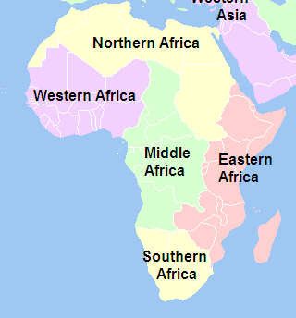
Knowing your entry points in the continent will maximize your returns…
North Africa North Africa comprises of important economies such as Egypt, Algeria and Morocco Egypt is the most advanced economy in terms of ICT and the preferred entry point into the region
West Africa West Africa comprises of countries such as Nigeria, Ghana and Ivory Coast Ghana, though being a smaller economy than Nigeria offers the most suitable investment climate in the region and is often referred as Gateway to West Africa
East Africa East Africa comprises of important economies such as Kenya, Tanzania and Uganda Kenya is the most aggressive ICT economy in the region with the government being proactive and willing to invest in the sector.
South Africa The Southern African region comprises of economies such as South Africa, Botswana and Zimbabwe South Africa offers a developed work environment and business climate and is a suitable entry point into the region

Slide 14
Africa as a Global Sourcing Location

Slide 15
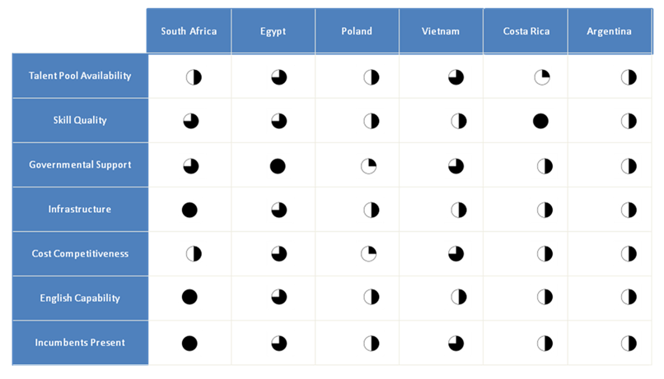
A number of African locations are presenting opportunities for delivering outsourcing services
 | Egypt | Tunisia | Morocco | South Africa | Kenya | Mauritius | Ghana
Key Cities | Cairo | Tunis | Rabat, Casablanca | Johannesburg, Cape Town | Nairobi | Port Louis, Ebene Cyber City | Accra
Key companies present | Cisco, Google, IBM, Microsoft, Orange, Convergys, EDS, Unisys | Teleperformance, IBM, Stream | Accenture, TCS, Atos Origin, EDS | IBM, Accenture, TCS, Atos Origin | Kencall | Accenture, Infosys, Ceridian, AXA, TNT, Orange | ACS
Processes currently offshored / potential | IT, Contact Center | R&D, Contact Center | IT, Contact Center | Contact Center, IT | Contact Center | Contact Center, IT, BPO | Contact Center, BPO
Languages | Arabic, English, French, German, Spanish | French, Arabic | French, Arabic | English | English | English, French | English, French
African locations are facing competition from a number of cities within the continent, with each location offering their own value proposition
The locations also face stiff competition from other emerging destinations in Latin America, South East Asia among others
Some of the mature locations such as South Africa, Egypt compare favorably with centers in other geographies

Slide 16











Global Corporations in Africa
A number of companies have made successful forays in Africa
IBM | 10 year $1.5-billion contract with Bharti Airtel to manage and support the IT infrastructure of its African operations. Consolidation of 16 different IT environments across Bharti Airtel's African operations into an integrated IT system and will oversee the management of all of the applications, data center operations, servers, storage and desktop services.
Tata Consultancy Services | $11.5-million transformational deal to design, install and integrate a tax administration system for the Uganda Revenue Authority (URA) Deals with government and private players in Morocco and Botswana including Botswana Telecom, Application Modernisation for Central Depository of Morocco
Mahindra Satyam | Engaged with South African State and Local Governments, Air Mauritius, State Bank and Revenue Authority of Mauritius ERP applications deal for Kenya Airways
HCL | Implementing IT Infrastructure for Prestigious Pan-African e-Network Project for Tele-education & Tele- medicine- connecting 53 African Nations
Infosys | Multiple installations for FINACLE in Nigeria and Kenya
Nucleus Software | 14+ implementations of its banking product in Africa
Notes:
16

Slide 17
Why should Global Business evaluate Africa?
Right Time
Africa has huge unmet ICT demand
Governments and business that were apprehensive till some time back have realized the potential of ICT and are willing to invest
Lesser Competition
Lack of service provider maturity has prevented many from outsourcing
Availability of competent providers can unlock the potential
Easier Market Penetration
With right approach and partnerships, Africa can be a more cost effective market to penetrate into than developed markets such as US / UK
Incentives & Support
Governments offering heavy incentives and tax benefits for investments in ICT including IT / BPO services
Favorable policies & red carpet welcome for ICT companies can be expected in most countries
Higher Realization
Billing rates are more lucrative than many regions of the world
Lack of deployable IT skills has also resulted in billing rates being higher than most developing nations

Slide 18

Case Studies

Slide 19
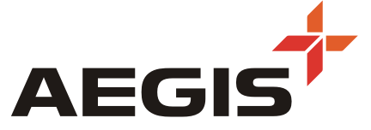
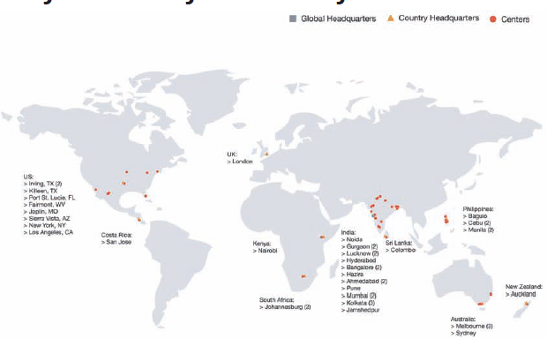

Aegis – Leading Emerging Markets Customer Care Company
Overview
A Tier One contact center company specializing in customer lifecycle services
US$ 500 MM Integrated BPO Leader providing Customer Interaction and Back-office Services
Ranks among the Top Contact Centers in India
33 Centers ; 10 in the US; 1 in Costa Rica; 15 in India; 5 in Philippines; 1 in Kenya & 1 in SAF
Employee: 31,000+ ; Seats: 20,000+
135 clients, 42 delivery centers, over 39,000 employees
2004
Essar acquires Aegis Communications Group; 2400 employees
2005
Acquires Swift Response, Customer First and Orion Dialog to gain access to Indian market
Service Offerings
Aegis CRM | Customer acquisition, service and retention, up-sell/cross-sell, travel planning and reservations, product inquiries, account billing, technical support
Aegis Collect | Early stage receivable, third party recoveries, data analytics, strict compliance adherence, payment processing, SAS 70 certification, skip tracing
Aegis Engineering | Hydrocarbon, petro chemical, metallurgy, power, OSBL/ISBL
Aegis Health | Revenue Cycle Management, claims processing, adjudication, eligibility and benefits
Aegis RapidText | Transcription, real-time & offline video captioning, time coding & indexing, data entry &verification services
Aegis Spend Mgmt | Source-to-contract processes, procure-to-pay processes, & invoice automation
Aegis Tech | Business solutions for unified communication, network infra., information security & apps, & business consulting
2006
Buys Technion to address database marketing space and gain VoiP expertise; reaches close to $ 100 mn revenues, 8000 FTEs
2007
Acquires Global Vantedge and Teletech to gain access to US receivables market
18000+ employees
2008
Acquires AOL India Captive, and People Support, Philippines
Crosses 30,000 employees; US$ 400 mn revenue
2009
Acquires CCN, South Africa, and UCMS (Australia) – reach 37,000 employees and $ 600 mn revenues

Slide 20
Thank You
Contact:
Kevin.S.Parikh
Senior Partner and CEO
Voice: (310) 643-3030
Mobile: (310) 995-1521
kevin.parikh@avasant.com
Consulting Advisors
for the Global Economy
Notes:
20

