Slide 1
Outline
Introduction
Anotation
Segmentation
Detection

Slide 2
Nodule interpretation (characteristics)
7 out of 9 semantic characteristics have a broad range of values for the 149 nodules
Characteristic | Possible Scores
Calcification | 1. Popcorn 2. Laminated 3. Solid 4. Non-central 5. Central 6. Absent
Internal structure | 1. Soft Tissue 2. Fluid 3. Fat 4. Air
Lobulation | 1. Marked 2. . 3. . 4. . 5. None
Malignancy | 1. Highly Unlikely 2. Moderately Unlikely 3. Indeterminate 4. Moderately Suspicious 5. Highly Suspicious
Characteristic | Possible Scores
Margin | 1. Poorly Defined 2. . 3. . 4. . 5. Sharp
Sphericity | 1. Linear 2. . 3. Ovoid 4. . 5. Round
Spiculation | 1. Marked 2. . 3. . 4. . 5. None
Subtlety | 1. Extremely Subtle 2. Moderately Subtle 3. Fairly Subtle 4. Moderately Obvious 5. Obvious
Texture | 1. Non-Solid 2. . 3. Part Solid/(Mixed) 4. . 5. Solid
2
Notes:
Talk more about interpretation (and interpretation variability) of separate semantic characteristics and move to the next two slides to show a specific example.

Slide 3
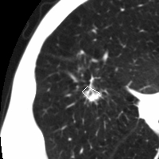
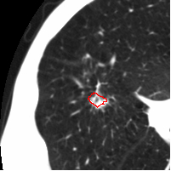

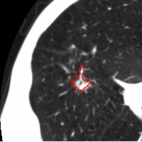

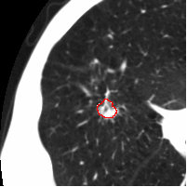

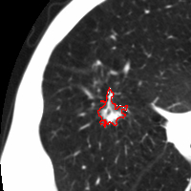
Interpretation
Reader 1 | Reader 2
Reader 3 | Reader 4
Lobulation - 4
Malignancy - 5
Margin - 4
Sphericity - 2
Spiculation - 1
Subtlety - 5
Texture - 4
Lobulation - 2
Malignancy - 5
Margin - 3
Sphericity - 5
Spiculation - 2
Subtlety - 5
Texture - 4
Lobulation - 1
Malignancy - 5
Margin - 3
Sphericity - 4
Spiculation - 2
Subtlety - 5
Texture - 5
Lobulation - 5
Malignancy - 5
Margin - 2
Sphericity - 3
Spiculation - 4
Subtlety - 5
Texture - 4
Not only ratings, but also boundaries are different

Slide 4
Proposed methodology
The automatic mapping extraction is:
    SEMI-SUPERVISED
    Only small amount of data is initially labeled.
    Based on ACTIVE LEARNING
    Iteratively adds data to the training set.

Slide 5
Methodology: Ensemble of classifiers (Active-Decorate)
5
Notes:
And how active decorate extends it

Slide 6
Results (Accuracy)
Characteristics | Decision trees | Add instances predicted with high confidence (60%) | Add instances predicted with high confidence (60%) and instances with low margin (5%)
Lobulation | 27.44% | 81.00% | 69.66%
Malignancy | 42.22% | 96.31% | 96.31%
Margin | 35.36% | 98.68% | 96.83%
Sphericity | 36.15% | 91.03% | 90.24%
Spiculation | 36.15% | 63.06% | 58.84%
Subtlety | 38.79% | 93.14% | 92.88%
Texture | 53.56% | 97.10% | 97.36%
Average | 38.52% | 88.62% | 86.02%
6
Notes:
Present the results. Show that both approaches improved the accuracy for all semantic characteristics in comparison with the decision trees. Mention that difference in accuracies between two approaches are not significant except for lobulation. Depending on how much time will be left talk about further work (what we are doing right now) either show and explain the next slide or list what we have tried to do.

Slide 7
Radiology report

Slide 8
IRMA
- T (technical): image modality
- D (directional): body orientation
- A (anatomical): body region examined
- B (biological): biological system examined
This allows a short and unambiguous notation (IRMA: TTTT – DDD – AAA – BBB),

Slide 9
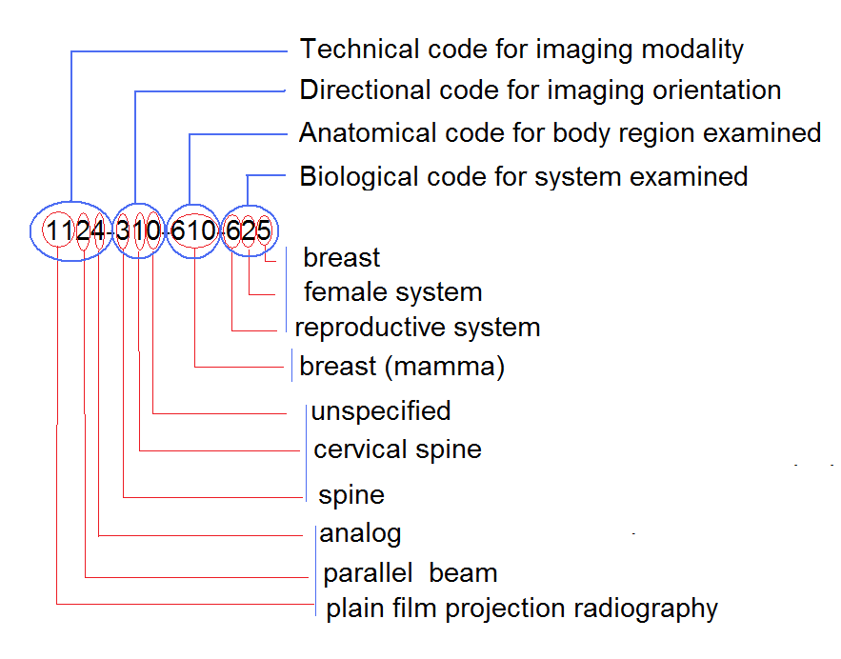
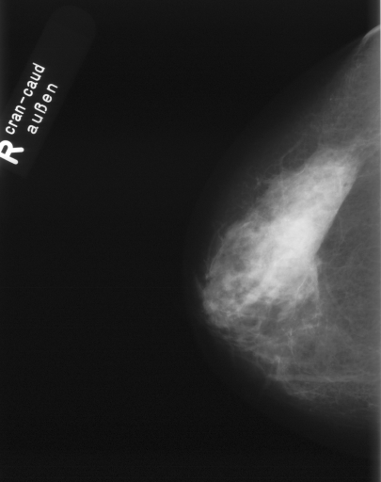
IRMA

Slide 10
Questions?

