Slide 1
Applications of NLP in determining Tag Redundancy in Folksonomies
Progress Report, November 9, 2009
Tom Schimoler

Slide 2
Big Question:
What is redundancy?
Although I have previously demonstrated examples of redundancy in tag clouds, there must be a formal, measurable way of expressing redundancy.

Slide 3
A Relational Model of Folksonomies
Folksonomies are comprised of 3 entity-types in a ternary relationship:
Users: generate annotation content (Subject)
Resources: items of interest (Object)
Tags: semantic “glue” tying users to resources (Predicate)
Aside from the basic annotation relation (u, r, t), we can define a number of relations which impart deeper information

Slide 4
General Tagging Relations
tag-tag: we can define 3 notions of “co-occurrence”
Annotation-level: the tags have been used by the same person on the same resource
User-level: the tags have been used by the same person for difference resources
Resource-level: the tags have been used by different people for the same resource
resource-resource: analogous to the above, we can also define 3 “co-occurrence” relations for resources
These relations are directly observable and do not impart explicit semantic information

Slide 5
Non-domain specific Semantic Relations
A basic assumption of folksonomy research is that the explicit tagging relations imply deeper semantic relations
tag-tag:
alternate spelling: (“rock and roll”, “rock ‘n’ roll”)
alias: (“nlp”, “natural language processing”)
sympathetic: (“awesome”, “cool”)
antithetic: (“cool”, “sucks”)

Slide 6
Semantic relations in the Music Domain
Within Last.fm are semantic relations which are specific to the music domain
tag-tag:
sub-genre: (“heavy metal”, “death metal”)
resource-tag:
genre: (The Pixies, “indie rock”)
location: (The Pixies, “boston”)
era: (The Pixies, “80s”)
resource-resource:
membership: (Frank Black, The Pixies)
label-mates: (Throwing Muses, The Pixies)
influence: (The Pixies, Nirvana)

Slide 7
Context-sensitive semantic relations
Some relations are useful only within a specific context (e.g., a user or community of users)
judgment: (The Pixies, “genius”)
misinformation: (The Pixies, “japanese”)

Slide 8
Redundancy as Relation
Redundancy: a resource-specific semantic relation between tags suggesting that both tags impart the same amount and style of information about a resource
Are “cool” and “awesome” in a redundancy relation?

Slide 9
Redundancy as Relation
Redundancy: a resource-specific semantic relation between tags suggesting that both tags impart the same amount and style of information about a resource
Are “cool” and “awesome” in a redundancy relation?
In the context of, for instance, Metallica, this seems like a reasonable assertion

Slide 10
Redundancy as Relation
Redundancy: a latent resource-specific semantic relation between tags in which both tags impart the same amount and style of information about the resource
Are “cool” and “awesome” in a redundancy relation?
In the context of, for instance, Metallica, this seems like a reasonable assertion
Given another resource, Miles Davis, the question is not clear cut; “cool” has a particular meaning (it’s a sub-genre of jazz) which is entirely different than the judgment tag “awesome”

Slide 11
Rule-based Determination of Redundancy
One way to methodically determine the redundancy relation is through rules in which the antecedents are given as explicit relations
Examples:
alt.spelling(t1, t2) → redundant(t1,t2) w.r.t. any resource r
location(r,t1) and location(r,t2) → redundant(t1,t2) w.r.t. r
Rules are learned and applied through ML

Slide 12
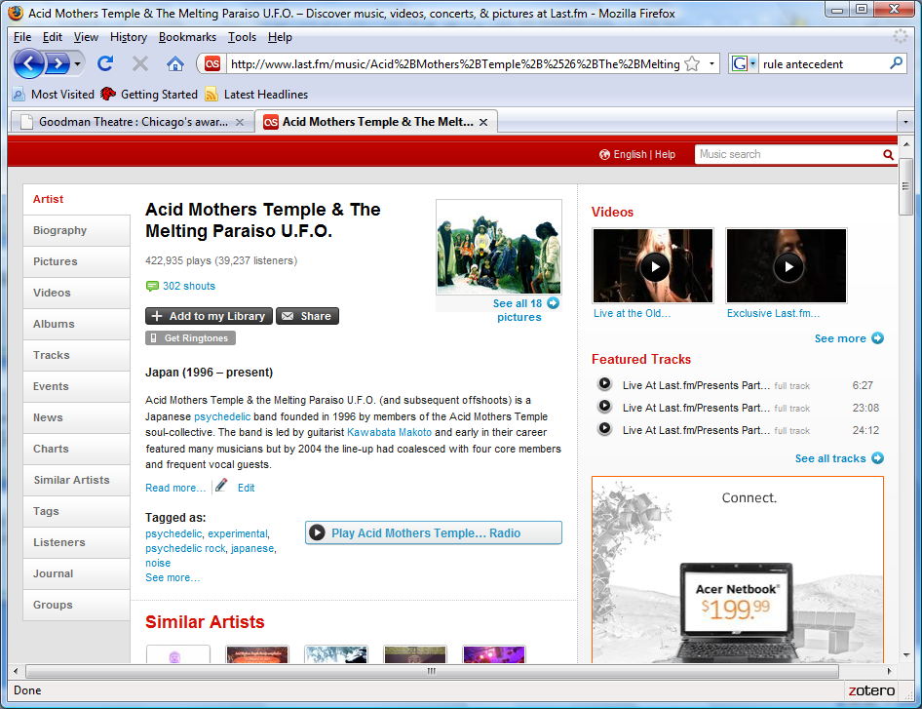
Problem
We require a great deal of a priori semantic information in order to derive rules
This information is embedded in the natural language text of wiki’s associated with both tags and resources
Therefore, NLP is used to extract this information
An alternative (augmented) approach is to defer to a full ontology; this is well beyond the scope of the current project

Slide 13
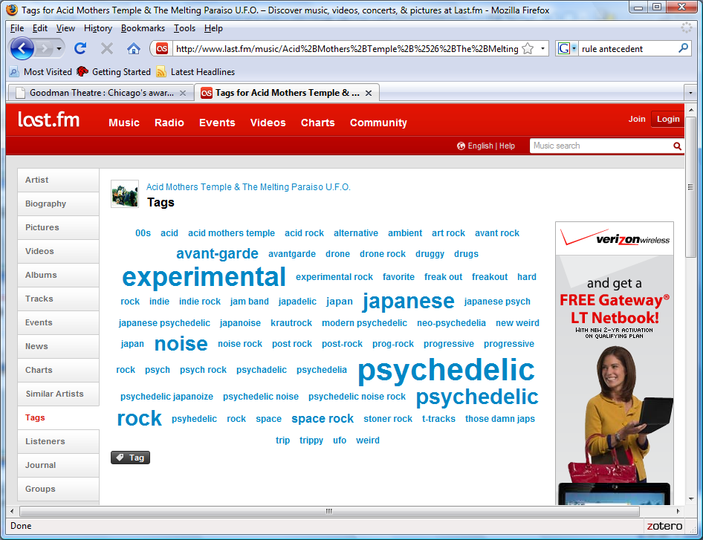

Slide 14
Data Example
<Acid Mothers Temple & the Melting Paraiso U.F.O.> (and subsequent offshoots) is a <<Japanese> <psychedelic>> band founded in <1996> by members of the <Acid Mothers Temple> soul-collective. The band is led by guitarist <Kawabata Makoto> and early in their career featured many musicians but by <2004> the line-up had coalesced with four core members and frequent vocal guests.
The band have a reputation for <<phenomenal> <live>> shows and releasing frequent albums on a number of international record labels, including the <Acid Mothers Temple> family record label which was established in <1998> to document the activities of the whole collective.
Offshoots and permutations include:
* <Acid Mothers Temple & The Cosmic Inferno>
* <Mothers of Invasion>
* <Acid Mothers Temple SWR>
* <Acid Mothers Afrirampo>
* <Acid Mothers Gong>
* <Acid Mothers Temple & The Pink Ladies Blues>
* <Acid Mothers Guru Guru>

