Slide 1
Towards the Question of Redundancy in Social Tagging Networks

Slide 2
Social Tagging
Users annotate things (resources) with labels (tags)
These annotations are shared, creating a collaborative dataset called a folksonomy
coffee
User A
programming
User B
java

Slide 3
Recommendation in Folksonomies
With some knowledge about a tagging user, we want to present that user with new information:
Given a resource, what are some tags that the user may find appropriate for annotation?
Given a tag (or set of tags), what are some relevant resources the user may find interesting?
Generally, what resources may interest the user?
What other users have similar interests to this user?
The first of these has been the focus of most recommender research.

Slide 4
Tag Recommendation
Task: Recommend tags during the annotation process
Benefits
Reduce user effort
Encourage tags more frequently
Encourage the application of more tags
Reuse common tags
Offer tags the user had not previously considered
Reduce noise created by capitalization inconsistencies, spelling errors and other discrepancies.
Results: A cleaner denser dataset that is useful in its own right or for future data mining techniques.

Slide 5
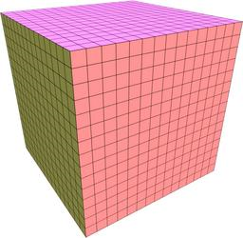
Data Structure
UR
UT
TR

Slide 6
Techniques for Tag Recommendation
Memory-based
Simple Popularity contest
K-Nearest Neighbor, adapted from CF
Model-based
Link Analysis (Adapted PageRank, FolkRank)
Latent Concept Models
LSA (using SVD or Hebbian deflation)
pLSA (using learned belief networks
Knowledge-based
Use external ontology to relate tags/resources

Slide 7
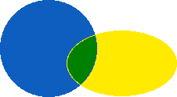
Evaluation
What makes a “good” tag recommendation?
According to IR tradition, we measure the predictive power of a recommendation algorithm

Slide 8
The Real Motivation
Consider the following recommendations for a resource representing a research paper on folksonomies
Is prediction really what we want in a practical recommendation system?

