Slide 1
Overview of Web Mining and
E-Commerce Data Analytics
Bamshad Mobasher
DePaul University

Slide 2
Why Data Mining
Increased Availability of Huge Amounts of Data
  point-of-sale customer data (Walmart: 60M transactions per day)
  E-commerce transaction data
  digitization of text, images, video, voice, etc.
  World Wide Web and Online collections
  usage/navigation data (Yahoo: 20 terabytes of clickstream data per day)
Data Too Large or Complex for Classical or Manual Analysis
  number of records in millions or billions
  high dimensional data (too many fields/features/attributes)
  often too sparse for rudimentary observations
  high rate of growth (e.g., through logging or automatic data collection)
  heterogeneous data sources
Business Necessity
  e-commerce
  high degree of competition
  personalization, customer loyalty, market segmentation

Slide 3
From Data to Wisdom
Data
  The raw material of information
Information
  Data organized and presented by someone
Knowledge
  Information read, heard or seen and understood and integrated
Wisdom
  Distilled knowledge and understanding which can lead to decisions
Wisdom
Knowledge
Information
Data
The Information Hierarchy

Slide 4
What is Data Mining
What do we need?
  Extract interesting and useful knowledge from the data
  Find rules, regularities, irregularities, patterns, constraints
  hopefully, this will help us better compete in business, do research, learn concepts, make money, etc.
Data Mining: A Definition
The non-trivial extraction of implicit, previously unknown and potentially useful knowledge from data in large data repositories
  Non-trivial: obvious knowledge is not useful
  implicit: hidden difficult to observe knowledge
  previously unknown
  potentially useful: actionable; easy to understand

Slide 5

Data Mining’s Virtuous Cycle
Identifying the business problem*
Mining data to transform it into actionable information
Acting on the information
Measuring the results
* Textbook interchanges “problem” with “opportunity”
5
Notes:
5

Slide 6
1. Identify the Business Opportunity
6
First Step: clearly identify the business problem that requires a solution
  Then translate this problem into a data mining problem
Many business processes are good candidates:
  New product introduction / eliminating a product line
  Direct marketing campaign
  Understanding customer attrition/churn
  Evaluating the results of a test market
Measurements from past DM efforts:
  What types of customers responded to our last campaign?
  Where do the best customers live?
  Are long waits in check-out lines a cause of customer attrition?
  What products should be promoted with our XYZ product?
Notes:
6

Slide 7
2. Mining data to transform it into actionable information
Success is making business sense of the data
Need to identify the right data mining tasks that can address the specified problem
Numerous data “issues”:
  Bad data formats (alpha vs numeric, missing, null, bogus data)
  Confusing data fields (synonyms and differences)
  Lack of functionality (“I wish I could…”)
  Legal ramifications (privacy, etc.)
  Organizational factors (unwilling to change “our ways”)
  Lack of timeliness
7
Notes:
7

Slide 8
3. Acting on the Information
This is the purpose of Data Mining – with the hope of adding value
What type of action?
  Interactions with customers, prospects, suppliers
  Modifying service procedures
  Adjusting inventory levels
  Consolidating
  Expanding
  Etc…
8
Notes:
8

Slide 9
4. Measuring the Results
Assesses the impact of the action taken
Often overlooked, ignored, skipped
Planning for the measurement should begin when analyzing the business opportunity, not after it is “all over”
Assessment questions (examples):
  Did this ____ campaign do what we hoped?
  Did some offers work better than others?
  Did these customers purchase additional products?
  Tons of others…
9
Notes:
9

Slide 10
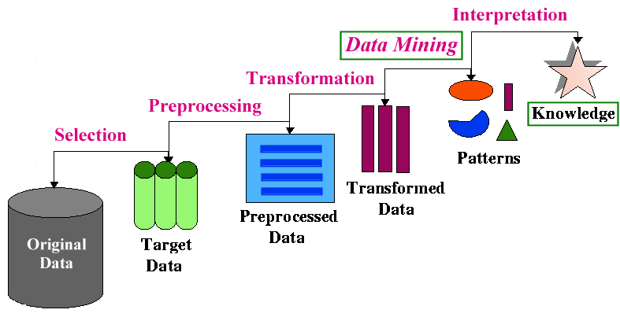
The Knowledge Discovery Process
Data Mining v. Knowledge Discovery in Databases (KDD)
  DM and KDD are often used interchangeably
  actually, DM is only part of the KDD process
- The KDD Process

Slide 11
What Can Data Mining Do
Two kinds of knowledge discovery: directed and undirected
Directed Knowledge Discovery
  Purpose: Explain value of some field in terms of all the others (goal-oriented)
  Method: select the target field based on some hypothesis about the data; ask the algorithm to tell us how to predict or classify new instances
  Examples:
    what products show increased sale when cream cheese is discounted
    which banner ad to use on a web page for a given user coming to the site
Undirected Knowledge Discovery
  Purpose: Find patterns in the data that may be interesting (no target field)
  Method: clustering, affinity grouping
  Examples:
    which products in the catalog often sell together
    market segmentation (groups of customers/users with similar characteristics)

Slide 12
What Can Data Mining Do
Many Data Mining Tasks
  often inter-related
  often need to try different techniques for each task
  each tasks may require different types of knowledge discovery
What are some of data mining tasks
  Classification
  Prediction
  Characterization
  Discrimination
  Affinity Grouping
  Clustering
  Sequence Analysis
  Description

Slide 13
Some Applications of Data mining
Business data analysis and decision support
  Marketing focalization
    Recognizing specific market segments that respond to particular characteristics
    Return on mailing campaign (target marketing)
  Customer Profiling
    Segmentation of customer for marketing strategies and/or product offerings
    Customer behavior understanding
    Customer retention and loyalty
    Mass customization / personalization

Slide 14
Some Applications of Data mining
Business data analysis and decision support (cont.)
  Market analysis and management
    Provide summary information for decision-making
    Market basket analysis, cross selling, market segmentation.
    Resource planning
  Risk analysis and management
    "What if" analysis
    Forecasting
    Pricing analysis, competitive analysis
    Time-series analysis (Ex. stock market)

Slide 15
Some Applications of Data mining
Fraud detection
  Detecting telephone fraud:
    Telephone call model: destination of the call, duration, time of day or week
    Analyze patterns that deviate from an expected norm
    British Telecom identified discrete groups of callers with frequent intra-group calls, especially mobile phones, and broke a multimillion dollar fraud scheme
  Detection of credit-card fraud
  Detecting suspicious money transactions (money laundering)
Text mining:
  Message filtering (e-mail, newsgroups, etc.)
  Newspaper articles analysis
  Text and document categorization
Web Mining . . .

Slide 16
What is Web Mining
From its very beginning, the potential of extracting valuable knowledge from the Web has been quite evident
  Web mining is the collection of technologies to fulfill this potential.
Web Mining Definition
application of data mining and machine learning techniques to extract useful knowledge from the content, structure, and usage of Web resources.

Slide 17
Types of Web Mining
Web Mining
Web Content
Mining
Web Usage
Mining
Web Structure
Mining

Slide 18
Types of Web Mining
Web Mining
Web Content
Mining
Web Usage
Mining
Web Structure
Mining
Extracting useful knowledge from the contents of Web documents or other semantic information about Web resources

Slide 19
Types of Web Mining
Web Mining
Web Content
Mining
Web Usage
Mining
Web Structure
Mining
Content data may consist of text, images, audio, video, structured records from lists and tables, or item attributes from backend databases.

Slide 20
Types of Web Mining
Web Mining
Web Content
Mining
Web Usage
Mining
Web Structure
Mining
Applications:
document clustering or
categorization
topic identification / tracking
concept discovery
focused crawling
content-based personalization
intelligent search tools

Slide 21
Types of Web Mining
Web Mining
Web Content
Mining
Web Usage
Mining
Web Structure
Mining
Extracting interesting patterns from user interactions with resources on one or more Web sites

Slide 22
Types of Web Mining
Web Mining
Web Content
Mining
Web Usage
Mining
Web Structure
Mining
Applications:
user and customer behavior modeling
Web site optimization
e-customer relationship management
Web marketing
targeted advertising
recommender systems

Slide 23
Types of Web Mining
Web Mining
Web Content
Mining
Web Usage
Mining
Web Structure
Mining
Discovering useful patterns from the hyperlink structure connecting Web sites or Web resources

Slide 24
Types of Web Mining
Web Mining
Web Content
Mining
Web Usage
Mining
Web Structure
Mining
Data sources include the explicit hyperlink between documents, or implicit links among objects (e.g., two objects being “tagged” using the same keyword).

Slide 25
Types of Web Mining
Web Mining
Web Content
Mining
Web Usage
Mining
Web Structure
Mining
Applications:
document retrieval and
ranking (e.g., Google)
discovery of “hubs” and
“authorities”
discovery of Web
communities
social network analysis

Slide 26
Web Content Mining
:: common approaches and applications
Basic notion: document similarity
  Most Web content mining and information retrieval applications involve measuring similarity among two or more documents
  Vector representation facilitates similarity computations using vector-space operations (such as Cosine of the angle between two vectors)
Examples
  Search engines: measure the similarity between a query (represented as a vector) and the indexed document vectors to return a ranked list of relevant documents
  Document clustering: group documents based on similarity or dissimilarity (distance) among them
  Document categorization: measure the similarity of a new document to be classified with representations of existing categories (such as the mean vector representing a group of document vectors)
  Personalization: recommend documents or items based their similarity to a representation of the user’s profile (may be a term vector representing concepts or terms of interest to the user)

Slide 27
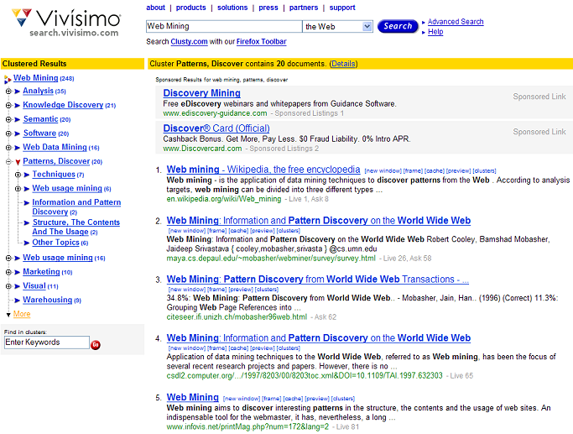
Web Content Mining
:: example – clustered search results
Can drill down within clusters to view sub-topics or to view the relevant subset of results

Slide 28
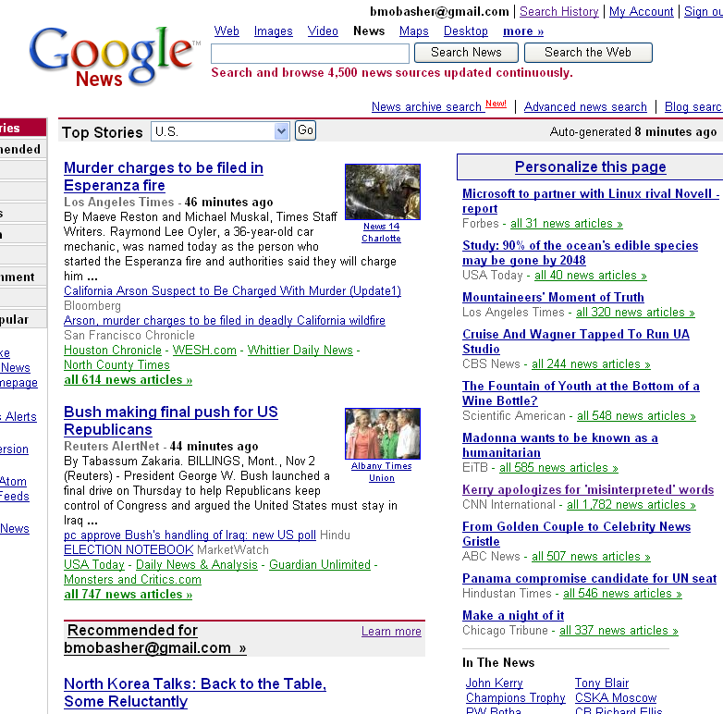
Web Content Mining
:: example – personalized content delivery
Google's personalized news is an example of a content-based recommender system which recommends items (in part) based on the similarity of their content to a user’s profile (gathered from search and click history)

Slide 29
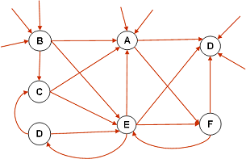
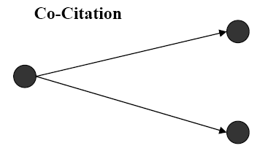
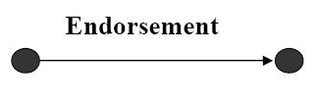
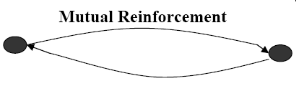
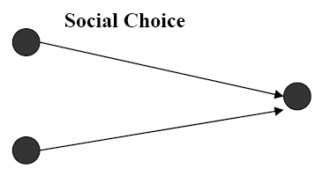
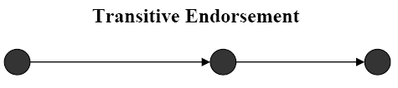
Web Structure Mining
:: graph structures on the Web
The structure of a typical Web graph
  Web pages as nodes
  hyperlinks as edges connecting two related pages
Hyperlink Analysis
  Hyperlinks can serve as a tool for pure navigation
  But, often they are used to point to pages with authority on the same topic as the source page (similar to a citation in a publication)
Some interesting Web structures *

Slide 30
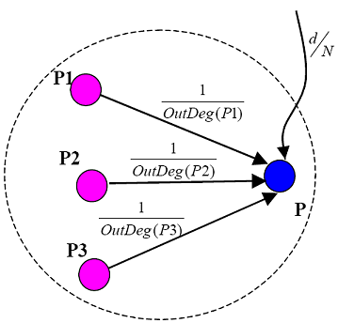

Web Structure Mining
:: example – Google’s PageRank algorithm
Basic idea:
  Rank of a page depends on the ranks of pages pointing to it
  Out Degree of page is the number of edges pointing away from it – used to compute the contribution of the page to those to which it points
  The final PageRank value represents the probability that a random surfer will reach the page
  d is the prob. that a random surfer chooses the page directly rather than getting there via navigation
Illustration of PageRank propagation

Slide 31
Web Structure Mining
:: example – Hubs and Authorities
Basic idea
  Authority comes from in-edges
  Being a hub comes from out-edges
Mutually re-enforcing relationship
  A good authority is a page that is pointed to by many good hubs.
  A good hub is a page that points to many good authorities.
  Together they tend to form a bipartite graph
This idea can be used to discover authoritative pages related to a topic
  HITS algorithm – Hypertext Induced Topic Search
Hubs
Authorities

Slide 32
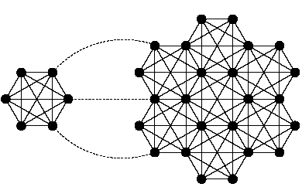
Web Structure Mining
:: example – online communities
Community 2
Basic idea
  Web communities are collections of Web pages such that each member node has more hyperlinks (in either direction) within the community than outside the community.
Typical approach: Maximal-flow model *
  Ex: separate the two subgraphs with any choice of source node (left subgraph) and sink node (right subgraph), removing the three dashed links
Community 1
Source
node
sink
* Source: G. Flake, et al. “Self-Organization and Identification of Web Communities”, IEEE Computer,
Vol. 35, No. 3, pp. 66-71, March 2002 .

Slide 33
Web Usage Mining
The Problem: analyze Web navigational data to
  Find how the Web site is used by Web users
  Understand the behavior of different user segments
  Predict how users will behave in the future
  Target relevant or interesting information to individual or groups of users
  Increase sales, profit, loyalty, etc.
Challenge
  Quantitatively capture Web users’ common interests and characterize their underlying tasks

Slide 34
Applications of Web Usage Mining
Electronic Commerce
  design cross marketing strategies across products
  evaluate promotional campaigns
  target electronic ads and coupons at user groups based on their access patterns
  predict user behavior based on previously learned rules and users’ profiles
  present dynamic information to users based on their interests and profiles: “Web personalization”
Effective and Efficient Web Presence
  determine the best way to structure the Web site
  identify “weak links” for elimination or enhancement
  prefetch files that are most likely to be accessed
  enhance workgroup management & communication
Search Engines
  Behavior-based ranking

Slide 35
Web Usage Mining
:: data sources
Typical Sources of Data:
  automatically generated Web/application server access logs
  e-commerce and product-oriented user events (e.g., shopping cart changes, product clickthroughs, etc.)
  user profiles and/or user ratings
  meta-data, page content, site structure
User Transactions
  sets or sequences of pageviews possibly with associated weights
  a pageview is a set of page files and associated objects that contribute to a single display in a Web Browser

Slide 36
What’s in a Typical Server Log?

Slide 37
Typical Fields in a Log File Entry
client IP address 1.2.3.4
base url maya.cs.depaul.edu
date/time 2006-02-01 00:08:43
http method GET
file accessed /classes/cs589/papers.html
protocol version HTTP/1.1
status code 200 (successful access)
bytes transferred 9221
referrer page http://dataminingresources.blogspot.com/
user agent Mozilla/4.0+(compatible;+MSIE+6.0;+Windows+NT+5.1;
+SV1;+.NET+CLR+2.0.50727)
In addition, there may be fields corresponding to
login information
client-side cookies (unique keys, issued to clients in order to identify
a repeat visitor)
session ids issued by the Web or application servers

Slide 38
Basic Entities in Web Usage Mining
User (Visitor) - Single individual that is accessing files from one or more Web servers through a Browser
Page File - File that is served through HTTP protocol
Pageview - Set of Page Files that contribute to a single display in a Web Browser
User Session - Set of Pageviews served due to a series of HTTP requests from a single User across the entire Web.
Server Session - Set of Pageviews served due to a series of HTTP requests from a single User to a single site
Transaction (Episode) - Subset of Pageviews from a single User or Server Session

Slide 39
Main Challenges in Data Collection and Preprocessing
Main Questions:
  what data to collect and how to collect it; what to exclude
  how to identify requests associated with a unique user sessions (HTTP is “stateless”)
  how to identify/define user transactions (within each session)
  how to identify what is the basic unit of analysis (e.g., pageviews, items purchased)
  how to integrate e-commerce data with usage data
Problems:
  user ids are usually suppressed due to security concerns
  individual IP addresses are sometimes hidden behind proxy servers; may not be unique
  client-side & proxy caching makes server log data less reliable
  data must be integrated from multiple sources (e.g., server logs, content data, e-commerce applications servers, customer demographic data, etc.)
Standard Solutions/Practices:
  user registration, cookies, server extensions and URL re-writing, cache busting
  heuristic approaches to session/user identification and “path completion”

Slide 40
Usage Data Preparation Tasks
Data cleaning
  remove irrelevant references and fields in server logs
  remove references due to spider navigation
  add missing references due to client-side caching
Data integration
  synchronize data from multiple server logs
  integrate e-commerce and application server data
  integrate meta-data
Data Transformation
  pageview identification
  identification of unique users
  sessionization – partitioning each user’s record into multiple sessions or transactions (usually representing different visits)
  mapping between user sessions and topics or categories
  Associating weights with object/pageviews in one session or transaction

Slide 41
Conceptual Representation of User Transactions or Sessions
Pageview/objects
Sessions/user transactions
This is the typical representation of the data, after preprocessing, that is used for input into data mining algorithms. Raw weights may be binary, based on time spent on a page, or other measures of user interest in an item. In practice, need to normalize or standardize this data.

Slide 42
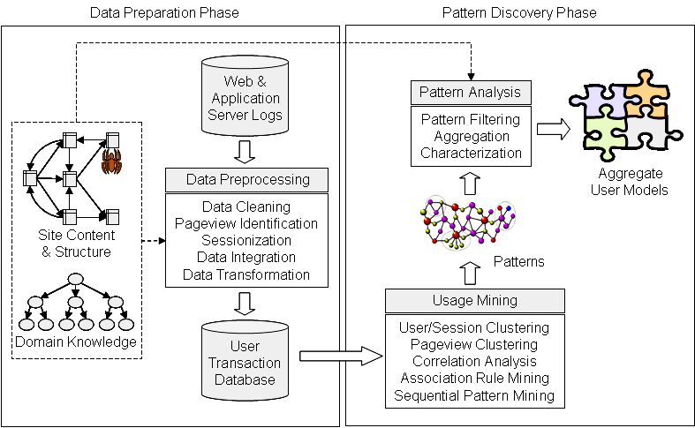
Web Usage Mining as a Process

Slide 43
E-Commerce Data
Integrating E-Commerce and Usage Data
  Needed for analyzing relationships between navigational patterns of visitors and business questions such as profitability, customer value, product placement, etc.
  E-business / Web Analytics
  E.g., tracking and analyzing conversion of browsers to buyers
E-Commerce v. Simple Usage Data
  E-commerce data is product oriented while usage data is pageview oriented
  Usage events (pageviews) are well defined and have consistent meaning across all Web sites
  E-commerce events are often only applicable to specific domains, and the definition of certain events can vary from site to site
  Major difficulty for Usage events is getting accurate preprocessed data
  Major difficulty for E-commerce events is defining and implementing the events for a particular site

Slide 44
Why We Need Web Analytics
Are we attracting new people to our site?
Is our site ‘sticky’? Which regions in it are not?
What is the health of our lead qualification process?
How adept is our conversion of browsers to buyers?
What behavior indicates purchase propensity?
What site navigation do we wish to encourage?
How can profiling help use cross-sell and up-sell?
How do customer segments differ?
What attributes describe our best customers?
Can we target other prospects like them?
What makes customers loyal?
How do we measure loyalty?

Slide 45
Three Skill Sets Required
Technology
  How do we get the data? Are we collecting the right data?
Analytics
  How do we turn the data into insightful information?
Business Management
  What action do we take? How do we measure the impact of that action?
Data Collection / Preprocessing / Integration
Analysis Tools, OLAP, Data Mining
E-Metrics

Slide 46
Using Analytics for E-Business Management
Navigation Calibration
Calculating Content
  Popularity
  Freshness
  Stickiness / Slipperiness / Leakage
  Stimulus - Inducement
Conversion Quotient
Interaction Computation
Customer Service Assessment
Customer Experience Evaluation
Branding
Refresh rate
Visit Frequency
< 1 ?

Slide 47
Web Usage and E-Business Analytics
Different Levels of Analysis
Session Analysis
Static Aggregation and Statistics
OLAP
Data Mining

Slide 48
Session Analysis
Simplest form of analysis: examine individual or groups of server sessions and e-commerce data.
Advantages:
  Gain insight into typical customer behaviors.
  Trace specific problems with the site.
Drawbacks:
  LOTS of data.
  Difficult to generalize.

Slide 49
Static Aggregation (Reports)
Most common form of analysis.
Data is aggregated by predetermined units such as days or sessions.
Generally gives most “bang for the buck.”
Advantages:
  Gives quick overview of how a site is being used.
  Minimal disk space or processing power required.
Drawbacks:
  No ability to “dig deeper” into the data.

Slide 50
Online Analytical Processing (OLAP)
Allows changes to aggregation level for multiple dimensions.
Generally associated with a Data Warehouse.
Advantages & Drawbacks
  Very flexible
  Requires significantly more resources than static reporting.

Slide 51
Data Mining: Going Deeper
Frequent Itemsets and Association Rules
  The “Donkey Kong Video Game” and “Stainless Steel Flatware Set” product pages are accessed together in 1.2% of the sessions.
  When the “Shopping Cart Page” is accessed in a session, “Home Page” is also accessed 90% of the time.
  When the “Stainless Steel Flatware Set” product page is accessed in a session, the “Donkey Kong Video” page is also accessed 5% of the time.
  30% of clients who accessed /special-offer.html, placed an online order in /products/software/
Sequential Patterns
  Add an extra dimension to frequent itemsets and association rules - time
    “x% of the time, when AB appears in a transaction, C appears within z transactions”)
  40% of people who bought the book “How to cheat IRS” booked a flight to South America 6 months later
  The “Video Game Caddy” page view is accessed after the “Donkey Kong Video Game” page view 50% of the time. This occurs in 1% of the sessions.
  15% of visitors followed the path home > * > software > * > shopping cart > checkout

Slide 52
Data Mining: Going Deeper
Clustering: Content-Based or Usage-Based
  Customer/visitor segmentation
  Categorization of pages and products
Classification
  Classifying users into behavioral groups (browser, likely to purchase, loyal customer, etc.)
  Examples:
    Cusotmers who access Video Game Product pages, have income of 50K+, and have 1 or more children, should get a banner ad for Xbox in their next visit.
    Customers who make at least 4 purchases in one year should be categorized as “loyal”
    Load applicants in 45K-60K income range, low debt, and good-excellent credit should be approved for a new mortgage.

Slide 53
Example: Path Analysis for Ecommerce
Visit
90%
10%
No Search
Search
(64% successful)
Avg sale per visit: $X
Avg sale per visit: 2.2X
30%
70%
Last Search Failed
Last Search Succeeded
Avg sale per visit: 0.9X
Avg sale per visit: 2.8X

Slide 54






Example: Association Analysis for Ecommerce
Website
Recommended Products
Product
Association
Lift Confidence
Fully
Reversible
Mats
Egyptian Cotton
Towels
J Jasper Towels
456 41%
Confidence 1.4%
White Cotton
T-Shirt Bra
Plunge
T-Shirt Bra
Black embroidered underwired bra
246 25%
Confidence 1%
Confidence: 41% who purchased Fully Reversible Mats also purchased Egyptian Cotton Towels
Lift: People who purchased Fully Reversible Mats were 456 times more likely to purchase the Egyptian Cotton Towels compared to the general population

Slide 55
Web Usage Mining: clustering example
Transaction Clusters:
  Clustering similar user transactions and using centroid of each cluster as a usage profile (representative for a user segment)
Sample cluster centroid from dept. Web site (cluster size =330)
Support | URL | Pageview Description
1.00 | /courses/syllabus.asp?course=450-96-303&q=3&y=2002&id=290 | SE 450 Object-Oriented Development class syllabus
0.97 | /people/facultyinfo.asp?id=290 | Web page of a lecturer who thought the above course
0.88 | /programs/ | Current Degree Descriptions 2002
0.85 | /programs/courses.asp?depcode=96&deptmne=se&courseid=450 | SE 450 course description in SE program
0.82 | /programs/2002/gradds2002.asp | M.S. in Distributed Systems program description

Slide 56
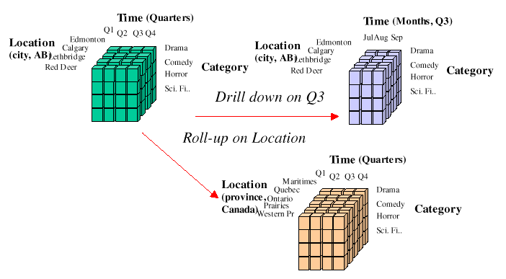
Basic Framework for E-Commerce Data Analysis
Site
Content
Content
Analysis
Module
Data Cleaning /
Sessionization
Module
Integrated
Sessionized
Data
Usage
Analysis
OLAP
Tools
Web/Application
Server Logs
Data
Integration
Module
E-Commerce
Data Mart
OLAP
Analysis
Data Cube
Site Map
customers
orders
Data Mining
Engine
Pattern
Analysis
products
Site
Dictionary
Operational
Database

Slide 57
Components of E-Commerce Data Analysis Framework
Content Analysis Module
  extract linkage and semantic information from pages
  potentially used to construct the site map and site dictionary
  analysis of dynamic pages includes (partial) generation of pages based on templates, specified parameters, and/or databases (may be done in real time, if available as an extension of Web/Application servers)
Site Map / Site Dictionary
  site map is used primarily in data preparation (e.g., required for pageview identification and path completion); it may be constructed through content analysis and/or analysis of usage data (e.g., from referrer information)
  site dictionary provides a mapping between pageview identifiers / URLs and content/structural information on pages; it is used primarily for “content labeling” both in sessionized usage data as well as integrated e-commerce data

Slide 58
Components of E-Commerce Data Analysis Framework
Data Integration Module
  used to integrate sessionized usage data, e-commerce data (from application servers), and product/user data from databases
  user data may include user profiles, demographic information, and individual purchase activity
  e-commerce data includes various product-oriented events, including shopping cart changes, purchase information, impressions, click-throughs, and other basic metrics
  primarily used for data transformation and loading mechanism for the Data Mart
E-Commerce Data mart
  this is a multi-dimensional database integrating data from a variety of sources, and at different levels of aggregation
  can provide pre-computed e-metrics along multiple dimensions
  is used as the primary data source in OLAP analysis, as well as in data selection for a variety of data mining tasks (performed by the data mining engine

