Slide 1
Personalizing & Recommender Systems
Bamshad Mobasher
Center for Web Intelligence
DePaul University, Chicago, Illinois, USA

Slide 2
Personalization
The Problem
  Dynamically serve customized content (books, movies, pages, products, tags, etc.) to users based on their profiles, preferences, or expected interests
Why we need it?
  Information spaces are becoming much more complex for user to navigate (huge online repositories, social networks, mobile applications, blogs, ….)
  For businesses: need to grow customer loyalty / increase sales
  Industry Research: successful online retailers are generating as much as 35% of their business from recommendations

Slide 3
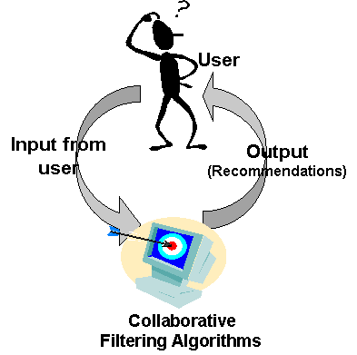
Recommender Systems
Most common type of personalization: Recommender systems
User
profile
Recommendation
algorithm

Slide 4
Common Approaches
Collaborative Filtering
  Give recommendations to a user based on preferences of “similar” users
  Preferences on items may be explicit or implicit
  Includes recommendation based on social / collaborative content
Content-Based Filtering
  Give recommendations to a user based on items with “similar” content in the user’s profile
Rule-Based (Knowledge-Based) Filtering
  Provide recommendations to users based on predefined (or learned) rules
  age(x, 25-35) and income(x, 70-100K) and children(x, >=3) → recommend(x, Minivan)
Hybrid Approaches

Slide 5
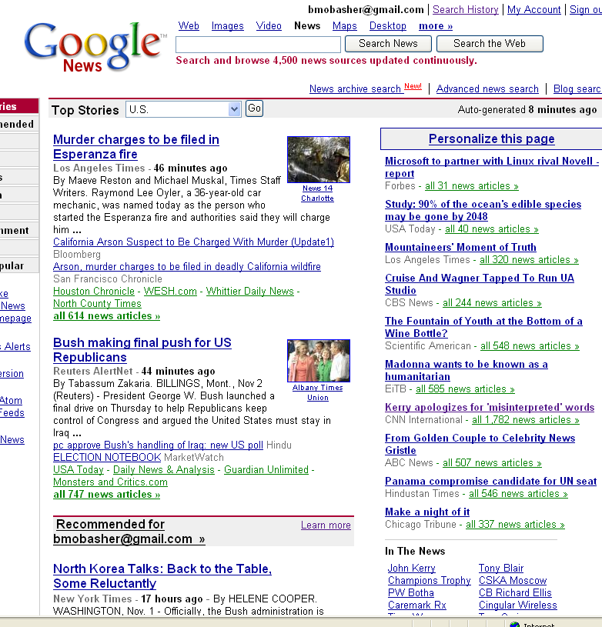
Content-Based Recommender Systems

Slide 6

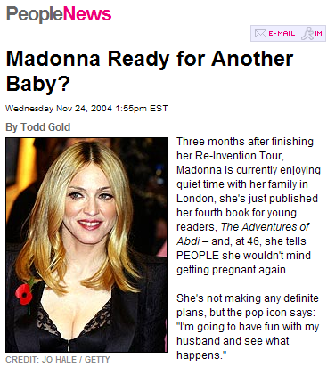
Content-Based Recommenders:
Personalized Search Agents
How can the search engine determine the “user’s context”?
?
Query: “Madonna and Child”
?
Need to “learn” the user profile:
  User is an art historian?
  User is a pop music fan?

Slide 7
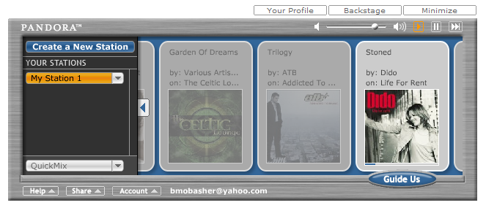
Content-Based Recommenders
:: more examples
Music recommendations
Play list generation
Example: Pandora

Slide 8
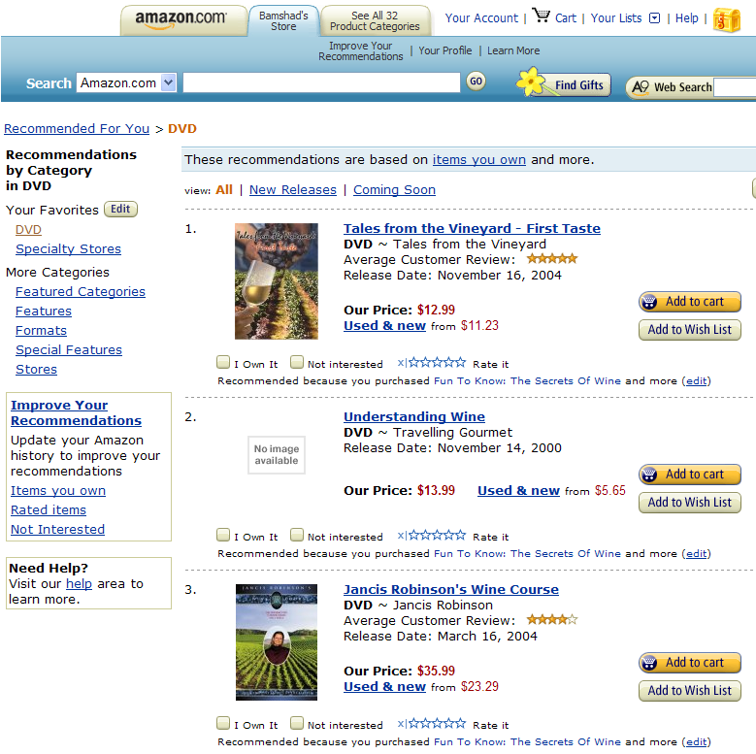
Collaborative Recommender Systems

Slide 9

Collaborative Recommender Systems

Slide 10
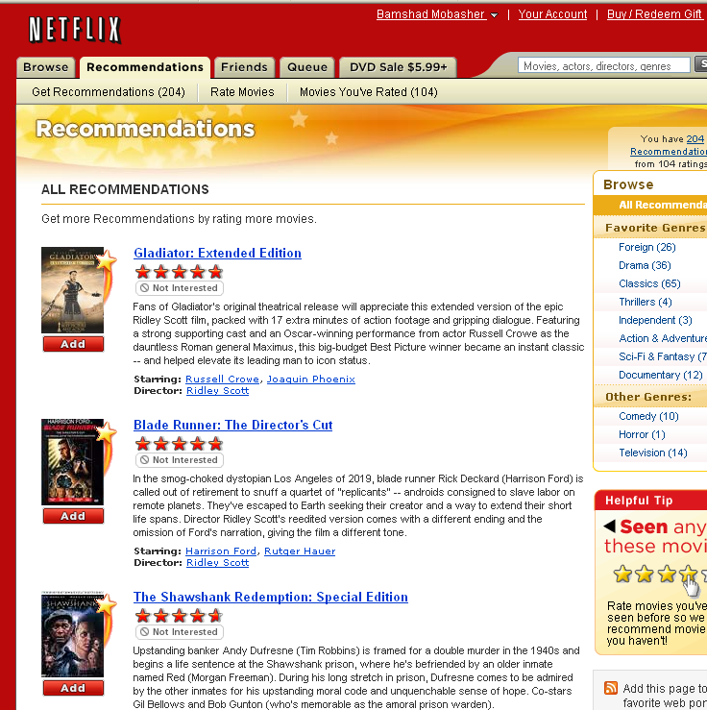
Collaborative Recommender Systems

Slide 11
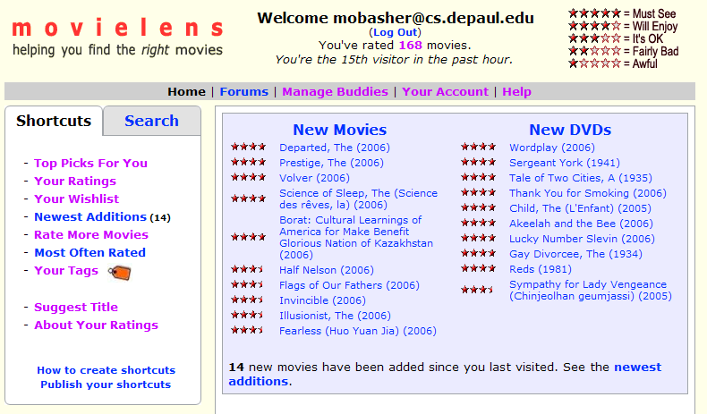
Collaborative Recommender Systems
http://movielens.umn.edu

Slide 12
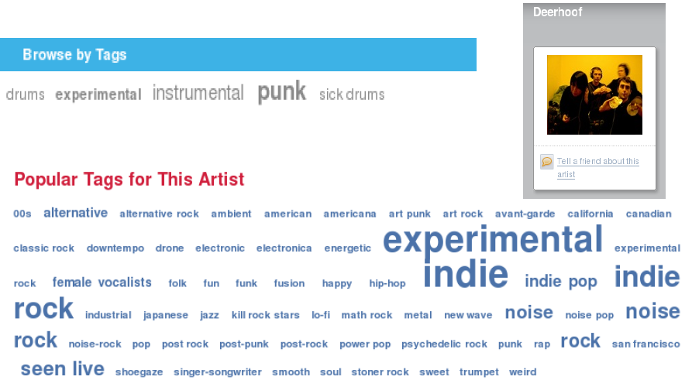
Social / Collaborative Tags

Slide 13
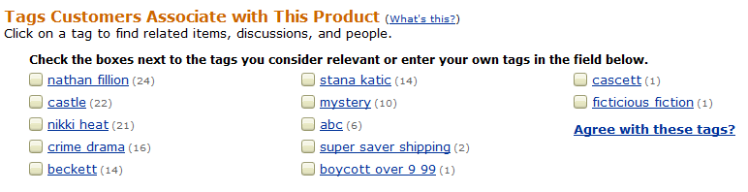

Example: Tags describe the Resource
Tags can describe
  The resource (genre, actors, etc)
  Organizational (toRead)
  Subjective (awesome)
  Ownership (abc)
  etc

Slide 14
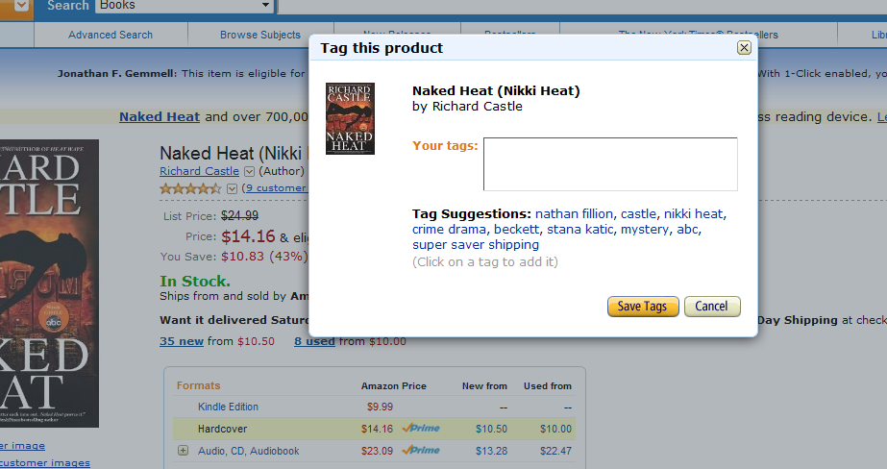
Tag Recommendation

Slide 15
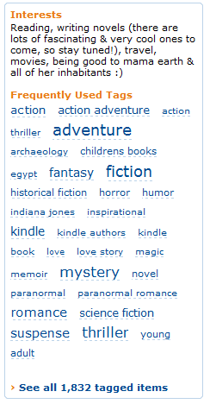


Tags describe the user
These systems are “collaborative.”
  Recommendation / Analytics based on the “wisdom of crowds.”
Rai Aren's profile
co-author
“Secret of the Sands"

Slide 16

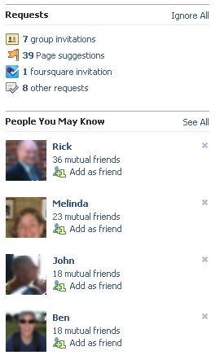
Social Recommendation
A form of collaborative filtering using social network data
  Users profiles represented as sets of links to other nodes (users or items) in the network
  Prediction problem: infer a currently non-existent link in the network

Slide 17
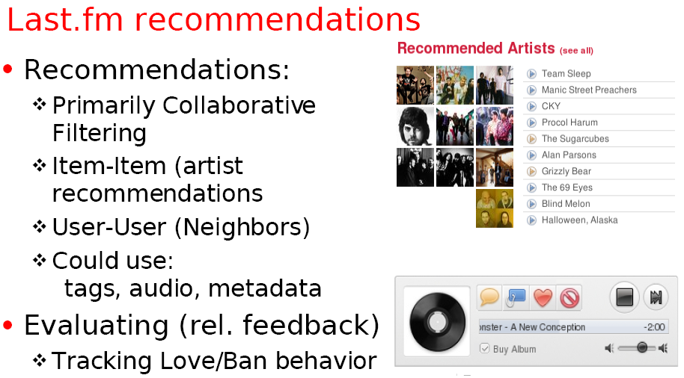
Example: Using Tags for Recommendation

Slide 18

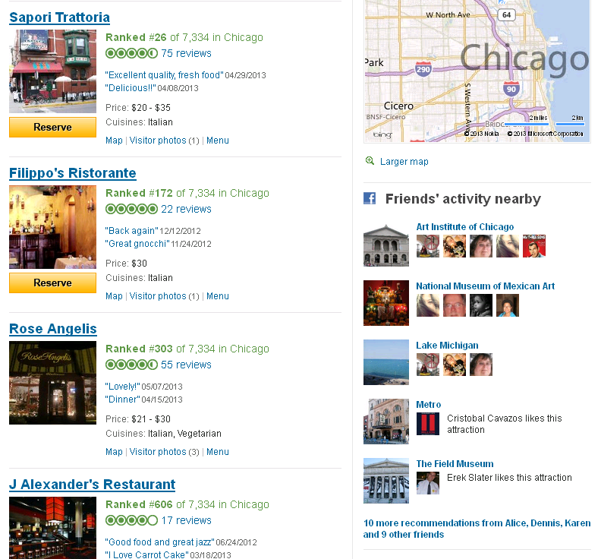
Aggregation & Personalization across social, collaborative, and content channels

Slide 19
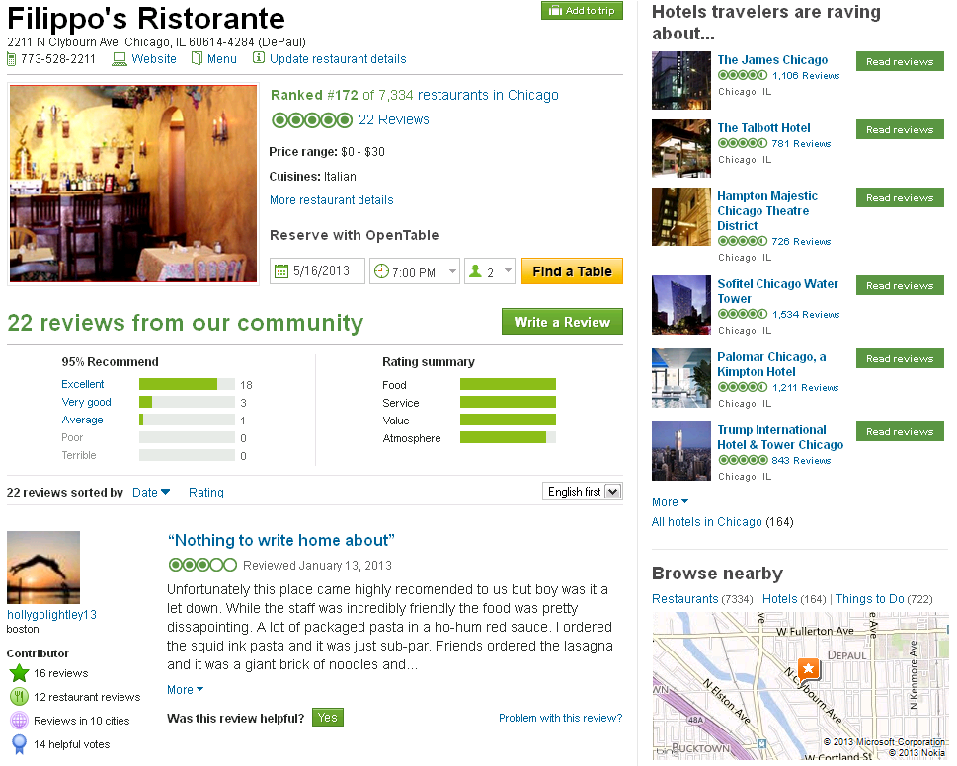

Slide 20
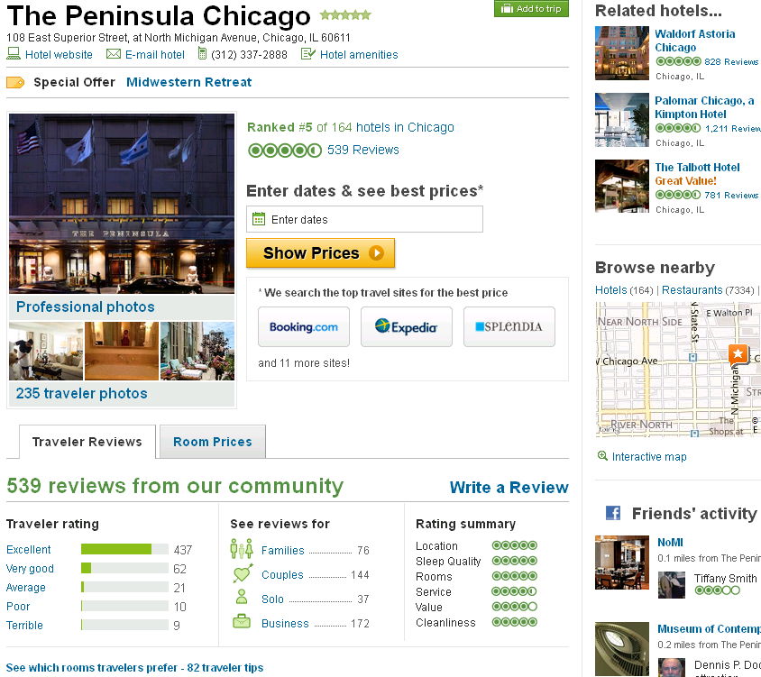

Slide 21
Possible Interesting Project Ideas
Build a content-based recommender for
  News stories (requires basic text processing and indexing of documents)
  Blog posts, tweets
  Music (based on features such as genre, artist, etc.)
Build a collaborative or social recommender
  Movies (using movie ratings), e.g., movielens.org
  Music, e.g., pandora.com, last.fm
    Recommend songs or albums based on collaborative ratings, tags, etc.
    recommend whole playlists based on playlists from other users
  Recommend users (other raters, friends, followers, etc.), based similar interests

Slide 22
The Recommendation Task
Basic formulation as a prediction problem
Typically, the profile P_{u} contains preference scores by u on some other items, {i₁, …, i_{k}} different from i_{t}
  preference scores on i₁, …, i_{k} may have been obtained explicitly (e.g., movie ratings) or implicitly (e.g., time spent on a product page or a news article)
Given a profile P_{u} for a user u, and a target item i_{t}, predict the preference score of user u on item i_{t}

Slide 23
Collaborative Recommender Systems
Collaborative filtering recommenders
  Predictions for unseen (target) items are computed based the other users’ with similar interest scores on items in user u’s profile
    i.e. users with similar tastes (aka “nearest neighbors”)
    requires computing correlations between user u and other users according to interest scores or ratings
    k-nearest-neighbor (knn) strategy
Can we predict Karen’s rating on the unseen item Independence Day?

Slide 24
Basic Collaborative Filtering Process
Current User Record
<user, item1, item2, …>
Neighborhood
Formation
Nearest
Neighbors
Recommendation
Engine
Combination
Function
Historical
User Records
user
item
rating
Recommendations
Neighborhood Formation Phase
Recommendation Phase

Slide 25
Collaborative Filtering: Measuring Similarities
Pearson Correlation
  weight by degree of correlation between user U and user J
  1 means very similar, 0 means no correlation, -1 means dissimilar
  Works well in case of user ratings (where there is at least a range of 1-5)
  Not always possible (in some situations we may only have implicit binary values, e.g., whether a user did or did not select a document)
  Alternatively, a variety of distance or similarity measures can be used
Average rating of user J
on all items.

Slide 26
Collaborative Recommender Systems
Collaborative filtering recommenders
  Predictions for unseen (target) items are computed based the other users’ with similar interest scores on items in user u’s profile
    i.e. users with similar tastes (aka “nearest neighbors)
    requires computing correlations between user u and other users according to interest scores or ratings
prediction
Predictions for Karen on Indep. Day based on the K nearest neighbors
Correlation to Karen

Slide 27
Collaborative Filtering: Making Predictions
When generating predictions from the nearest neighbors, neighbors can be weighted based on their distance to the target user
To generate predictions for a target user a on an item i:
  r_{a} = mean rating for user a
  u₁, …, u_{k} are the k-nearest-neighbors to a
  r_{u,i} = rating of user u on item I
  sim(a,u) = Pearson correlation between a and u
This is a weighted average of deviations from the neighbors’ mean ratings (and closer neighbors count more)

Slide 28
Example Collaborative System
 | Item1 | Item 2 | Item 3 | Item 4 | Item 5 | Item 6 | Correlation with Alice
Alice | 5 | 2 | 3 | 3 |  | ?
User 1 | 2 |  | 4 |  | 4 | 1 | -1.00
User 2 | 2 | 1 | 3 |  | 1 | 2 | 0.33
User 3 | 4 | 2 | 3 | 2 |  | 1 | .90
User 4 | 3 | 3 | 2 |  | 3 | 1 | 0.19
User 5 |  | 3 |  | 2 | 2 | 2 | -1.00
User 6 | 5 | 3 |  | 1 | 3 | 2 | 0.65
User 7 |  | 5 |  | 1 | 5 | 1 | -1.00
Prediction

Best
match
Using k-nearest neighbor with k = 1

Slide 29
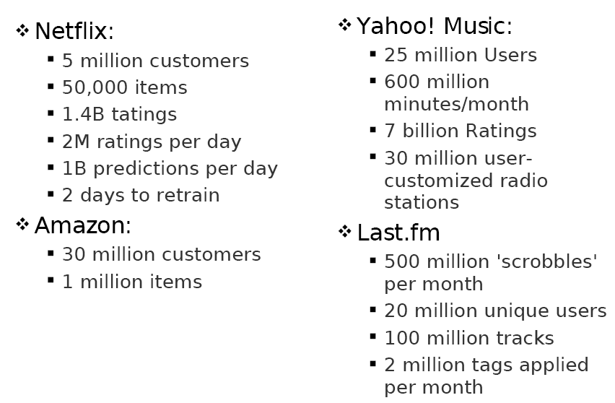
Collaborative Recommenders
:: problems of scale

Slide 30
Item-based Collaborative Filtering
Find similarities among the items based on ratings across users
  Often measured based on a variation of Cosine measure
Prediction of item I for user a is based on the past ratings of user a on items similar to i.
Suppose:
Predicted rating for Karen on Indep. Day will be 7, because she rated Star Wars 7
  That is if we only use the most similar item
  Otherwise, we can use the k-most similar items and again use a weighted average
sim(Star Wars, Indep. Day) > sim(Jur. Park, Indep. Day) > sim(Termin., Indep. Day)

Slide 31
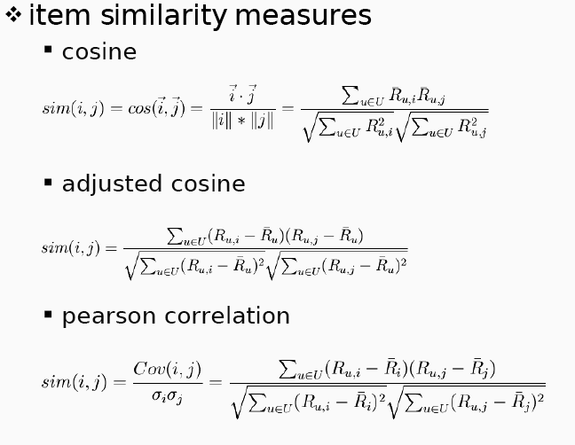
Item-based collaborative filtering

Slide 32
Item-Based Collaborative Filtering
Prediction

 | Item1 | Item 2 | Item 3 | Item 4 | Item 5 | Item 6
Alice | 5 | 2 | 3 | 3 |  | ?
User 1 | 2 |  | 4 |  | 4 | 1
User 2 | 2 | 1 | 3 |  | 1 | 2
User 3 | 4 | 2 | 3 | 2 |  | 1
User 4 | 3 | 3 | 2 |  | 3 | 1
User 5 |  | 3 |  | 2 | 2 | 2
User 6 | 5 | 3 |  | 1 | 3 | 2
User 7 |  | 5 |  | 1 | 5 | 1
Item similarity | 0.76 | 0.79 | 0.60 | 0.71 | 0.75
Best
match

Slide 33
Collaborative Filtering: Evaluation
split users into train/test sets
for each user a in the test set:
  split a’s votes into observed (I) and to-predict (P)
  measure average absolute deviation between predicted and actual votes in P
  MAE = mean absolute error
average over all test users

Slide 34
Data sparsity problems
Cold start problem
  How to recommend new items? What to recommend to new users?
Straightforward approaches
  Ask/force users to rate a set of items
  Use another method (e.g., content-based, demographic or simply non-personalized) in the initial phase
Alternatives
  Use better algorithms (beyond nearest-neighbor approaches)
    In nearest-neighbor approaches, the set of sufficiently similar neighbors might be too small to make good predictions
    Use model-based approaches (clustering; dimensionality reduction, etc.)

Slide 35
Example algorithms for sparse datasets
Recursive CF
  Assume there is a very close neighbor n of u who has not yet rated the target item i .
  Apply CF-method recursively and predict a rating for item i for the neighbor
  Use this predicted rating instead of the rating of a more distant direct neighbor
 | Item1 | Item2 | Item3 | Item4 | Item5
Alice | 5 | 3 | 4 | 4 | ?
User1 | 3 | 1 | 2 | 3 | ?
User2 | 4 | 3 | 4 | 3 | 5
User3 | 3 | 3 | 1 | 5 | 4
User4 | 1 | 5 | 5 | 2 | 1
sim = 0.85
Predict rating for
User1

Slide 36
More model-based approaches
Many Approaches
  Matrix factorization techniques, statistics
    singular value decomposition, principal component analysis
  Approaches based on clustering
  Association rule mining
    compare: shopping basket analysis
  Probabilistic models
    clustering models, Bayesian networks, probabilistic Latent Semantic Analysis
  Various other machine learning approaches
Costs of pre-processing
  Usually not discussed
  Incremental updates possible?

Slide 37
Dimensionality Reduction
Basic idea: Trade more complex offline model building for faster online prediction generation
Singular Value Decomposition for dimensionality reduction of rating matrices
  Captures important factors/aspects and their weights in the data
  factors can be genre, actors but also non-understandable ones
  Assumption that k dimensions capture the signals and filter out noise (K = 20 to 100)
Constant time to make recommendations
Approach also popular in IR (Latent Semantic Indexing), data compression, …

Slide 38





A picture says …
Sue
Bob
Mary
Alice

Slide 39


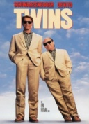


Matrix factorization
SVD:
U_{k} | Dim1 | Dim2
Alice | 0.47 | -0.30
Bob | -0.44 | 0.23
Mary | 0.70 | -0.06
Sue | 0.31 | 0.93
V_{k}^{T}
Dim1 | -0.44 | -0.57 | 0.06 | 0.38 | 0.57
Dim2 | 0.58 | -0.66 | 0.26 | 0.18 | -0.36
 | Dim1 | Dim2
Dim1 | 5.63 | 0
Dim2 | 0 | 3.23
Prediction:
      = 3 + 0.84 = 3.84

Slide 40
Content-based recommendation
Collaborative filtering does NOT require any information about the items,
    However, it might be reasonable to exploit such information
    E.g. recommend fantasy novels to people who liked fantasy novels in the past
What do we need:
    Some information about the available items such as the genre ("content")
    Some sort of user profile describing what the user likes (the preferences)
The task:
    Learn user preferences
    Locate/recommend items that are "similar" to the user preferences

Slide 41






Content-Based Recommenders
Predictions for unseen (target) items are computed based on their similarity (in terms of content) to items in the user profile.
E.g., user profile P_{u} contains
recommend highly: and recommend “mildly”:

Slide 42
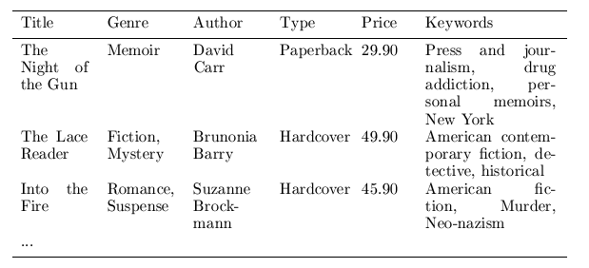
Content representation & item similarities
Represent items as vectors over features
  Features may be items attributes, keywords, tags, etc.
  Often items are represented a keyword vectors based on textual descriptions with TFxIDF or other weighting approaches
    Has the advantage of being applicable to any type of item (images, products, news stories, tweets) as long as a textual description is available or can be constructed
  Items (and users) can then be compared using standard vector space similarity measures
Notes:
Intersection

Slide 43
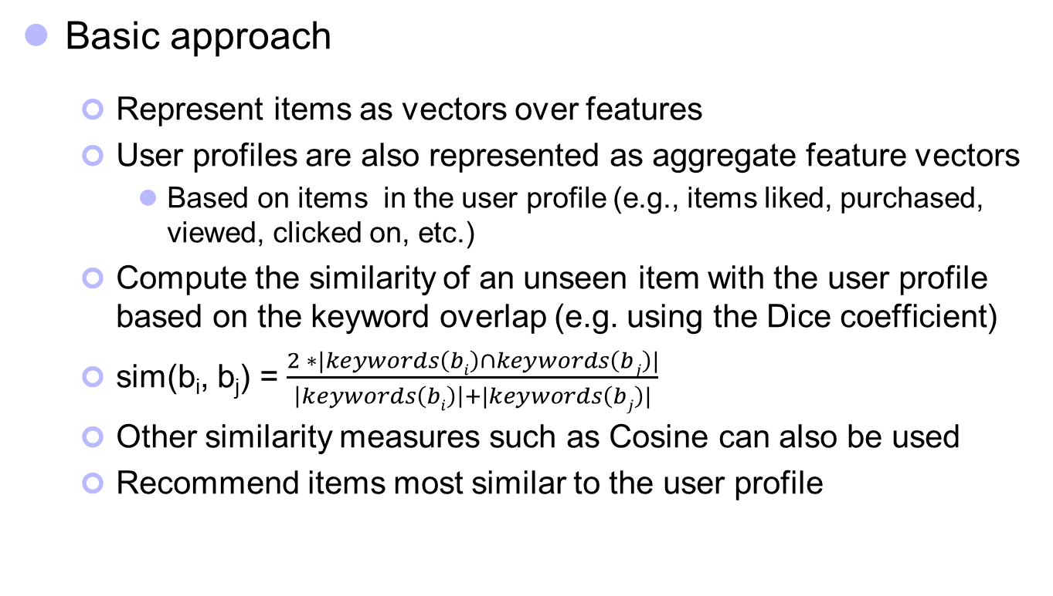
Content-based recommendation
Basic approach
  Represent items as vectors over features
  User profiles are also represented as aggregate feature vectors
    Based on items in the user profile (e.g., items liked, purchased, viewed, clicked on, etc.)
  Compute the similarity of an unseen item with the user profile based on the keyword overlap (e.g. using the Dice coefficient)
  sim(b_{i}, b_{j}) = $\frac{2 ∗|keywords\left(bi\right)∩keywords\left(bj\right)|}{\left|keywords\left(bi\right)\right|+|keywords\left(bj\right)|}$
  Other similarity measures such as Cosine can also be used
  Recommend items most similar to the user profile
Notes:
Intersection

Slide 44
Combining Content-Based and Collaborative Recommendation
Example: Semantically Enhanced CF
  Extend item-based collaborative filtering to incorporate both similarity based on ratings (or usage) as well as semantic similarity based on content / semantic information
Semantic knowledge about items
  Can be extracted automatically from the Web based on domain-specific reference ontologies
  Used in conjunction with user-item mappings to create a combined similarity measure for item comparisons
  Singular value decomposition used to reduce noise in the content data
Semantic combination threshold
  Used to determine the proportion of semantic and rating (or usage) similarities in the combined measure

Slide 45
Semantically Enhanced Hybrid Recommendation
An extension of the item-based algorithm
  Use a combined similarity measure to compute item similarities:
  where,
    SemSim is the similarity of items i_{p} and i_{q} based on semantic features (e.g., keywords, attributes, etc.); and
    RateSim is the similarity of items i_{p} and i_{q} based on user ratings (as in the standard item-based CF)
  α is the semantic combination parameter:
    α = 1 → only user ratings; no semantic similarity
    α = 0 → only semantic features; no collaborative similarity

Slide 46
Semantically Enhanced CF
Movie data set
  Movie ratings from the movielens data set
  Semantic info. extracted from IMDB based on the following ontology

Slide 47
Semantically Enhanced CF
Used 10-fold x-validation on randomly selected test and training data sets
Each user in training set has at least 20 ratings (scale 1-5)

Slide 48
Semantically Enhanced CF
Dealing with new items and sparse data sets
  For new items, select all movies with only one rating as the test data
  Degrees of sparsity simulated using different ratios for training data

Slide 49
Data Mining Approach to Personalization
Basic Idea
  generate aggregate user models (usage profiles) by discovering user access patterns through Web usage mining (offline process)
    Clustering user transactions
    Clustering items
    Association rule mining
    Sequential pattern discovery
  match a user’s active session against the discovered models to provide dynamic content (online process)
Advantages
  no explicit user ratings or interaction with users
  enhance the effectiveness and scalability of collaborative filtering

Slide 50
Example Domain: Web Usage Mining
Web Usage Mining
  discovery of meaningful patterns from data generated by user access to resources on one or more Web/application servers
Typical Sources of Data:
  automatically generated Web/application server access logs
  e-commerce and product-oriented user events (e.g., shopping cart changes, product clickthroughs, etc.)
  user profiles and/or user ratings
  meta-data, page content, site structure
User Transactions
  sets or sequences of pageviews possibly with associated weights
  a pageview is a set of page files and associated objects that contribute to a single display in a Web Browser

Slide 51
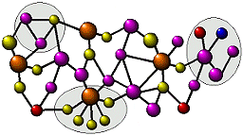
Personalization Based on Web Usage Mining
Offline Process
Data Preparation Phase
Pattern Discovery Phase
Web &
Application
Server Logs
Pattern Analysis
Pattern Filtering
Aggregation
Characterization
Data Preprocessing
Aggregate
Usage Profiles
Data Cleaning
Pageview Identification
Sessionization
Data Integration
Data Transformation
Site Content
& Structure
Patterns
Usage Mining
User
Transaction
Database
Transaction Clustering
Pageview Clustering
Correlation Analysis
Association Rule Mining
Sequential Pattern Mining
Domain Knowledge

Slide 52

Personalization Based on Web Usage Mining:
Online Process
Recommendation Engine
Aggregate
Usage Profiles
<user,item1,item2,…>
Integrated
User Profile
Recommendations
Stored
User Profile
Domain Knowledge
Active Session
Web Server
Client Browser

Slide 53
Conceptual Representation of User Transactions or Sessions
Pageview/objects
Session/user data
Raw weights are usually based on time spent on a page, but in practice, need to normalize and transform.

Slide 54
Web Usage Mining: clustering example
Transaction Clusters:
  Clustering similar user transactions and using centroid of each cluster as a usage profile (representative for a user segment)
Sample cluster centroid from CTI Web site (cluster size =330)
Support | URL | Pageview Description
1.00 | /courses/syllabus.asp?course=450-96-303&q=3&y=2002&id=290 | SE 450 Object-Oriented Development class syllabus
0.97 | /people/facultyinfo.asp?id=290 | Web page of a lecturer who thought the above course
0.88 | /programs/ | Current Degree Descriptions 2002
0.85 | /programs/courses.asp?depcode=96&deptmne=se&courseid=450 | SE 450 course description in SE program
0.82 | /programs/2002/gradds2002.asp | M.S. in Distributed Systems program description

Slide 55
Using Clusters for Personalization
Original Session/user data
Given an active session A ➔ B, the best matching profile is Profile 1. This may result in a recommendation for page F.html, since it appears with high weight in that profile.
Result of
Clustering
PROFILE 0 (Cluster Size = 3)
--------------------------------------
1.00 C.html
1.00 D.html
PROFILE 1 (Cluster Size = 4)
--------------------------------------
1.00 B.html
1.00 F.html
0.75 A.html
0.25 C.html
PROFILE 2 (Cluster Size = 3)
--------------------------------------
1.00 A.html
1.00 D.html
1.00 E.html
0.33 C.html

Slide 56
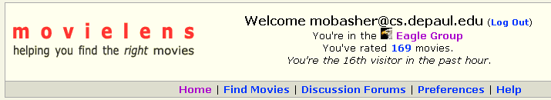
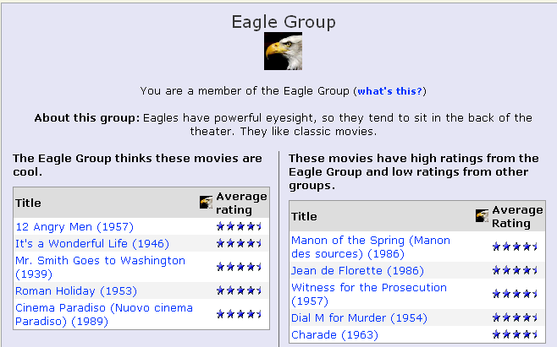
Clustering and Collaborative Filtering
:: clustering based on ratings: movielens

Slide 57
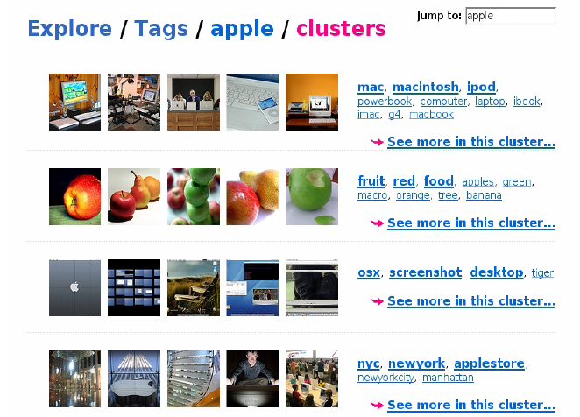
Clustering and Collaborative Filtering
:: tag clustering example

