Slide 1
Prediction Modeling for Personalization & Recommender Systems
Bamshad Mobasher
DePaul University

Slide 2
What Is Prediction?
Prediction is similar to classification
  First, construct a model
  Second, use model to predict unknown value
Prediction is different from classification
  Classification refers to predicting categorical class label (e.g., “yes”, “no”)
  Prediction models are used to predict values of a numeric target attribute
    They can be thought of as continuous-valued functions
Major method for prediction is regression
  Linear and multiple regression
  Non-linear regression
  K-Nearest-Neighbor
Most common application domains:
  Personalization & recommender systems, credit scoring, predict customer loyalty, etc.

Slide 3
Personalization
The Problem
  Dynamically serve customized content (books, movies, pages, products, tags, etc.) to users based on their profiles, preferences, or expected interests
Why we need it?
  Information spaces are becoming much more complex for user to navigate (huge online repositories, social networks, mobile applications, blogs, ….)
  For businesses: need to grow customer loyalty / increase sales
  Industry Research: successful online retailers are generating as much as 35% of their business from recommendations
Recommender Systems → the most common type of personalization systems

Slide 4
Recommender Systems:
Common Approaches
Collaborative Filtering
  Give recommendations to a user based on preferences of “similar” users
  Preferences on items may be explicit or implicit
  Includes recommendation based on social / collaborative content
Content-Based Filtering
  Give recommendations to a user based on items with “similar” content in the user’s profile
Hybrid Approaches

Slide 5
The Recommendation Task
Basic formulation as a prediction problem
Typically, the profile P_{u} contains preference scores by u on some other items, {i₁, …, i_{k}} different from i_{t}
  preference scores on i₁, …, i_{k} may have been obtained explicitly (e.g., movie ratings) or implicitly (e.g., time spent on a product page or a news article)
Given a profile P_{u} for a user u, and a target item i_{t}, predict the preference score of user u on item i_{t}

Slide 6






Example: Recommender Systems
Content-based recommenders
  Predictions for unseen (target) items are computed based on their similarity (in terms of content) to items in the user profile.
  E.g., user profile P_{u} contains
  recommend highly: and recommend “mildly”:

Slide 7
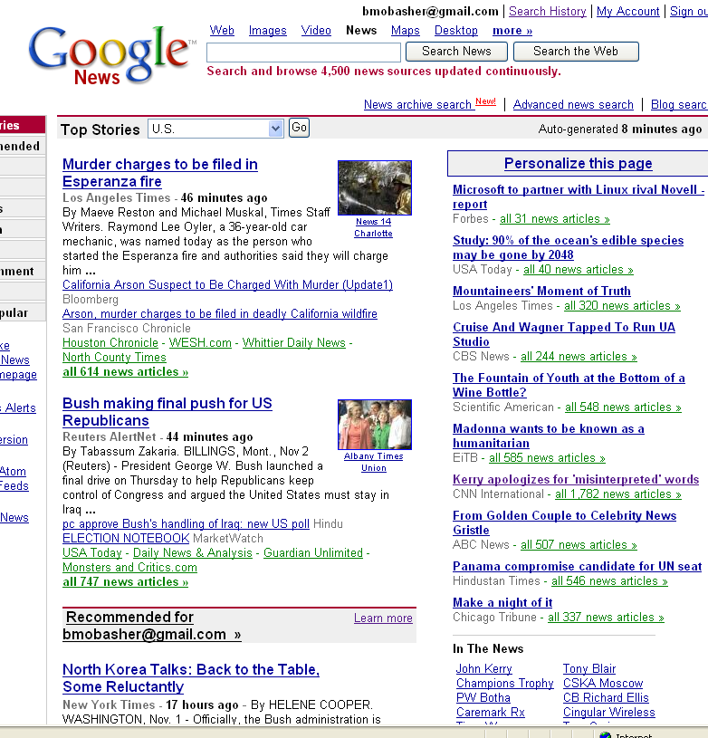
Content-Based Recommender Systems

Slide 8
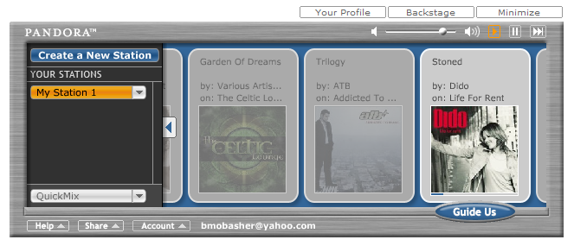
Content-Based Recommenders
:: more examples
Music recommendations
Play list generation
Example: Pandora

Slide 9
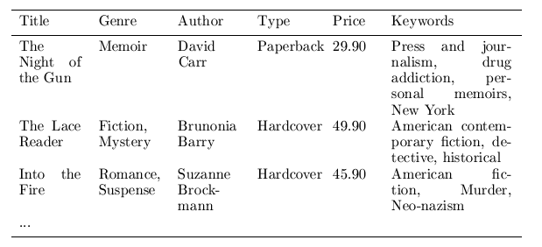
Content representation & item similarities
Represent items as vectors over features
  Features may be items attributes, keywords, tags, etc.
  Often items are represented a keyword vectors based on textual descriptions with TFxIDF or other weighting approaches
    Has the advantage of being applicable to any type of item (images, products, news stories, tweets) as long as a textual description is available or can be constructed
  Items (and users) can then be compared using standard vector space similarity measures
Notes:
Intersection

Slide 10
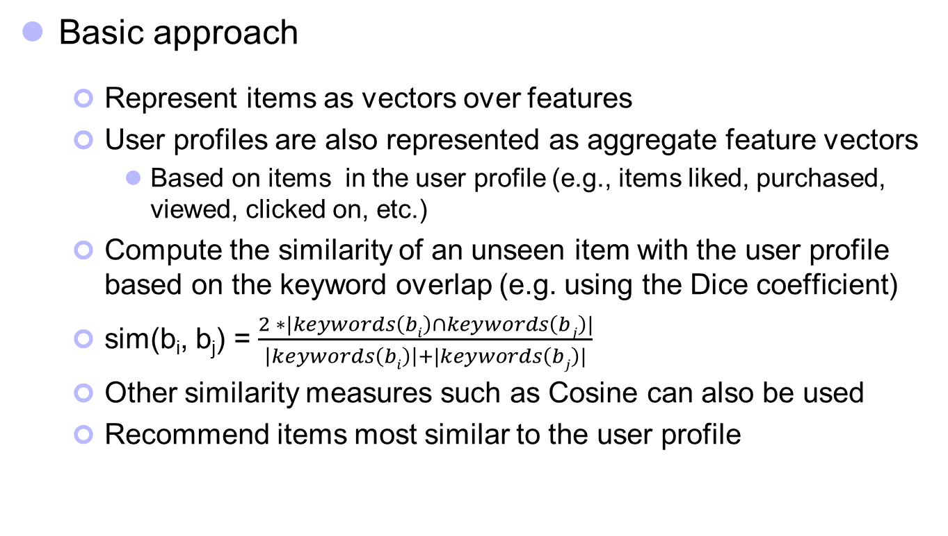
Content-based recommendation
Basic approach
  Represent items as vectors over features
  User profiles are also represented as aggregate feature vectors
    Based on items in the user profile (e.g., items liked, purchased, viewed, clicked on, etc.)
  Compute the similarity of an unseen item with the user profile based on the keyword overlap (e.g. using the Dice coefficient)
  sim(b_{i}, b_{j}) = $\frac{2 ∗|keywords\left(bi\right)∩keywords\left(bj\right)|}{\left|keywords\left(bi\right)\right|+|keywords\left(bj\right)|}$
  Other similarity measures such as Cosine can also be used
  Recommend items most similar to the user profile
Notes:
Intersection

Slide 11
Collaborative Recommender Systems
Collaborative filtering recommenders
  Predictions for unseen (target) items are computed based the other users’ with similar interest scores on items in user u’s profile
    i.e. users with similar tastes (aka “nearest neighbors”)
    requires computing correlations between user u and other users according to interest scores or ratings
    k-nearest-neighbor (knn) strategy
Can we predict Karen’s rating on the unseen item Independence Day?

Slide 12
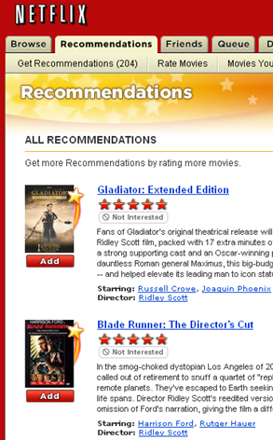
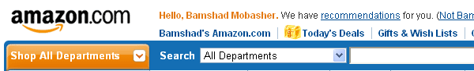
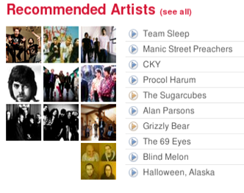
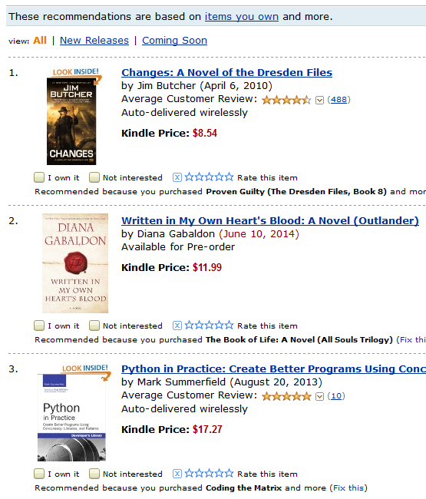
Collaborative Recommender Systems
Many examples in real world applications
Don’t need a representation for items, but compare user profiles instead

Slide 13
Collaborative Filtering: Measuring Similarities
Pearson Correlation
  weight by degree of correlation between user U and user J
  1 means very similar, 0 means no correlation, -1 means dissimilar
  Works well in case of user ratings (where there is at least a range of 1-5)
  Not always possible (in some situations we may only have implicit binary values, e.g., whether a user did or did not select a document)
  Alternatively, a variety of distance or similarity measures can be used
Average rating of user J
on all items.

Slide 14
Collaborative Filtering: Making Predictions
In practice a more sophisticated approach is used to generate the predictions based on the nearest neighbors
To generate predictions for a target user a on an item i:
  = mean rating for user a
  u₁, …, u_{k} are the k-nearest-neighbors to a
  r_{u,i} = rating of user u on item I
  sim(a,u) = Pearson correlation between a and u
This is a weighted average of deviations from the neighbors’ mean ratings (and closer neighbors count more)

Slide 15
Example: User-Based Collaborative Filtering
prediction
Correlation to Karen
Predictions for Karen on Indep. Day based on the K nearest neighbors

Slide 16
Possible Interesting Project Ideas
Build a content-based recommender for
  News stories (requires basic text processing and indexing of documents)
  Blog posts, tweets
  Music (based on features such as genre, artist, etc.)
Build a collaborative or social recommender
  Movies (using movie ratings), e.g., movielens.org
  Music, e.g., pandora.com, last.fm
    Recommend songs or albums based on collaborative ratings, tags, etc.
    recommend whole playlists based on playlists from other users
  Recommend users (other raters, friends, followers, etc.), based similar interests

Slide 17
Prediction Modeling for Personalization & Recommender Systems
Bamshad Mobasher
DePaul University

