Slide 1
E-Metrics and E-Business Analytics
Part 2 – Case Studies
Bamshad Mobasher
DePaul University

Slide 2


Case Studies
MEC (Mountain Equipment Co-op)
  Canadian company selling sport and mountain climbing gear
  leading supplier of quality outdoor gear and clothing
  Consumer cooperative that sells to members only
DEBENHAMS
  Department store chain in UK
  102 stores across the UK and Republic of Ireland

Slide 3

Bot Detection
Significant traffic may be generated by bots
Can you guess what percentage of sessions are generated by bots?
23% at MEC (outdoor gear)
40% at Debenhams
Without bot removal, your metrics will
be inaccurate
More than 150 different bot families on most sites.
Very challenging problem!

Slide 4
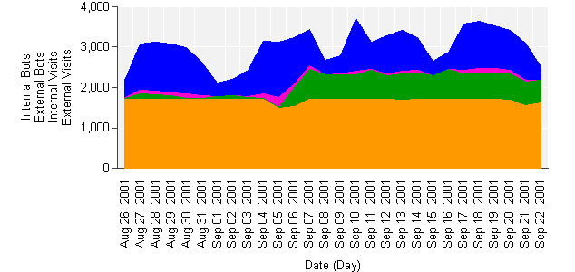
Example: Web Traffic
Sept-11
Note significant drop in human traffic, not bot traffic
Weekends
Internal Perfor-mance bot
Registration at Search Engine sites

Slide 5
Search Effectiveness at MEC
Customers that search are worth two times as much as customers that do not search. Failed searches hurt sales
Visit
90%
10%
No Search
Search
(64% successful)
Avg sale per visit: $X
Avg sale per visit: 2.2X
30%
70%
Last Search Failed
Last Search Succeeded
Avg sale per visit: 0.9X
Avg sale per visit: 2.8X

Slide 6
Referrers at Debenhams
Top Referrers
  MSN (including search and shopping)
    Average purchase per visit = X
  Google
    Average purchase per visit = 1.8X
  AOL search
    Average purchase per visit = 4.8X

Slide 7
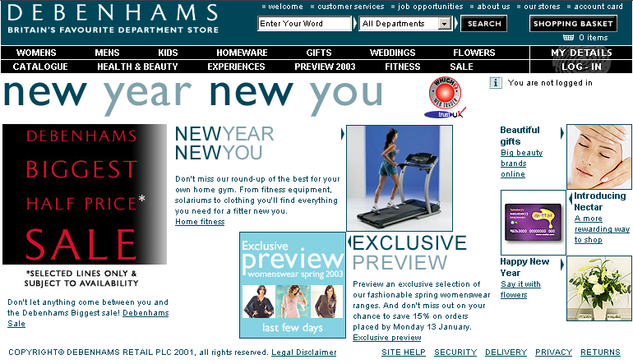
Page Effectiveness
Percentage of visits clicking on different links
14%
3%
2%
8%
2%
13%
9%
0.6%
Top Menu 6%
3%
2%
0.3%
2%
2%
18% of visits exit at the welcome page
Any product link 7%

Slide 8
Top Links followed from the Welcome Page:
Revenue per session associated with visits
5X
1.4X
2.3X
X
2.3X
1.3X
4.2X
1.4X
Top Menu 0.2X
10X
10.2X
1.2X
3.3X
1.7X
Note how effective physical
catalog item #s are
Product Links 2.1X

Slide 9
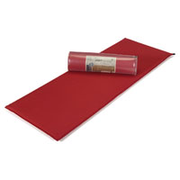


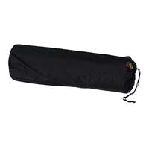

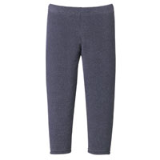
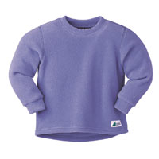



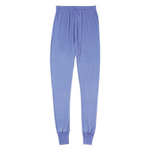



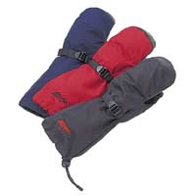


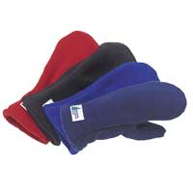
Product Affinities at MEC
Website
Recommended Products
Product
Association
Lift Confidence
Orbit
Sleeping Pad
Orbit
Stuff Sack
222 37%
Cygnet
Sleeping Bag
Primus Stove
Aladdin 2
Backpack
Bambini
Crewneck
Sweater
Children’s
Bambini
Tights Children’s
195 52%
Yeti Crew Neck
Pullover Children’s
Beneficial T’s
Organic Long
Sleeve T-Shirt Kids’
Silk Crew
Women’s
Silk
Long Johns
Women’s
304 73%
Micro Check
Vee Sweater
Volant
Pants
Composite Jacket
Cascade
Entrant
Overmitts
Polartec
300 Double
Mitts
51 48%
Volant
Pants
Windstopper
Alpine Hat
Tremblant 575
Vest Women’s
Minimum support for the associations is 80 customers
Confidence: 37% of people who purchased Orbit Sleeping Pad also purchased Orbit Stuff Sack
Lift: People who purchased Orbit Sleeping Pad were 222 times more likely to purchase the Orbit Stuff Sack compared to the general population

Slide 10

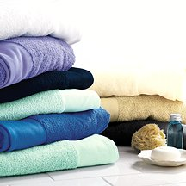
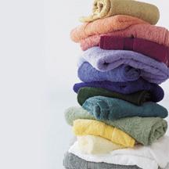
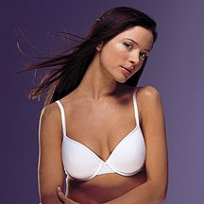
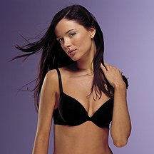

Product Affinities at Debenhams
Website
Recommended Products
Product
Association
Lift Confidence
Fully
Reversible
Mats
Egyptian Cotton
Towels
J Jasper Towels
456 41%
Confidence 1.4%
White Cotton
T-Shirt Bra
Plunge
T-Shirt Bra
Black embroidered underwired bra
246 25%
Minimum support: 50 customers
Confidence: 41% of people who purchased Fully
Reversible Mats also purchased Egyptian Cotton Towels
Lift: People who purchased Fully Reversible Mats were 456 times more likely to purchase the Egyptian Cotton Towels compared to the general population
Confidence 1%

Slide 11




Migration Study - MEC
Customers who migrated from low spenders in one 6 month period to high spenders in the following 6 month period
Oct 2001 – Mar 2002
Apr 2002 – Sep 2002
Spent over $200
Spent over $200
Migrators
(5.5%)
Spent under $200
Spent $1 to $200
(94.5%)

Slide 12
Key Characteristics of Migrators at MEC
During October 2001 – March 2002 (Initial 6 months)
  Purchased at least $70 of merchandise
  Purchased at least twice
  Largest single order was at least $40
  Used free shipping, not express shipping
  Live over 60 aerial kilometers from an MEC retail store
  Bought from these product families, such as socks, t-shirts, and accessories
  Customers who purchased shoulder bags and child carriers were LESS LIKELY to migrate
Recommendation:
Score light spending customers based on their likelihood of migrating and market to high scorers.

Slide 13
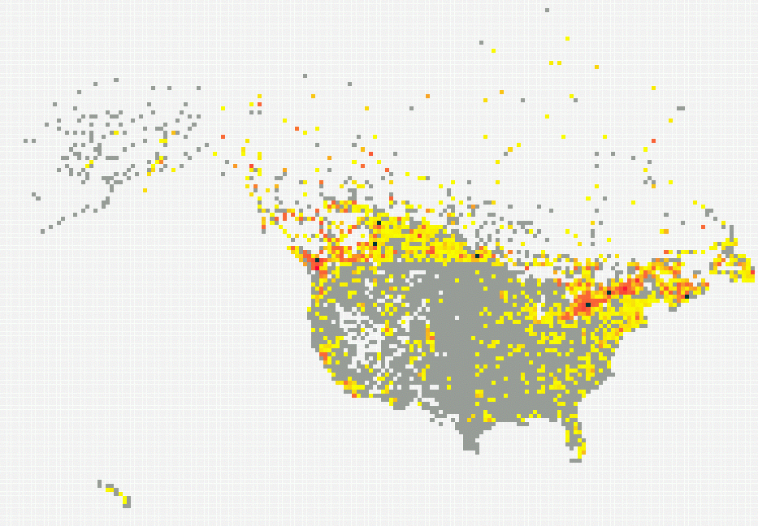
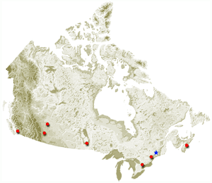
Customer Locations Relative to Retail Stores
Heavy purchasing areas away from retail stores can suggest new retail store locations
No stores in several hot areas:
MEC is building a store in Montreal right now.
Map of Canada with store locations.
Black dots show store locations.

Slide 14
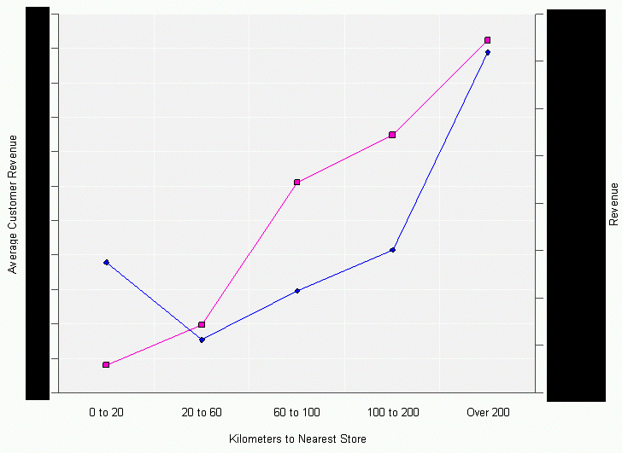
Distance From Nearest Store (MEC)
People farther away from retail stores
  spend more on average
  Account for most of the revenues

Slide 15
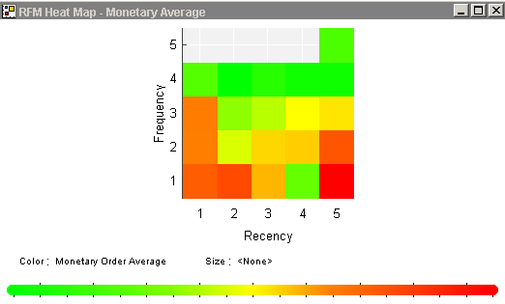
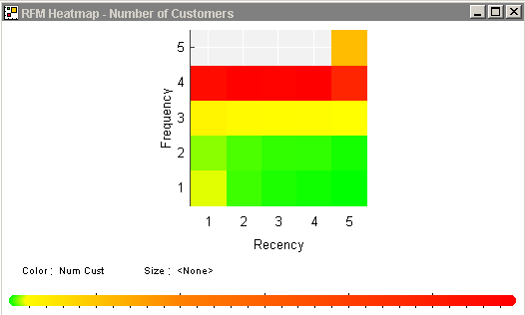
RFM Analysis (Debenhams)
  Anonymous purchasers have lower average order amount
  Customers who have opted out [e-mail] tend to have higher average order amount
  People in the age range 30-40 and 40-50 spend more on average
Majority of customers have purchased once
Low Medium High
Low Medium High
More frequent customers have higher average order amount
Recommendation: Targeted marketing campaigns to convert people to repeat purchasers, if they did not opt-out of e-mails

Slide 16
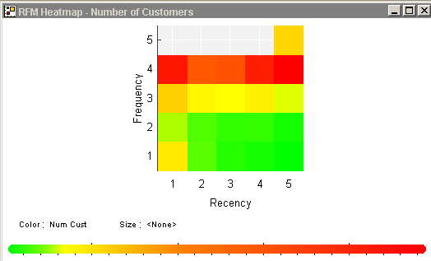
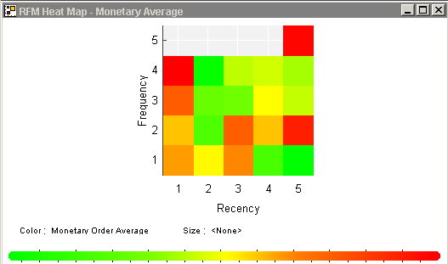
RFM for Debenhams Card Owners
Recommendation
Send targeted email campaign since these are Debenham’s customers. Try to “awaken” them!
Debenhams card owners
Large group (> 1000)
High average order amount
Purchased once (F = 5)
Not purchased recently (R=5)
Low Medium High
Low Medium High

Slide 17
Consumer Demographics - Acxiom
ADN – Acxiom Data Network
Comprehensive collection of US consumer and telephone data available via the internet
  Multi-sourced database
  Demographic, socioeconomic, and lifestyle information.
  Information on most U.S. households
  Contributors’ files refreshed a minimum of 3-12 times per year.
  Data sources include: County Real Estate Property Records, U.S. Telephone Directories, Public Information, Motor Vehicle Registrations, Census Directories, Credit Grantors, Public Records and Consumer Data, Driver’s Licenses, Voter Registrations, Product Registration Questionnaires, Catalogers, Magazines, Specialty Retailers, Packaged Goods Manufacturers, Accounts Receivable Files, Warranty Cards

Slide 18

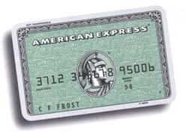
Consumer Demographics
Using Acxiom, we can compare online shoppers to a sample of the population
  People who have a Travel and Entertainment credit card are 48% more likely to be online shoppers (27% for people with premium credit card)
  People whose home was built after 1990 are 45% more likely to be online shoppers
  Households with income over $100K are 31% more likely to be online shoppers
  People under the age of 45 are 17% more
  likely to be online shoppers

Slide 19
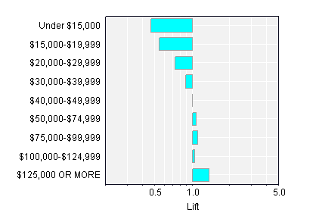
Demographics - Income
A higher household income means you are more likely to be an online shopper

Slide 20
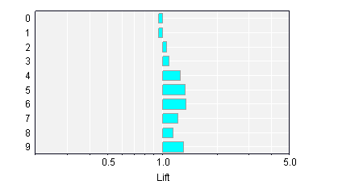
Demographics – Credit Cards
The more credit cards, the more likely you are to be an online shopper

Slide 21

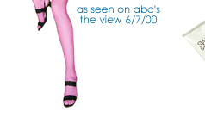
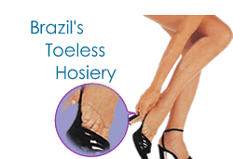
Gazelle.com
Gazelle.com was a legwear and legcare
web retailer.
Soft-launch: Jan 30, 2000
Hard-launch: Feb 29, 2000
with an Ally McBeal TV ad on 28th
and strong $10 off promotion
The data was used as part of the
KDD Cup competition
  Training set: 2 months
  Test sets: one month
  (split into two test sets)

Slide 22
Data Collection
Data collected includes:
  Clickstreams
    Session: date/time, cookie, browser, visit count, referrer
    Page views: URL, processing time, product, assortment
    (assortment is a collection of products, such as back to school)
  Order information
    Order header: customer, date/time, discount, tax, shipping.
    Order line: quantity, price, assortment
  Registration form: questionnaire responses

Slide 23
Data Pre-Processing
Acxiom enhancements: age, gender, marital status, vehicle type, own/rent home, etc.
Personal information removed, including: Names, addresses, login, credit card, phones, host name/IP, verification question/answer. Cookie, e-mail obfuscated.
Test users removed based on multiple criteria (e.g., credit card) not available to participants
Original data and aggregated data (to session level) were provided

Slide 24
KDD Cup Questions
Will visitor leave after this page?
Which brands will visitor view?
Who are the heavy spenders?
KDD Cup Statistics
170 requests for data
31 submissions
200 person/hours per submission (max 900)
Teams of 1-13 people (typically 2-3)

Slide 25
Decision trees most widely tried and by far the
most commonly submitted
Note: statistics from final submitters only

Slide 26
Evaluation Criteria
Accuracy (or score) was measured for the two questions with test sets
Analyses judged with help of retail experts from Gazelle and Blue Martini
Created a list of insights from all participants
  Each insight was given a weight
  Each participant was scored on all insights
  Additional factors: presentation quality, correctness

Slide 27
Question: Who Will Leave
Given set of page views, will visitor view another page on site or leave?
Hard prediction task because most sessions are of length 1. Gains chart for sessions longer than 5 is excellent.

Slide 28
Insight: Who Leaves
Crawlers, bots, and Gazelle testers
  Crawlers hitting single pages were 16% of sessions
Referring sites: mycoupons have long sessions, shopnow.com are prone to exit quickly
Returning visitors' prob. of continuing is double
View of specific products (Oroblue, Levante) causes abandonment - Actionable
Replenishment pages discourage customers. 32% leave the site after viewing them - Actionable

Slide 29
Insight: Who Leaves (II)
Probability of leaving decreases with page views
Many “discoveries” are simply explained by this.
E.g.: “viewing 3 different products implies low abandonment”
Aggregated training set contains clipped sessions
Many competitors computed incorrect statistics

Slide 30
Insight: Who Leaves (III)
People who register see 22.2 pages on average compared to 3.3 (3.7 without crawlers)
Free Gift and Welcome templates on first three pages encouraged visitors to stay at site
Long processing time (> 12 seconds) implies high abandonment - Actionable
Users who spend less time on the first few pages (session time) tend to have longer session lengths

Slide 31
Question: “Heavy” Spenders
Characterize visitors who spend more than $12 on an average order at the site
Small dataset of 3,465 purchases /1,831 customers
Insight question - no test set
Submission requirement:
  Report of up to 1,000 words and 10 graphs
  Business users should be able to understand report
  Observations should be correct and interesting
    average order tax > $2 implies heavy spender
  is not interesting nor actionable

Slide 32
Heavy Spender Insights
Factors correlating with heavy purchasers:
  Came to site from print-ad or news, not friends & family
  (broadcast ads vs. viral marketing)
  Very high and very low income
  Older customers (Acxiom)
  High home market value, owners of luxury vehicles (Acxiom)
  Geographic: Northeast U.S. states
  Repeat visitors (four or more times) - loyalty, replenishment
  Visits to areas of site - personalize differently (lifestyle assortments, leg-care vs. leg-ware)

Slide 33
Question: Brand View
Given set of page views, which product brand will visitor view in remainder of the session? (Hanes, Donna Karan, American Essentials, or none)
Good gains curves for long sessions
  lift of 3.9, 3.4, and 1.3 for three brands at 10% of data
Referrer URL is great predictor
  FashionMall, Winnie-Cooper are referrers for Hanes, Donna Karan - different population segments reach these sites
  MyCoupons, Tripod, DealFinder are referrers for American Essentials - AE contains socks, excellent for coupon users
Previous views of a product imply later views

Slide 34
E-Metrics and E-Business Analytics
Part 2 – Case Studies
Bamshad Mobasher
DePaul University

