Slide 1
Data Preparation for
Web Usage Analysis
Bamshad Mobasher
DePaul University

Slide 2
Web Usage Mining Revisited
Web Usage Mining
  discovery of meaningful patterns from data generated by user access to resources on one or more Web/application servers
Typical Sources of Data:
  clickstream data from Web/application server access logs or third-party page tagging services
  e-commerce and product-oriented user events (e.g., shopping cart changes, product click-throughs, purchases, etc.)
  user profiles data, user ratings, user contributed data (tags, comments, reviews)
  product meta-data, page content, site structure
User Transactions
  sets or sequences of pageviews possibly with associated weights
  a pageview is a set of page files and associated objects that contribute to a single display in a Web Browser

Slide 3
Web Usage Mining vs. Web Analytics
Web Analytics
  As a general concept refers to the measurement, analysis, and reporting of user behavior on the Web
  In practice, usually involves descriptive statistics from clickstream and other user behavior data at different levels of aggregations across predetermined dimensions such as time, content/product categories, referring sites, etc.
  Many tools and third party services available (e.g., Google Analytics)
  Often provides the “biggest bang for the buck”
Web Usage Mining
  Goes beyond basic analytics to discover patterns in usage data, identify and characterize important customer segments, find affinities across pages or products, build models to predict future behavior, etc.

Slide 4
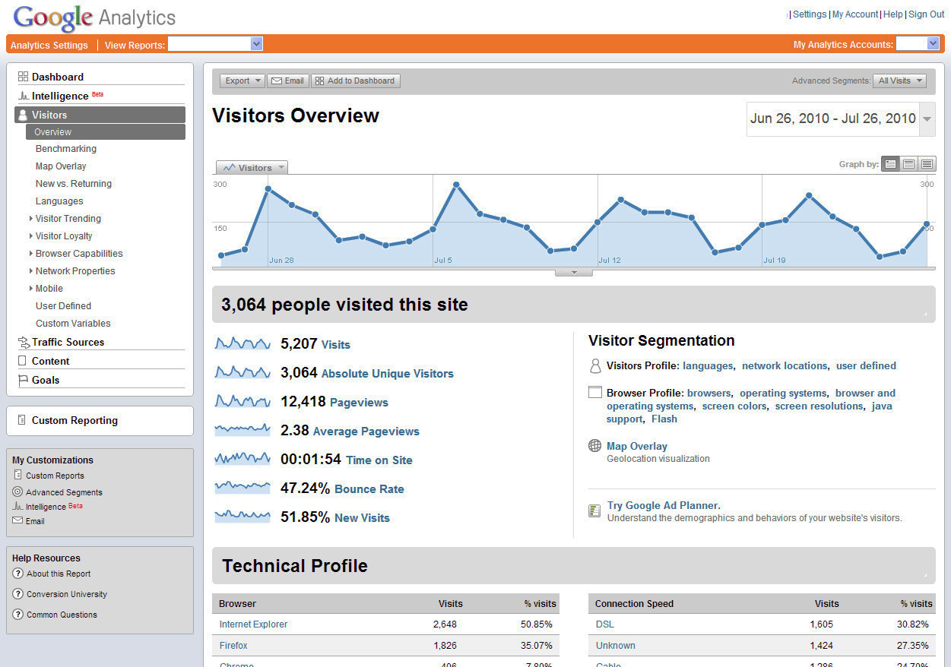
Google Analytics

Slide 5
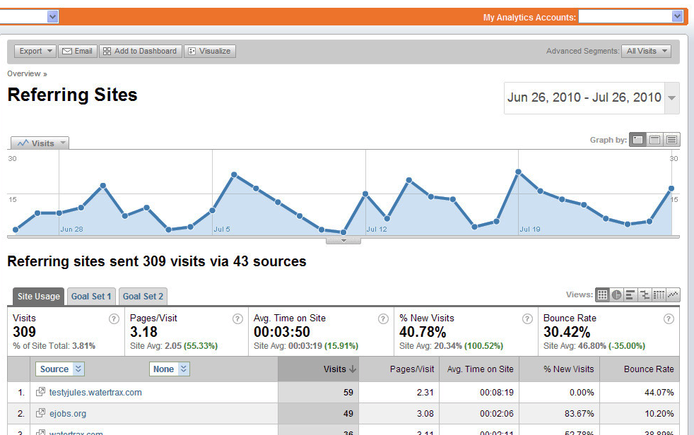
Google Analytics

Slide 6
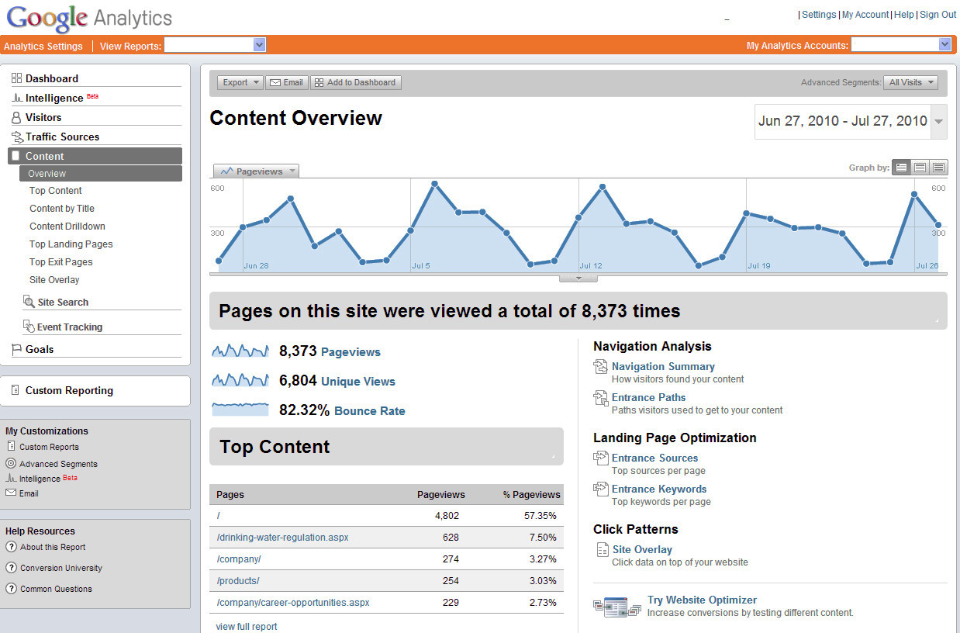
Google Analytics

Slide 7
Web Usage Mining: Going deeper
Prediction of next event
Markov chains
Sequence mining
Discovery of associated events, products, objects
Association rules
Discovery of visitor/customer groups with common characteristics
Clustering
Discovery of visitor/customer groups with common behavior or common interests
Session Clustering
Characterization of visitors/customers with respect to a set of predefined classes
Classification
Anomaly/attack detection

Slide 8
Common Clickstream Data Sources
Server Log Files
  Passive data collection
  Normal part of web browser/web server transaction
    Data is always available and does not depend on client setup
  Data belongs to the organization
    Fewer data security/privacy concerns due to sharing
    Access to full data allows for deeper analysis
Page Tagging
  Active (client-side) data collection
  Often requires a third party to implement – a vendor
    Vendor Supplies page tags, collects the data, and often analyzes the data to generate reports
  Usually involves adding code (Javascript) to each page that when loaded, sends back information to vendor

Slide 9
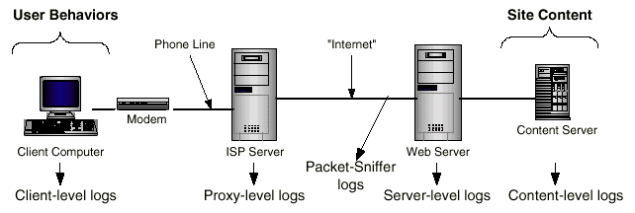
Simplified Web Access Layout

Slide 10
HTTP Protocol
Client sends a request to a server
Server sends a response to client
Connectionless
  Client:
    Opens connection to server
    Sends request
  Server
    Responds to request
    Closes connection
Stateless
  Client/Server have no memory of prior connections
  Server cannot distinguish one client request from another client

Slide 11
Cookies
Used to solve the “Statelessness” of the HTTP Protocol
  When an HTTP server responds to a request it may send additional information that is stored by the client - “state information”
  When client makes a request to this server the client will return the “cookie” that contains its state information
  State information may be a client ID that can be used as an index to a client data record on the server
Most common applications for Client-side cookies
  Identify repeat visitors
  Use third-party ad servers to track users across sites (e.g., using Web “bugs”)
Drawbacks
  Can be turned off on the client-side
  Potential privacy concerns, especially with user tracking

Slide 12
User Tracking via Cookies & Web Bug
Server C
Server B
Res: Page_C.html
Req:
Page_B.html
Page C cnts
- URLs & Img Src
- WebBug Img@
WBS. TRKSTRM.COM
Req:
Page_C.html
Res: Page_B.html
Page B cnts
- URLs & Img Src
- WebBug Img@
WBS. TRKSTRM.COM
Req:
WebBug IMG
-Referer Header
- Any cookie for
TRKSTRM.com
WBS
Client
Browser
My_Brwsr
Req: Page_A.html
Server A
Res: Page_A.html
Cookie: My_Brwsr
Pg A - Server A
Pg B - Server B
Pg C - Server C
1. Render page
2. Click on URL
Res:
WebBug Img
-Cookie to client
Browser on 1st Req.
Page A cnts
- URLs & Img Src
- WebBug Img @
WBS. TRKSTRM.COM
Illustration from Robert J. Boncella, Washburn University

Slide 13
Server Log Files
Each time a client requests a resource the server of that resource may record the following in its log files:
  The name & IP address of the client computer
  The time of the request
  The URL that was requested
  The time it took to send the resource
  If HTTP authentication used; the username of the user of the client will be recorded
  Status code for errors or successful request
  The referrer (location where request originated)
  The agent: the kind of web browser and operating system that was used
  The Client-side cookies

Slide 14
What’s in a Typical Server Log?
<ip_addr> <base_url> - <date> <method> <file> <protocol> <code> <bytes> <referrer> <user_agent>
203.30.5.145 www.acr-news.org - [01/Jun/1999:03:09:21 -0600] "GET /Calls/OWOM.html HTTP/1.0" 200 3942 "http://www.lycos.com/cgi-bin/pursuit?query=advertising+psychology&maxhits=20&cat=dir" "Mozilla/4.5 [en] (Win98; I)"
203.30.5.145 www.acr-news.org - [01/Jun/1999:03:09:23 -0600] "GET /Calls/Images/earthani.gif HTTP/1.0" 200 10689 "http://www.acr-news.org/Calls/OWOM.html" "Mozilla/4.5 [en] (Win98; I)"
203.30.5.145 www.acr-news.org - [01/Jun/1999:03:09:24 -0600] "GET /Calls/Images/line.gif HTTP/1.0" 200 190 "http://www.acr-news.org/Calls/OWOM.html" "Mozilla/4.5 [en] (Win98; I)"
203.30.5.145 www.acr-news.org - [01/Jun/1999:03:09:25 -0600] "GET /Calls/Images/red.gif HTTP/1.0" 200 104 "http://www.acr-news.org/Calls/OWOM.html" "Mozilla/4.5 [en] (Win98; I)"
203.252.234.33 www.acr-news.org - [01/Jun/1999:03:32:31 -0600] "GET / HTTP/1.0" 200 4980 "" "Mozilla/4.06 [en] (Win95; I)"
203.252.234.33 www.acr-news.org - [01/Jun/1999:03:32:35 -0600] "GET /Images/line.gif HTTP/1.0" 200 190 "http://www.acr-news.org/" "Mozilla/4.06 [en] (Win95; I)"
203.252.234.33 www.acr-news.org - [01/Jun/1999:03:32:35 -0600] "GET /Images/red.gif HTTP/1.0" 200 104 "http://www.acr-news.org/" "Mozilla/4.06 [en] (Win95; I)"
203.252.234.33 www.acr-news.org - [01/Jun/1999:03:32:35 -0600] "GET /Images/earthani.gif HTTP/1.0" 200 10689 "http://www.acr-news.org/" "Mozilla/4.06 [en] (Win95; I)"
203.252.234.33 www.acr-news.org - [01/Jun/1999:03:33:11 -0600] "GET /CP.html HTTP/1.0" 200 3218 "http://www.acr-news.org/" "Mozilla/4.06 [en] (Win95; I)"

Slide 15
What’s in a Typical Server Log?

Slide 16
Typical Fields in a Log File Entry
client IP address 1.2.3.4
base url maya.cs.depaul.edu
date/time 2006-02-01 00:08:43
http method GET
file accessed /classes/cs589/papers.html
protocol version HTTP/1.1
status code 200 (successful access)
bytes transferred 9221
referrer page http://dataminingresources.blogspot.com/
user agent Mozilla/4.0+(compatible;+MSIE+6.0;
+Windows+NT+5.1;+SV1;+.NET+CLR+2.0.50727)
In addition, there are fields corresponding to
  login information
  client-side cookies
  session ids issued by the Web or application servers (if any)

Slide 17
Basic Entities in Web Usage Mining
User (Visitor) - Single individual that is accessing files from one or more Web servers through a Browser
Page File - File that is served through HTTP protocol
Pageview - Set of Page Files that contribute to a single display in a Web Browser
User Session - Set of Pageviews served due to a series of HTTP requests from a single User across the entire Web.
Server Session - Set of Pageviews served due to a series of HTTP requests from a single User to a single site
Transaction (Episode) - Subset of Pageviews from a single User or Server Session

Slide 18
Higher-Level Data Abstractions
Abstractions concerning Visitors
Establishes precise semantics for the concepts
  Unique Visitor
  Conversion Rate
  Abandonment Rate
  Attrition
  Loyalty
  Frequency
  Recency

Slide 19
Main Challenges in Data Collection and Preprocessing
Main Questions:
  what data to collect and how to collect it; what to exclude
  how to identify unique visitors/users
  how to identify requests associated with a unique user session (HTTP is “stateless”)
  how to identify what is the basic unit of analysis (e.g., pageviews, items purchased, user ratings, events, etc.)
  how to identify/define user transactions
  how to integrate data across channels: e-commerce data, clickstream data, user profiles, social media data, product meta data, etc.

Slide 20
Usage Data Preparation Tasks
Data cleaning
  remove irrelevant references and fields in server logs
  remove references due to spider navigation
  add missing references due to client-side caching
Data integration
  synchronize data from multiple server logs
  integrate e-commerce and application server data
  integrate meta-data
Data Transformation
  pageview identification
  identification of product-oriented events
  identification of unique users
  sessionization – partitioning each user’s record into multiple sessions or transactions (usually representing different visits)
  integrating meta-data and user profile data with user sessions

Slide 21
Conceptual Representation of User Transactions or Sessions
Pageview/objects
Sessions/user transactions
This is the typical representation of the data, after preprocessing, that is used for input into data mining algorithms. Raw weights may be binary, based on time spent on a page, or other measures of user interest in an item. In practice, need to normalize or standardize this data.

Slide 22
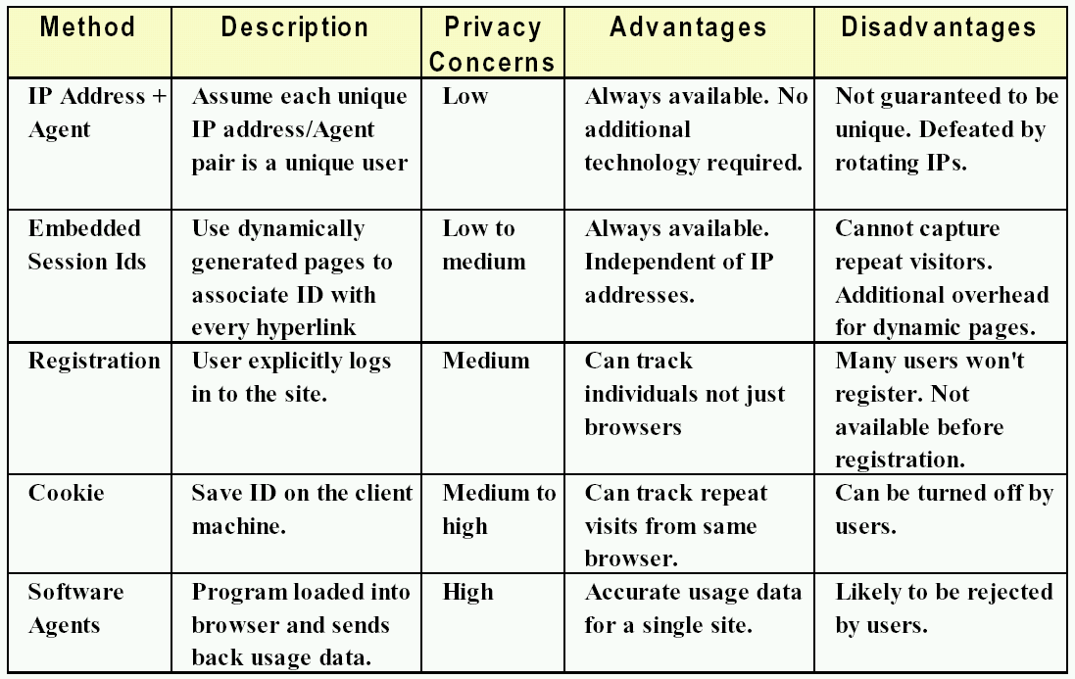
Mechanisms for User Identification
Examples: page tags (javascript), some browser plugins

Slide 23
Identifying Users and Sessions
1. First partition the log file into “user activity logs”
  this is a sequence of pageviews associated with one user encompassing all user visits to the site
  can use the methods described earlier
  most reliable (but not most accurate) is IP+Agent heuristic
2. Apply sessionization heuristics to partition each user activity log into sessions
  can be based on an absolute maximum time allowed for each session
  or based on the amount of elapsed time between two pageviews
  can also use navigation-oriented heuristics based on site topology or the referrer field in the log file
3. Path completion to infer cached references:
  e.g., expanding a session A ==> B ==> C by an access pair (B ==> D) results in: A ==> B ==> C ==> B ==> D;
  to disambiguate paths, sessions are expanded based on heuristics such as number of back references required to complete the path

Slide 24
Sessionization Heuristics
Server log L is a list of log entries each containing
  timestamp
  user host identifiers
  URL request (including URL stem and query)
  and possibly, referrer, agent, cookie, etc.
User identification and sessionization
  user activity log is a sequence of log entries in L belonging to the same user
  user identification is the process of partitioning L into a set of user activity logs
  the goal of sessionization is to further partition each user activity log into sequences of entries corresponding to each user visit
Real v. Constructed Sessions
  Conceptually, the log L is partitioned into an ordered collection of “real” sessions R
  Each heuristic h partitions L into an ordered collection of “constructed sessions” C_{h}
  The ideal heuristic h*: C_{h*} = R

Slide 25
Sessionization Heuristics
Time-Oriented Heuristics
  consider boundaries on time spent on individual pages or in the entire a site during a single visit
  boundaries can be based on a maximum session length or based on maximum time allowable for each pageview
  additional granularity can be obtained by treating different boundaries on different (types of) pageviews
Navigation-Oriented Heuristics
  take the linkage between pages into account in sessionization
  “linkage” can be based on site topology (e.g., split a session at a request that could not have been reached from previous requests in the session)
  “linkage” can also be usage-based (based on referrer information in log entries)
    usually more restrictive than topology-based heuristics
    more difficult to implement in frame-based sites

Slide 26
Some Selected Heuristics
Time-Oriented Heuristics:
  h1: Total session duration may not exceed a threshold θ . Given t₀, the timestamp for the first request in a constructed session S, the request with timestamp t is assigned to S, iff t - t₀ ≤ θ.
  h2: Total time spent on a page may not exceed a threshold δ. Given t₁, the timestamp for request assigned to constructed session S, the next request with timestamp t₂ is assigned to S, iff t₂ - t₁ ≤ δ.
Referrer-Based Heuristic:
  href: Given two consecutive requests p and q, with p belonging to constructed session S. Then q is assigned to S, if the referrer for q was previously invoked in S.
Note: in practice, it is often useful to use a combination of time-
and navigation-oriented heuristics in session identification.

Slide 27
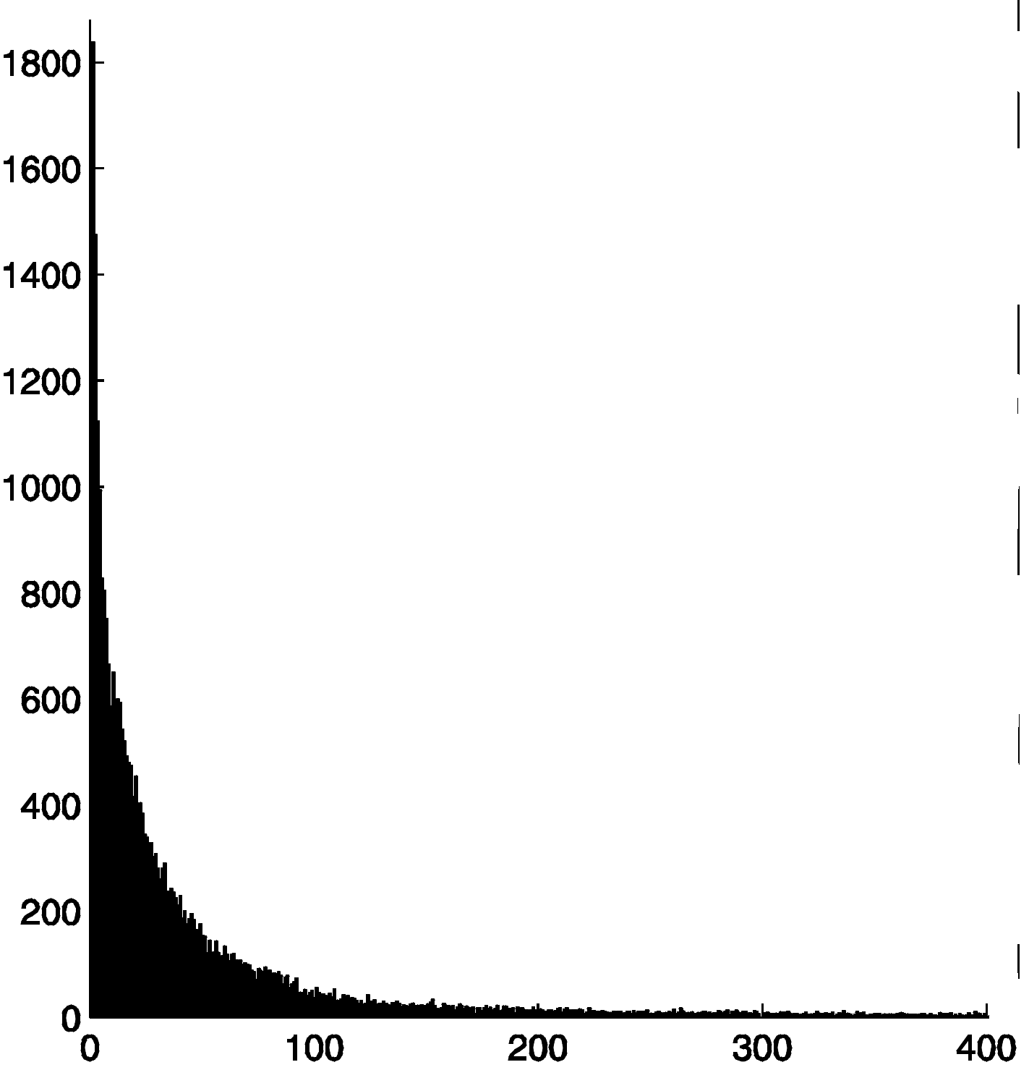
Inferring User Transactions from Sessions
Studies show that reference lengths follow Zipf distribution
Page types: navigational, content, mixed
Page types correlate with reference lengths
Can automatically classify pages as navigational or content using statistical methods
A transaction can be defined as an intra-session path ending in a content page, or as a set of content pages in a session
Histogram of
page reference
lengths (secs)
content
pages
navigational
pages

Slide 28
Path Completion
A
User’s actual navigation path:
A →B → D → E → D → B → C
What the server log shows:
URL Referrer
A --
B A
D B
E D
C B
B
C
D
E
F
  Need knowledge of link structure to complete the navigation path.
  There may be multiple candidate for completing the path. For example consider the two paths : E => D => B => C and E => D => B => A => C.
  In this case, the referrer field allows us to partially disambiguate. But, what about: E => D => B => A => B => C?
  One heuristic: always take the path that requires the fewest number of “back” references.
  Problem gets much more complicated in frame-based sites.

Slide 29
Sessionization Example
A
B
C
D
E
F

Slide 30
Sessionization Example
1. Sort users (based on IP+Agent)

Slide 31
Sessionization Example
2. Sessionize using heuristics
The h1 heuristic (with timeout variable of 30 minutes) will result in the two sessions given above.
How about the heuristic href?
How about heuristic h2 with a timeout variable of 10 minutes?

Slide 32
Sessionization Example
2. Sessionize using heuristics (another example)
In this case, the referrer-based heuristics will result in a single session, while the h1 heuristic (with timeout = 30 minutes) will result in two different sessions.
How about heuristic h2 with timeout = 10 minutes?

Slide 33
Sessionization Example
3. Perform Path Completion
A
B
C
D
E
F
A=>C , C=>B , B=>D , D=>E , C=>F
Need to look for the shortest backwards path from E to C based on the site topology. Note, however, that the elements of the path need to have occurred in the user trail previously.
E=>D, D=>B, B=>C

Slide 34
E-Commerce Data
Integrating E-Commerce and Usage Data
  Needed for analyzing relationships between navigational patterns of visitors and business questions such as profitability, customer value, product placement, etc.
  E-business / Web Analytics
  E.g., tracking and analyzing conversion of browsers to buyers
E-Commerce Event Models
  Major difficulty for E-commerce events is defining and implementing the events for a particular site
  Events may involve a collection or sequence of actions by a user possibly involving multiple pageviews or interactions with applications
  Typical product oriented events:
    View
    Click-through
    Shopping Cart Change
    Buy or Bid

Slide 35
Content and Structure Preprocessing
Processing content and structure of the site are often essential for successful usage analysis
Two primary tasks:
  determine what constitutes a unique content item (i.e., pageview, product, content category)
  represent content and structure of the items in a quantifiable form
Basic elements in content and structure processing
  creation of a site map
    captures linkage and frame structure of the site
    also needs to identify script templates for dynamically generated pages
  extracting important content elements in pages
    meta-information, keywords, internal and external links, etc.
  identifying and classifying pages based on their content and structural characteristics

Slide 36
Data Preparation Tasks for
Mining Content Data
Extract relevant features from text and meta-data
  meta-data is required for product-oriented pages
  keywords are extracted from content-oriented pages
  weights are associated with features based on domain knowledge and/or text frequency (e.g., tf.idf weighting)
  the integrated data can be captured in the XML representation of each pageview
Feature representation for pageviews
  each pageview p is represented as a k-dimensional feature vector, where k is the total number of extracted features from the site in a global dictionary
  feature vectors obtained are organized into an inverted file structure containing a dictionary of all extracted features and posting files for pageviews

Slide 37
Basic Automatic Text Processing
Parse documents to recognize structure
  e.g. title, date, other fields
Scan for word tokens
  lexical analysis to recognize keywords, numbers, special characters, etc.
Stopword removal
  common words such as “the”, “and”, “or” which are not semantically meaningful in a document
Stem words
  morphological processing to group word variants such as plurals (e.g., “compute”, “computer”, “computing”, … can be represented by the stem “comput”)
Weight words
  using frequency in documents and across documents
Store Index
  Stored in a Term-Document Matrix (“inverted index”) which stores each document as a vector of keyword weights

Slide 38
Inverted Indexes
An Inverted File is essentially a vector file “inverted” so that rows become columns and columns become rows
Term weights can be:
Binary
Raw Frequency in document (Text Freqency)
Normalized Frequency
TF x IDF

Slide 39
How Inverted Indexes Are Created
Sorted Array Implementation
  Documents are parsed to extract tokens. These are saved with the Document ID.
Doc 1
Doc 2
Now is the time
for all good men
to come to the aid
of their country
It was a dark and
stormy night in
the country
manor. The time
was past midnight

Slide 40
How Inverted Files are Created
Then the file can be split into a Dictionary and a Postings file
Notes: The links between postings for a term is usually implemented as a linked list. The dictionary is enhanced with some term statistics such as Document frequency and the total frequency in the collection.

Slide 41
Assigning Weights
tf x idf measure:
  term frequency (tf)
  inverse document frequency (idf)
  Want to weight terms highly if they are
    frequent in relevant documents … BUT
    infrequent in the collection as a whole
Goal: assign a tf x idf weight to each term in each document

Slide 42
Example: Discovery of “Content Profiles”
Content Profiles
  Represent concept groups within a Web site or among a collection of documents
  Can be represented as overlapping collections of pageview-weight pairs
  Instead of clustering documents we cluster features (keywords) over the n-dimensional space of pageviews (see the term clustering example of previous lecture)
  for each feature cluster derive a content profile by collecting pageviews in which these features appear as significant (this is the centroid of the clusters, but we only keep elements in the centroid whose mean weight is greater than a threshold)
Example Content Profiles from the ACR Site:

Slide 43
How Content Profiles Are Generated
1. Extract important features
(e.g., word stems) from each
document:
2. Build a global dictionary of all features
(words) along with relevant statistics
Total Documents = 41
Feature-id Doc-freq Total-freq Feature
0 6 44 1997
1 12 59 1998
2 13 76 1999
3 8 41 2000
… … … …
123 26 271 confer
124 9 24 consid
125 23 165 consum
… … … …
439 7 45 psychologi
440 14 78 public
441 11 61 publish
… … … …
549 1 6 vision
550 3 8 volunt
551 1 9 vot
552 4 23 vote
553 3 17 web
… … … …

Slide 44
How Content Profiles Are Generated
3. Construct a document-word matrix with normalized tf-idf weights
4. Now we can perform clustering on word (or documents) using one of the
techniques described earlier (e.g., k-means clustering on features).

Slide 45
How Content Profiles Are Generated
Examples of feature (word) clusters obtained using k-means:
CLUSTER 0
----------
anthropologi
anthropologist
appropri
associ
behavior
...
CLUSTER 4
----------
consum
issu
journal
market
psychologi
special
CLUSTER 10
----------
ballot
result
vot
vote
...
CLUSTER 11
----------
advisori
appoint
committe
council
...
5. Content profiles are now generated from feature clusters based on centroids of
each cluster (similar to usage profiles, but we have words instead of users/sessions).

Slide 46
Content Enhanced User Transactions
Essentially combines usage and content profiling techniques discussed earlier
Basic Idea:
  for each user/session, extract important features of the selected documents/items
  based on the global dictionary create a user-feature matrix
  each row is a feature vector representing significant terms associated with documents/items selected by the user in a given session
  weight can be determined as before (e.g., using tf.idf measure)
Applications:
  Can analyze user behavior at a more granular level of concepts or keywords associated with item purchased, pages visited, etc.
  Can create user segments based on their common underlying interests
  Help explain emerging patterns in user behavior data

Slide 47
 | A.html | B.html | C.html | D.html | E.html
user1 | 1 | 0 | 1 | 0 | 1
user2 | 1 | 1 | 0 | 0 | 1
user3 | 0 | 1 | 1 | 1 | 0
user4 | 1 | 0 | 1 | 1 | 1
user5 | 1 | 1 | 0 | 0 | 1
user6 | 1 | 0 | 1 | 1 | 1
User transaction matrix UT
 | A.html | B.html | C.html | D.html | E.html
web | 0 | 0 | 1 | 1 | 1
data | 0 | 1 | 1 | 1 | 0
mining | 0 | 1 | 1 | 1 | 0
business | 1 | 1 | 0 | 0 | 0
intelligence | 1 | 1 | 0 | 0 | 1
marketing | 1 | 1 | 0 | 0 | 1
ecommerce | 0 | 1 | 1 | 0 | 0
search | 1 | 0 | 1 | 0 | 0
information | 1 | 0 | 1 | 1 | 1
retrieval | 1 | 0 | 1 | 1 | 1
Feature-Document
Matrix FP

Slide 48
Content Enhanced Transactions
User-Feature
Matrix UF
Note that: UF = UT x FP^{T}
 | web | data | mining | business | intelligence | marketing | ecommerce | search | information | retrieval
user1 | 2 | 1 | 1 | 1 | 2 | 2 | 1 | 2 | 3 | 3
user2 | 1 | 1 | 1 | 2 | 3 | 3 | 1 | 1 | 2 | 2
user3 | 2 | 3 | 3 | 1 | 1 | 1 | 2 | 1 | 2 | 2
user4 | 3 | 2 | 2 | 1 | 2 | 2 | 1 | 2 | 4 | 4
user5 | 1 | 1 | 1 | 2 | 3 | 3 | 1 | 1 | 2 | 2
user6 | 3 | 2 | 2 | 1 | 2 | 2 | 1 | 2 | 4 | 4
Example: users 4 and 6 are more interested in concepts related to Web information retrieval, while user 3 is more interested in data mining.

Slide 49
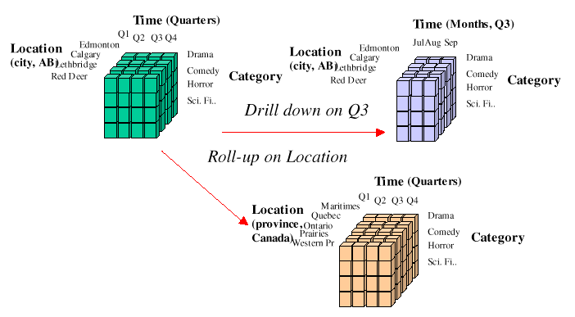
Architectural Framework for Web Usage Mining
Site
Content
Content
Analysis
Module
Preprocessing /
Sessionization
Module
Integrated
Sessionized
Data
Usage
Analysis
OLAP
Tools
Web/Application
Server Logs
Data
Integration
Module
E-Commerce
Data Mart
OLAP
Analysis
Data Cube
Site Map
customers
orders
Data Mining
Engine
Pattern
Analysis
products
Site
Dictionary
Operational
Database

Slide 50
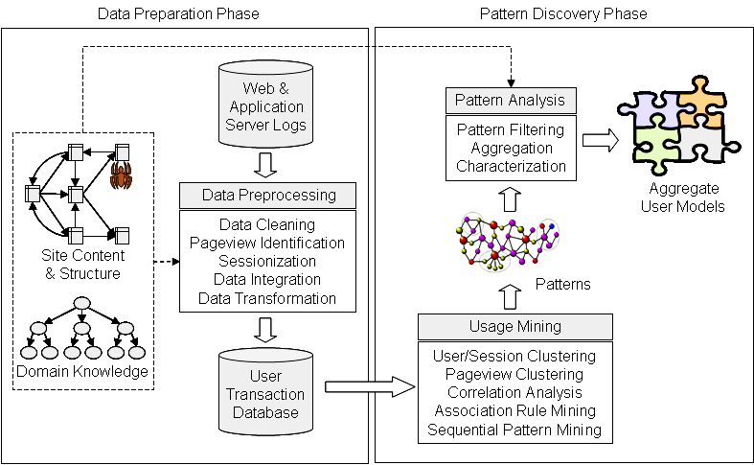
Web Usage Mining as a Process

Slide 51
Data Preparation for
Web Usage Analysis
Bamshad Mobasher
DePaul University

