Slide 1
Overview of Data Mining & The Knowledge Discovery Process
Bamshad Mobasher
DePaul University

Slide 2
Why Data Mining?
The Explosive Growth of Data: from terabytes to petabytes
Data collection and data availability
Automated data collection tools, database systems, Web, computerized society
Major sources of abundant data
Business: Web, e-commerce, transactions, stocks, …
Science: Remote sensing, bioinformatics, scientific simulation, …
Society and everyone: news, images, video, documents, ….
Notes:
In today’s digital universe we have a fundamentally different scale in data availability than even about a decade ago.
The explosive growth of data is because of myriad ways in which we are automatically collecting data, especially on the Web.

Slide 3
Source: Intel, 2012
Notes:
This picture illustrates the scale and scope of data transmitted across the internet in one minute. And the future growth is staggering. Much of this data is generated as a result of user interactions with a variety of online applications. What distinguishes the current social web from the web in the 90s and early 2000’s is the ability of users to share content and resources, and to interact. All of this leads to the generation and collection of vast amounts of data.
The ability of all of these systems and companies to effectively serve their users depends on how successfully they mine, analyze, and leverage this data.

Slide 4
From Data to Wisdom
Data
The raw material of information
Information
Data organized and presented by someone
Knowledge
Information read, heard or seen and understood and integrated
Wisdom
Distilled knowledge and understanding which can lead to decisions
Wisdom
Knowledge
Information
Data
The Information Hierarchy
Notes:
This is where data mining and knowledge discovery come in. The goal is to process and distill raw data into knowledge that can be harnessed and used for decision making.
This goal is illustrated by what’s known as the information hierarchy. At the bottom of this pyramid, we have raw data collected from real world observations. This data must be processed and organized to become information. Once this information is further processed, integrated with other sources of information and put into a context, it may lead to knowledge that we previously not available. Of course, ultimately, we want the gained knowledge to be harnessed and put into effective use in a particular setting or domain.

Slide 5
What is Data Mining
What do we need?
Extract interesting and useful knowledge from the data
Find rules, regularities, irregularities, patterns, constraints
hopefully, this will help us better compete in business, do research, learn concepts, make money, etc.
Data Mining: A Definition
The non-trivial extraction of implicit, previously unknown and potentially useful knowledge from data in large data repositories
Non-trivial: obvious knowledge is not useful
implicit: hidden difficult to observe knowledge
previously unknown
potentially useful: actionable; easy to understand

Slide 6
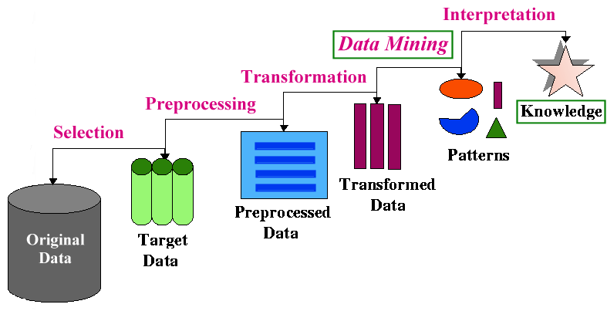
The Knowledge Discovery Process
Data Mining v. Knowledge Discovery in Data (KDD)
DM and KDD are often used interchangeably
actually, DM is only part of the KDD process
- The KDD Process

Slide 7
Types of Knowledge Discovery
Two kinds of knowledge discovery: directed and undirected
Directed Knowledge Discovery
Purpose: Explain value of some field in terms of all the others (goal-oriented)
Method: select the target field based on some hypothesis about the data; ask the algorithm to tell us how to predict or classify new instances
Examples:
what products show increased sale when cream cheese is discounted
which banner ad to use on a web page for a given user coming to the site
Undirected Knowledge Discovery
Purpose: Find patterns in the data that may be interesting (no target field)
Method: clustering, affinity grouping
Examples:
which products in the catalog often sell together
market segmentation (find groups of customers/users with similar characteristics or behavioral patterns)

Slide 8
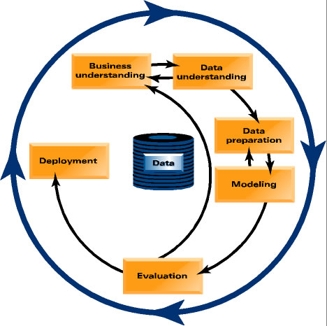
From Data Mining to Data Science
Notes:
Of course, data mining must be understood in the context of problem solving in real world. In recent years, people have started to use the term data science. This term emphasizes that data mining is a set of tools and techniques that are used as part of a scientific approach to solving problems. One must always start with a problem formulation is a specific application or business domain. A data-driven solution to this problem involves understanding the data that provide the observations relevant to the problem. These observations and preliminary analysis lead to a formulation of one or more hypotheses. The knowledge discovery process is guided by the hypotheses, including the data preparation and transformation, and well as the derivation of various models. The models must then be evaluated with appropriate test data. This evaluation, including the accuracy of predictive models, tells us whether we must go back and revise our hypotheses, or to modify our procedures. Eventually, the successful models must be deployed and tested in real-world situations.

Slide 9
Data Mining: On What Kinds of Data?
Database-oriented data sets and applications
Relational database, data warehouse, transactional database
Object-relational databases, Heterogeneous databases and legacy databases
Advanced data sets and advanced applications
Data streams and sensor data
Time-series data, temporal data, sequence data (incl. bio-sequences)
Structure data, graphs, social networks and information networks
Spatial data and spatiotemporal data
Multimedia database
Text data and other semi-structured data
The World-Wide Web

Slide 10
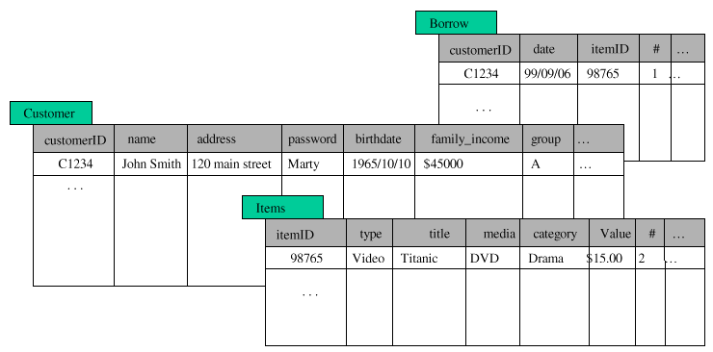
Data Mining: What Kind of Data?
Structured Databases
relational, object-relational, etc.
can use SQL to perform parts of the process
e.g., SELECT count(*) FROM Items WHERE
type=video GROUP BY category

Slide 11
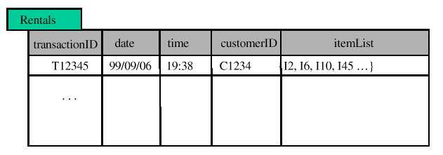
Data Mining: What Kind of Data?
Flat Files
most common data source
can be text (or HTML) or binary
may contain transactions, statistical data, measurements, etc.
Transactional databases
set of records each with a transaction id, time stamp, and a set of items
may have an associated “description” file for the items
typical source of data used in market basket analysis

Slide 12
Data Mining: What Kind of Data?
Other Types of Databases
legacy databases
multimedia databases (usually very high-dimensional)
spatial databases (containing geographical information, such as maps, or satellite imaging data, etc.)
Time Series Temporal Data (time dependent information such as stock market data; usually very dynamic)
World Wide Web
basically a large, heterogeneous, distributed database
need for new or additional tools and techniques
information retrieval, filtering and extraction
agents to assist in browsing and filtering
Web content, usage, and structure (linkage) mining tools
The “social Web”
User generated meta-data, social networks, shared resources, etc.

Slide 13
What Can Data Mining Do
Many Data Mining Tasks
often inter-related
often need to try different techniques/algorithms for each task
each tasks may require different types of knowledge discovery
What are some of data mining tasks
Classification
Prediction
Clustering
Affinity Grouping / Association discovery
Sequence Analysis
Characterization
Discrimination

Slide 14
Some Applications of Data mining
Business data analysis and decision support
Marketing focalization
Recognizing specific market segments that respond to particular characteristics
Return on mailing campaign (target marketing)
Customer Profiling
Segmentation of customer for marketing strategies and/or product offerings
Customer behavior understanding
Customer retention and loyalty
Mass customization / personalization

Slide 15
Some Applications of Data mining
Business data analysis and decision support (cont.)
Market analysis and management
Provide summary information for decision-making
Market basket analysis, cross selling, market segmentation.
Resource planning
Risk analysis and management
"What if" analysis
Forecasting
Pricing analysis, competitive analysis
Time-series analysis (Ex. stock market)

Slide 16
Some Applications of Data mining
Fraud detection
Detecting telephone fraud:
Telephone call model: destination of the call, duration, time of day or week
Analyze patterns that deviate from an expected norm
British Telecom identified discrete groups of callers with frequent intra-group calls, especially mobile phones, and broke a multimillion dollar fraud scheme
Detection of credit-card fraud
Detecting suspicious money transactions (money laundering)
Text mining:
Message filtering (e-mail, newsgroups, etc.)
Newspaper articles analysis
Text and document categorization
Web Mining
Mining patterns from the content, usage, and structure of Web resources

