Slide 1
CSC 480 Artificial Intelligence I
Rational Agents &
Markov Decision Processes
Bamshad Mobasher

Slide 2
Rational Agents and Uncertainty
In presence of uncertainty, rational agents must make choices as they decide on actions that are most likely to achieve a goal
  agent needs to have preferences among different possible outcomes
  the notion of utility is used to reason about preferences
  agents must assign utilities to various states, based on domain-specific information
Decision Theory
  preferences (utilities) are combined with probabilities to provide a general theory of rational decision making
  decision theory = probability theory + utility theory
  principle of Maximum Expected Utility: “an agent is rational if and only if it chooses actions that yields the highest expected utility, averaged over all possible outcomes of the action”
  so, when evaluating an action, the utility of a particular outcome is weighted by the probability that the outcome occurs

Slide 3
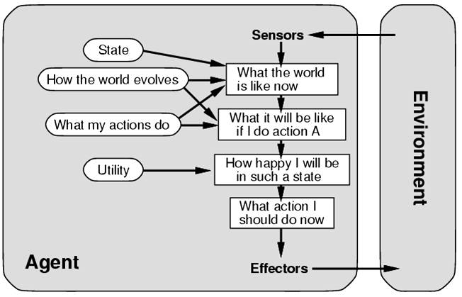
Recall: Utility-Based Agents
Utility-based agents
  An agent's utility function is an internalization of the performance measure (which is external)
Utility Function
  a mapping of states onto utility values
  allows rational decisions by evaluating trade-offs between competing or conflicting goals
  E.g., favoring routes that reduce distance to the destination

Slide 4
General Framework
An agent operates in a certain state space:
There is no goal state; instead, states provide rewards (positive, negative, or null)
A state’s reward quantifies in a single unit system what the agent gets when it visits this state (a bag of gold, a sunny afternoon on the beach, a speeding ticket, etc...)
Each action has several possible outcomes, each with some probability; sensing may also be imperfect
The agent’s goal is to plan a strategy (here, it is called a policy) to maximize the expected amount of rewards collected
As usual, there are many variants ...

Slide 5





Example: Grid World
A maze-like problem
  The agent lives in a grid
  Walls block the agent’s path
Noisy movement: actions do not always go as planned
  80% of the time, the action North takes the agent North
  (if there is no wall there)
  10% of the time, North takes the agent West; 10% East
  If there is a wall in the direction the agent would have been taken, the agent stays put
The agent receives rewards each time step
  Small “living” reward each step (can be negative)
  Big rewards come at the end (good or bad)
Goal: maximize sum of rewards

Slide 6



Grid World Actions
Deterministic Grid World
Stochastic Grid World

Slide 7
Markov Decision Processes (MDP)
An MDP is defined by:
  A set of states s ∈ S
  A set of actions a ∈ A
  A transition function T(s, a, s’)
    Probability that a from s leads to s’, i.e., P(s’| s, a)
    Also called the model or the dynamics
  A reward function R(s, a, s’)
    Sometimes just R(s) or R(s’)
  A start state
  Maybe a terminal state

Slide 8


What is Markov about MDPs?
“Markov” generally means that given the present state, the future and the past are independent
For Markov decision processes, “Markov” means action outcomes depend only on the current state
This is just like search, where the successor function could only depend on the current state (not the history)
Andrey Markov (1856-1922)

Slide 9
Action Model
Action a:
s ∈ S → a(s) = {s₁ (p₁), s₂ (p₂), ... , s_{n} (p_{n})}
probabilistic distribution
of possible successor states
Markov assumption: The action model a(s) does not depend on what happened prior to reaching s
[Otherwise, the prior history should be encoded in s]

Slide 10
A Simple Example
s₀
S₀ describes many actual states of the real world. A₁ reaches s₁ in some states, s₂ in others, and s₃ in the remaining ones
If the agent could return to S₀ many times in independent ways and if at each time it executed A₁, then it would reach s₁ 20% of the times, s₂, 70% of the times, and s₃ 10% of the times
A₁
s₁
s₂
s₃
0.2
0.7
0.1

Slide 11
Introducing rewards ...
s₀
Assume that the agent receives rewards in some states (rewards can be positive or negative)
If the agent could execute A₁ in S₀ many times, the average (expected) reward that it would get is:
U₁(S₀) = 100x0.2 + 50x0.7 + 70x0.1
= 20 + 35 + 7
= 62
A₁
s₁
s₂
s₃
0.2
0.7
0.1
100
50
70 ← rewards associated with
states s₁, s₂, and s₃

Slide 12
... and a second action ...
s₀
U₁(S₀) = 62
U₂(S₀) = 78
If the agent chooses to execute A₂, it will maximize the average collected rewards
A₁
A₂
s₁
s₂
s₃
s₄
0.2
0.7
0.1/0.2 0.8
100
50
70 80

Slide 13
... and action costs
s₀
We may associate costs with actions, which are subtracted from the rewards
U₁(S₀) = 62 – 5 = 57
U₂(S₀) = 78 – 25 = 53
When in s₀, the agent will now gain more on the average by executing A₁ than by executing A₂
A₁
A₂
(5)
(25)
s₁
s₂
s₃
s₄
0.2
0.7
0.1/0.2 0.8
100
50
70 80

Slide 14
Generalization
Inputs:
  Initial state s₀
  Action model
  Reward R(s) collected in each state s
A state is terminal if it has no successor
Starting at s₀, the agent keeps executing actions until it reaches a terminal state
Its goal is to maximize the expected sum of rewards collected (additive rewards)
Assume that the same state can’t be reached twice (no cycles)

Slide 15
Utility of a State
The utility of a state s measures its desirability:
If s is terminal:
U(s) = R(s)
If s is non-terminal,
U(s) = R(s) + max_{a∈Appl(s)}S_{s’∈Succ(s,a)}P(s’|a.s)U(s’)
[the reward of s augmented by the expected sum of rewards collected in future states]

Slide 16
U(s) = R(s) + max_{a∈Appl(s)}Σ_{s’∈Succ(s,a)} P(s’|a.s)U(s’)
Appl(s) is the set of all actions applicable to state s
Succ(s,a) is the set of all possible states after applying a to s
P(s’|a.s) is the probability of being in s’ after executing a in s

Slide 17
Utility with Action Costs
U(s) =
R(s) + max_{a∈Appl(s)}[-cost(a) + Σ_{s’∈Succ(s,a)} P(s’|a.s)U(s’)]

Slide 18
Optimal Policy
A policy is a function that maps each state s into the action to execute if s is reached
The optimal policy P* is the policy that always lead to maximizing the expected sum of rewards collected in future states
(Maximum Expected Utility principle)
P*(s) = arg max_{a∈Appl(s)}[-cost(a)+S_{s’∈Succ(s,a)} P(s’|a.s)U(s’)]

Slide 19
Basic Decision Theoretic Agent
function DT-Agent (percept) returns an action
static: a set of probabilistic beliefs about the state of the world
1. calculate updated probabilities for current state based on available evidence, including current percept and previous actions
2. calculate outcome probabilities for actions, given action descriptions and probabilities of current state
3. select action with highest expected utility, given probabilities of outcomes and a utility function
4. return action

Slide 20
Solving MDPs
Note: For further detail on methods to solve MDPs, such as Value Iteration and Policy Iteration see Chapter 17 of the Russell and Norvig book.
MDPs and their extension to Reinforcement Learning will be covered in more detail in the sequel course: Artificial Intelligence II.

