Slide 1
CSC 480 Artificial Intelligence I Logical inference & Reasoning Agents
Bamshad Mobasher

Slide 2
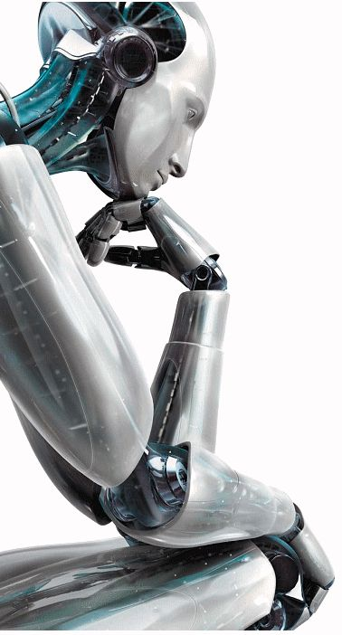
Recall: Definitions of AI
Thinking humanly (Haugeland, 1985) The ... effort to make computers ... with minds, in the full and literal sense.
Acting humanly (Kurzweil, 1990) The study of how to make computers perform functions that require intelligence when performed by people.
Thinking rationally (Winston, 1992) The study of the computations that make it possible to perceive, reason, and act.
Acting rationally (Nilsson, 1998) AI ... is concerned with intelligent behavior…

Slide 3
Recall: Thinking and Acting Rationally
Thinking Rationally
Capture ``correct'' reasoning processes”
How do we do this
Develop a formal model of reasoning (formal logic) that “always” leads to the “right” answer
Implement this model
How do we know when we've got it right?
when we can logically prove that the results of the programmed reasoning
soundness and completeness of first-order logic
Acting Rationally
Act so that desired goals are achieved
The rational agent approach
Figure out how to make correct decisions, which sometimes means thinking rationally and other times means having rational reflexes
reasoning versus acting; limited rationality

Slide 4
Logic
Logic is a great knowledge representation language for many AI problems
Propositional logic is the simple foundation and fine for some AI problems
First order Predicate Logic is much more expressive as a KR language and more commonly used in AI
There are many variations: horn logic, higher order logic, many-valued logics, probabilistic logics, etc.
The key feature of formal logical languages is that it they allow for logical reasoning through logical inferences
I.e., we can represent our knowledge about the world using logic
Then we can make inferences and derive new facts through reasoning

Slide 5
Knowledge Representation
Intended role of knowledge representation in AI is to reduce problems
of intelligent action to search problems. --Ginsberg, 1993
An Analogy between AI Problems and Programming
Programming
Artificial Intelligence
1. Devise an algorithm to solve the problem
2. Select a programming language in which the algorithm can be encoded
3. Capture the algorithm in a program
4. Run the program
1. Identify the knowledge needed to solve the problem
2. Select a language in which the knowledge can be represented
3. Write down the knowledge in the language
4. Use the consequences of the knowledge to solve the problem
It is the final step that usually involves search

Slide 6
Knowledge-Based Agent Architecture
Recall the simple reflex agent
A knowledge-based agent represents the state of the world using a set of sentences called a knowledge base.
loop forever
Input percepts
state ← Update-State(state, percept)
rule ← Rule-Match(state, rules)
action ← Rule-Action[rule]
Output action
state ← Update-State(state, action)
end
This agent keeps track of the state of the external world using its "update" function.
loop forever
Input percepts
KB ← tell(KB, make-sentence(percept))
action ← ask(KB, action-query)
Output action
KB ← tell(KB, make-sentence(action))
end
At each time instant, whatever the agent currently perceived is stated as a sentence, e.g. "I am hungry".

Slide 7
“Tell” and “Ask” Operations
There are two fundamental operations on a knowledge base:
"tell" it a new sentence
"ask" it a query
These are NOT simple operations. For example:
the "tell" operation may need to deal with the new sentence contradicting a sentence already in the knowledge base
the "ask" operation must be able to answer "wh" queries like "which action should I take now?" as well as yes/no queries
there may be uncertainty involved in the result of queries
Fundamental Requirements
the “ask” operation should give an answer that follows from the knowledge base (i.e., what has been told)
it is the inference mechanism that determines what follows from the knowledge base

Slide 8
Inference and Entailment
The knowledge representation language provides a declarative representation of real-world objects and their relationships
Entailment
KB entails a sentence s: KB |= s
KB derives (proves) a sentence s: KB |- s
Soundness and Completeness
Soundness: KB |- s ⇒ KB |= s, for all s
Completeness : KB |= s ⇒ KB |- s, for all s
sentences
sentences
Representation
entails
Semantics
(interpretation)
Real World
follows
facts
facts

Slide 9
Propositional logic

Slide 10
Propositional logic
Logical constants: true, false
Propositional symbols: P, Q, R, ... (atomic sentences)
Represent a statement/proposition that may be true or false
Atomic sentences are combined by connectives:
∧ and [conjunction]
∨ or [disjunction]
⇒ implies [implication / conditional]
⇔ is equivalent [biconditional]
¬ not [negation]
Literal: an atomic sentence or a negated atomic sentence
P, ¬ P

Slide 11
Propositional logic
Examples of compound sentences:

Slide 12
Sentences Represent StaTements
P means “It is hot.”
Q means “It is humid.”
R means “It is raining.”
(P ∧ Q) → R
“If it is hot and humid, then it is raining”
Q → P
“If it is humid, then it is hot”
We can also use variables that are more human readable:
(Hot ∧ Humid) → Rain

Slide 13
Propositional Logic: Semantics
In propositional logic, the semantics of connectives are specified by truth tables:
Truth tables can also be used to determine the validity of sentences:

Slide 14
Notes on Implication
If p and q are both true, then p ⇒ q is true.
If 1+1 = 2 then the sun rises in the east.
Here p: "1+1 = 2" and q: "the sun rises in the east."
If p is true and q is false, then p ⇒ q is false.
When it rains, I carry an umbrella.
p: "It is raining," and q: "I am carrying an umbrella."
we can rephrase as: "If it is raining then I am carrying an umbrella."
On days when it rains (p is true) and I forget to bring my umbrella (q is false), the statement p ⇒ q is false
If p is false, then p ⇒ q is true, no matter whether q is true or not. For instance:
If the moon is made of green cheese, then I am the King of England.

Slide 15
Interpretations and Models
A world in which a sentence s is true under a particular interpretation is called a model for s
Entailment is defined in terms of models:
a sentence s is entailed by KB (KB |= s) if any model of KB is also a model of s
i.e., whenever KB is true in some interpretation, so is s in that interpretation
Models as mappings:
we can think of the models for a sentence s as those mappings (from variables to truth values) which make s true
each such mapping is an interpretation; thus models of s are interpretations that make s true

Slide 16
Interpretations and Models
In propositional logic, each interpretation of a sentence s corresponds to a row of the truth table for s, and models are those rows for which s has the value true
s is satisfiable if there is at least one model (i.e., one row that makes s true)
s is valid if all rows of the table make s true (s is a tautology)
s is unsatisfiable if it is false for all interpretations (s is inconsistent); alternatively, s is inconsistent, if there is a sentence t such that s entails both t and ¬t.

Slide 17
Some Useful Tautologies
Conversion between => and \/
and more generally:
DeMorgan’s Laws
Distributivity

Slide 18
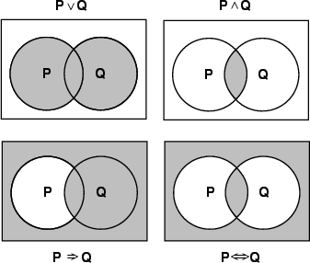
Models of complex sentences

Slide 19
Logical Equivalence
How do we show that two sentences are logically equivalent?
Sentences s and t are equivalent if they are true in exactly the same models
In propositional logic, interpretations correspond to truth-value assignments (i.e., rows of the truth table)
models of s are those rows that make s True
check equivalence by examining all rows for s and t: s logically implies (entails) t, if whenever s is True, so is t; s and t are equivalent, if they are True in exactly the same rows (i.e., columns for s and t are identical). (enumeration method)
How do we show that ?

Slide 20
Propositional Entailment
Let and
Does KB entail α?
check all possible interpretations; α must be true whenever KB is true

Slide 21
Normal Forms
Other approaches to inference use syntactic operations on sentences (often expressed in a standardized form)
Conjunctive Normal Form (CNF)
conjunction of disjunction of literals
E.g.,
Disjunctive Normal Form (DNF)
disjunction of conjunction of literals
E.g.,
Horn Clauses
conjunction of Horn clauses (clauses with at most 1 positive literal)
E.g.,
often written as a set of implications:
clauses

Slide 22
Inference rules
Logical inference is used to create new sentences that logically follow from a given set of predicate calculus sentences (KB)
An inference rule is sound if every sentence X produced by an inference rule operating on a KB logically follows from the KB. (That is, the inference rule does not create any contradictions)
An inference rule is complete if it is able to produce every expression that logically follows from (is entailed by) the KB

Slide 23
Inference Rules for Propositional Logic
(MP) Modes Ponens (Implication-elimination)
(AI) And-introduction (OI) Or-introduction
(AE) And-elimination
(NE) Negation-elimination

Slide 24
Inference Rules for Propositional Logic
(UR) Unit Resolution
(R) General Resolution
Notes:
Resolution is used with knowledge bases in CNF (or clausal form), and is complete for propositional logic
Modes Ponens (the general form)
is complete for Horn knowledge bases, and can be used in both forward and backward chaining.

Slide 25
Proving things
A proof is a sequence of sentences, where each sentence is either a premise or a sentence derived from earlier sentences in the proof by the application of one of the rules of inference.
The last sentence is the theorem (also called goal or query) that we want to prove.
Example for the “weather problem” given above.
1 Humid Premise “It is humid”
2 Humid→Hot Premise “If it is humid, it is hot”
3 Hot Modus Ponens (1,2) “It is hot”
4 (Hot∧Humid)→Rain Premise “If it’s hot & humid, it’s raining”
5 Hot∧Humid And Introduction (1,2) “It is hot and humid”
6 Rain Modus Ponens (4,5) “It is raining”

Slide 26
Using Inference Rules
Given
prove
Note: in each of the steps in the proof we could have applied other rules to derive new sentences, thus the inference problem is really a search problem:
initial state = KB
goal state = conclusion to be proved
operators = ?

Slide 27
The Island of Knights & Knaves

Slide 28
Exercise: The Island of Knights & Knaves
We are in an island all of whose inhabitants are either knights or knaves
knights always tell the truth
knaves always lie
So, here are some facts we know about this world (we’ll use “~” for negation):
(1) says(A,S) /\ knave(A) => ~S
(2) says(A,S) /\ knight(A) => S
(3) ~knight(A) => knave(A)
(4) ~knave(A) => knight(A)
Problem:
you meet inhabitants A and B, and A tells you “at least one of us is a knave”
can you determine who is a knave and who is a knight?

Slide 29
Exercise: The Island of Knights & Knaves
Suppose A is a knave:
Knave(A)
Says(A, “knave(A) \/ knave(B)”)
By (1) and MP we can conclude: ~(knave(A) \/ knave(B))
By DeMorgan’s Law: ~knave(A) /\ ~knave(B)
By AE: ~knave(A)
This is a contradiction, so our assumption that “knave(A)” was false
Therefore it must be the case that ~knave(A) which by MP and (4) results in knight(A).
But, what is B?
We know from above that knight(A)
Says(A, “knave(A) \/ knave(B))
By (2) and MP we conclude: knave(A) \/ knave(B)
But we know form above that ~knave(A)
So, by the resolution rule we conclude: knave(B).

Slide 30
Exercise: The Island of Knights & Knaves
Problem 1”
You meet inhabitants A and B. A says: “We are both knaves.”
What are A and B?
Problem 2:
You meet inhabitants A, B, and C. You walk up to A and ask: "are you a knight or a knave?" A gives an answer but you don't hear what she said. B says: "A said she was a knave." C says: "don't believe B; he is lying.”
What are B and C?
Can you tell something about A?

Slide 31
Propositional logic: pro and con
Advantages
Simple KR language sufficient for some problems
Lays the foundation for higher logics (e.g., FOL)
Reasoning is decidable, though NP complete, and efficient techniques exist for many problems
Disadvantages
Not expressive enough for most problems
Even when it is, it can very “un-concise”

Slide 32
PL is a weak KR language
Hard to identify “individuals” (e.g., Mary, 3)
Can’t directly talk about properties of individuals or relations between individuals (e.g., “Bill is tall”)
Generalizations, patterns, regularities can’t easily be represented (e.g., “all triangles have 3 sides”)
First-Order Logic (FOL) is expressive enough to represent this kind of information using relations, variables and quantifiers, e.g.,
Every elephant is gray: ∀ x (elephant(x) → gray(x))
There is a white alligator: ∃ x (alligator(X) ^ white(X))

Slide 33
First Order Predicate Calculus

Slide 34
First-Order Predicate Logic
Constants
represent objects in real world
john, 0, 1, book, etc. (notation: a, b, c, …)
Functions
names for objects not individually identified (notation: f, g, h, …)
successor(1), sqrt(successor(3)), child_of(john, mary), f(a, g(b,c))
Predicates
represent relations in the real world (notation: P, Q, R, …)
likes(john, mary), x > y, valuable(gold)
special predicate for equality: =
Variables
placeholders for objects (notation: x, y, z, …)
Connectives and Quantifiers
¬ , ∧, ∨, ⇒, ⇔, ∀, ∃

Slide 35
First-Order Predicate Logic
Atomic Sentences (atomic formulas)
predicate (term₁, term₂, …, term_{k})
where
term = function(term₁, term₂, …, term_{k}) or constant, or variable
Compound Formulas

Slide 36
Quantifiers
Universal quantification
(∀x) P(x) means that P holds for all values of x in the domain associated with that variable
E.g., ∀x dolphin(x) → mammal(x)
Existential quantification
(∃ x) P(x) means that P holds for some value of x in the domain associated with that variable
E.g., ∃x mammal(x) ∧ lays-eggs(x)
Permits one to make a statement about some object without naming it

Slide 37
Quantifiers
∀ can be thought of as “conjunction” over all objects in domain:
e.g.,
can be interpreted as
∃ can be thought of as “disjunction” over all objects in domain:
e.g.,
can be interpreted as
Quantifier Duality
each can be expressed using the other
this is an application of DeMorgan’s laws
examples:

Slide 38
Transformation to FOPC: Dealing with Quantifiers
Usually use ⇒ with ∀:
e.g.,
says, all humans are mortal
but,
say, everything is human and mortal
Usually use ∧ with ∃:
e.g.,
says, there is a bird that does not fly
but,
is also true for anything that is not a bird
∀x∃y is not the same as ∃y∀x :
e.g.,
says, there is someone who loves everyone
but,
says, everyone is loved by at least one person

Slide 39
Transformation to FOPC
Mary got good grades in courses CS101 and CS102
John passed CS102
Student who gets good grades in a course passes that course
Students who pass a course are happy
A student who is not happy hasn’t passed all his/her courses
Only one student failed all the courses

Slide 40
Transformation to FOPC More Examples
Every gardener likes the sun.
∀x gardener(x) → likes(x,Sun)
You can fool some of the people all of the time.
∃x ∀t person(x) ∧time(t) → can-fool(x,t)
You can fool all of the people some of the time.
∀x ∃t (person(x) → time(t) ∧can-fool(x,t))
∀x (person(x) → ∃t (time(t) ∧can-fool(x,t)))
All purple mushrooms are poisonous.
∀x (mushroom(x) ∧ purple(x)) → poisonous(x)
No purple mushroom is poisonous.
¬∃x purple(x) ∧ mushroom(x) ∧ poisonous(x)
∀x (mushroom(x) ∧ purple(x)) → ¬poisonous(x)
There are exactly two purple mushrooms.
∃x ∃y mushroom(x) ∧ purple(x) ∧ mushroom(y) ∧ purple(y) ^ ¬(x=y) ∧ ∀z (mushroom(z) ∧ purple(z)) → ((x=z) ∨ (y=z))
Equivalent
Equivalent

Slide 41
Example: Axiomatizing the Knights and Knaves Domain
. . .
Query: can an inhabitant say “I am a knave”?

Slide 42
Interpretations & Models in FOPC
Definition: An interpretation is a mapping which assigns
objects in the domain to constants in the language
functional relationships in domain to function symbols
relations to predicate symbols
usual logical relationships to connectives and quantifiers: ¬, ∧, ∨, ⇒, ⇔, ∀, ∃
Definition: Models
An interpretation M is a model for a set of sentences S, if every sentence in S is true with respect to M (if S is a singleton {s}, then we say that M is a model for s).
Notation: S
If there is a model M for S, then S is satisfiable
If S is true in every interpretation M (every interpretation is a model for S), then S is valid
M

Slide 43
Interpretations & Models in FOPC
Example:
where N, L are predicate symbols, and f a function symbol
interpretation 1
domain = positive integers
N(x) = “x is a natural number”
L(x,y) = “x is less than y”
f(x) = “predecessor of x” (i.e., x-1)
then s says: “any natural number is a less than its predecessor” (of course this is false, so this interpretation is not a model for s)
interpretation 2
domain = all people
N(x) = “x is a person”
L(x,y) = “x likes y”
f(x) = “mother of x”
then s says: “everyone likes their mother”

Slide 44
Semantics of FOPC Operators
Let F and G be FOPC Formulas, and M be any interpretation
F ∧ G is true in M iff both F and G are true in M
F ∨ G is true in M iff at least one of F or G is true in M
¬F is true in M iff F is false in M
F ⇒ G is true in M iff either F is false in M or G is true in M
F ⇔ G is true in M iff both F and G are true in M or both are false in M
So far this is the same as propositional; how about quantifiers:
∀x F is true in M iff for any object d in the domain, F[d] is true in M, where F[d] is the result of replacing every free occurrence of x in F with d
∃x F is true in M iff for some object d in the domain, F[d] is true in M, where F[d] is the result of replacing every free occurrence of x in F with d
Example: Again consider KB =
∃x(bird(x) ∧ flies(x)) is entailed by KB, since bird(tweety) ∧ flies(tweety), is true in every model of KB (taking d = tweety)

Slide 45
Proof Theory of FOPC
The rules of inference for propositional logic still apply in the context of FOPC:
And-Introduction (AI)
And-Elimination (AE)
Or-Introduction (OI)
Negation-Elimination(NE)
Modes Ponens (MP)
In addition we have inference rules for quantifiers:
Universal Instantiation (UI)
where, t is a term replacing free occurrences
of x in F (x must not occur in t)
Existential Instantiation (EI)
where, f is a new function symbol, and y
is a free variable (not quantified in F)
The formula F is derivable (provable) from KB, if:
1. F is already in KB (a fact or axiom)
2. F is the result of applying a rule of
inference to sentences derivable
from KB

Slide 46
Universal / Existential Instantiation
Universal Instantiation (UI)
where, t is a term replacing free occurrences
of x in F (x must not occur in t)
Example:
From ∀y(likes(jean,y)) we can infer: likes(jean,joe), likes(joe, mother_of(joe)), etc
Existential Instantiation (EI)
where, f is a new function symbol, and y
is a free variable (not quantified in F)
Example:
Consider ∃y(likes(x,y)); we can infer: likes(x,f(x)), where f is a new function symbol representing an object that satisfies ∃y(likes(x,y)) (f is called a Skolem function)
If there are no free variables in F, then we can use a new constant symbol (a function with no arguments):
Consider ∃y∀x(likes(x,y)); we can infer: ∀x(likes(x,a), where a is a new constant symbol (a is called a Skolem constant)

Slide 47
Example of Derivation
Let KB = { parent(john,mary), parent(john,joe),
This derivation shows that KB

Slide 48
Resolution Rule of Inference
Resolution provides a complete rule of inference for first order predicate calculus
if used in conjunction with a refutation proof procedure (proof by contradiction)
requires that formulas be written in clausal form
Refutation procedure
to prove that KB |= α, show that KB ∧ ¬α is unsatisfiable
i.e., assume the contrary of α, and arrive at a contradiction
KB and ¬α, must be in CNF, i.e. conjunction of clauses (disjunctions)
each step in the refutation procedure involves applying resolution to two clauses, in order to get a new clause
inference continues until the empty clause is derived (a contradiction)
C₁
C₂
C

Slide 49
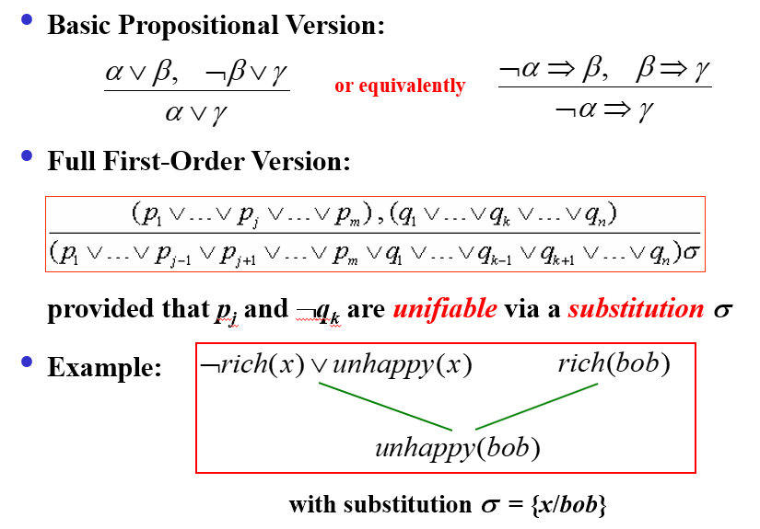
Resolution Rule of Inference

Slide 50
Conjunctive Normal Form - Revisited
Literal = possibly negated atomic sentence
e.g., ¬rich(x), or unhappy(bob), etc.
Clause = disjunction of literals
e.g., ¬rich(x) ∨ unhappy(x)
The KB is a conjunction of clauses
Any first-order logic KB can be converted into CNF:
1. Replace P ⇒ Q with ¬P ∨ Q
2. Move inward the negation symbol, e.g., ¬∀x P becomes ∃x ¬P
3. Standardize variables apart, e.g., ∀x P ∨ ∃x Q becomes ∀x P ∨ ∃y Q
4. Move quantifiers left in order, e.g., ∀x P ∨ ∃y Q becomes ∀x∃y (P ∨ Q)
5. Eliminate ∃ by Skolemization (see later slide)
6. Drop universal quantifiers (we’ll assume they are implicit)
7. Distribute ∧ over ∨ , e.g., ( P ∧ Q) ∨ R becomes (P ∨ Q) ∧ (P ∨ R)
8. Split conjunctions (into a set of clauses) and rename variables to avoid conflicts

Slide 51
Conversion to CNF - Example 1
Original sentence
Eliminate ⇒:
Move in negation:
Distribute ∧ over ∨:
Split conjunction
or equivalently
This is a set of two clauses

Slide 52
Skolemization
The rules for Skolemization is essentially the same as those we described for quantifier inference rules
if ∃ does not occur within the scope of a ∀, then drop ∃, and replace all occurrence of the existentially quantified variable with a new constant symbol (called the Skolem constant)
e.g., ∃x P(x) becomes P(â), where â is a new constant symbol
if ∃ is within the scope of any ∀, then drop ∃, and replace the associated variable with a Skolem function (a new function symbol), whose arguments are the universally quantified variables
e.g., ∀x∀y∃z P(x, y, z) becomes ∀x∀y P(x, y, sk(x, y))
e.g., ∀x person(x) ⇒ ∃y heart(y) ∧ has(x,y) becomes ∀x person(x) ⇒ heart(sk(x)) ∧ has(x, sk(x))

Slide 53
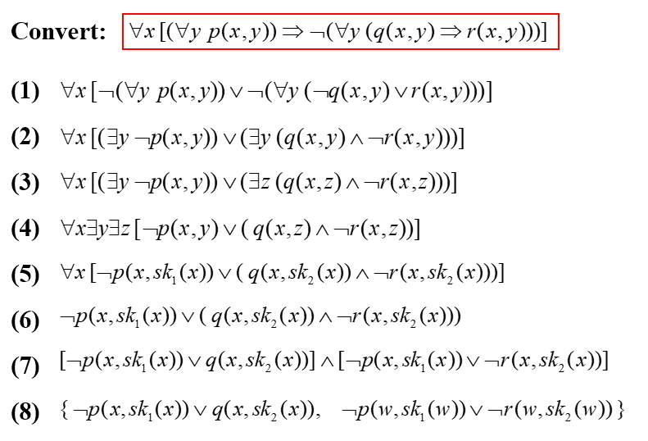
Conversion to CNF - Example 2

Slide 54
Refutation Procedure - Example
Given KB =
prove KB |= C
Start with the negation of the goal and try to arrive at a contradiction (empty clause)
(clause 1)
(clause 3)
(clause 4)
(clause 2)
(clause 5)

Slide 55
Refutation Procedure - Example 2
KB =
Converting 4 to CNF:
Converting 5 to CNF:

Slide 56
Refutation Procedure - Example 2 (cont.)
Here is the final KB in clausal form:
KB =
A digression: what if we wanted to add a clause saying that there is someone
who is neither the father nor the mother of john:
Skolem constant
In clausal form:
Next we want to prove each of the following using resolution refutation:
(sue is a grandparent of mary)
(there is someone who is john’s parent)

Slide 57
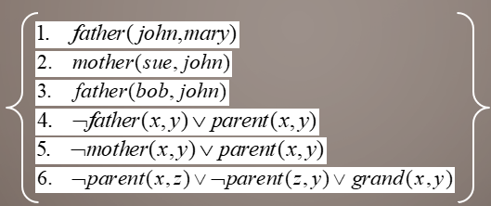
Refutation Procedure - Example 2 (cont.)
To prove, we must first negate the goal and transform into clausal form:
Goal: Prove
The refutation (proof by contradiction):
(clause 4)
KB:
y = john
(clause 3)
x = bob
Note that the proof is constructive: we end up with an answer x = bob

Slide 58
Refutation Procedure - Example 2 (cont.)
Now, let’s prove that sue is the grandparent of mary:
(clause 6)
x = sue
y = mary
(clause 4)
z = x₁
y₁ = mary
KB:
(clause 1)
x₁ = john
(clause 5)
x₂ = sue
y₂ = john
(clause 2)

Slide 59
A common error
You can only apply one resolution rule at a time
Example:
broke(Bob) ∨ well-fed(Bob) ∨ happy(Bob) ¬broke(Bob) ∨ ¬hungry(Bob) ∨ ¬happy(Bob)
You can resolve on broke to get:
well-fed(Bob) ∨ happy(Bob) ∨ ¬hungry(Bob) ∨ ¬happy(Bob) ≡ T
Or you can resolve on happy to get:
broke(Bob) ∨ well-fed(Bob) ∨ ¬broke(Bob) ∨ ¬hungry(Bob) ≡ T
Note that both legal resolutions yield a tautology (a trivially true statement, containing X ∨ ¬X), which is correct but useless
But you cannot resolve on both at once to get:
well-fed(Bob) ∨ ¬hungry(Bob)

Slide 60
Substitutions and Unification
A substitution is a set of bindings of the form v = t, where v is a variable and t is a term
If P is an expression and σ is a substitution, then application of σ to P, denoted by (P)σ, is the result of simultaneously replacing each variable x in P with a term t, where x = t is in σ
E.g., P = likes(sue, z), and σ = {w = john, z = mother_of(john)}
then (P)σ = likes(sue, mother_of(john))
E.g., P = likes(father_of(w), z), and σ = {w = john, z = mother_of(x)}
then (P)σ = likes(father_of(john), mother_of(x))
E.g., P = likes(father_of(z), z), and σ = {z = mother_of(john)}
then (P)σ = likes(father_of(mother_of(john)), mother_of(john))
E.g., P = likes(w, z), and σ = {w = john, z = mother_of(w)}
then (P)σ = likes(john, mother_of(john))

Slide 61
Substitutions and Unification
Let P and Q be two expressions, and σ a substitution. Then σ is a unifier of P and Q, if (P)σ = (Q)σ
In the above definition, “=” means syntactic equality only
E.g., P = likes(john, z), and Q = likes(w, mother_of(john))
then σ = {w = john, z = mother_of(john)} is a unifier of P and Q
E.g., E₁ = p(x, f(y)), and E₂ = p(g(z), w)
then σ₁ = { x = g(a), y = b, z = a, w = f(b) }
σ₂ = { x = g(a), z = a, w = f(y) }
σ₃ = { x = g(z), w = f(y) }
are all unifiers for the two expressions. What’s the difference?
In the above example, σ₂ is more general than σ₁, since by applying some other substitution (in this case {y = b}) to elements of σ₂, we can obtain σ₁. We say that σ₁ is an instance of σ₂. Note that σ₃ is in fact the most general unifier (mgu) of E₁ and E₂: all instances of σ₃ are unifiers, and any substitution that is more general than σ₃ is not a unifier of E₁ and E₂ (e.g., σ₄ = { x = v, w = f(y) } is more general than σ₃, but is not a unifier.

Slide 62
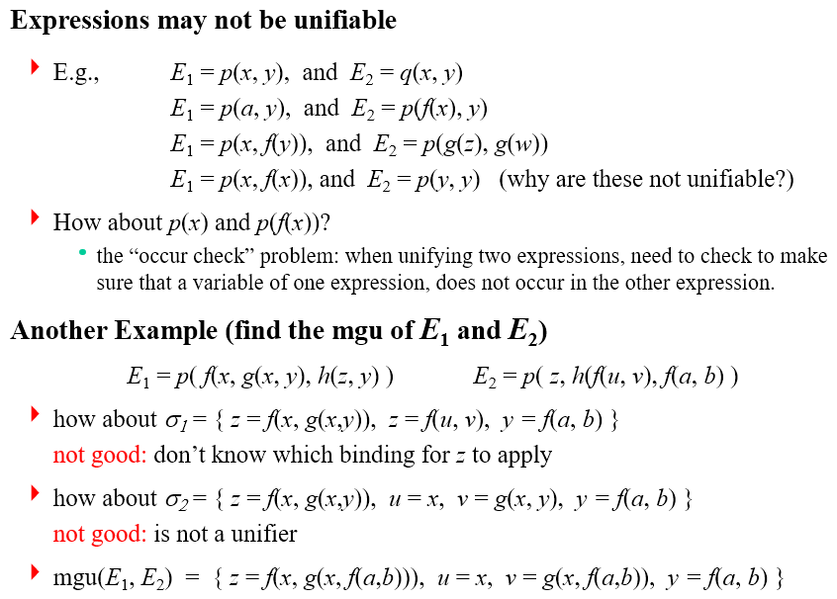
Substitutions and Unification

Slide 63
Forward and Backward Chaining
Generalized Modus Ponens
GMP is complete for Horn knowledge bases
Recall: a Horn knowledge base is one in which all sentences are of the form
p₁ /\ p₂ /\ …/\ p_{n} => q OR
p₁ /\ p₂ /\ …/\ p_{n}
In other words, all sentence are in the form of an implication rule with zero or one predicate on the right-hand-side (sentences with zero predicates on the rhs are sometimes referred to as “facts”).
For such knowledge bases, we can apply GMP in a forward or a backward direction.
where θ is a substitution that unifies p_{i} and q_{i} for all i, i.e., (p_{i})θ = (q_{i})θ.

Slide 64
Forward and Backward Chaining
Forward Chaining
Start with KB, infer new consequences using inference rule(s), add new consequences to KB, continue this process (possibly until a goal is reached)
In a knowledge-based agent this amounts to repeated application of the TELL operation
May generate many irrelevant conclusions, so not usually suitable for solving for a specific goal
Useful for building a knowledge base incrementally as new facts come in
Usually, the forward chaining procedure is triggered when a new fact is added to the knowledge base
In this case, FC will try to generate all consequences of the new fact (based on existing facts) and adds those which are note already in the KB.

Slide 65
Forward and Backward Chaining
Backward Chaining
Start with goal to be proved, apply modus ponens in a backward manner to obtain premises, then try to solve for premises until known facts (already in KB) are reached
This is useful for solving for a particular goal
In a knowledge-based agent this amounts to applications of the ASK operation
The proofs can be viewed as an “AND/OR” tree
Root is the goal to be proved
For each node, its children are the subgoals that must be proved in order to prove the goal at the current node
If the goal is conjunctive (i.e., the premise of rule is a conjunction), then each conjunct is represented as a child and the node is marked as an “AND node” – in this case, both subgoals have to be proved
If the goal can be proved using alternative facts in KB, each alternate subgoal is represented as a child and the node is marked as an “OR node” – in this case, only one of the subgoals need to be proved

Slide 66
Proof Tree for Backward Chaining
KB =
prove KB |= C
B is an AND node: both branches must succeed in order for B to succeed.
A is an OR node: it’s sufficient for one branch to succeed in order for A to succeed.
C
A
B
F
E
D
E
fail;
backtrack
success
success
success
What if clause 4 was G => A instead?

Slide 67
Proof Tree for Backward Chaining
KB =
z = john
z = z₁
z = z₂
x = x₁
x = x₂
fail
z₁ = john
x₁ = bob
x₂ = sue

Slide 68
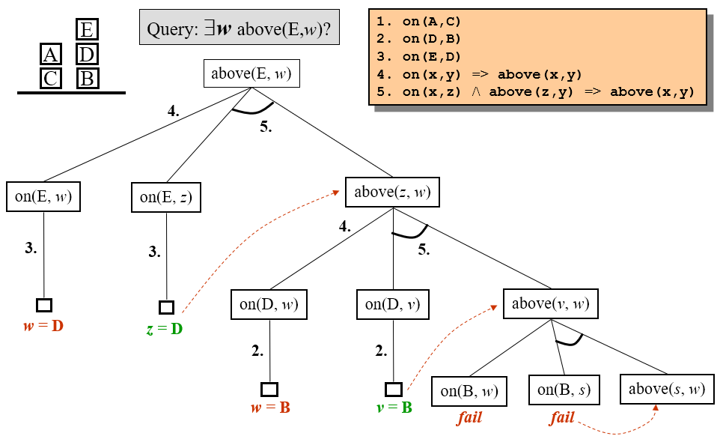
Backward Chaining: Blocks World

Slide 69
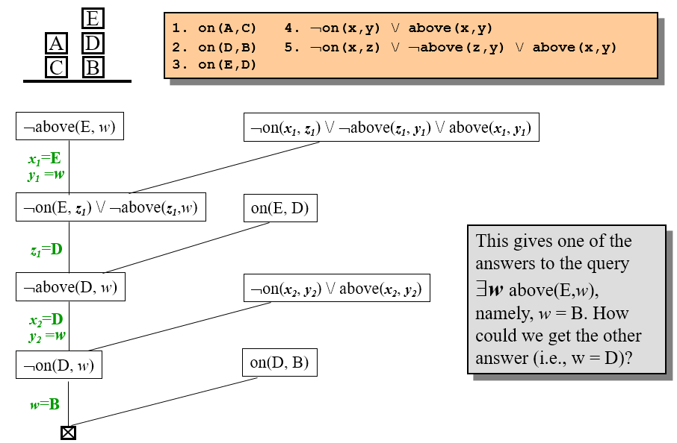
Example: Using Resolution in Blocks World

Slide 70
CSC 480 Artificial Intelligence I Logical inference & Reasoning Agents
Bamshad Mobasher

