Slide 1
CSC 480 Artificial Intelligence I Problem solving as Search
Bamshad Mobasher

Slide 2
Part III
Heuristic Search

Slide 3
Problem with uniform cost search
We are only considering the cost so far, not the expected cost of getting to the goal node
But, we don’t know before hand the cost of getting to the goal from a previous state
Solution: use heuristics (rules of thumb based on the knowledge of the domain) to estimate the cost of getting to a goal node

Slide 4
Heuristic Search
Estimate for each state the cost of getting from there to a goal state
Use “heuristic” information to guess which nodes to expand next
A heuristic is in the form of an evaluation function based on domain-specific information related to the problem.
Gives us a way to evaluate a node “locally” based on an estimate of the cost to get from the node to a goal node (the idea is to find the least cost path to a goal node).

Slide 5
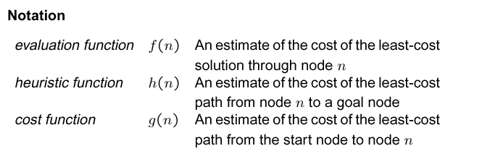
Evaluation Functions
h(n) is the heuristic function g(n): cost of the best path found so far between the initial node and n
f(n) = g(n) → uniform cost search
f(n) = h(n) → greedy best-first search
f(n) = g(n) + h(n) → A* algorithm

Slide 6
Best-First Search
Basic Idea: always expand the node that minimizes (or maximizes) the evaluation function f(n)
Greedy strategy: f(n) = h(n), where h(n) estimates the cost of getting from the node n to the goal
if we keep nodes in memory (on the queue) for backtracking, then this is called (Greedy) Best-First search; if no queue and we stop as soon as f(n) is worse for the children than the parent, then this is called Hill-Climbing.
What happens if we always try at each step to move closer to the goal node?
The BFS algorithm in this case will
find the longer solution path,
since it will begin by moving
forward and then be committed
to this choice.
What about hill-climbing?

Slide 7
Best-First Search
The evaluation function f maps each search node n to positive real number f(n)
The smaller f(n) = h(n), the more promising n
Best-first search sorts the search queue at each step in increasing order of f
random order is assumed among nodes with equal values of f
“Best” only refers to the value of f,
not to the quality of the actual path.
Best-first search does not generate
optimal paths in general

Slide 8
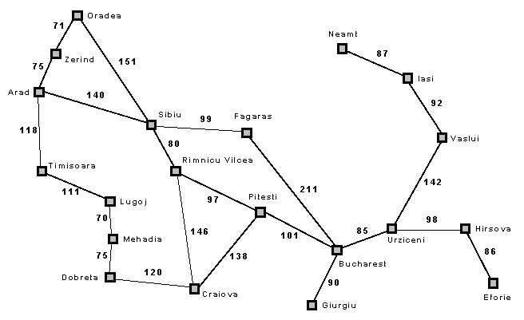
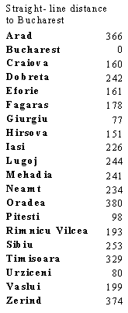
Best-First Search Example
Suppose we don’t know the actual “road” distances to Bucharest beforehand
But can figure out the “as-a-crow-flies” distances from a map
Heuristic evaluation function:
h(n) = straight-line distance between n and Bucharest
h(n) is a heuristic because it is an estimate of the actual cost of getting from n to the goal
Note that h(goal) = 0 always

Slide 9
Greedy Best-First Search
Arad
h(n) = 366
<== Arad <==

Slide 10
Greedy Best-First Search
Arad
h(n) = 366
h(n) = 253
Sibiu
h(n) = 329
Timisoara
h(n) = 374
Zerind
<== Sibiu, Timisoara, Zerind <==

Slide 11
Greedy Best-First Search
Arad
h(n) = 366
h(n) = 253
Sibiu
h(n) = 329
Timisoara
h(n) = 374
Zerind
366
178
380
193
Arad
Fagaras
Oradea
Rimnicu
<== Fagaras, Rimnicu, Timisoara, Zerind, Oradea <==

Slide 12
Greedy Best-First Search
Arad
h(n) = 366
h(n) = 253
Sibiu
h(n) = 329
Timisoara
h(n) = 374
Zerind
178
380
193
Fagaras
Oradea
Rimnicu
253
h(n) = 0
Sibiu
Bucharest
<== Bucharest, Rimnicu, Timisoara, Zerind, Oradea <==

Slide 13
Greedy Best-First Search
Arad
h(n) = 366
h(n) = 253
Sibiu
h(n) = 329
Timisoara
h(n) = 374
Zerind
178
380
193
Fagaras
Oradea
Rimnicu
253
h(n) = 0
Actual cost of the solution:
Arad => Sibiu => Fagaras => Bucharest
is 140 + 99 + 211 = 450
But, consider the path:
Arad => Sibiu => Rimnicu => Pitesti => Bucharest
with the cost 418 – So we got a suboptimal solution
Sibiu
Bucharest

Slide 14
Properties of Best-First (Greedy) Search
Complete?
No - can get stuck in loops
e.g., Iasi => Neamt => Iasi => Neamt => …
It is complete in finite space with repeated-state checking
Time Complexity:
In worst case: O(b^{m})
but good heuristic can give dramatic improvement
Space Complexity:
In worst case: O(b^{m})
keeps all nodes in memory
Optimal: No

Slide 15
A* Search (most popular algorithm in AI)

Slide 16
Basic Idea: avoid expanding paths that are already expensive
Evaluation function: f(n) = g(n) + h(n)
g(n) = cost so far to reach n
h(n) = estimated cost to goal from n
f(n) = estimated total cost of path through n to reach the goal
Admissible heuristics
i.e., h(n) ≤ h*(n), for all n, where h*(n) is the true cost from n
Ex: straight-line distance never overestimates the actual road distance
A* search is optimal (finds lowest cost solution) if h(n) is admissible
however, the number of nodes expanded depends on how good the heuristic is
best case: h(n) = h*(n) for all n ➔ A* will find the best solution with no search
if h(n) > h*(n) for some n, then A*
might still work
but might not find any solution at all

Slide 17
Arad
f(n) = 366
140
75
118
h(n) = 253
f(n) = 393
Sibiu
h(n) = 329
f(n) = 447
Zerind
h(n) = 374
f(n) = 449
Timisoara
140
99
151
80
Arad
Fagaras
Oradea
Rimnicu
f(n) = 413
f(n) = 646
f(n) = 417
f(n) = 661
146
97
80
Craiova
Pitesti
Sibiu
f(n) = 526
f(n) = 415
f(n) = 553

Slide 18
...
h(n) = 253
f(n) = 393
Sibiu
140
99
151
80
Arad
Fagaras
Oradea
Rimnicu
f(n) = 413
f(n) = 646
f(n) = 417
f(n) = 661
146
97
80
Craiova
f(n) = 415
Pitesti
Sibiu
f(n) = 526
f(n) = 553
138
101
97
Rimnicu
Craiova
Bucharest
f(n) = 607
f(n) = 615
f(n) = 418

Slide 19
...
h(n) = 253
f(n) = 393
Sibiu
140
99
80
151
Arad
f(n) = 417
Fagaras
Oradea
Rimnicu
f(n) = 413
f(n) = 646
f(n) = 526
99
211
146
97
80
Sibiu
Bucharest
Craiova
f(n) = 415
Pitesti
Sibiu
f(n) = 591
f(n) = 450
f(n) = 526
f(n) = 553
138
101
97
Rimnicu
Craiova
Bucharest
f(n) = 607
f(n) = 615
f(n) = 418

Slide 20
A* and Repeated States
It is not harmful to discard a node revisiting a state if the new path to this state has higher cost than the previous one
A* remains optimal, but the size of the search tree can still be exponential in the worst case
Fortunately, for a large family of admissible heuristics – consistent heuristics – there is a much easier way of dealing with revisited states

Slide 21
A* and Consistency (Monotonicity)
A heuristic h(n) is consistent if for every node n and every successor of n, succ(n):
h(n) – h(succ(n)) ≤ cost( n →succ(n) )
i.e., decrease in heuristic value due to an action is never more than the cost of the action
All consistent heuristics are admissible
For an admissible heuristic
the values of f(n) along any path are non-decreasing (monotonincity)
A* expands nodes according to non-decreasing order of f(n)

Slide 22
A* and Consistency (Monotonicity)
5
8
1
2
3
4
2
1
4
5
6
7
3
6
7
8
STATE(N)
goal
h₁(N) = number of misplaced tiles
h₂(N) = sum of the (Manhattan) distances of every tile to its goal position
both heuristics are consistent

Slide 23
A* and Repeated States
Theorem: If h is consistent, then whenever A* expands a node, it has already found an optimal path to this node’s state
Dealing with Repeated States:
If a newly generated state was previously expanded, then discard the new state
If multiple (unexpanded) instances of a state end up on the queue, we only keep the instance that has the smallest f value.

Slide 24
Finding good heuristics for a problem
Relax restrictions on operators: in general, the cost of an exact solution to a relaxed problem is a good heuristic for the original problem

Slide 25
A* and “Informedness”
Multiple admissible heuristics?
given admissible heuristics h₁ and h₂, if h₂(n) > h₁(n), for all n, then h₂ dominates h₁
the dominating admissible heuristic usually expands fewer nodes (it is more informed)
if there are several admissible heuristics none of which dominates any others, we can take the composite heuristic: h(n) = max ( h₁(n), h₂(n), … , h_{k}(n) )
A* Efficiency and Informedness
A* expands every node n for which f(n) < f*
i.e., every node with h(n) < f* - g(n) will be expanded
so, if h₁(n) ≥ h₂(n), for all n, every node expanded by h₁ must also be expanded by h₂
Moral of the story: heuristic functions with higher values work better so long as they are admissible (in other words, we want our heuristic to get as close as possible to h*).

Slide 26
When to Use Search Techniques?
The search space is small, and
No other technique is available, or
Developing a more efficient technique is not worth the effort
The search space is large, and
No other technique is available, and
There exist “good” heuristics

