Slide 1
CSC 480 Artificial Intelligence I Problem solving as Search
Bamshad Mobasher

Slide 2
Introduction to Search
Search is one of the most powerful approaches to problem solving in AI
Search is a universal problem solving mechanism that
Systematically explores the alternative paths in the problem space
Finds the sequence of steps towards a solution
Problem Space Hypothesis (Allen Newell, SOAR: An Architecture for General Intelligence)
All goal-oriented symbolic activities occur in a problem space
Search in a problem space is claimed to be a completely general model of intelligence

Slide 3
Search and Knowledge Representation
Goal-based and utility-based agents require representation of:
states within the environment
actions and effects (effect of an action is transition from one state to another state)
Utilities / Goals
Problems can often be formulated as a search problem
The collection of states and transitions among these states based on available actions can be represented as a graph structure
To satisfy a goal, agent must find a sequence of actions (a path in the state-space graph) from the starting state to a goal state.
To do this efficiently, agents must have the ability to reason with their knowledge about the world and the problem domain
which path to follow (which action to choose from in each step)
how to determine if a goal state is reached OR how decide if a satisfactory state has been reached.

Slide 4
Stating a Problem as a Search Problem
Need to specify the following:
S
State space S
A successor function: successors(x)
given state x in S returns a set of possible next states
Cost of a move from one state to another
The initial state s₀
Goal test: Boolean g = isGoal(x)
1
3
2

Slide 5
State-Space Graph
The state-space graph is a representation of all possible legal configurations of the problem resulting from applications of legal operators
each node in the graph is a representation a possible legal state
each directed edge is a representation of a possible legal move applied to a state (resulting in a new state of the problem)
States:
representation of states should provide all information necessary to describe relevant features of a problem state
Operators (described by the successor function):
Operators may be simple functions representing legal actions;
Operators may be rules specifying an action given that a condition (set of constraints) on the current state is satisfied
In the latter case, the rules are sometimes referred to as “production rules” and the system is referred to as a production system
This is the case with simple reflex agents.

Slide 6
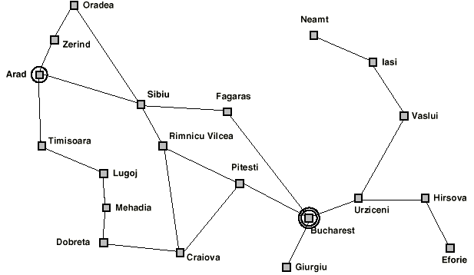
Example (Romania)
Initial Situation
On Holiday in Romania; currently in Arad
Flight leaves tomorrow from Bucharest
Formulate Goal
be in Bucharest
Formulate Problem
states: various cities
operators: drive between cities
Find Solution
sequence of cities (with roads between them)
must start at starting state and end in the goal state

Slide 7
Example (Romania)
Given a State Space, the problem is defined by four items:
operators (or successor function S(x))
e.g., Arad ==> Zerind Arad ==> Sibiu
path cost (additive)
e.g., sum of distances, number of operators executed, etc.
initial state
e.g., ``at Arad''
goal test, can be
explicit, e.g., x = ``at Bucharest''
A solution is a sequence of operators leading from the initial state to a goal state

Slide 8
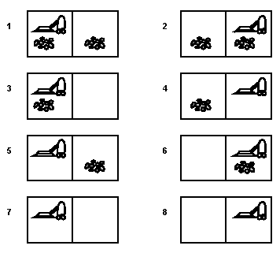
Example: Vacuum World
States:
Two rooms (A and B); Dirt or no-dirt
The agent may be in either room
Initial State: both rooms dirty; Agent in room A
Goal test: No dirt
note that there are two goal states
Problem:
8 possible states
Successor function: go left, go right, suck dirt
Solution:
Sequence of actions (applications of the successor function) leading to one of the goal states
Goal states

Slide 9
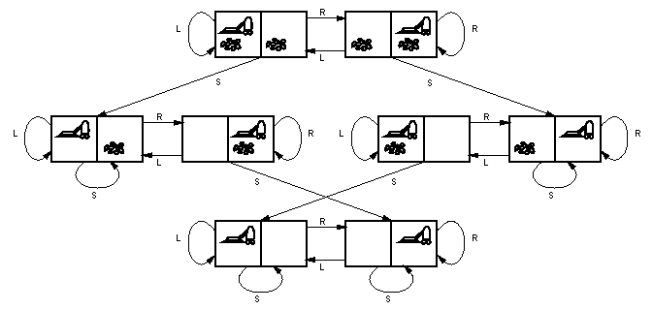
Vacuum World State-Space Graph
State-space graph does not include initial or goal states
Search Problem: Given specific initial and goal states, find a path in the graph from an initial to a goal state
Such a path represents a solution to the problem which can then be executed by the agent

Slide 10
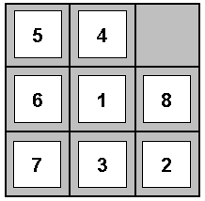
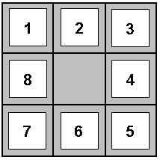
Example: The 8-Puzzle
States? Represented by the integer location of tiles
Operators? move blank left, right, up, down
Goal Test? = goal state (given)
Path Cost? One per move

Slide 11
8-Puzzle: Successor Function
8
2
7
3
4
5
1
6
8
2
8
2
7
8
2
7
3
4
7
3
4
6
3
4
5
1
6
5
1
5
1
6

Slide 12
Solution to the Search Problem
A solution is a path connecting the initial to a goal node (any one)
There may be many solutions
In some cases, there may be no solution
The cost of a path is the sum of the edge costs along this path
An optimal solution is a solution path of minimum cost

Slide 13
Searching the State Space
Often it is not feasible to build a complete representation of the state-space graph
A problem solver must construct a solution by exploring a small portion of the graph
For a specific search problem (with a given initial and goal state) we can view the relevant portion of the graph as a search tree

Slide 14
Searching the State Space

Slide 15
Searching the State Space
Search tree

Slide 16
Searching the State Space
Search tree

Slide 17
Searching the State Space
Search tree

Slide 18
Searching the State Space
Search tree

Slide 19
Searching the State Space
Search tree

Slide 20
Portion of Search Tree for an Instance of the 8-Puzzle Problem
. . .

Slide 21
Example: Blocks World Problem
World consists of blocks A, B, C, and the Floor
Can move a block that is “clear” on top of another clear block or onto the Floor
State representation: using the predicate “on(x,y)”
on(x,y) means the block x is on top of block y
on(x, Floor) means block x is on the Floor
on(_, x) means block x has nothing on it (it is “clear”)
Can specify operators as a set of production rules:
1. on(_, x) ➔ on (x, Floor)
2. on(_, x) and on(_, y) ➔ on(x, y)
Initial state: some initial configuration
E.g., on(A, Floor) and on(C, A) and on(B, Floor) and on(_, B) and on(_, A)
Goal state: some specified configuration
E.g., on(B,C) and on(A,B)
A
C
B

Slide 22
Blocks World: State-Space Graph
1
on(_, x) → on (x, Floor)
2
on(_, x) and on(_, y) → on(x, y)
A
2
2
B
B
B
1
1
A
A
C
A
C
C
B
C
1
1
2
2
C
2
2
B
A
A
2
2
C
C
B
C
B
A
C
B
A
B
A
1
1
1
1
2
2
A
2
2
C
C
C
B
B
B
A
B
1
1
A
C
A
1
1

Slide 23
Blocks World: A Search Problem
A
Search tree for the problem
A
A
B
C
B
C
B
C
B
A
Notes:
Repeated states have been eliminated in diagram.
The highlighted path represents (in this case) the only solution for this instance of the problem.
The solution is a sequence of legal actions: move(A, Floor) ➔ move(B, C) ➔ move(A, B).
A
C
B
C
A
C
B
C
B
C
B
A
B
A
C
A
B
A
C
C
A
A
B
C
A
C
B
C
B
B
B
C
A
A

Slide 24
8-Queens Problem
Place 8 queens in a chessboard so that no two queens are in the same row, column, or diagonal.
A solution
Not a solution

Slide 25
Formulation #1
States: all arrangements of 0, 1, 2, ..., or 8 queens on the board
Initial state: 0 queen on the board
Successor function: each of the successors is obtained by adding one queen in an empty square
Arc cost: 1 (irrelevant)
Goal test: 8 queens are on the board, with no two of them attacking each other
→ 64x63x...x53 ~ 3x10¹⁴ states

Slide 26
Formulation #2
States: all arrangements of k = 0, 1, 2, ..., or 8 queens in the k leftmost columns with no two queens attacking each other
Initial state: 0 queen on the board
Successor function: each successor is obtained by adding one queen in any square that is not attacked by any queen already in the board, in the leftmost empty column
Arc cost: 1 (irrelevant)
Goal test: 8 queens are on the board
→ 2,057 states

Slide 27
Path Planning
What is the state space?

Slide 28
Formulation #1
Cost of one horizontal/vertical step = 1
Cost of one diagonal step = √2

Slide 29
Optimal Solution
This path is the shortest in the discretized state space, but not in the original continuous space

Slide 30
Formulation #2
Visibility graph
Cost of one step: length of segment

Slide 31
Solution Path
The shortest path in this state space is also the shortest in the original continuous space

