Slide 1
CSC 480: Artificial Intelligence I Introduction to AI and Intelligent Agents Bamshad Mobasher School of Computing DePaul University

Slide 2
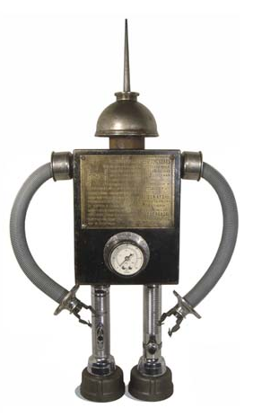
The Myths of AI

Slide 3
HAL
2001: A Space Odyssey
classic science fiction movie from 1969
HAL
part of the story centers around an intelligent computer called HAL
HAL is the “brains” of an intelligent spaceship
In the movie, HAL can
speak easily with the crew
see and understand the emotions of the crew
navigate the ship automatically
diagnose on-board problems
make life-and-death decisions
display emotions
In 1969 this was science fiction: is it still science fiction?

Slide 4
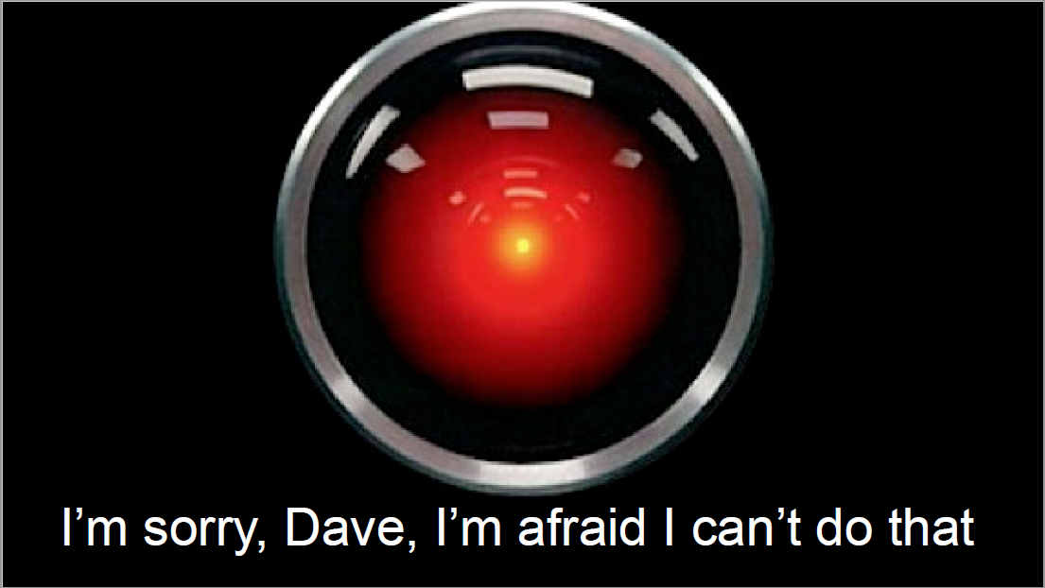

Slide 5
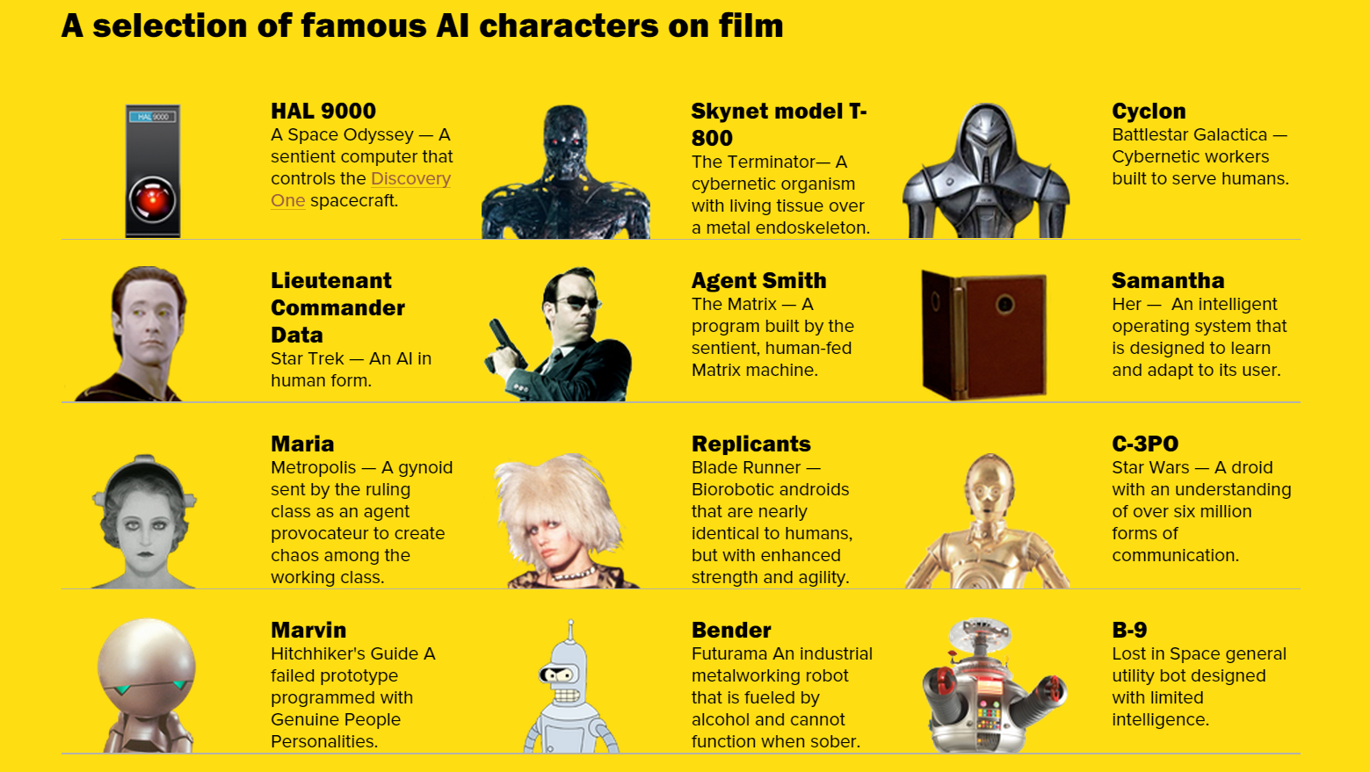

Slide 7
What Can AI Do?
Which of the following can be done at present?
Play a decent game of Jeopardy?
Win against any human at chess?
Win against the best humans at Go?
Grab a particular cup and put it on a shelf?
Unload any dishwasher in any home?
Drive safely along the highway?
Drive safely along a busy urban street?
Buy a week's worth of groceries on the web?
Buy a week's worth of groceries at farmer’s market?
Discover and prove a new mathematical theorem?
Perform a surgical operation?
Translate spoken Chinese into spoken English in real time?
Write an intentionally funny story?
Notes:
IBM Watson vs Ken Jennings
Kasparov vs IBM 1997 Deep Blue
AlphaGo
At least works reasonably for table tennis.
Cool research on basic home tasks here at BAIR
Any dishwater any home? Key word any – generalization is really hard
Drive safe on the highway? Tesla Drive safe on Telegraph – no way.
Instacart
Berkeley bowl, no way.
Math? Progress being made in symbolic math.
Surgical operation? Depends what you count. Some parts of it yes! I saw some sweet videos
Translate! Yeah!
We’ll look at the comedic story in more detail!
Well looks at this one

Slide 8
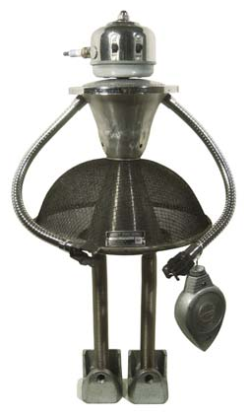
The Question of AI

Slide 9
The Dartmouth Conference
J. McCarthy, M. L. Minsky, N. Rochester, and C.E. Shannon. August 31, 1955. "We propose that a 2 month, 10 man study of artificial intelligence be carried out during the summer of 1956 at Dartmouth College in Hanover, New Hampshire. The study is to proceed on the basis of the conjecture that every aspect of learning or any other feature of intelligence can in principle be so precisely described that a machine can be made to simulate it."

Slide 10
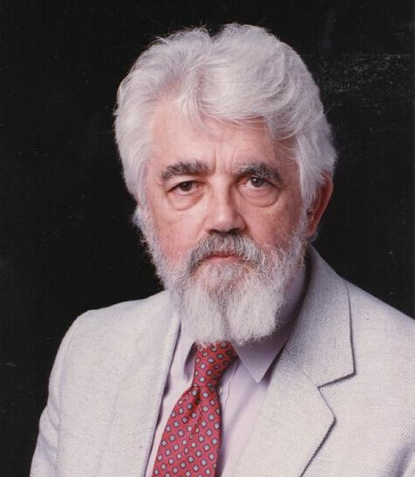
What is Artificial Intelligence? (John McCarthy, Stanford University)
The term “Artificial Intelligence” (AI) was coined in 1956 by John McCarthy, “the science and engineering of making intelligent machines”
What is artificial intelligence?
It is the science and engineering of making intelligent machines, especially intelligent computer programs. It is related to the similar task of using computers to understand human intelligence, but AI does not have to confine itself to methods that are biologically observable.
Yes, but what is intelligence?
Intelligence is the computational part of the ability to achieve goals in the world. Varying kinds and degrees of intelligence occur in people, many animals and some machines.
Isn't there a solid definition of intelligence that doesn't depend on relating it to human intelligence?
Not yet. The problem is that we cannot yet characterize in general what kinds of computational procedures we want to call intelligent. We understand some of the mechanisms of intelligence and not others.

Slide 11
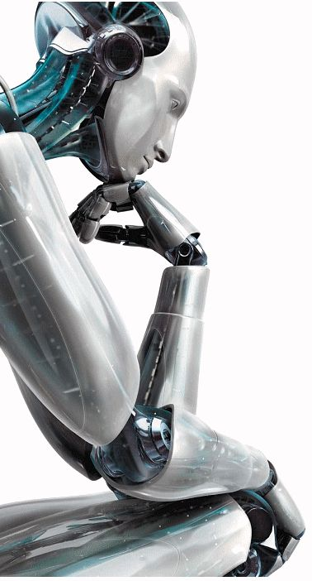
What is artificial intelligence?
Thinking humanly (Haugeland, 1985) The ... effort to make computers ... with minds, in the full and literal sense.
Acting humanly (Kurzweil, 1990) The study of how to make computers perform functions that require intelligence when performed by people.
Thinking rationally (Winston, 1992) The study of the computations that make it possible to perceive, reason, and act.
Acting rationally (Nilsson, 1998) AI ... is concerned with intelligent behavior…

Slide 12
Thinking and Acting Humanly
Thinking humanly: cognitive modeling
Develop a precise theory of mind, through experimentation and introspection, then write a computer program that implements it
Early Example: GPS - General Problem Solver (Newell and Simon, 1961) - trying to model the human process of problem solving in general
Acting humanly
"If it looks, walks, and quacks like a duck, then it is a duck”
The Turing Test
Interrogator communicates with TWO hidden agents (one human, one AI). Can say and ask anything, in a natural language for a specified period. If the interrogator cannot decide which of the two agents is a human and which is a computer (after several tries), then the computer has achieved AI
An OPERATIONAL definition of intelligence.

Slide 13
Thinking and Acting Rationally
Thinking Rationally
Capture ``correct'' reasoning processes”
How do we do this
Develop a formal model of reasoning (formal logic) that “always” leads to the “right” answer
Implement this model
How do we know when we've got it right?
when we can logically prove that the results of the programmed reasoning
soundness and completeness of first-order logic
Acting Rationally
Act so that desired goals are achieved
The rational agent approach (this is what we’ll focus on in this course)
Figure out how to make correct decisions, which sometimes means thinking rationally and other times means having rational reflexes
reasoning versus acting; limited rationality

Slide 14
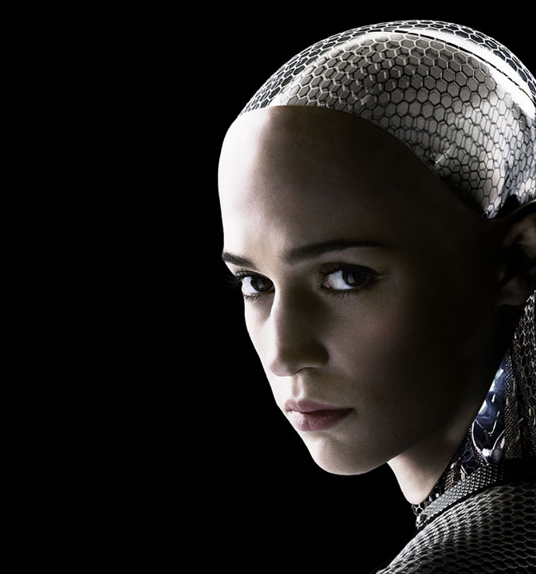
The Turing Test
Proposed by Alan Turing in 1950 - Intended to (partially) answer the question, Can machines think?
I propose to consider the question, Can machines think? This should begin with definitions of the meaning of the terms machine and think. The definitions might be framed so as to reflect so far as possible the normal use of the words, but this attitude is dangerous. If the meaning of the words machine and think are to be found by examining how they are commonly used it is difficult to escape the conclusion that the meaning and the answer to the question, Can machines think? is to be sought in a statistical survey such as a Gallup poll. But this is absurd. Instead of attempting such a definition I shall replace the question by another, which is closely related to it and is expressed in relatively unambiguous words.
Ex Machina (2015)

Slide 15
ELIZA
Written in the 1960's by Joseph Weizenbaum, a skeptic of the Turing test
Engages in ``conversations'' with a user
Implementations on the Web: see Wikipedia entry for ELIZA
Try this one: http://www.cyberpsych.org/eliza/
Eliza's responses are generated through pattern-matching
Eliza's memory contains a set of patterns and responses
``Transformed'' input is matched against the patterns; whichever pattern matches determines the response
Occasionally, inputs are stored so that they can be responded to later
Weizenbaum claimed that such a program would be able to pass the Turing test, but it obviously wasn't intelligent

Slide 16
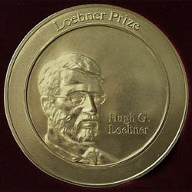
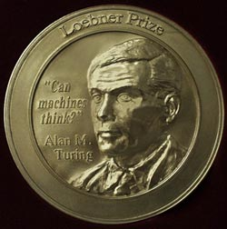
The Loebner prize
In 1990, Hugh Loebner set up a $100,000 prize to be awarded to the first programmer/group to develop a program that passed the Turing Test
Annual competitions are held in which a smaller award is given awards to the creator(s) of a "chatterbot" considered by the judges to be the most human-like
Judges are untrained
Time limit of 5 minutes to communicate with each chatterbot
2006 winner: Jabberwacky http://www.jabberwacky.com/
2008 winner: Elbot http://www.elbot.com/

Slide 17
The Loebner prize
The Loebner prize (since 2004)
Year | Winner | Program
2004 | Richard Wallace | Artificial Linguistic Internet Computer Entity (A.L.I.C.E.)
2005 | Rollo Carpenter | George (Jabberwacky)
2006 | Rollo Carpenter | Joan (Jabberwacky)
2007 | Robert Medeksza | Ultra Hal
2008 | Fred Roberts | Elbot
2009 | David Levy | Do-Much-More
2010 | Bruce Wilcox | Suzette
2011 | Bruce Wilcox | Rosette
2012 | Mohan Embar | Chip Vivant
2013 | Steve Worswick | Mitsuku
2014 | Bruce Wilcox | Rose
2015 | Bruce Wilcox | Rose
2016 | Steve Worswick | Mitsuku
2017 | Steve Worswick | Mitsuku
2018 | Steve Worswick | Mitsuku
2019 | Steve Worswick | Mitsuku

Slide 18
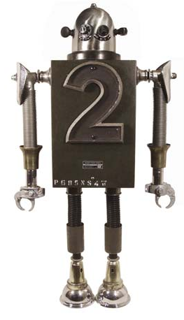
Subfields of AI

Slide 19
Some Sub-fields of AI
Problem solving
Lots of early success here
Solving puzzles, playing games such as chess and Go
Constraint satisfaction problems
Uses techniques like search and problem reduction
Logical reasoning
Prove things by manipulating database of facts (Logic Programing)
Theorem proving
Automatic Programming
Writing computer programs given some sort of description or specification
Automatic code generation or recommendation
Automatic program verification

Slide 20
Some Sub-fields of AI
Language understanding and semantic modeling
One of the earliest problems
Huge advances in the past 5-6 years with deep learning
Includes answering questions, information extraction, learning from written text, and speech recognition
Some aspects of language understanding:
Understanding language forms, such as prefixes/suffixes/roots
Syntax; how to form grammatically correct sentences
Natural language translation
Semantics; understanding meaning of words, phrases, sentences
Finding/predicting related terms based on co-occurrence and contextual relationships
Conversation

Slide 21
Some Sub-fields of AI
Machine Learning
Supervised Machine Learning
Classification, regression, ensemble methods
By far the most prevalent applications of AI in the real world (image and speech recognition, text categorization, recommender systems, medical diagnosis, ….)
Unsupervised Machine Learning
Clustering, topic modeling, PCA, learning encodings (auto encoder/decoders)
Reinforcement learning
Learning in dynamic domains
Exploration/exploitation; Multi-armed bandits

Slide 22
Some Sub-fields of AI
Pattern Recognition, Vision
Computer-aided identification of objects/shapes/sounds
Needed for speech and image understanding
Requires signal acquisition, feature extraction, feature embeddings, …
Again, lots of advances in recent years with deep learning methods such as Convolutional Neural Networks
Planning, Robotics and Vision
Planning how to perform actions
Recognizing, and manipulating objects
Handling unexpected obstacles in dynamic environments

Slide 23
Some Sub-fields of AI
Knowledge-Based Systems
Using domain knowledge and semantic information about events and entities to reason, explain, diagnose, and solve problems
In early work, domain experts and domain specific rules were used to develop expert systems → problem: knowledge engineering bottleneck
Modern systems can rely on both general and domain specific publicly available knowledge graphs
Google Knowledge Graph
Wikipedia
Graph embeddings used as part of deep learning models to integrate semantic information; provide ability to explain results

Slide 24
AI in Everyday Life?
AI techniques are used in many common applications
Intelligent user interfaces
Spell/grammar checkers
Context sensitive help systems
Medical diagnosis systems
Regulating/Controlling hardware devices and processes (e.g., in smart devices / homes)
Voice/image recognition (more generally, pattern recognition)
Scheduling systems (airlines, hotels, manufacturing)
Error detection/ correction in electronic communication
Program verification / compiler and programming language design
Web search engines / Web spiders
Recommender systems (collaborative/content-based filtering)
Personal agents and assistants
Intelligent CRM and business Intelligence
Credit card verification / fraud detection
Computer games
Autonomous vehicles

Slide 25
A Model of AI

Slide 26
AI Systems as Intelligent Agents
An agent is something that can
perceive its "environment" through sensors (percepts)
act upon that environment through actuators (or effectors)
An agent is defined by its internal agent function
A percept sequence is the complete history of everything the agent has ever perceived
The agent function maps all possible percept sequences onto actions
We implement an agent by writing an agent program

Slide 27
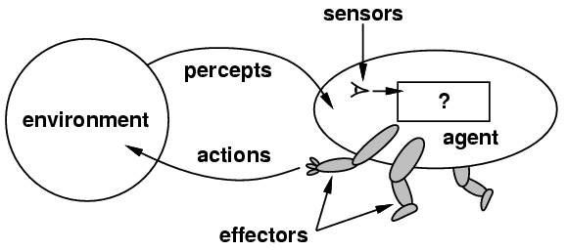
AI Systems as Intelligent Agents
Goal: Design rational agents that do a “good job” of acting in their environments.
Success determined based on some extrernal objective performance measure

Slide 28
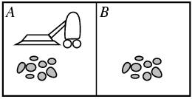
Example agent: a vacuum robot
Percepts: 2-tuples [square, state]
Actions: Left, Right, Suck
Agent function maps percept sequences to actions
E.g., [A, Clean] ➔ Right

Slide 29
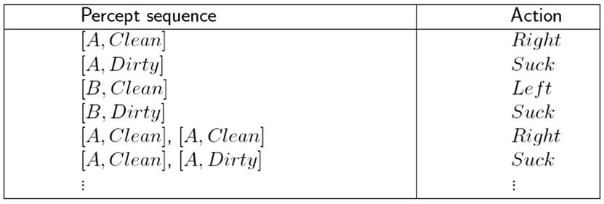
A good agent function:

Slide 30
What makes an agent Rational?
We need to define a performance measure for the agent.
Performance measure: An objective criterion for success of an agent's behavior.
E.g., performance measure of a vacuum-cleaner agent could be amount of dirt cleaned up, amount of time taken, amount of electricity consumed, etc.
Rational Agent: At any given time, an intelligent agent selects an action which, given its percept sequence and whatever built-in knowledge the agent has, maximizes the expected value of its performance measure.

Slide 31
A performance measure for the vacuum robot
Assume:
the agent has a lifetime of x time steps
the performance measure awards 1 point for each clean square at each time step
the agent knows the geography of its environment (2 squares, A and B) a priori
initial dirt distribution and location of the agent are not known
3 possible actions that the agent can perform
The agent correctly perceives its location and whether that location contains dirt
Under these conditions, the agent function shown in the table is rational.

Slide 32
PEAS analysis
PEAS: Performance measure, Environment, Actuators, Sensors
Designing an intelligent agent involves specifying each of these
Obviously, the performance measure depends on sensors and actuators
Sensors determine how much of the environment the agent can detect
Actuators determine the effects that the agent has on the environment

Slide 33
Examples:
Autonomous Vehicle/Taxi
Performance measure: Safe, fast, legal, comfortable trip, maximize profits
Environment: Roads, traffic signs, other vehicles, pedestrians, customers
Actuators: Steering wheel, accelerator, brake, signal, horn
Sensors: Cameras, sonar, speedometer, GPS, odometer, engine sensors, microphones, ….
Medical diagnosis system
Performance measure: Patient health, treatment costs, diagnosis accuracy rate
Environment: Patient, hospital, staff
Actuators: Screen display (questions, tests, diagnoses, treatments, referrals)
Sensors: Keyboard, touchscreen (entry of symptoms, findings, patient's answers)

Slide 34
Examples:
Online Shopping Agent
Performance measure: ???
Environment: ???
Actuators: ???
Sensors: ???
Backgammon Agent
Performance measure: ???
Environment: ???
Actuators: ???
Sensors: ???

Slide 35
Types of environments
Fully vs. partially observable environments
Fully observable: agent's sensors give it access to the complete state of the environment at all times
Deterministic vs. stochastic environments
deterministic environment: the next state is completely determined by the current state and the action executed by the agent.
Episodic vs. sequential environments
Sequential environments require memory of past actions to determine the next best action. Episodic environments are a series of one-shot actions. An AI that looks at radiology images to determine if there is a sickness is an example of an episodic environment. One image has nothing to do with the next.
Static vs. dynamic environments
A static environment is unchanged while an agent is deliberating (the environment is semi-dynamic if the environment itself does not change with the passage of time but the agent's performance score does).
Discrete vs. continuous environments
A discrete environment has a limited number of clearly defined percepts and actions
Single vs. multi-agent

Slide 36
Types of environments

Slide 37
Structure of an Intelligent Agent
All agents have the same basic structure:
accept percepts from environment
generate actions
A Skeleton Agent:
Observations:
agent may or may not build percept sequence in memory (depends on domain)
performance measure is not part of the agent; it is applied externally to judge the success of the agent
function Skeleton-Agent(percept) returns action
static: memory, the agent's memory of the world
memory ← Update-Memory(memory, percept)
action ← Choose-Best-Action(memory)
memory ← Update-Memory(memory, action)
return action

Slide 38
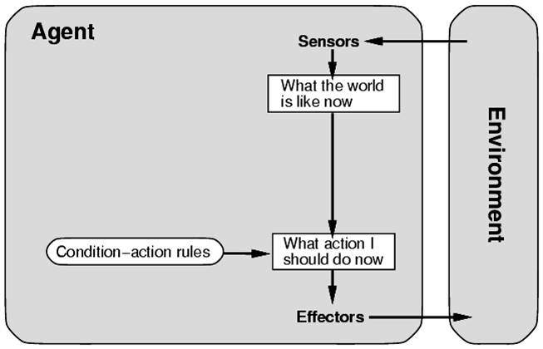
Agent types
Simple reflex agents
The action to be selected only depends on the most recent percept, not a percept sequence
As a result, these agents are stateless devices which do not have memory of past world states
Actions determined by pre-specified condition-action rules
E.g., if car-in-front-brakes then initiate braking
function Simple-Reflex-Agent(percept) returns action
static: rules, a set of condition-action rules
state ← Interpret-Input(percept)
rule ← Rule-Match(state, rules)
action ← Rule-Action[rule]
return action

Slide 39
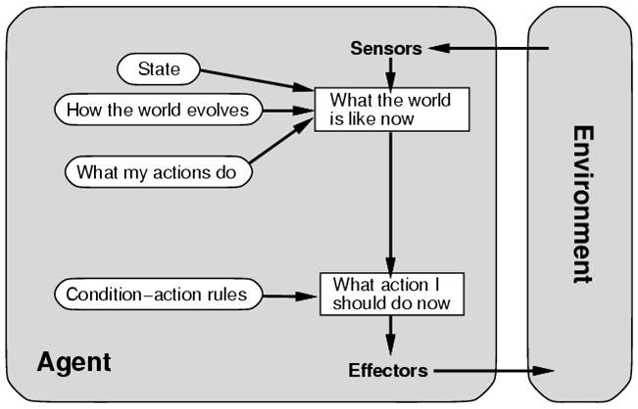
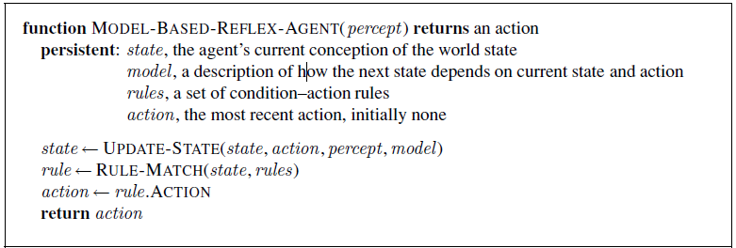
Agent types
Model-based reflex agents
Have internal state which is used to keep track of past states of the world (i.e., percept sequences may determine action)
Requires knowledge of how the world evolves independently of the agent

Slide 40
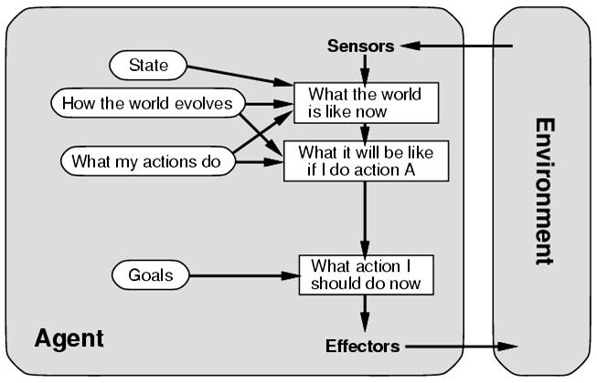
Agent types
Goal-based agents
Agent can act differently depending on what the final state should look like
i.e., act by reasoning about which actions achieve the goal
Example: automated taxi takes actions necessary to eventually arrive at a specified destination

Slide 41
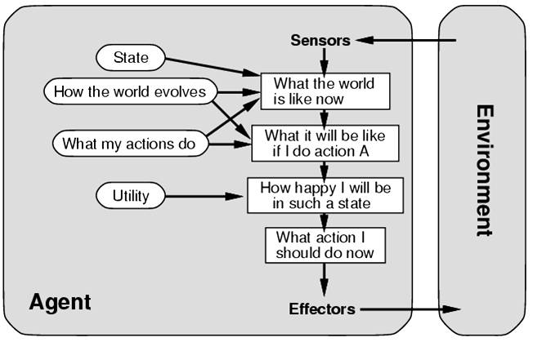
Agent types
Utility-based agents
An agent's utility function is an internalization of the performance measure (which is external)
Utility Function
a mapping of states onto utility values
allows rational decisions by evaluating trade-offs between competing or conflicting goals
E.g., favoring routes that reduce distance to the destination

Slide 42
Shopping Agent Example
Navigating: Move around store; avoid obstacles
Reflex agent: store map precompiled.
Goal-based agent: create an internal map, reason explicitly about it, use signs and adapt to changes (e.g., specials at the ends of aisles).
Gathering: Find and put into cart groceries it wants, need to induce objects from percepts.
Reflex agent: wander and grab items that look good.
Goal-based agent: follow a shopping list.
Menu-planning: Generate shopping list, modify list if store out of an item.
Goal-based agent: required; what happens when a needed item is not there? Achieve the goal some other way. e.g., no milk cartons: get canned milk or powdered milk.
Choosing among alternative brands
utility-based agent: trade off quality for price.

Slide 43
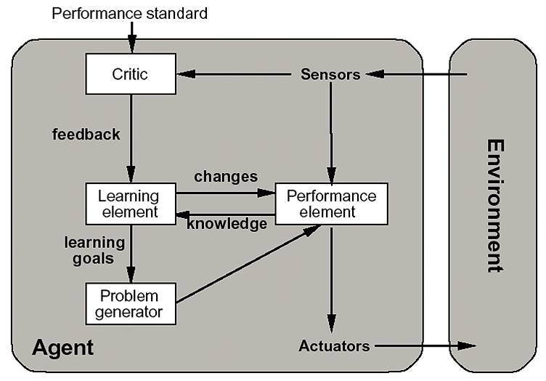
Agent types
Learning agents
Cuts across all of the other types of agents: any kind of agent can learn
Performance element: the agent function
Learning element: responsible for making improvements by observing performance
Critic: gives feedback to learning element by measuring agent’s performance
Problem generator: suggest other possible courses of actions (exploration)

Slide 44
Exercise
News Filtering Internet Agent
uses a static user profile (e.g., a set of keywords specified by the user)
on a regular basis, searches a specified news site (e.g., Reuters or AP) for news stories that match the user profile
can search through the site by following links from page to page
presents a set of links to the matching stories that have not been read before (matching based on the number of words from the profile occurring in the news story)
(1) Give a detailed PEAS description for the news filtering agent
(2) Characterize the environment type (as being observable, deterministic, episodic, static, multi-agent, etc).

Slide 45
Search and Knowledge Representation
Goal-based and utility-based agents require representation of:
states within the environment
actions and effects (effect of an action is transition from the current state to another state)
goals
utilities
Problems can often be formulated as a search problem
to satisfy a goal, agent must find a sequence of actions (a path in the state-space graph) from the starting state to a goal state.
To do this efficiently, agents must have the ability to reason with their knowledge about the world and the problem domain
which path to follow (which action to choose from) next
how to determine if a goal state is reached OR how decide if a satisfactory state has been reached.

Slide 46
Introduction to Search
Search is one of the most powerful approaches to problem solving in AI
Search is a universal problem solving mechanism that
Systematically explores the alternatives
Finds the sequence of steps towards a solution
Problem Space Hypothesis (Allen Newell, SOAR: An Architecture for General Intelligence)
All goal-oriented symbolic activities occur in a problem space
Search in a problem space is claimed to be a completely general model of intelligence

Slide 47
Problem-Solving Agents
function Simple-Problem-Solving-Agent(percept)
returns action
inputs: p, a percept
static: s, an action sequence, initially empty
state, a description of current world state
g, a goal, initially null
problem, a problem formulation
state ← Update-State(state, p)
if s = empty then
g ← Formulate-Goal(state)
problem ← Formulate-Problem(state, g)
s ← Search(problem)
endif
action ← first(s)
s ← remainder(s)
return action
Assumptions on Environment
Static: formulating and solving the problem does not take any changes into account
Discrete: enumerating all alternative courses of action
Deterministic: actions depend only on previous actions
Observable: initial state is completely known
The agent follows a simple “formulate, search, execute” design

