Slide 1
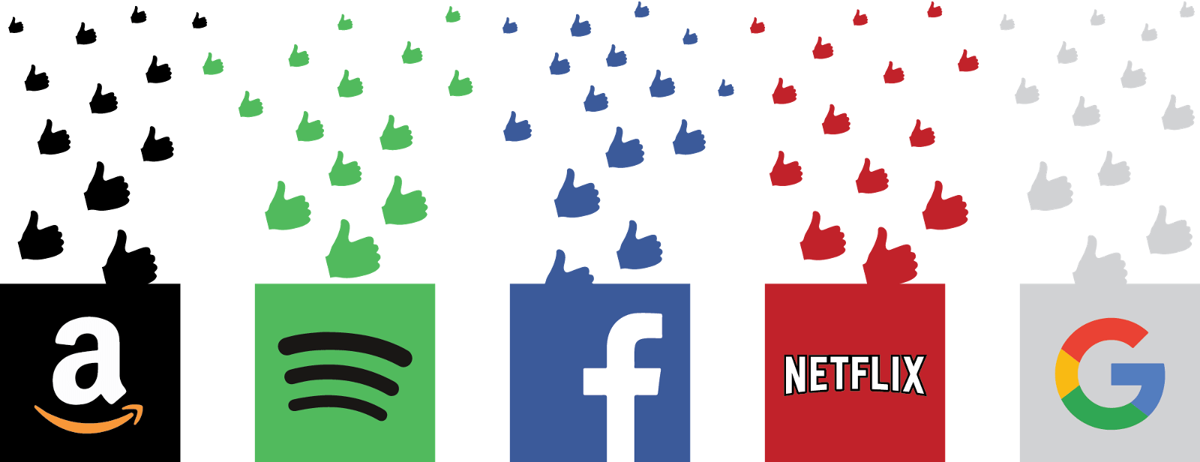
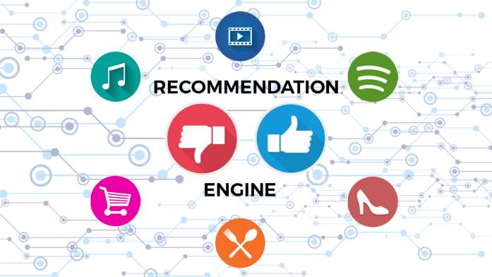
Overview of Recommender Systems
Bamshad Mobasher
DePaul University

Slide 2
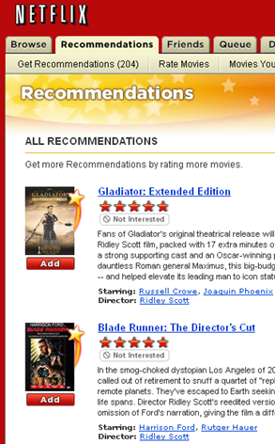
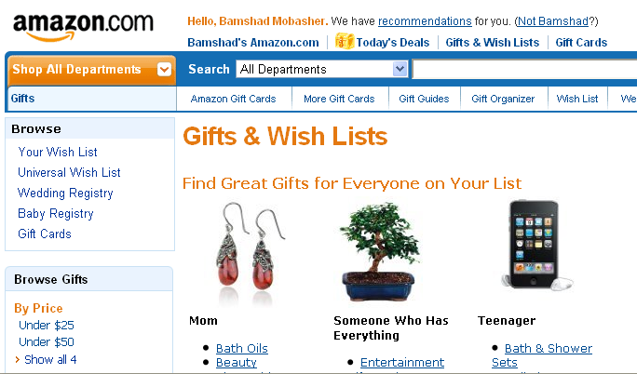
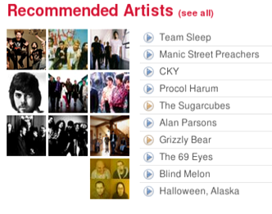
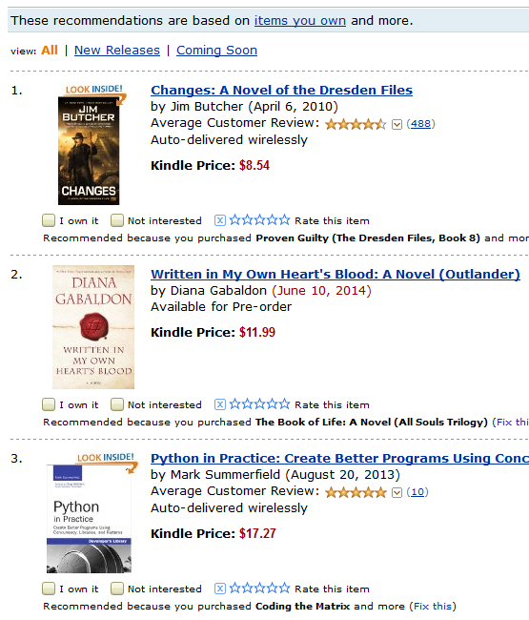
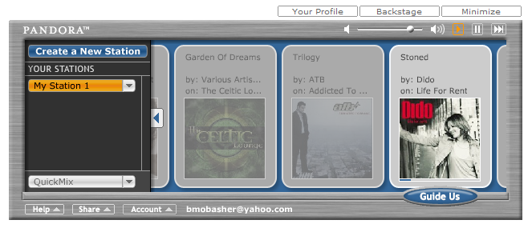
Recommender Systems
Personalized information filtering systems that present items (products, movies, video, music, books, news, restaurants, images, web pages, etc.) that are likely to be of interest to a given user

Slide 3
Recommender Systems
Wikipedia:
  Recommender systems ... are a subclass of information filtering system that seek to predict the "rating" or "preference" that a user would give to an item.
Boarder Definition
  Any system that guides the user in a personalized way to interesting or useful objects in a large space of possible options or that produces such objects as output.
Aspects of these definitions
  basis for recommendation: personalization
  process of recommendation: interactivity
  results of recommendation: interest / useful objects

Slide 4
Personalization
  Any system that guides the user in a personalized way to interesting or useful objects in a large space of possible options or that produces such objects as output.
Definitions agree that recommendations are personalized
  Some might say that suggesting a best-seller to everyone is a form of recommendation
Meaning
  the process is guided by some user-specific information
    could be a user model (e.g., long-term or short-term user profile)
    could be a query

Slide 5
Interactivity
  Any system that guides the user in a personalized way to interesting or useful objects in a large space of possible options or that produces such objects as output.
Many possible interaction styles
  query / retrieve
  recommendation list
  predicted rating
  dialog

Slide 6
Results
  Any system that guides the user in a personalized way to interesting or useful objects in a large space of possible options or that produces such objects as output.
Recommendation = Search?
Search
  a query matching process
  given a query
    return all items that match it
Recommendation
  a preference satisfaction process
  given a set of preferences
    return items that are likely to match them
    User preference profile vs. a specified query

Slide 7
User profile
A key question in personalization
  what do we know about the user?
Many sites have a lot of complex structured data about users
  purchase / browsing history
  zipcode
  ratings
  reviews
  queries
  etc.
Any / all could be incorporated into a user profile

Slide 8
“Find relevant items”
Our assumption
  The goal of the recommender is to find a small number of highly-relevant or useful items for the user
Suggests
  that the output should be a short, ranked list
  a good recommender is one that puts good items high up on that list
  Relevant and useful → high likelihood of user interest in the item
    Could also mean that suggestions are unexpected, serendipitous

Slide 9
Domain specificity
User bases vary
  dedicated subscribers vs anonymous untraceable visitors
Item catalogs vary
  objects of durable value vs ephemera
  low cost vs high cost
Domains vary
  recommending news articles is different from
  recommending restaurants is different from
  recommending music tracks is different from
  recommending romantic partners is different from
  recommending investments, etc.

Slide 10
Some notation
User: a unique individual (for the system’s purposes), possibly the target of personalization
  u or v
  U (all users)
Item: a unique item (for the system’s purposes), possibly to be recommended to a user
  i or j
  I (all items)
Rating / preference score: a numerical association between some u and some i
  r_{uj}
  R (all ratings)

Slide 11
The Recommendation Task
Basic formulation as a prediction problem
Typically, the profile P_{u} contains preference scores by u on some other items, {i₁, …, i_{k}} different from it
  preference scores on i₁, …, i_{k} may have been obtained explicitly (e.g., movie ratings) or implicitly (e.g., time spent on a product page or a news article)
Given a profile P_{u} for a user u, and a target item i_{t}, predict the preference score of user u on item i_{t}

Slide 12
Recommendation as Rating Prediction
Two types of entities: Users and Items
Utility of item i for user u is represented by some rating r (where r ∈ Rating)
Each user typically rates a subset of items
Recommender system then tries to estimate/predict the unknown ratings, i.e., to extrapolate rating function Rec based on the known ratings:
  Rec: Users × Items → Rating
  i.e., two-dimensional recommendation framework
The recommendations to each user are made by offering his/her highest-rated items

Slide 13




User Preferences
Ratings
Binary Feedback
Reviews
Behaviors
Explicit
Implicit

Slide 14
Preferences as Ratings
 | I1 | I2 | I3 | I4 | I5 | I6 | I7 | I8
U1 | 4 |  | 3 | 4 |  | 2 |  | 5
U2 |  | 3 | 4 | 2 | 5
U3 |  | 4 |  | 4 |  | 2 | 2 | 4
U4 | 3 |  | 5 |  | 2 | 4
U5 | 2 | 5 |  | 2 |  | 4 | ? | 4
Note: in general, missing values not the same as 0’s.

Slide 15
Preferences as Ratings
Using Sparse Matrix Format
User ID | Item ID | Rating
U1 | I1 | 4
U1 | I3 | 3
U1 | I4 | 4
U1 | I6 | 2
U1 | I8 | 5
U2 | I2 | 3
U2 | I3 | 4
U2 | I4 | 2
U2 | I5 | 5
U3 | I2 | 4
U3 | I4 | 4
U3 | I6 | 2
…
 | I1 | I2 | I3 | I4 | I5 | I6 | I7 | I8
U1 | 4 |  | 3 | 4 |  | 2 |  | 5
U2 |  | 3 | 4 | 2 | 5
U3 |  | 4 |  | 4 |  | 2 | 2 | 4
U4 | 3 |  | 5 |  | 2 | 4
U5 | 2 | 5 |  | 2 |  | 4 | ? | 4

Slide 16
Types of recommender systems
Collaborative
  predict u’s preference for i using other user’s profiles in U
  i.e., give recommendations to a user based on preferences of “similar” users
  “peer” oriented model
Content-based
  predict u’s preference for i using data about i
  i.e., give recommendations to a user based on items with “similar” content/features in the user’s profile
  item-oriented model
Knowledge-based
  prediction u’s preference for i using knowledge about u and I
  age(x, 25-35) & income(x, 70-100K) & children(x, >=3)
  → recommend(x, Minivan)
  domain-oriented model
Hybrid
  use some combination of techniques

Slide 17
Collaborative Recommenders
Neighborhood-Based Models
User-Based:
  For a target user u, find the top k most similar users (based on their rating profiles) who have rated the target item
  k-nearest-neighbor (knn) strategy
  Predicted rating on target item is weighted average of ratings by the neighbors.
Item-based Collaborative Filtering
  item-item similarities are computed in space of ratings
    two items are similar if they are rated similarly by users
  prediction for target item is computed based on user u’s own ratings on the k most similar items

Slide 18

Collaborative Recommender Systems

Slide 19

Collaborative Recommender Systems

Slide 20
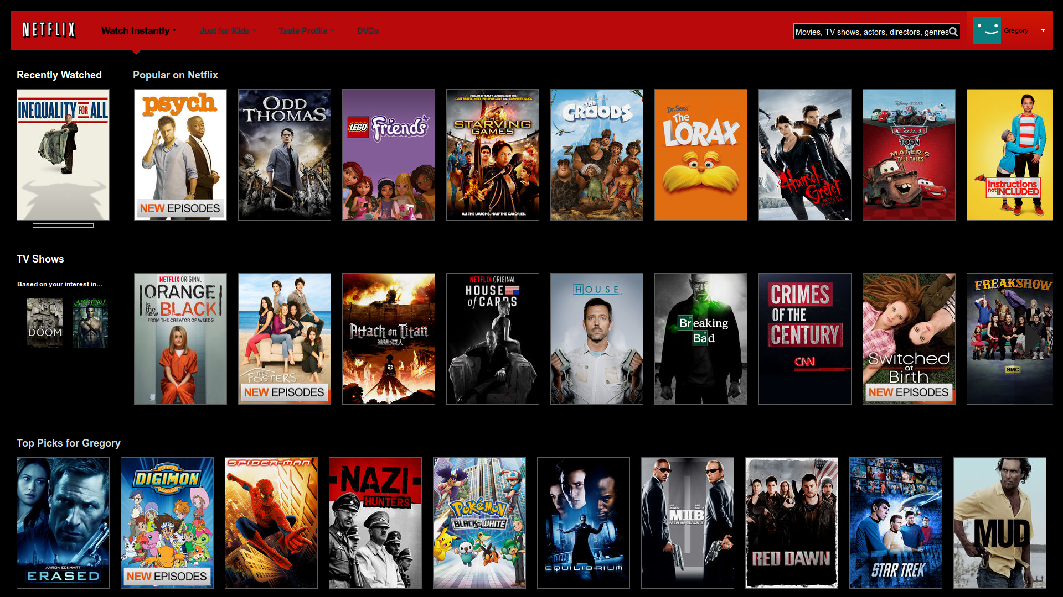
Collaborative Recommender Systems

Slide 21

Collaborative Recommender Systems

Slide 22
Collaborative Filtering
“Social Learning”
  idea is to give recommendations to a user based on the “ratings” of objects by other users
  usually assumes that features in the data are similar objects (e.g., Web pages, music, movies, etc.)
  usually requires “explicit” ratings of objects by users based on a rating scale
  there have been some attempts to obtain ratings implicitly based on user behavior (mixed results; problem is that implicit ratings are often binary)
Will Karen like “Independence Day?”

Slide 23
Collaborative Filtering: Nearest-Neighbor Strategy
Basic Idea:
  find other users that are most similar preferences or tastes to the target user
  Need a metric to compute similarities among users (usually based on their ratings of items)
Pearson Correlation
  Similarity based on the degree of correlation between user U and user J
  1 means very similar, 0 means no correlation, -1 means dissimilar
Average rating of user J
on all items.

Slide 24
Collaborative Filtering: Making Predictions
When generating predictions from the nearest neighbors, neighbors can be weighted based on their distance to the target user
To generate predictions for a target user a on an item i:
  r_{a} = mean rating for user a
  u₁, …, u_{k} are the k-nearest-neighbors to a
  r_{u,i} = rating of user u on item I
  sim(a,u) = Pearson correlation between a and u
This is a weighted average of deviations from the neighbors’ mean ratings (and closer neighbors count more)

Slide 25

Example User-Based Collaborative Filtering
Using k-nearest neighbor with k = 3
 | Item1 | Item 2 | Item 3 | Item 4 | Item 5 | Item 6 | Mean Rating | Correlation with Alice
Alice | 5 | 2 | 3 | 3 |  | ? | 3.25
User 1 | 2 |  | 4 |  | 4 | 1 | 2.75 | -1.00
User 2 | 2 | 1 | 3 |  | 1 | 2 | 1.8 | 0.33
User 3 | 4 | 2 | 3 | 2 |  | 1 | 2.4 | .90
User 4 | 3 | 3 | 2 |  | 3 | 1 | 2.4 | 0.19
User 5 |  | 3 |  | 2 | 2 | 2 | 2.25 | -1.00
User 6 | 5 | 3 |  | 1 | 3 | 2 | 2.8 | 0.65
User 7 |  | 5 |  | 1 | 5 | 1 | 3.0 | -1.00
$$\text{Pred}\text{(}\text{Alice}\text{,}\text{Item}\text{6}\text{) = 3.25 + }\frac{.9×(1−2.4)+.65×(2−2.8)+0.33×(2−1.8)}{\left|0.9+.65+.33\right|}$$
$=3.25+ \frac{−1.854}{1.88}$ = 3.25 – 0.986 = 2.26

Slide 26
Distance or Similarity Measures
Pearson Correlation
  Works well in case of user ratings (where there is at least a range of 1-5)
  Not always possible (in some situations we may only have implicit binary values, e.g., whether a user did or did not select a document)
  Alternatively, a variety of distance or similarity measures can be used
Common Distance Measures:
  Manhattan distance:
  Euclidean distance:
  Cosine distance:

Slide 27
Item-based Collaborative Filtering
Find similarities among the items based on ratings across users
  Often measured based on a variation of Cosine measure
Prediction of item I for user a is based on the past ratings of user a on items similar to I.
Suppose:
Predicted rating for Karen on Indep. Day will be 7, because she rated Star Wars 7
  That is if we only use the most similar item
  Otherwise, we can use the k-most similar items and again use a weighted average
sim(Star Wars, Indep. Day) > sim(Jur. Park, Indep. Day) > sim(Termin., Indep. Day)

Slide 28
Item-based Collaborative Filtering
Compute item similarities based on user ratings
  Columns of the rating matrix
  Item-Item similarities computed offline
Find k most similar items to the target item
Compute predictions based on the target user’s own ratings of the peer items
  Weighted average based on similarity to the target item

Slide 29



Item-based Collaborative Filtering
Note that Pearson
normalized by
subtracting the
row (user) mean
Item-based definition would imply subtracting item mean
  “adjusted cosine”
Predictions:
mean-adjusted
rating for item j
top-k matching items to
item t, where user u has ratings

Slide 30
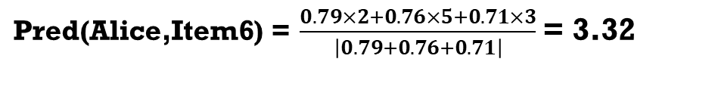
Item-Based Collaborative Filtering
 | Item1 | Item 2 | Item 3 | Item 4 | Item 5 | Item 6
Alice | 5 | 2 | 3 | 3 |  | ?
User 1 | 2 |  | 4 |  | 4 | 1
User 2 | 2 | 1 | 3 |  | 1 | 2
User 3 | 4 | 2 | 3 | 2 |  | 1
User 4 | 3 | 3 | 2 |  | 3 | 1
User 5 |  | 3 |  | 2 | 2 | 2
User 6 | 5 | 3 |  | 1 | 3 | 2
User 7 |  | 5 |  | 1 | 5 | 1
Cosine sim to Item 6 | 0.76 | 0.79 | 0.60 | 0.71 | 0.75
Item mean | 3.5 | 2.71 | 3 | 1.8 | 3 | 1.43
Example with standard Cosine similarity (k = 3)
Exercise: do this with adjusted Cosine
$\text{Pred}\text{(}\text{Alice}\text{,}\text{Item}\text{6}\text{) =} \frac{0.79×2+0.76×5+0.71×3}{\left|0.79+0.76+0.71\right|}$ = 3.32

Slide 31
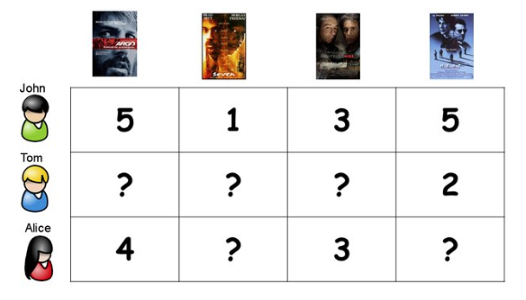

Collaborative Recommenders
Model-Based Approaches
Given observed (user, item) ratings, learn a model that predicts the missing ratings

Slide 32
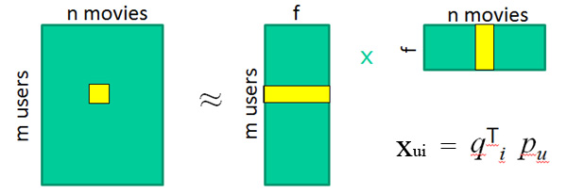
Model-Based Collaborative Filtering
Example: Matrix Factorization
User | HarryPotter | Batman | Spiderman
U1 | 5 | 3 | 4
U2 | ? | 2 | 4
U3 | 4 | 2 | ?
Identify latent (unobserved) factors that “explain” observations in the data (ratings).
The factors may represent combinations of features or characteristics of items and users that result in the ratings
R
P
Q

Slide 33
Evaluation
What is the recommender trying to accomplish?
“Interesting or useful objects”
  Deliberately vague
There are well-established evaluation measures
  but in practice, what matters is very site-specific
This is a tricky problem without a general solution

Slide 34


Evaluation: Rating Prediction
User | Item | Rating
U1 | I1 | 4
U1 | I2 | 3
U1 | I3 | 3
U2 | I2 | 4
U2 | I3 | 5
U2 | I4 | 5
U3 | I4 | 4
U1 | I4 | 3
U2 | I1 | 2
U3 | I1 | 2
U3 | I2 | 3
U3 | I3 | 4
P(U, T) in testing set
Prediction error:
e = R(U, I) – P(U, I)
Mean Absolute Error (MAE) =
Other evaluation metrics:
Root Mean Square Error (RMSE)
Coverage
many more …
Train
Test

Slide 35
Content-based recommendation
Collaborative filtering does NOT require any information about the items,
    However, it might be reasonable to exploit such information
    E.g. recommend fantasy novels to people who liked fantasy novels in the past
What do we need:
    Some information about the available items such as the genre ("content")
    Some sort of user profile describing what the user likes (the preferences)
The task:
    Learn user preferences
    Locate/recommend items that are "similar" to the user preferences

Slide 36






Content-Based Recommenders
Predictions for unseen (target) items are computed based on their similarity (in terms of content) to items in the user profile.
E.g., user profile contains
recommend highly: and recommend “mildly”:

Slide 37
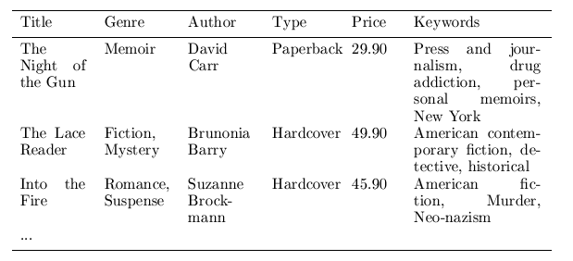
Content representation & item similarities
Represent items as vectors over features
  Features may be items attributes, keywords, tags, etc.
  Often items are represented a keyword vectors based on textual descriptions with TFxIDF or other weighting approaches
    applicable to any type of item (images, products, news stories) as long as a textual description is available or can be constructed
  Items (and users) can then be compared using standard vector space similarity measures (e.g., Cosine similarity)
Notes:
Intersection

Slide 38
User Profiles
Represent items as vectors over features
User profiles are also represented as aggregate feature vectors
  Based on items in the user profile (e.g., items liked, purchased, viewed, clicked on, etc.)
  Ex: profile could be the sum or average of feature vectors for all items previously liked/selected by the user
  Or, it could be a vector representation based on the values of a specific feature or attribute (e.g., genre, category, etc.)
    If the user has liked star wars movies and Indiana Jones movies, then a vector representation with genres as dimensions will have high values for “sci-fi” and “action-adventure”, but low values for “drama” and “documentary”

Slide 39
Non-Personalized Content-Based Recommendation
Given a target item (represented as a feature vector over a feature set for all items)
 | F1 | F2 | F3 | F4 | F5 | F6 | F7 | F8
target | 3 | 1 | 0 | 4 | 1 | 0 | 2 | 1
Find the top k most similar items to the target item from the item database
 | F1 | F2 | F3 | F4 | F5 | F6 | F7 | F8
Item1 | 2 | 0 | 4 | 3 | 0 | 1 | 0 | 2
Item2 | 0 | 2 | 4 | 0 | 2 | 3 | 0 | 0
Item3 | 4 | 0 | 1 | 3 | 0 | 1 | 0 | 1
Item4 | 0 | 1 | 0 | 2 | 0 | 0 | 1 | 0
Item5 | 0 | 0 | 2 | 0 | 0 | 4 | 0 | 0
Item6 | 1 | 1 | 0 | 2 | 0 | 1 | 1 | 3
Item7 | 2 | 1 | 3 | 4 | 0 | 2 | 0 | 2

Slide 40
Non-Personalized Content-Based Recommendation
We can use standard KNN with Cosine Similarity
(Dice or Jaccard could be used if feature weights are binary)
 | F1 | F2 | F3 | F4 | F5 | F6 | F7 | F8 | Sim(Target, Di)
Item1 | 2 | 0 | 4 | 3 | 0 | 1 | 0 | 2 | 0.61
Item2 | 0 | 2 | 4 | 0 | 2 | 3 | 0 | 0 | 0.12
Item3 | 4 | 0 | 1 | 3 | 0 | 1 | 0 | 1 | 0.84
Item4 | 0 | 1 | 0 | 2 | 0 | 0 | 1 | 0 | 0.79
Item5 | 0 | 0 | 2 | 0 | 0 | 4 | 0 | 0 | 0.00
Item6 | 1 | 1 | 0 | 2 | 0 | 1 | 1 | 3 | 0.73
Item7 | 2 | 1 | 3 | 4 | 0 | 2 | 0 | 2 | 0.72
target | 3 | 1 | 0 | 4 | 1 | 0 | 2 | 1
With K = 3, Items 3, 4, and 6 will be recommended

Slide 41

Non-Personalized Content-Based Recommendation
Could be used to give “more like this” type recommendations

Slide 42

Personalized Content-Based Recommendation
There is no target (or query) item. But suppose we have preference information (e.g., ratings) from user u on some items
 | F1 | F2 | F3 | F4 | F5 | F6 | F7 | F8 | User u’s Rating
Item1 | 2 | 0 | 4 | 3 | 0 | 1 | 0 | 2
Item2 | 0 | 2 | 4 | 0 | 2 | 3 | 0 | 0 | ?
Item3 | 4 | 0 | 1 | 3 | 0 | 1 | 0 | 1 | ?
Item4 | 0 | 1 | 0 | 2 | 0 | 0 | 1 | 0 | ?
Item5 | 0 | 0 | 2 | 0 | 0 | 4 | 0 | 0
Item6 | 1 | 1 | 0 | 2 | 0 | 1 | 1 | 3 | ?
Item7 | 2 | 1 | 3 | 4 | 0 | 2 | 0 | 2
User u’s profile could be the mean vector representing the rated documents, or simply the sum of those vectors (weighted by the rating)
Item1 + Item7 + (-Item5)
Note that this is basically Rocchio’s method with positive and negative feedback based on rated items
 | F1 | F2 | F3 | F4 | F5 | F6 | F7 | F8
Item1 | 2 | 0 | 4 | 3 | 0 | 1 | 0 | 2
Item5 | 0 | 0 | -2 | 0 | 0 | -4 | 0 | 0
Item7 | 2 | 1 | 3 | 4 | 0 | 2 | 0 | 2
U’s Profile | 4 | 1 | 5 | 7 | 0 | -1 | 0 | 0

Slide 43
Personalized Content-Based Recommendation
Now given u’s profile, we can recommend k most similar items not already rated by u
 | F1 | F2 | F3 | F4 | F5 | F6 | F7 | F8
U’s Profile | 4 | 1 | 5 | 7 | 0 | -1 | 0 | 0
Using Cosine similarity:
 | F1 | F2 | F3 | F4 | F5 | F6 | F7 | F8 | Sim(u, Item_i)
Item2 | 0 | 2 | 4 | 0 | 2 | 3 | 0 | 0 | 0.34
Item3 | 4 | 0 | 1 | 3 | 0 | 1 | 0 | 1 | 0.81
Item4 | 0 | 1 | 0 | 2 | 0 | 0 | 1 | 0 | 0.64
Item6 | 1 | 1 | 0 | 2 | 0 | 1 | 1 | 3 | 0.46
E.g., with k = 2, Items 3 and 4 should be recommended to user u

Slide 44
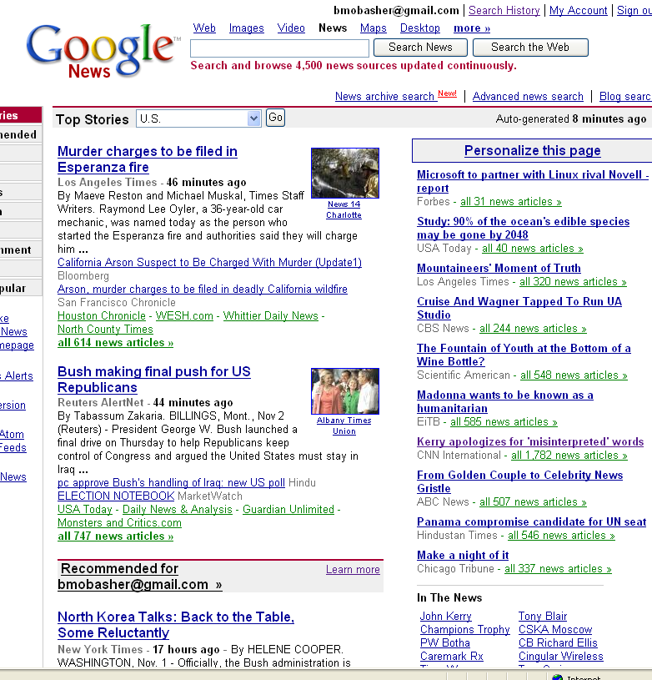
Content-Based Recommender Systems

Slide 45
Content-Based Recommenders
Music recommendations
Play list generation
Example: Pandora

Slide 46

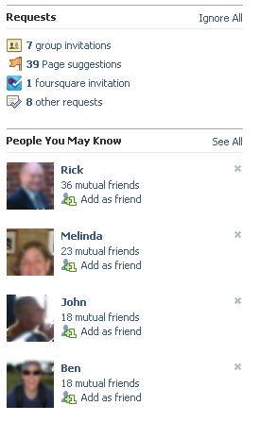
Social Recommendation
A form of collaborative filtering using social network data
  Users profiles represented as sets of links to other nodes (users or items) in the network
  Prediction problem: infer a currently non-existent link in the network

Slide 47
Possible Interesting Project Ideas
Build a content-based recommender for
  News stories (requires basic text processing and indexing of documents)
  Blog posts, tweets
  Music (based on features such as genre, artist, etc.)
Build a collaborative or social recommender
  Movies (using movie ratings), e.g., movielens.org
  Music, e.g., pandora.com, last.fm
    Recommend songs or albums based on collaborative ratings, tags, etc.
    recommend whole playlists based on playlists from other users
  Recommend users (other raters, friends, followers, etc.), based similar interests

