Slide 1
Qualitative Research
Baris Dingil

Slide 2
Qualitative Research Methods
(Chapter 8, Leedy and Ormrod)

Slide 3
Introduction
Some questions require deep, exploratory methods
Qualitative research builds a rich picture of real-world phenomena
Used when:
Variables are unknown
Existing theory is inadequate
Detailed human experience is central
Emphasizes natural settings and complexity
Data collection & analysis are often recursive and evolving
Notes:
To begin, qualitative research is about digging deep—beyond just numbers. It helps us understand the meaning and complexity of real-world phenomena. It’s used widely when little is known about a topic or when we want to explore how people make sense of their experiences. Unlike quantitative research, data collection and analysis here often happen in a back-and-forth process. This chapter introduces six key qualitative methods, and over the next few slides, we’ll explore what each of them looks like.

Slide 4
RESEARCH PROBLEMS AND METHODOLOGY
CHOICE IN QUALITATIVE RESEARCH
Initial research questions may be broad (e.g., “What is it like to…?”)
Questions and methods evolve as deeper understanding develops
Planning is essential, even with evolving strategies
Researchers must be:
Trained in qualitative techniques
Familiar with existing literature
Skilled in managing and interpreting large data sets
Notes:
Unlike quantitative studies where we define a precise hypothesis early, qualitative research often begins with broad questions. As the study progresses, those questions evolve, and so do the methods. It’s a dynamic, recursive process—but still one that demands rigorous planning, training, and deep familiarity with the subject. This adaptability makes qualitative research especially useful for exploring complex, messy, or poorly understood phenomena.

Slide 5
Potential Advantages of a Qualitative Approach
Exploration
Multifaceted description
Verification
Theory development
Problem identification
Evaluation
Notes:
■■Exploration. They can help you gain initial insights into what has previously been a little-studied topic or phenomenon.
■■ Multifaceted description. They can reveal the complex, possibly multilayered
nature of certain situations, settings, processes, relationships, systems, or people.
■■ Verification. They allow you to test the validity of certain assumptions, claims,
theories, or generalizations within real-world contexts.
■■ Theory development. They can enable you to develop new concepts or theoretical perspectives related to a phenomenon.
■■ Problem identification. They can help you uncover key problems, obstacles, or
enigmas that exist within the phenomenon.
■■ Evaluation. They provide a means through which you can judge the effectiveness of particular policies, practices, or innovations.

Slide 6
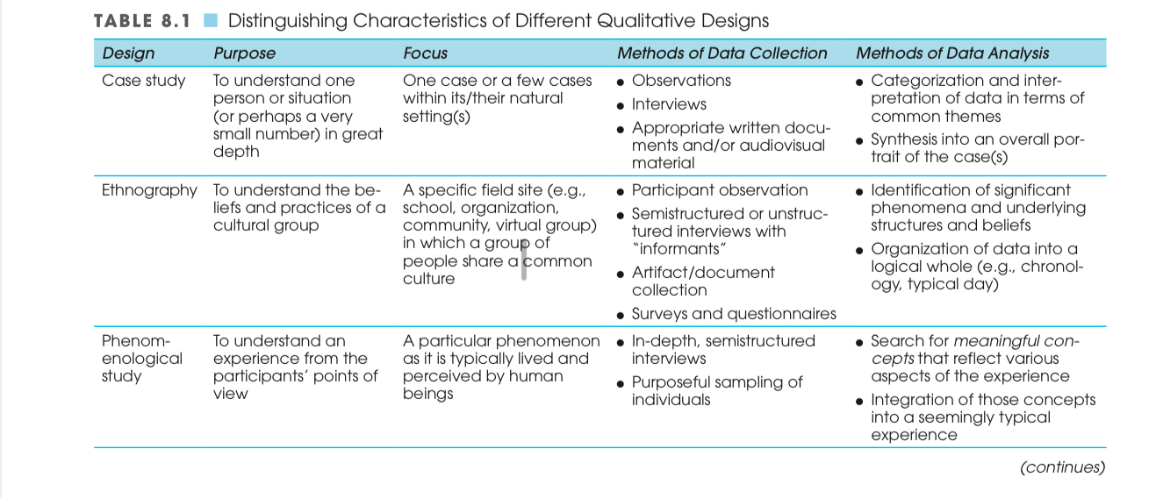
QUALITATIVE RESEARCH DESIGNS
Notes:
Let’s start with three foundational qualitative designs.
First, case studies focus deeply on one or a few individuals or situations in their natural setting. The aim is to capture detailed, meaningful insights using observations, interviews, and documents.
Next, ethnography is about understanding the shared beliefs and behaviors of a cultural group. Researchers immerse themselves in the setting, often for extended periods, to identify core patterns and values.
Then we have phenomenological studies, which focus on how people perceive and experience a particular phenomenon—like grief, identity, or chronic illness. Through in-depth interviews, researchers extract meaningful themes to describe a common essence across participants.

Slide 7
Notes:
The next three designs each serve unique goals.
Grounded theory seeks to build a theory from the ground up, using data collected from real-world settings. It involves constant comparison—collecting and analyzing data at the same time until categories and theories emerge.
Narrative inquiry explores personal stories over time, often drawing from interviews, writings, or visual materials. The goal is to identify themes and reorganize narratives into a coherent story that reveals deeper meaning.
Finally, content analysis systematically breaks down communication—whether it’s text, visuals, or behavior—into measurable categories. It’s especially useful for analyzing trends or patterns across large sets of data.

Slide 8
Collecting Data in Qualitative Research
Multiple data types: observations, interviews, documents, images, online content
Memos support early interpretation:
Reflective (bias & perspective)
Methodological (approach/strategy)
Analytical (emerging themes/theories)
Emerging design: data collection adapts as understanding deepens
Planning is critical—especially for new researchers and IRB proposals
Ethics: informed consent, confidentiality, pseudonyms
Notes:
Qualitative researchers draw from diverse data sources—from interviews to graffiti to seating patterns in a lunchroom. Memos help track early insights: reflective memos uncover personal bias, methodological memos guide the process, and analytical memos capture emerging ideas. While flexibility is a strength, it also requires careful planning—especially for IRB approval. And as always, ethical guidelines must be followed, including informed consent and confidentiality.

Slide 9
PRACTICAL APPLICATION Ensuring That Qualitative Data Collection Yields Credible, Trustworthy Data
Reflexivity – Reflecting on researcher bias
Triangulation – Using multiple data sources
Clear distinction – Observations vs. interpretations
Seek disconfirming evidence – Avoid confirmation bias
Prolonged site engagement – Gather depth, context
Member checking – Verify data with participants
Audit trail – Document all steps in detail
Notes:
Qualitative research isn’t about objectivity—it’s about credibility. Strategies like reflexivity and triangulation help ensure that what we uncover is trustworthy. We must clearly separate what we observe from how we interpret it. And rather than rushing to conclusions, good qualitative researchers seek out contradictions and spend meaningful time in the field. Member checking and audit trails provide further accountability—ensuring the study’s findings are rooted in what actually happened.

Slide 10
PRACTICAL APPLICATION Selecting an Appropriate
Sample for a Qualitative Study
Purposive Sampling: Selecting individuals or items that are especially informative or relevant to the research question.
Theoretical Sampling: In grounded theory, selecting new data sources based on emerging concepts to build and refine theory.
Discriminant Sampling: Returning to certain sources to test or support the developing theory (often in grounded theory).
Primary Informants: Key individuals in ethnographic research who provide access and deep cultural knowledge.
Extreme Case Sampling: Focusing on unusual or deviant cases to gain insights from outliers (often in case studies).
Convenience Sampling: Using easily accessible participants or settings due to constraints like time or access.
Snowball Sampling: Asking participants to refer others who fit the study criteria—useful for hard-to-reach populations.
Notes:
In qualitative research, we typically don’t aim for random samples. Instead, we use purposive sampling, meaning we select people or materials that are most relevant to the research question.
In grounded theory, we might use theoretical sampling—choosing participants based on emerging concepts, so we can refine our developing theory. Later, we might return to earlier participants for discriminant sampling—to test if the theory still holds.
Ethnographers often rely on primary informants—key people who can explain the group’s culture and help connect the researcher with others.
Sometimes, we use extreme case sampling, where we focus on unique or unusual individuals to explore the edges of a phenomenon.
If access is limited, we might rely on convenience sampling, choosing whoever is available, or use snowball sampling, where participants help recruit others with relevant experiences.
Regardless of strategy, the goal is to capture meaningful diversity—different roles, experiences, or perspectives—so we can build a fuller picture of what’s going on

Slide 11
PRACTICAL APPLICATION Making Observations
in a Qualitative Study
Flexible & unstructured: open to emerging insights
Detailed recording: field notes, audio, video
Challenges:
Knowing what to focus on
Researcher influence (reactivity)
Limitations of recording tools
Best practices:
Test & practice recording methods
Clarify your role at the site
Get informed consent early
Separate observations from interpretations
Notes:
Unlike quantitative observation, which is structured and focused, qualitative observation is open-ended and responsive. It gives the researcher freedom to follow what emerges—but that freedom also comes with risk: it’s easy to miss what matters.
Recording is another challenge. Field notes are limited, and tech like video or audio can fail—or make participants uneasy. So before entering the field, it’s crucial to test different tools and get comfortable using them.
Once you’re in the site, make sure your role is clear—especially in structured environments like classrooms.
And finally, always separate what you actually see and hear from how you interpret it. Your early impressions may change, and separating data from memos keeps the record honest and flexible.

Slide 12
PRACTICAL APPLICATION Planning and Conducting
Interviews in a Qualitative Study
Interviews gather: Facts, beliefs, feelings, behaviors, motives
Style: Informal, conversational, open-ended
Types:
One-on-one interviews
Focus groups (6–12 people)
Useful for exploring deep perspectives in participants’ own words
Planning:
Align questions with research goals
Avoid leading questions
Be culturally sensitive
Choose participants purposefully
Notes:
Interviews are central to qualitative research because they let us explore people's experiences, beliefs, and behaviors in their own words.
Unlike quantitative interviews, they’re more conversational and informal. We might sit with one person or lead a small focus group.
It’s important to plan questions in advance—but keep them open-ended and culturally respectful. You want to guide, not lead.
Your participants should feel like they’re talking with someone who’s genuinely listening—not being surveyed.

Slide 13
Good interview practice:
Build rapport & trust
Ask for concrete examples, not abstract ideas
Record verbatim responses
Let participants speak freely—don’t interrupt
Keep personal reactions neutral
Focus groups:
Useful for group interaction & time efficiency
Can be homogeneous or diverse
Manage dynamics so everyone speaks
Keep questions short and focused
Notes:
A good interview feels like a real conversation, but it’s still structured by your purpose.
You want to draw out stories and details without revealing your own views—your job is to listen, not lead.
In focus groups, group dynamics matter. Some people dominate, others hold back—so you need to create space for all voices to be heard.
And finally, remember: what people say reflects their perspectives, not always objective facts. Your goal is to capture their realities.

Slide 14
Criteria for Evaluating Qualitative Research
Purposefulness – Clear alignment between question and methods
Stated Assumptions – Researcher biases and beliefs are disclosed
Rigor – Thorough, systematic data collection and analysis
Open-Mindedness – Willingness to revise interpretations
Completeness – Rich, contextualized understanding (“thick description”)
Coherence – Data supports a consistent and logical story
Persuasiveness – Evidence strongly supports interpretations
Consensus – Participants and scholars agree with findings
Usefulness – Findings have practical or theoretical value
Notes:
“As we conclude this chapter, it’s important to know how qualitative research is judged. These nine criteria help reviewers, advisors, and even participants assess the strength of a study.
First is purposefulness: A strong study begins with a clear research question that drives the methods—not the other way around.
Second, explicitness of assumptions and biases: Researchers must acknowledge their own background, values, and potential blind spots. This transparency builds trust.
Third is rigor. Just because the methods are flexible doesn’t mean they’re casual. A good study is precise, systematic, and thorough.
Next is open-mindedness—the willingness to revise interpretations when the data points in a new direction.
Completeness means the researcher paints a full picture, using thick description—capturing the setting, behaviors, and participant voices in depth.
Then there’s coherence. The findings should make sense. Data from multiple sources should align—or if they don’t, those contradictions should be acknowledged and explained.
Persuasiveness is about building a strong, logical case for your interpretations, supported by real evidence—not just opinion.
The eighth criterion is consensus. Ideally, other researchers—or even the participants themselves—should recognize the accuracy and validity of the findings.
And finally, usefulness. A great study gives us something meaningful—whether it’s deeper understanding, better predictions, or solutions to real problems.
Together, these criteria remind us that qualitative research, when done well, is both art and science—deeply thoughtful, carefully crafted, and incredibly valuable.”

Slide 15
Analyzing Qualitative and Mixed-Methods Data
(Chapter 12, Leedy and Ormrod)

Slide 16
Introduction
Analysis begins early and evolves continuously
Often drives later data collection
Involves inductive reasoning
Researcher is a central part of the process
Complex, layered, and deeply interpretive
Insightful—but not free from bias
Notes:
In qualitative research, data analysis doesn’t wait until the end. It begins almost immediately—driving what we notice, what we question, and even what data we collect next.
This process is iterative, reflective, and inductive. We move from specific observations to broader meanings, often coding and interpreting along the way.
But that flexibility brings challenges. It’s easy for our expectations and personal biases to color what we see. That’s why qualitative researchers must stay aware of their own role—we’re not just analyzing data; we’re part of the instrument.
The work is time-consuming and complex, but it can also be incredibly rewarding. It’s in the analysis where the raw stories we collect start to make sense.

Slide 17
Qualitative Analysis Strategies - General Strategies for Organizing and Analyzing Qualitative Data
10-Step Strategy Overview:
Prepare data → Transcribe, digitize, clean
Organize data → By time, type, or source
Create codes → Start list, open coding, or in vivo
Segment data → Break into meaningful units
Pilot test codes → Refine and clean
Finalize codebook → Define codes clearly, add examples
Ensure reliability → Use multiple raters when possible
Look for patterns → Themes, sequences, relationships
Spot contradictions → Stay open to tensions in the data
Interpret meaningfully → Link back to research question
Notes:
When analyzing qualitative data, the process isn’t linear—it’s a spiral. We go back and forth between our raw materials and emerging insights.
First, we clean and organize our data—transcribe interviews, label photos, sort documents. Then we start coding, breaking the data into units and tagging them with meaningful labels.
Sometimes we begin with a start list of codes. Other times, we do open coding, letting patterns emerge naturally. These codes are refined through a process called coding clean-up.
From there, we analyze for themes and patterns. We might notice repeated emotions, social dynamics, or cause-effect sequences. We also watch for contradictions, which often lead to deeper insights.
Finally, we interpret the findings—comparing groups, linking to theory, even visualizing patterns with charts or maps. Throughout the process, we reflect with memos, staying grounded in both data and purpose.

Slide 18
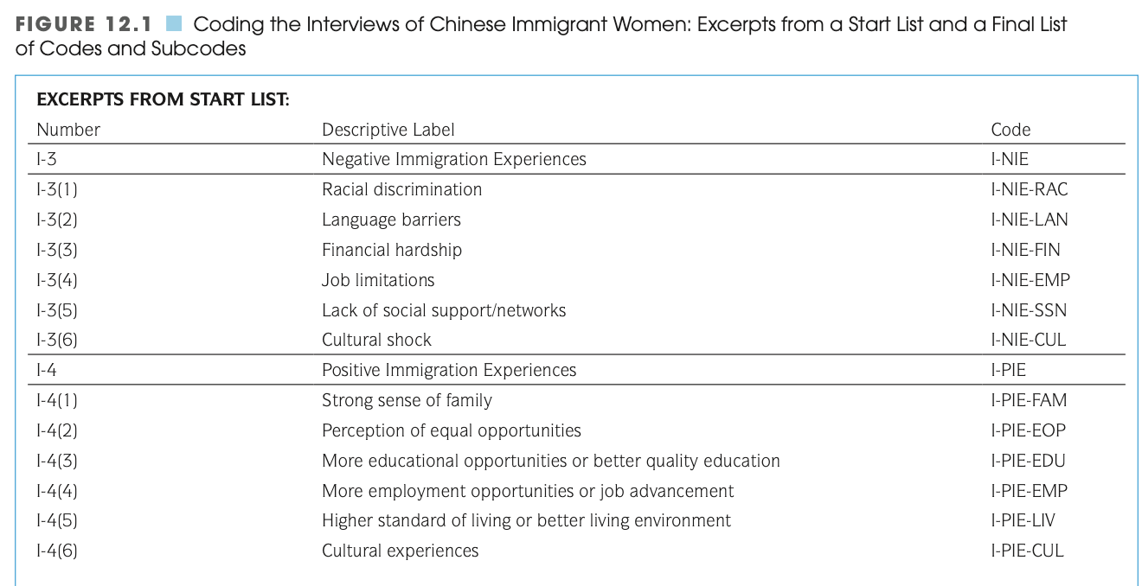

Slide 19
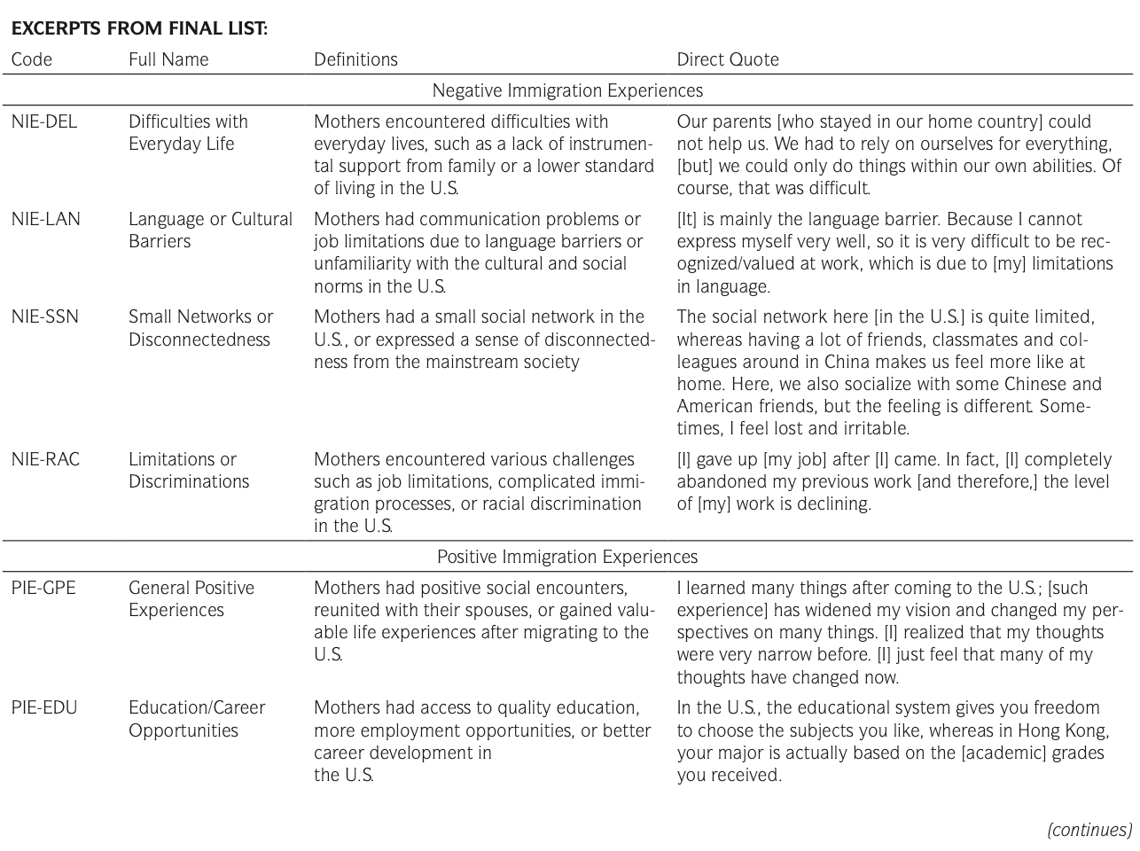

Slide 20
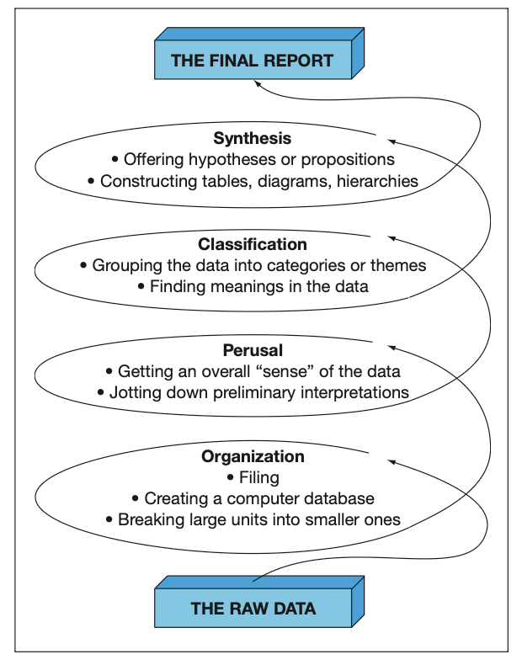
Qualitative Analysis Strategies - Creswell’s Data Analysis Spiral
Notes:
This spiral, developed by John Creswell, offers a helpful visual for understanding how qualitative analysis works.
We don’t just move in a straight line from data to conclusions. Instead, we cycle through stages:
First, we organize our raw data—whether it’s audio, field notes, or documents. Then, we read through it all to get a general sense, jotting memos and first impressions. Next, we begin identifying patterns—categories, themes, subthemes—and labeling the data accordingly. Finally, we pull it all together: we summarize, we explain relationships, and we present it clearly to others—often using charts or diagrams to make meaning visible.
It’s a process that loops and refines—until our insights feel solid, clear, and grounded in the data.

Slide 21
Acknowledging the Role of Researcher-as-Instrument in Qualitative Research
Researchers make ongoing judgments during analysis
Complete objectivity is unlikely, so strive for rigorous subjectivity
Three key strategies to ensure credibility:
Strive for balance and fairness
Triangulate data
Seek contradictory evidence
Saturate categories
Include multiple perspectives
Document your analysis steps
Code creation, revision, interrater reliability
Transparent, replicable process
Acknowledge personal biases
Share assumptions, cultural lens, expectations
Builds trust and integrity
Notes:
In qualitative research, we are the primary instrument. That means we don’t just analyze the data — we filter, interpret, and give meaning to it.
But this also means our own background, beliefs, and biases can shape what we see. That’s why we don’t pretend to be perfectly objective. Instead, we aim for what’s called rigorous subjectivity.
We use strategies like triangulation, category saturation, and peer checking to strengthen our interpretations.
We also need to be transparent about our process — how we built our codebook, trained coders, or resolved disagreements.
And perhaps most importantly, we must acknowledge our biases in our final reports. That honesty doesn’t weaken our study — it strengthens it. It shows that we’re critically aware of our role in shaping the knowledge we’re presenting.”

Slide 22
Analyzing and Interpreting Mixed-Methods Data
Mixed-methods = both qualitative and quantitative data
Analysis depends on research design (e.g., sequential or concurrent)
Integration strategies:
Merge data sets for side-by-side comparison
Connect findings across phases
Embed one type of data within the other
Aim: Broader understanding than either method alone
Notes:
“In mixed-methods research, we bring together the strengths of both quantitative and qualitative approaches. This means we might be working with statistics and narratives at the same time.
The way we analyze this combined data depends on the research design. If our design is sequential, we analyze one type first—usually quantitative—then use the results to guide the qualitative phase.
In concurrent designs, we analyze both data types separately, then integrate them to compare or deepen insights.
Integration is key. Sometimes we merge data sets to compare results side by side. Other times, we connect findings — like using qualitative data to explain surprising quantitative results. And in some studies, one method is embedded within the other, like using interviews inside a larger survey.
The goal is a richer, more complete understanding of the research problem than either method could provide alone.

Slide 23
Systematic Reviews of Qualitative and Mixed-Methods Studies
Systematic Review: A rigorous, structured method to synthesize findings from many qualitative/mixed-methods studies
Steps Include:
Comprehensive literature search
Quality evaluation of studies
Thematic coding & categorization
Drawing overarching analytical themes
(Optional) Quantitative meta-analysis for studies with statistical findings
Practical Tip: Read published studies by experienced researchers to see how they handle design, data collection, coding, and reporting
Caution: Not all published studies are strong—analyze their strengths/weaknesses to inform your own research
Notes:
As researchers, we often stand on the shoulders of others—and systematic reviews help us do that on a large scale. When we want to synthesize what many qualitative or mixed-methods studies say about a topic, we conduct a systematic review. This isn’t statistical meta-analysis, but rather a careful, structured process of selecting studies, coding their findings, and drawing analytical themes across them.
Harden and Thomas give us a great example: their study on how to help children eat more healthfully. They looked at dozens of studies, coded children’s perspectives and behaviors, and identified six big-picture themes that guided future interventions.
Finally, if we want to get better at conducting these kinds of studies ourselves, there’s no substitute for learning from the pros. Read good studies—analyze their methodology and their logic. And don’t be afraid to critique weaker studies, because every example is a lesson.

Slide 24
Thank you ☺

