Slide 1
" Responsible Conduct and Ethical Standards in Research."
Daniel Badro,
Juan Carlos Barrera
CSC 426 - Spring 2023
DePaul University
May 18, 2023
Chicago, IL USA

Slide 2
Agenda
Introduction
Ethics in research
On Being A Scientist: Responsible Conduct in Research
Class Exercise
Experimental standards for Research
Conclusion
Q&A
Sources

Slide 3
1) Introduction
What is ethics?
Ethics or moral philosophy is a branch of philosophy that "involves systematizing, defending, and recommending concepts of right and wrong behavior". [1][2]
Ethics seeks to resolve questions of human morality by defining concepts such as good and evil, right and wrong, virtue and vice, justice and crime. [3]
https://ethics-institute.dartmouth.edu/
Notes:
There are four philosophies of ethics and social responsibility.
The Friedman view argues that a company’s sole responsibility is to maximize profits for its owners (or shareholders) while operating within the law.
Many people disagree with this argument and say the discussion Is not whether a company has CSR obligations but how tit will fulfill them.
The cultural relativist view says that a company should adopt local ethics wherever it operates because right and wrong are determined within a cultural context.
“When in Rome, do as the Romans do” captures the essence of this view.
The righteous moralist view argues that a company should maintain its home-country ethics wherever it operates because the home–country’s view of ethics and responsibility is superior.
If headquarters instructs a subsidiary manager to refrain from bribing local officials, it imposes its righteous moralist view on the local manager.
The utilitarian view says that a company should behave in a way that maximizes “good” outcomes and minimizes “bad” outcomes wherever it operates.
A utilitarian manager will take the action that produces the best outcome for all affected parties.

Slide 4
2) Ethics in Research
Ethics in Research is based on the same ethical values that apply in everyday life, including honesty, fairness, objectivity, openness, trustworthiness, and respect for others.
A “scientific standard” refers to the application of these values in the
context of research.
Science is built on trust and Researchers are expected to be honest
The most common form of unethical behavior in computing is plagiarism

Slide 5
Ethics in Research (cont’d)
Why is ethics important to research?
Promotes a variety of moral and societal values
Advances key aims of research itself
Ensures that researchers and funders are held accountable to the public
Researchers have a duty to value:
Human rights
Legal compliance
Safety
Researchers should be free from conflicts of interest

Slide 6
Ethics in Research (cont’d)
Researchers developed professional standards to enhance the progress of science and to avoid or minimize the difficulties of research.
Researchers have three professional obligations:
(1) To honor the trust that their colleagues place in them.
(2) An obligation to themselves.
(3) An obligation to act in ways that serve the public.
Advising: An adviser oversees the conduct of research, offering guidance and advice on matters connected to research.
Mentoring: A mentor—who also may be an adviser—takes a personal as well as a professional interest in the development of a researcher

Slide 7
Ethics in Research (cont’d)
Many of the ethical issues that arise in research are related to Intellectual Creation (ownership of both ideas and descriptions of them).
Copyright concerns the expression of ideas; that is, the words and pictures used to say something are protected, but not the ideas themselves.
Patents and prior invention protect processes, inventions, and concepts; that is, the ideas, but not how they are described.
Plagiarism is re-use in one paper of material that has appeared in another, without appropriate acknowledgement.
Self-plagiarism is when authors who re-use their own text may well be plagiarizing. Using the same text in two papers is publishing the same work twice.

Slide 8
Ethics in Research (cont’d)
Misrepresentation (fraud) occurs when a paper does not accurately reflect the outcomes that were observed or the contributions of previous research.
Authorship deciding who has merited authorship of a paper can be a difficult and emotional issue.
Established on the basis of the quality and quantity of one’s contributions to a study, not status, power, or any other factor
Many research journals have now adopted guidelines to help authorship groups determine credit
Confidentiality and Conflict of Interest Researchers need to respect each other’s privacy and Commercial relationships may need to be disclosed to editors or in the text of a submitted paper.

Slide 9
Ethics in Research (cont’d)
Misconduct (does not include honest error or differences of opinion)
The U.S. Office of Science and Technology Policy defines misconduct as “fabrication, falsification, or plagiarism in proposing, performing, or reviewing research, or in reporting research results.”
Three elements of misconduct are defined as follows:
(1) Fabrication is “making up data or results.”
(2) Falsification is “manipulating research materials, equipment, or processes, or changing or omitting data or results such that the research is not accurately represented in the research record.”
(3) Plagiarism is “the appropriation of another person’s ideas, processes, results, or words without giving appropriate credit.”

Slide 10
Ethics in Research (cont’d)
In Summary:
Source: https://www.youtube.com/watch?v=k7C-lPrpsLo
Research World : youtube Channel

Slide 11
3) On Being a Scientist
The Treatment of Data:
Researchers who manipulate their data in ways that deceive others, even if the manipulation seems insignificant at the time.
Misleading data can arise from poor experimental design or careless measurements as well as from improper manipulation
Most researchers are not required to share data with others as soon as the data are generated.
A period of confidentiality allows researchers to check the accuracy of their data and draw conclusions.

Slide 12
On Being a Scientist (cont’d)
Responding to Suspected Violations of Ethical Standards:
Science is largely a self-regulating community.
Self-regulation ensures that decisions about professional conduct will be made by experienced and qualified peers.
for self-regulation to work, researchers must be willing to alert others when they suspect that a colleague has violated professional standards or disciplinary practices.

Slide 13
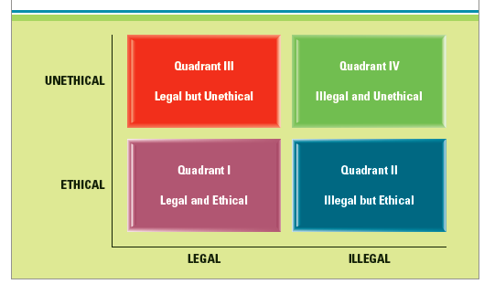
On Being a Scientist (cont’d)
Historical Cases of Unethical Research
Key events
Nazi Experimentation during WWII and the Nuremberg Code
Stanley Milgram’s Obedience Studies
The Thalidomide Tragedy
The Tuskegee Syphilis Study
Source [5]
Notes:
Nazi Experimentation: In order to improve the survival and treatment of army personnel and to advance the racial and ideological tenets of their worldview, Nazi physicians carried out as many as 30 different types of human experiments on concentration camp inmates (Tyson, 2000).
Milgram Studies: While the Nazi experiments were related to the issue of physical harm to research subjects, Milgram’s work brought about awareness regarding the potential of subjecting research participants to psychological harm.
Thalidomide Tragedy: This event involved the occurrence of very serious birth defects in children of pregnant women who had been given Thalidomide as a sedative. The drug side effects should have been known and available to doctors and patients, but were not until much harm had been done.
The Tuskegee Syphilis Study: This was a 40-year observational study of the impact of untreated syphilis on men. The participants in the study were low-income African American men who were lead to believe they were receiving treatment when in fact they were not. This was one of the major stimuli of the Belmont Conference.

Slide 14
On Being a Scientist (cont’d)
As a result of the Tuskegee Study:
The National Research Act of 1974 was passed
The Belmont Report issued ethical guidelines for research on human subjects
Respect for persons
Vulnerable populations
Assent
Informed consent
Voluntary participation
Beneficence
No greater than minimal risk
Justice
Notes:
National Research Act of 1974: When the press leaked the story, the Tuskegee study in Alabama came to an abrupt end and a massive public outcry ensued over the immorality of knowingly denying treatment to individuals with syphilis. As a result, congressional hearings were initiated and the National Research Act was passed in 1974.
The Belmont Report: The Belmont report includes basic standards that should underlie the conduct of any biomedical and behavioral research involving human participants. It emphasizes universal principles that are unbounded by time or technology. The three core principles described in the Belmont Report are:
1) respect for persons
2) beneficence, and
3) justice.
Respect for persons: This principle means that people are to be treated as independent and autonomous individuals. It also means that the wellbeing of those who are not in a position to be fully autonomous should also be protected.
Vulnerable populations:
This is the term used to designate those who may not be fully in control of their decision making. There are several specific groups included in this definition, including children, prisoners, and people with impaired cognitive capacity (e.g., with mental retardation or dementia). Children under 18 are not of legal age to provide consent. Instead, researchers must seek permission from parents or legal guardians.
Assent: Assent means that a child has affirmatively agreed to participate in a study. It is not the mere absence of an objection. The appropriateness of an assent procedure depends on the child’s developmental level and is determined by the researcher in consultation with the IRB.
Informed consent: A policy of informing study participants about the procedures and risks involved in research that ensures that all participants must give their consent to participate.
Voluntary participation: The right of voluntary participation is one of the most basic and important of all research participant rights. It means that fully informed individuals have the right to decide whether or not to participate in a study without coercion. It also means that they can terminate participation at any point without negative consequences.
Beneficence: The expected impact on a person’s well-being that may result from participation in research. Researchers should attempt to maximize the benefits of participation and take steps to identify and limit the potential for harm.
“No greater than minimal risk”: This is the risk assessment used by researchers and IRBs in assessing the level of risk associated with participation in a study. It specifically means that the risk of harm is not greater than that experienced in everyday life situations like typical academic or medical examinations.
Justice: Justice means that participation in research should be based on fairness and not on circumstances that give researchers access or control of a population based on status (as in the Tuskegee and Nazi experiments). The principle of justice also means that recruiting should be done in a way that respects the rights of individuals and does not take advantage of their status as patients, students, prisoners, children, or others not fully able to make independent decisions.

Slide 15
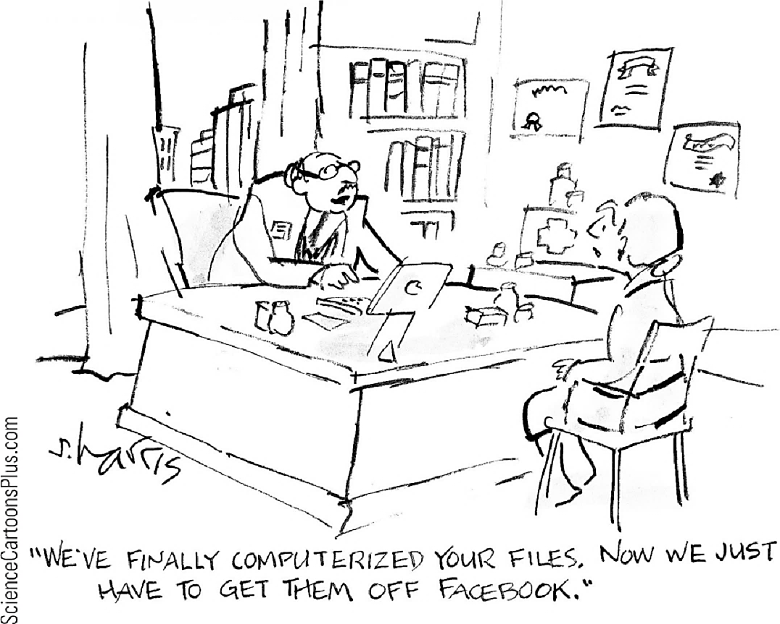
On Being a Scientist (cont’d)
Related Guidelines on Human Subject Participation:
Privacy
Anonymity
Confidentiality
De-identification
Deception and debriefing
Right to service
Use of placebos
Notes:
Privacy: Privacy in research means protection of personal information about participants. It is typically accomplished through the use of confidentiality procedures that specify who will have access to personally identifying data and the limits of that access. It can also include the use of anonymous data in which no personally identifying information is ever collected.
Anonymity: The assurance that no one, including the researchers, will be able to link data to a specific individual. This is the strongest form of privacy protection in research because no identifying information is collected on participants.
Confidentiality: An assurance made to study participants that identifying information about them acquired through the study will not be released to anyone
outside of the study.
De-identification: The process of removing identifying information from data sets in order to preserve the anonymity of individuals.
Deception: This is the intentional use of false or misleading information in study procedures. Researchers must justify the use of deception on scientific grounds and be certain to provide complete debriefing about the actual nature of the study once it has been completed.
Debriefing: This is the process of providing participants with full information about the purpose of a study once a person has completed participation.
Right to service: This is a right of study participants that guarantees access to the best available and most appropriate services relevant to a condition (e.g., depression) that is part of a study.
Placebo: This is the use of a treatment that may look like the real treatment, but is inert. The use of placebos in research is allowed if careful assessment of the scientific need and care of participants can be provided.

Slide 16
On Being a Scientist (cont’d)
IRBs Institutional Review Boards
Ethics in Clinical Research
A panel of people who review research protocols to ensure the safety and rights of the participants in the proposed study
Protocols
Detailed documents that summarize the purposes and procedures of a study
ACM Code of Ethics and Professional Conduct
https://www.acm.org/code-of-ethics
Patient Protection versus Access
The FDA’s approach to approving new drugs is a “go slow” mentality
Phase I studies
Phase II studies
Phase III studies
Ethics in Research with Animals
IRBs are required to maintain a committee on the care of animals used in research
Institutional Animal Care and Use Committee
Notes:
Phase I study: A research study designed to test a new drug or treatment in a small group of people for the first time to evaluate its safety, determine a safe dosage range, and identify potential side effects.
Phase II study: A research study designed to test a drug or treatment that is given in a larger group of people than in a Phase I study to see if it is effective and to further evaluate its safety.
Phase III study: A research study designed to test a drug or treatment that is given to large groups of people using a highly controlled research design, in order to confirm the intervention’s effectiveness, monitor side effects, compare it to commonly used treatments, and collect information that will allow the drug or treatment to be used safely.

Slide 17
4) Class Exercise
Tests on Students
For his dissertation project in psychology, Antonio is studying new approaches to strengthen memory. He can apply these techniques to create interactive Web-based instructional modules. He plans to test these modules with students in a general psychology course for which he is a teaching assistant. He expects that student volunteers who use the modules will subsequently perform better on examinations than other students. He hopes to publish the results in a conference proceedings on research in learning, because he plans to apply for an academic position after he completes the doctorate.
Let’s vote
1. Should Antonio seek IRB approval for his research project with human participants?
YES NO
2. Do they need to give formal informed consent?
YES NO

Slide 18
5) Experimental Standards for Research
Zobel’s Reliable Research Article
Ethical norms differ between disciplines.
Standards for conduct and recording experiments not adopted in computer science.
Lack of standards can be seen as approval for fraudulent research.
Public records can be used to form new research.

Slide 19
Experimental Standards (cont’d)
Standards for Experimentation
AVCC’s Statement and Guidelines on Research Practice.
Record-keeping, a valuable tradition, is not taught in many disciplines.
Record-keeping has a long history – notes of Newton are still available.

Slide 20
Experimental Standards (cont’d)
William McBride – Fraud Case
Incorrect claims about morning sickness.
Claims made based on concocted results.
Estimated to have cost the manufacturer around $100,000,000.

Slide 21
Experimental Standards (cont’d)
Stephen Breuning – Fraud Case
Recommendations led to changes in drug regimes.
Convicted on two felonies.

Slide 22
Experimental Standards (cont’d)
Motivations for Record-Keeping (1 of 2)
Provides evidence of precedent.
Records can form the basis of reproduction of experiments.
Can detect misconduct.
Allows for verification.

Slide 23
Experimental Standards (cont’d)
Motivations for Record-Keeping (2 of 2)
Provides rigor as researchers must proceed with care.
Prevents fraudulent claims.
Adds a level of credibility to the researcher.
Provides guidance.

Slide 24
Experimental Standards (cont’d)
Experiments in Computer Science (1 of 2)
The kind of records needed for computer science depend on the research.
Examples of record-keeping scenarios:
Evaluating algorithmic activity.
Comparing algorithms.
Identifying appropriate parameters.
Demonstrating that a concept is feasible.
Testing of human factors.

Slide 25
Experimental Standards (cont’d)
Experiments in Computer Science (2 of 2)
Certain activities do not require similar records.
It is difficult to replicate results.
The existence of code does not diminish the need for record-keeping.
Evaluation requires more than lines of code.

Slide 26
Experimental Standards (cont’d)
Practice in Computer Science (1 of 2)
Good researchers keep some record of their work.
Failure to keep such records is not seen as poor practice.
Why do computer scientists, at the undergraduate level, not receive training?

Slide 27
Experimental Standards (cont’d)
Practice in Computer Science (2 of 2)
In some disciplines, work is not published unless supporting data is available.
Researchers in computer science resist the publication of code and data.
It is essential that some record-keeping exists.

Slide 28
Experimental Standards (cont’d)
Record-Keeping Practices
Should be reasonable.
Should be widely accepted.
Should be appropriate to the research.

Slide 29
Experimental Standards (cont’d)
Standards for Record-Keeping
It is difficult to do this, however, there is a general understanding:
Records must fill voids.
Records must be verifiable.
Corroborating testimonies.

Slide 30
Experimental Standards (cont’d)
Instruments for Record-Keeping
Notebooks.
This can be used to record dates, notes, names, etc.
Code.
Required if the experiments are to be run again.
Logs.
Transcripts of the output of each experiment.

Slide 31
Experimental Standards (cont’d)
Summary: Zobel’s Reliable Research (1 of 2)
Standards for recording research are not high in computer science.
There is a need to develop standards and practices.
Record-keeping is not a burden.

Slide 32
Experimental Standards (cont’d)
Summary: Zobel’s Reliable Research (2 of 2)
Computer Scientists must not make the error of urging a technical solution before the problem is understood.
Adoption of better experimental standards will provide computer science more credibility.

Slide 33
6) Conclusion (BR2 – Discussion on D2L)
“Why computer scientists do not as undergraduates receive the kind of training in scientific method that is compulsory in other disciplines?” (Andrea Watkins)
“It was very hard to teach the importance of things like documentation, compliance with regulations, and business requirements that had not been taught in all computer science programs.” (Jennifer Vander Loop)
“In addition to ethical standards, many CS areas including AI is making researchers become cognizant of building unbiased algorithms that improve trust and confidence which has given rise to RAI (responsible AI) and XAI (explainable AI).” (Nandhini Gulasingam)

Slide 34
7) Q&A

Slide 35
8) Sources
[1] Rolfes, H., & Eilers, F. J. (2007). Communicatio socialis: challenge of theology and ministry in the church; Festschrift for Franz-Josef Eilers. Kassel Univ. Press.
[2] Internet Encyclopedia of Philosophy ""Ethics"". Archived from the original on January 18, 2018. Retrieved January 7, 2012. http://www.iep.utm.edu/ethics
[3] Martinez, V. R. (2020). More Meaningful Ethics. U. Chi. L. Rev. Online, 53.
[4] Zobel, J. (1998, February). Reliable research: Towards experimental standards for computer science. In Proceedings of the 21st Australian Computer Science Conference (pp. 217-229).
[5] Baltzan, P., & Phillips, A. (2014). Ebook: Business Driven Information Systems. McGraw Hill.
Images:
https://ethics-institute.dartmouth.edu/ (Slide 3)
www.ScienceCartoonsPlus.com (Slide 15)
Video:
https://www.youtube.com/watch?v=k7C-lPrpsLo (Slide 10)
Research World: youtube channel.

