Slide 1
Descriptive Research
by
Parisa Arbab and Nandhini Gulasingam
5/11/2023

Slide 2
Descriptive Research
The term descriptive research encompasses a variety of methodologies that are best suited to examining and trying to make sense of a situation or event as it currently exists in the world. This general category of research designs includes both (a) designs aimed at characterizing the general nature of an observed phenomenon and (b) designs aimed at revealing possible associations among two or more phenomena. By and large, descriptive research does not involve changing or modifying a situation under investigation, nor is it intended to determine cause-and-effect relationships.

Slide 3
1. Observation Study
Observation studies focus on specific behaviors, often with plants or objects, and use precise quantification methods. They require planning and attention to detail and can provide quantitative data on human behavior.
Example: Kontos's study on preschool teachers' roles during children's free-play.

Slide 4
2. Correlational Research
Correlational research examines the relationship between two or more variables to see if they are associated with one another. Researchers gather quantitative data about two or more characteristics and analyze it to determine the degree and direction of correlation between the variables. Interpretation of the data is critical, and correlational research can provide insights into predicting future outcomes.

Slide 5
3. Developmental Designs
Developmental designs study how a characteristic changes with age. Two types: cross-sectional (compare different age groups) and longitudinal (follow a single group over time). Both have weaknesses, so sometimes researchers use a combination in a cohort-sequential study.

Slide 6
4. Experience-Sampling Methods
Experience-sampling methods (ESM) collect frequent data from people's everyday lives using technology like smartphones. ESM is used in quantitative and qualitative research to investigate well-being, social environments, and emotional states. It increases accuracy, validity, and reliability and can be combined with other research methods. Example study combined ESM and observations to investigate instructional activities and student engagement.

Slide 7
5. Survey Research
Survey research collects information by asking questions and tabulating answers. It draws conclusions about a larger population. Surveys can be conducted in different ways, but design is essential for reliable results. Change is constant, even though surveys capture a moment in time..

Slide 8
5.1 Face-to-Face and Telephone Interviews
In survey research, interviews can be standardized or semi-structured. Face-to-face interviews have high response rates but are time-consuming and expensive. Telephone interviews are less expensive but have lower response rates and potential bias. Video-conferencing interviews are in between. Personal interviews allow for follow-up information but may not be practical for large sample sizes.

Slide 9
5.2 Questionnaires
Questionnaires are useful for collecting data from people in faraway locations and providing anonymity, but suffer from low response rates and potential selection bias. The quality of responses may be limited by reading and writing skills and the questions asked. Careful planning, construction, and distribution are necessary to obtain useful data.

Slide 10
Planning for Data Collection in a Descriptive Study
To plan a quantitative descriptive study, researchers must consider measurement techniques for tangible and intangible phenomena. Simple variables can be measured straightforwardly, but complex variables may require tools such as observations, interviews, or questionnaires to gather data.

Slide 11
1. Practical Application: Checklists, Rating Scales and Rubrics
In quantifying complex phenomena, checklists, rating scales, and rubrics are useful tools. Checklists list behaviors or characteristics and researchers indicate their presence or absence. Rating scales evaluate a phenomenon on a continuum, while rubrics include two or more rating scales with concrete descriptions of performance. These tools can be used for various research, but using rating scales or rubrics may not provide information about why participants respond as they do. However, rubrics can offer explicit and concrete alternatives to rating scales when evaluating performance.

Slide 12
2. Practical Application: Computerizing Observations
It suggests that computerizing observations can enhance data collection efficiency. One way to do this is by creating a spreadsheet or using data-collection software on a laptop, tablet, or smartphone. For complex observations, a template document can be created and saved for each entity being observed. Existing software programs like CyberTracker can also be used to record observations with GPS signals and custom-designed checklists for specific characteristics of each observation.

Slide 13
3. Practical Application: Planning and Conducting Interviews in a Quantitative Study
Planning and conducting interviews in a quantitative study can be an effective way to gather more in-depth information on a specific topic or research question.

Slide 14
Guidelines Conducting Interviews in a Quantitative Study
Limit questions to those that will directly or indirectly help answer the research question.
Consider how to quantify responses and modify questions accordingly.
Restrict each question to a single idea.
Consider asking a few qualitative questions.
Consider using computer software to streamline the process.
Pilot-test the questions.
Courteously introduce yourself to potential participants and explain the general purpose of the study.
Get written permission from all participants.
Save controversial questions for the latter part of the interview.
Seek clarifying information when necessary.

Slide 15
4. Practical Application: Constructing and Administering a Questionnaire
Constructing and administering a questionnaire involves designing and implementing questions to collect data. The process includes determining research questions, selecting question types, developing and pretesting the questionnaire, administering it, analyzing the data, and presenting findings. The goal is to gather reliable and valid data to answer research questions or test hypotheses.

Slide 16
Guidelines: Constructing a Questionnaire
Keep it short and essential.
Keep the respondent's task simple and concrete.
Provide straightforward, specific instructions.
Use simple, clear, unambiguous language.
Give a rationale for any items whose purposes may be unclear.
Check for unwarranted assumptions implicit in your questions.
Word your questions in ways that don't give clues about preferred or more desirable responses.
Determine in advance how you will code the responses.
Check for consistency by asking the same question in different ways.
Pilot test your questionnaire.
Consider the visual layout.
Consider using incentives.

Slide 17
Guidelines: Technology to Facilitate Questionnaire Administration and Data Analysis
Have participants respond on a laptop or tablet when with you.
Use email to request participation and get responses from participants who are not in the same location.
Personalize your correspondence using word-processing software.
Use a scanner to help with data tabulation for large samples.
Use a computer database to keep track of responses.

Slide 18
Guidelines: Maximizing Your Return Rate for a Questionnaire
The response rate for mailed or e-mailed questionnaires is typically low, with return rates of 50% or less. A doctoral student studying reading sent out 103 questionnaires to teachers, with only a 13% return rate. The student later improved the return rate to 35% by seeking volunteers on the Internet. Despite the limited response, the student was able to complete her dissertation successfully.

Slide 19
5. Practical Application: Internet to Collect Data for a Descriptive Study
It discusses the use of the internet for collecting data through online surveys. It highlights the advantages of online surveys such as cost-effectiveness, adaptability, and comparability to face-to-face surveys. However, researchers need to consider ethical standards, confidentiality, and potential harm to participants. The article recommends researchers to work with their advisors and IRBs to develop appropriate precautions and strategies for selecting an appropriate sample.

Slide 20
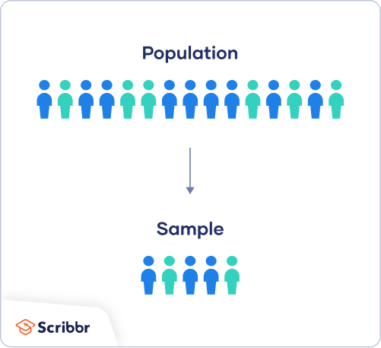
Agenda for this section
Population vs sample
Sampling techniques
Sampling issues
Sample size
Bias in descriptive research
Validity – external validity

Slide 21
Population vs Sample
Population - is the entire group that you want to draw conclusions about
Sample - is the selection of a representative subset of the population of interest in a research study

Slide 22
Why Sample?
Sampling allows researchers to obtain enough data to answer the research question(s) without having to query the entire population
Sampling a subset saves time and money

Slide 23
Issues Associated with Sampling
Might be difficult to gain access to a representative sample
Size and geography – Large, demographically mixed, and/or geographically dispersed populations
Persons who are rare – pregnant women, incarcerated
Hidden populations – drug users
Difficult to enumerate – homeless population, displaced due to disasters
Lack of a representative sample affects the validity of your results
Research biases, particularly sampling bias

Slide 24
Sampling Methods
Probability Sampling
Random - every member has a chance of being selected
When to use?
Mainly used in quantitative research
If you want to produce results that are representative of the whole population
Non-Probability Sampling
Non-Random - individuals are selected based on non-random criteria, and not every individual has a chance of being included
When to use?
Mainly used in exploratory and qualitative research to develop initial understanding of a small or under-researched population

Slide 25
Types Sampling
Sampling
Probability Sampling
(Random)
Non-Probability Sampling
(Not Random)
Simple Random Sampling
Stratified Random Sampling
Proportional Stratified Sampling
Systematic Sampling
Cluster Sampling
Judgement / Purposive Sampling
Convenient Sampling
Quota Sampling
Snowball Sampling
Voluntary Response Sampling

Slide 26
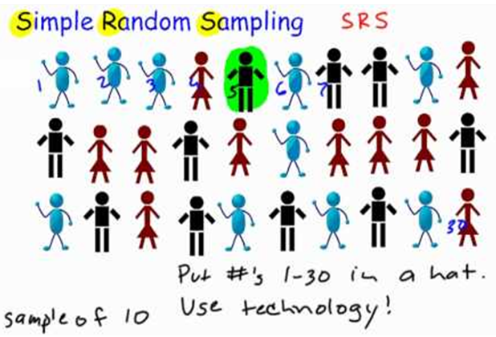
Probability Sampling: Simple Random Sampling
Randomly selected
Each person/object has equal chance or probability of being selected
Challenges
It is easy when the population is small and all of its members are known
Advantages
Reduces selection bias

Slide 27
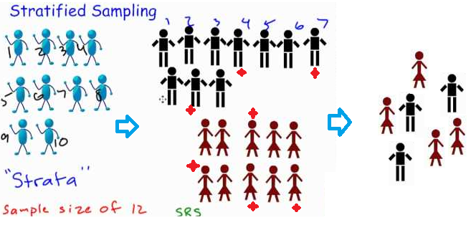
Probability Sampling: Stratified Random Sampling
Population is first divided into subgroups (or strata) with similar characteristics, and then randomly sampled
It is used when measurement of interest vary between the different subgroups, and want to ensure representation from all the subgroups
Challenges
Requires knowledge of the characteristics of the sampling frame
It can be difficult to decide which characteristic(s) to stratify by
Advantages
Improves the accuracy
Reduces sampling bias

Slide 28
Probability Sampling: Proportional Stratified Random Sampling
Extension of Stratified Random sampling
Appropriate when various strata are different in size
Challenges
Requires knowledge of the characteristics of the sampling frame
It can be difficult to decide which characteristic(s) to stratify by
Advantages
Improves the accuracy
Reduces sampling bias

Slide 29
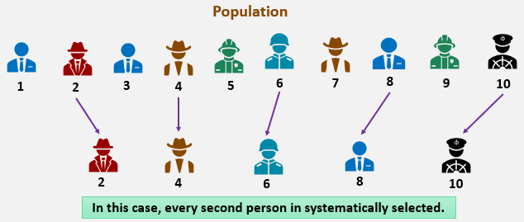
Probability Sampling: Systematic Sampling
Selected at regular intervals from the sampling frame
The intervals are chosen to ensure an adequate sample size
If you need a sample size n from a population of size x, select every x/n^{th} individual for the sample
e.g. if you wanted a sample size of 100 from a population of 1000, select every 1000/100 = 10th member
Challenges
May lead to bias
Advantages
More convenient than simple random sampling
Easy to administer

Slide 30
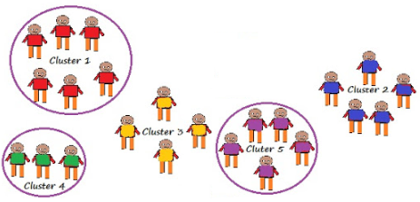
Probability Sampling: Cluster Sampling
Subgroups of the population are used as the sampling unit, rather than individuals
The population is divided into subgroups, known as clusters, which are randomly selected to be included in the study
Clusters are usually already defined
Challenges
Requires knowledge of characteristics of the clusters
Increased risk of bias
Advantages
More efficient than simple random sampling
Easy to administer

Slide 31
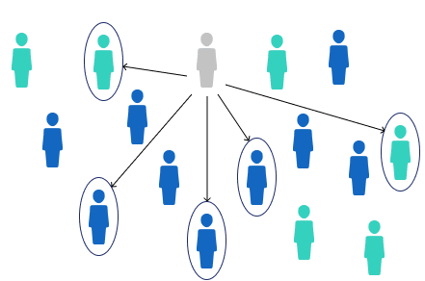
Non-Probability Sampling: Judgement or Purposive Sampling
Also known as selective, or subjective, sampling
It relies on the judgement of the researcher choosing participants
Researchers may implicitly choose a “representative” sample to suit their needs, or specifically approach individuals with certain characteristics
Used by the media when canvassing the public for opinions
Challenges
Includes bias
Prone to errors of judgement by the researcher and the findings
Advantages
Time-and cost-effective

Slide 32
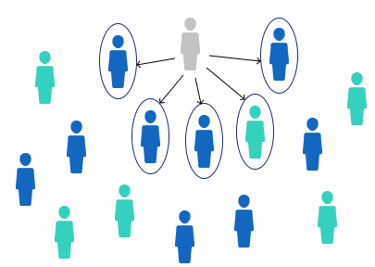
Non-Probability Sampling: Convenient Sampling
Participants are selected based on availability and willingness to take part
Useful results can be obtained, but the results are prone to significant bias
Challenges
Significant bias
Advantages
Easiest

Slide 33
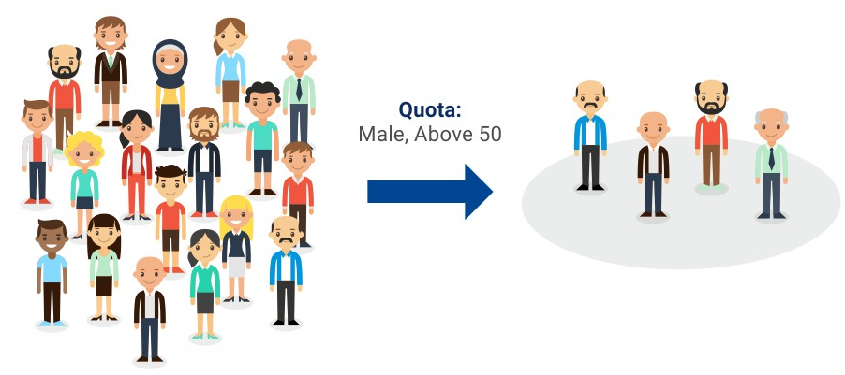
Non-Probability Sampling: Quota Sampling
Relies on the non-random selection of a predetermined number or proportion of units. This is called a quota
Divide the population into mutually exclusive subgroups (called strata) and then recruit sample units until you reach your quota
Characteristics of subgroups and units share should be determined prior to selection
Aim of quota sampling is to control what or who makes up your sample
Advantages and Challenges
Relatively straightforward and potentially representative,
but the chosen sample may not be representative

Slide 34
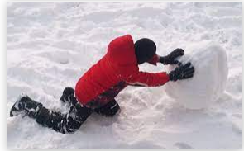
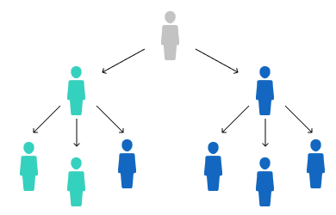
Non-Probability Sampling: Snowball Sampling
Commonly used in social sciences when investigating hard-to-reach groups
Existing subjects are asked to nominate further subjects known to them, so the sample increases in size like a rolling snowball
It is effective when a sampling frame is difficult to identify
Challenges
Significant bias when known people are recruited
Advantages
Only way to obtain hard-to-reach groups

Slide 35
Non-Probability Sampling: Voluntary Response Sampling
Similar to a convenience sample
Instead of the researcher choosing participants and directly contacting them, people volunteer themselves (e.g. by responding to a public online survey)
Challenges
Biased
Some will be more likely to volunteer, leads to self-selection bias
Advantages
Convenient
Less cost w.r.t recruitment
Easy

Slide 36
Sample Size
Using a correct sample size is crucial for your research
Sample size measures the number of individual observations measured or used in your study
Five steps to finding your sample size
Define population size or number of people
Designate your margin of error
Determine your confidence level
Predict expected variance (or standard deviation)
Finalize your sample size

Slide 37
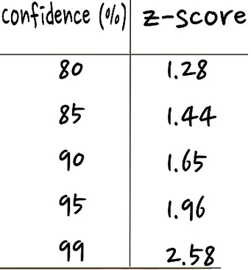
Sample Size
10000
1.96
0.05
0.5
Source
Computation : Link

Slide 38
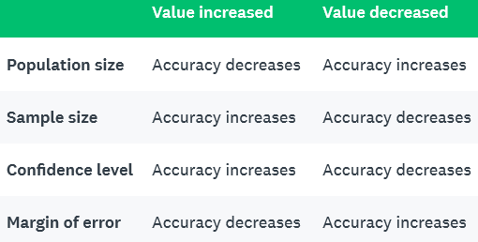
Sample Size
Effect of the Various Components on Accuracy

Slide 39
Bias in Descriptive Studies
Bias - is any influential factor that distorts the data obtained or conclusions drawn
Types of Bias
Sampling Bias
Survey Method Bias
Instrumentation Bias
Response Bias
Researcher Bias

Slide 40
Bias in Descriptive Studies
Types of Bias
Sampling Bias
Any factor that yields a non-representative and non-random sample
E.g. All non-probability samples
Survey Method Bias
Any factor that affects the way the surveys are administered
E.g. Phone interviews (can survey only those who have phone or will answer), Online interviews (survey those who have internet and computer)
Instrumentation Bias
Assessment strategies that skew the results
E.g. Overlooking certain questions/variables, perception of researcher vs responder

Slide 41
Bias in Descriptive Studies
Types of Bias
Response Bias
What they believe to be true vs what sounds good (social desirability effect)
E.g. Survey question - Have you abused kids in your life?
Researcher Bias
Effects of a researcher’s expectations, values, and general belief systems affect the design or data collection process
E.g. High school students are asked to state how school has impacted their learning. Students assume learning to be understanding of materials, while researcher’s goal for asking the question was beyond just learning materials, but social skills, etc.

Slide 42
Acknowledging Bias in Research
It’s almost impossible to avoid biases
Biases influence the data collected, conclusions drawn, or both
Admit certain biases may well have influenced findings

Slide 43
External Validity
External validity - extent to which the findings could be generalized to other situations, people, settings
Providing evidence of generalization
Sampling
Proximal Similarity

Slide 44
External Validity
Sampling
Identify population to generalize it to
Draw a fair sample from that population and conduct your research with the sample
Sample is representative of the population, generalize results back to the population
Issues:
Not know whom you want to generalize it to at the time of the study
May not be easy to draw a fair or representative sample
Impossible to sample across all times that you might like to generalize to (like next year)

Slide 45
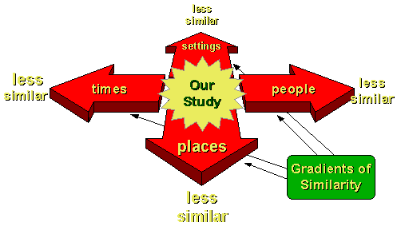
External Validity
2. Proximal Similarity
Proximal = nearby and similarity = similar
Different generalizability contexts – people, place, time settings
Issues:
People – e.g. unusual type of people who were in the study
Place – e.g. characteristics of the place is different
Settings, Time – e.g. Pre-COVID vs during Pandemic lockdown

Slide 46
Improve External Validity
Sample
Fair and representative sample, use random sampling
Once the sample is selected, keep the dropout rates low
Proximal Similarity
Explain the context and how people, places, sittings and times differ
Provide sufficient data on degree of similarity between various groups of people, places, settings and times

Slide 47
Exercise
Senario-1: DePaul’s student population consists of graduate, undergraduate, certificate students and non-degree-seeking students. The administration wants to sample students to evaluate effectiveness of the introductory courses taught.
Senario-2: Researcher selects individuals whom he/she thinks are between the ages of 18-21 to complete on a survey on young adult movies. Note: The researcher did not explain what ‘young adult’ movies are to the participants.
Pick any one of the scenarios to answer the following questions
What is the sampling technique(s) that can be used?
Is there a bias? What type(s) of bias exist?
How would you explain the external validity? (Hint: fair, bias, representative, generalizability of people, place, settings, time)

