Slide 1
Query Operations:
Query Expansion & Word Embeddings
CSC 575
Intelligent Information Retrieval

Slide 2
Topics
  This Lecture: Query Expansion
    Thesaurus based
    Automatic global and local analysis
    Word Embeddings
  Later:
    Relevance Feedback & Query modification
    Personalization & Recommender Systems
      Collaborative and Content-Based filtering

Slide 3
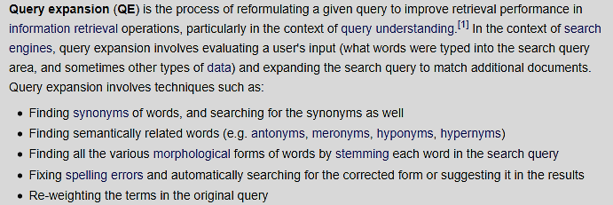
Query Expansion in IR
From Wikipedia:

Slide 4
Thesaurus-Based Query Expansion
For each term, t, in a query, expand the query with synonyms and related words of t from the thesaurus.
May weight added terms less than original query terms.
Generally increases recall.
May significantly decrease precision, particularly with ambiguous terms.
  “interest rate” → “interest rate fascinate evaluate”
WordNet
  A more detailed database of semantic relationships between English words.
  Developed by famous cognitive psychologist George Miller and a team at Princeton University.
  About 144,000 English words.
  Nouns, adjectives, verbs, and adverbs grouped into about 109,000 synonym sets called synsets.

Slide 5
WordNet Synset Relationships
Antonym: front → back
Attribute: benevolence → good (noun to adjective)
Pertainym: alphabetical → alphabet (adjective to noun)
Similar: unquestioning → absolute
Cause: kill → die
Entailment: breathe → inhale
Holonym: chapter → text (part-of)
Meronym: computer → cpu (whole-of)
Hyponym: tree → plant (specialization)
Hypernym: fruit → apple (generalization)
WordNet Query Expansion
  Add synonyms in the same synset.
  Add hyponyms to add specialized terms.
  Add hypernyms to generalize a query.
  Add other related terms to expand query.

Slide 6
Statistical Thesaurus
Problems with human-developed thesauri
  Existing ones are not easily available in all languages.
  Human thesuari are limited in the type and range of synonymy and semantic relations they represent.
  Semantically related terms can be discovered from statistical analysis of corpora.
Automatic Global Analysis
  Determine term similarity through a pre-computed statistical analysis of the complete corpus.
  Compute association matrices which quantify term correlations in terms of how frequently they co-occur.
  Expand queries with statistically most similar terms.

Slide 7
Simple Co-occurrence Thesaurus
Sec. 9.2.3
Simplest way to compute one is based on term-term similarities in C = AA^{T} where A is term-document matrix.
w_{ij} = weight for (t_{i} ,d_{j}) (typically normalized)
For each t_{i}, pick terms with high values in C
d_{j}
A
t_{i}
w_{ij}

Slide 8
Term Co-occurrence Matrix
A
A^{T}
 | D1 | D2 | D3 | D4 | D5 | D6
T1 | 0 | 5 | 3 | 1 | 0 | 2
T2 | 3 | 0 | 0 | 8 | 1 | 0
T3 | 1 | 0 | 4 | 0 | 0 | 2
T4 | 0 | 0 | 3 | 3 | 0 | 0
T5 | 0 | 3 | 4 | 0 | 0 | 0
 | T1 | T2 | T3 | T4 | T5
D1 | 0 | 3 | 1 | 0 | 0
D2 | 5 | 0 | 0 | 0 | 3
D3 | 3 | 0 | 4 | 3 | 4
D4 | 1 | 8 | 0 | 3 | 0
D5 | 0 | 1 | 0 | 0 | 0
D6 | 2 | 0 | 2 | 0 | 0
X
C = AA^{T}
 | T1 | T2 | T3 | T4 | T5
T1 | 39 | 8 | 16 | 12 | 27
T2 | 8 | 74 | 3 | 24 | 0
T3 | 16 | 3 | 21 | 12 | 16
T4 | 12 | 24 | 12 | 18 | 12
T5 | 27 | 0 | 16 | 12 | 25
The co-occurrence scores can also be normalized to obtain Cosine, Jaccard, or other similarity coefficients.
Dot-Product(T4,T2)

Slide 9
Association Matrix
w₁ w₂ w₃ …………………..w_{n}
c_{ij}: Correlation factor between
term i and term j
w₁
w₂
w₃
.
.
w_{n}
c₁₁ c₁₂ c₁₃…………………c_{1n}
c₂₁
c₃₁
.
.
c_{n1}
f_{ik} : Frequency of term i in document k
c_{ij} corresponds to the dot product of term vectors for terms i an j on the term-document matrix
Dot product favors more frequent terms.
Solutions: Normalize association scores:
Normalized score is 1 if two terms have the same frequency in all documents.

Slide 10
Metric Correlation Matrix
Association correlation does not account for the proximity of terms in documents, just co-occurrence frequencies within documents.
Metric correlations account for term proximity.
Can also normalize scores to account for term frequencies:
V_{i}: Set of all occurrences of term i in any document.
r(k_{u},k_{v}): Distance in words between word occurrences k_{u} and k_{v}
(∞ if k_{u} and k_{v} are occurrences in different documents).

Slide 11
Query Expansion with Correlation Matrix
For each term i in query,
  expand query with the n terms, j, with the highest value of c_{ij} (s_{ij}).
This adds semantically related terms in the “neighborhood” of the query terms.
Problems with Global Analysis
  Term ambiguity may introduce irrelevant statistically correlated terms.
    “Apple computer” → “Apple red fruit computer”
  Since terms are highly correlated anyway, expansion may not retrieve many additional documents.

Slide 12
Query Expansion with Correlation Matrix
C = AA^{T}
 | T1 | T2 | T3 | T4 | T5
T1 | 39 | 8 | 16 | 12 | 27
T2 | 8 | 74 | 3 | 24 | 0
T3 | 16 | 3 | 21 | 12 | 16
T4 | 12 | 24 | 12 | 18 | 12
T5 | 27 | 0 | 16 | 12 | 25
Consider a query: Q0 = (T1, T4) and say, n = 1 (so for each query term we want to add only one related term. What would be the expanded query?
Note: must ignore the diagonal since that is term t itself. Then, must find the top n terms in the row (or column) for t that are most similar to t.
Q1 = (T1, T5, T4, T2)

Slide 13
Automatic Local Analysis
At query time, dynamically determine similar terms based on analysis of top-ranked retrieved documents.
Base correlation analysis on only the “local” set of retrieved documents for a specific query.
Avoids ambiguity by determining similar (correlated) terms only within relevant documents.
  “Apple computer” → “Apple computer Macbook laptop”
Global vs. Local Analysis
  Global analysis requires intensive term correlation computation only once at system development time.
  Local analysis requires intensive term correlation computation for every query at run time (although number of terms and documents is less than in global analysis).
  But local analysis gives better results.

Slide 14
Global Analysis Refinements
Only expand query with terms that are similar to all terms in the query.
  “fruit” not added to “Apple computer” since it is far from “computer.”
  “fruit” added to “apple pie” since “fruit” close to both “apple” and “pie.”
Use more sophisticated term weights (instead of just frequency) when computing term correlations.

Slide 15
Automatic thesaurus generation example … sort of works
Word | Nearest neighbors
absolutely | absurd, whatsoever, totally, exactly, nothing
bottomed | dip, copper, drops, topped, slide, trimmed
captivating | shimmer, stunningly, superbly, plucky, witty
doghouse | dog, porch, crawling, beside, downstairs
makeup | repellent, lotion, glossy, sunscreen, skin, gel
mediating | reconciliation, negotiate, cease, conciliation
keeping | hoping, bring, wiping, could, some, would
lithographs | drawings, Picasso, Dali, sculptures, Gauguin
pathogens | toxins, bacteria, organisms, bacterial, parasites
senses | grasp, psyche, truly, clumsy, naïve, innate
Problem: Too sparse with lots of words. Also, can produce huge association matrices: e.g., 100,000 words = 10¹⁰ entries in C.

Slide 16
How can we represent term relations?
Sec. 9.2.2
With the standard symbolic encoding of terms, each term is a dimension
Different terms have no inherent similarity
Basic IR is scoring on dot product: q^{T}d
If query on hotel and document has motel, then our query and document vectors are orthogonal
motel [0 0 0 0 0 0 0 0 0 0 1 0 0 0 0]^{T}
hotel [0 0 0 0 0 0 0 3 0 0 0 0 0 0 0] = 0
No treatment of synonyms; no machine learning
Idea: learn a matrix of parameters W to rank via q^{T}Wd
  But, to keep W small, we need low dimensional representation of the words

Slide 17
Solution: Low dimensional vectors
The number of topics that people talk about is small (in some sense)
  Clothes, movies, politics, …
Idea: store “most” of the important information in a fixed, small number of dimensions: a dense vector
Usually 25 – 1000 dimensions
How to reduce the dimensionality?
  Go from big, sparse co-occurrence count vectors to low dimensional “word embedding” vectors

Slide 18
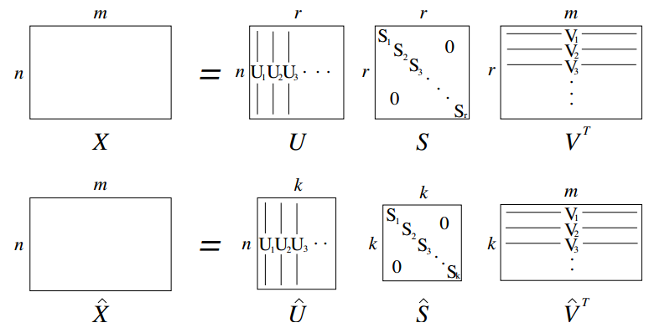
Traditional Way:
Latent Semantic Indexing/Analysis
Sec. 18.2
Use Singular Value Decomposition (SVD) to find a low-dimensional representation for terms and documents
“Noise” of term variation gets replaced by semantic “concepts” represented by singular values
  Motel = [0.286, 0.792, -0.177, -0.107, 0.109, -0.542, 0.349, 0.271]

Slide 19
How can we represent term relations?
Sec. 9.2.2
Alternatively, we can directly learn word relations
Learn a dense low-dimensional representation of a word in d dimensions such that dot products u^{T}v express word similarity
We could still include a “translation” matrix between vocabularies (e.g., cross-language): u^{T}Wv
  But now W is small!
Supervised Semantic Indexing (Bai et al. Journal of Information Retrieval 2009) shows successful use of learning W for information retrieval

Slide 20
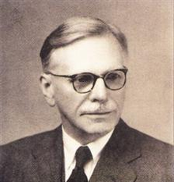
Distributional similarity-based representations
You can get a lot of value by representing a word by means of its neighbors
“You shall know a word by the company it keeps”
--(J. R. Firth 1957)
One of the most successful ideas of modern
statistical NLP
   These words will represent banking 
…government debt problems turning into | banking | crises as happened in 2009…
…saying that Europe needs unified | banking | regulation to replace the hodgepodge…
…India has just given its | banking | system a shot in the arm…
   These “context” words will represent banking 
Notes:
You can vary whether you use local or large context to get a more syntactic or semantic clustering

Slide 21
More Recent Approach: Neural Embeddings
Basic Idea:
  build a dense vector for each word type, chosen so that it is good at predicting other words appearing in its context
0.286
0.792
−0.177
−0.107
0.109
−0.542
0.349
0.271
Words that appear in the same contexts, should have similar vectors.
banking =

Slide 22
More Recent Approach: Neural Embeddings
Basic Idea:
  We define a model that aims to predict between a center word w_{t} and context words in terms of word vectors
    p(context|w_{t}) = …
  which has a loss function, e.g.,
    J = 1 − p(w_{−t} |w_{t})
  We look at many positions t in a big language corpus
  We keep adjusting the vector representations of words to minimize this loss

Slide 23
Learning low-dimensional word vectors based on ability to predict
Old idea: Learning representations by back-propagating errors. (Rumelhart et al., 1986)
A neural probabilistic language model (Bengio et al., 2003)
NLP (almost) from Scratch (Collobert & Weston, 2008)
A recent, even simpler and faster model:
word2vec (Mikolov et al. 2013)
The GloVe model from Stanford (Pennington, Socher, and Manning 2014) connects back to matrix factorization
Per-token representations: Deep contextual word representations: ELMo, BERT
Non-linear and slow
Fast bilinear models
Current state of the art

Slide 24
Word2vec is a family of algorithms
[Mikolov et al. 2013]
  Idea: Predict between every word and its context words!
Two algorithms
  Skip-grams (SG)
    Predict context words given target (position independent)
  Continuous Bag of Words (CBOW)
    Predict target word from bag-of-words context

Slide 25





Word2Vec Skip-gram Model
Example windows and process for computing$P\left(w_{t+j} | w_{t}\right)$
$$P\left(w_{t−2} | w_{t}\right)$$
$$P\left(w_{t+2} | w_{t}\right)$$
$$P\left(w_{t−1} | w_{t}\right)$$
$$P\left(w_{t+1} | w_{t}\right)$$
…
problems
turning
into
banking
crises
as
…
outside context words
in window of size 2
center word
at position t
outside context words
in window of size 2

Slide 26
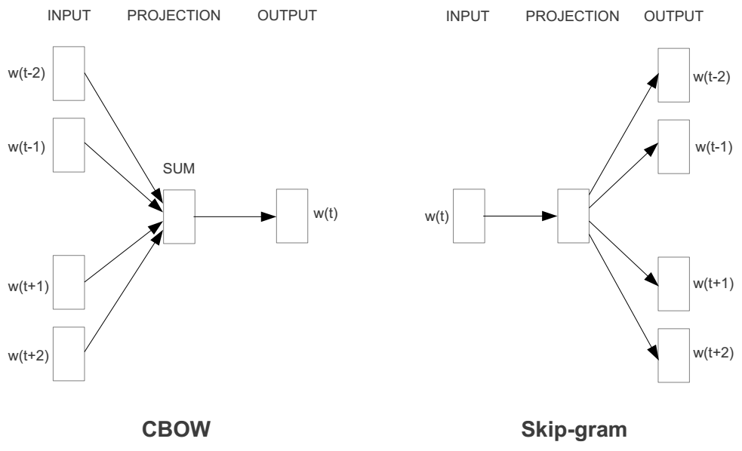
Word2vec is a family of algorithms
[Mikolov et al. 2013]

Slide 27
Skip-gram
Notes:
If we take our one-hot vector and multiply it by our W matrix, that gives us a vector that we call the projection layer – it’s just the column in W that corresponds to the word we’re looking at.

Slide 28
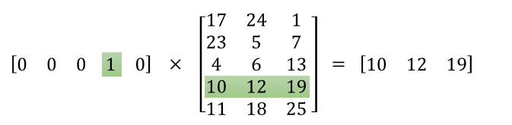
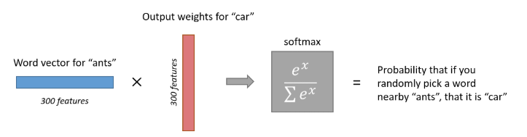
Finding Related Terms
One Hot Input Vector for a word
Low Dimensional Embedding Word Vector

Slide 29
Notes:
But if we then run gradient descent using those calculated derivatives, after a while, a miracle occurs.
With soft similarity this will be good for recall. It could be problematic for precision!

Slide 30
Linear Relationships in word2vec
These representations are very good at encoding similarity and dimensions of similarity!
Analogies testing dimensions of similarity can be solved quite well just by doing vector subtraction in the embedding space
  Syntactically
  x_{apple} − x_{apples} ≈ x_{car} − x_{cars} ≈ x_{family} − x_{families}
  Similarly for verb and adjective morphological forms
  Semantically
  x_{shirt} − x_{clothing} ≈ x_{chair} − x_{furniture}
  x_{king} − x_{man} ≈ x_{queen} − x_{woman}

Slide 31
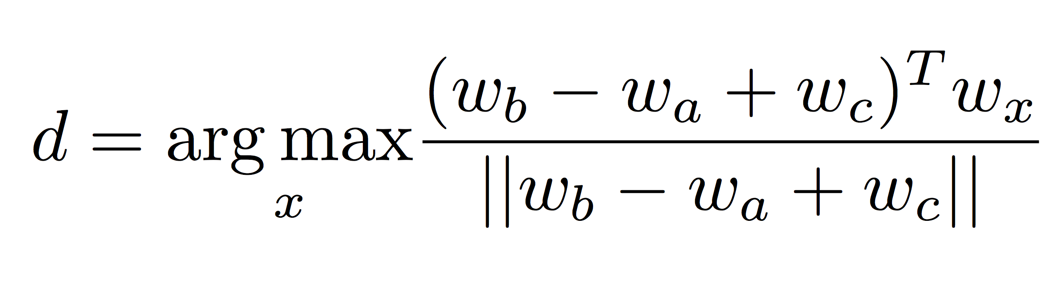
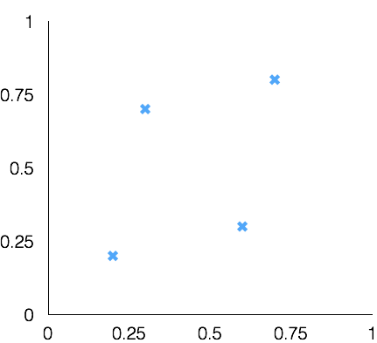
Word Analogies
Test for linear relationships, examined by Mikolov et al.
a:b :: c:?
man:woman :: king:?
+
king
[ 0.30 0.70 ]
queen
king
−
man
[ 0.20 0.20 ]
+
woman
[ 0.60 0.30 ]
woman
queen
[ 0.70 0.80 ]
man

Slide 32
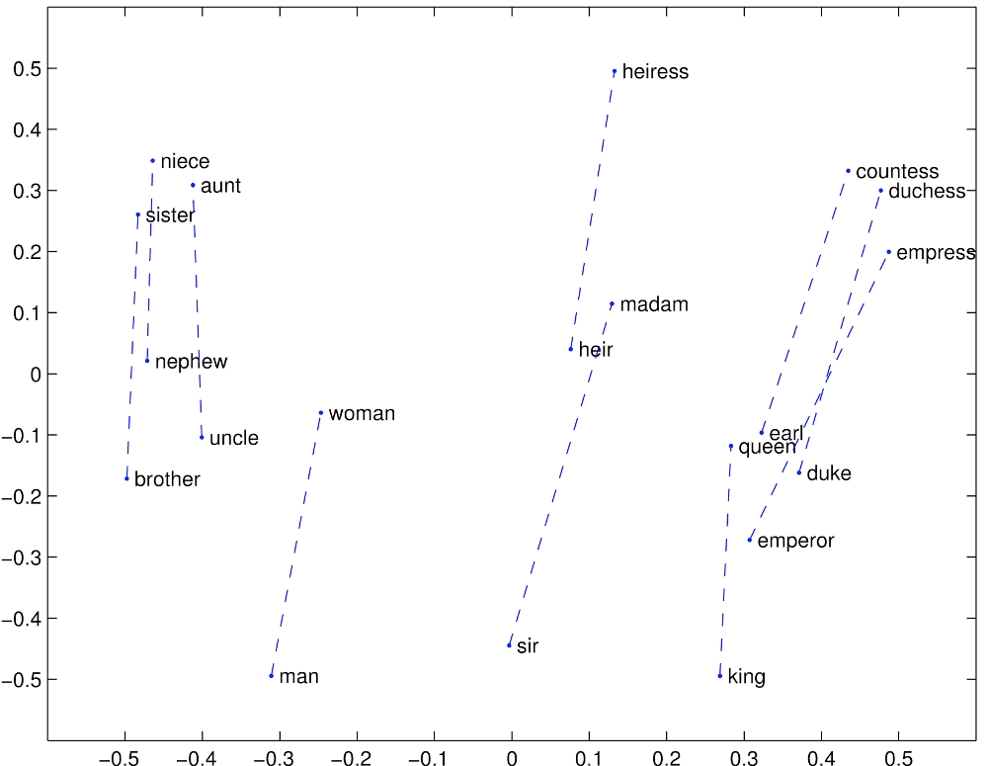
GloVe Visualizations
http://nlp.stanford.edu/projects/glove/

Slide 33
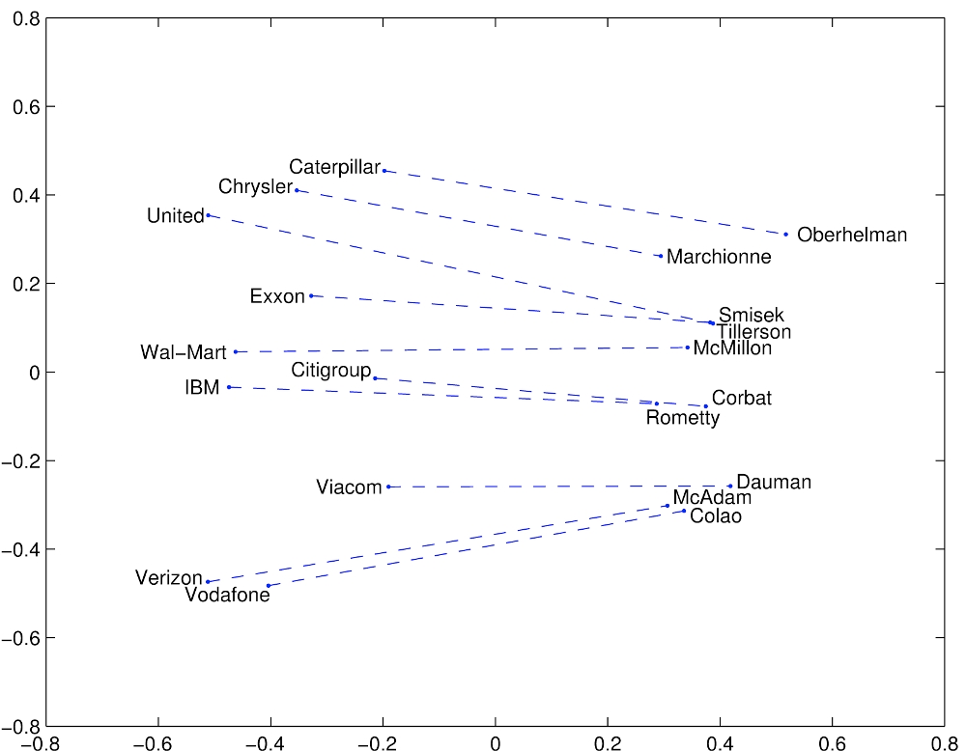
Glove Visualizations: Company - CEO

Slide 34
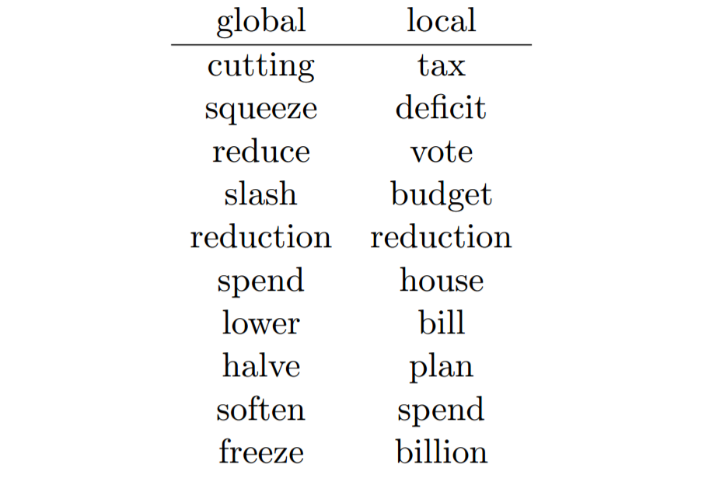
Global vs. Local Embedding
Terms similar to “cut” for word2vec model trained on a general news corpus and another trained only on documents related to “gasoline tax”.

Slide 35
Word Embedding Applications
Lots of applications wherever knowing word context or similarity helps prediction:
Synonym handling in search / query expansion
Document aboutness
Ad serving
Language models: from spelling correction to email response
Machine translation
Sentiment analysis
…

Slide 36
Query Operations:
Query Expansion & Word Embeddings
CSC 575
Intelligent Information Retrieval

