Slide 1
Relevance Feedback and Personalization
Part II
CSC 575
Intelligent Information Retrieval

Slide 2
Content-based recommendation
Collaborative filtering does NOT require any information about the items,
    However, it might be reasonable to exploit such information
    E.g. recommend fantasy novels to people who liked fantasy novels in the past
What do we need:
    Some information about the available items such as the genre/category, keywords, tags, or other features
    Some sort of user profile describing what the user likes (the preferences)
The task:
    Learn user preferences
    Locate/recommend items that are "similar" to the user preferences

Slide 3
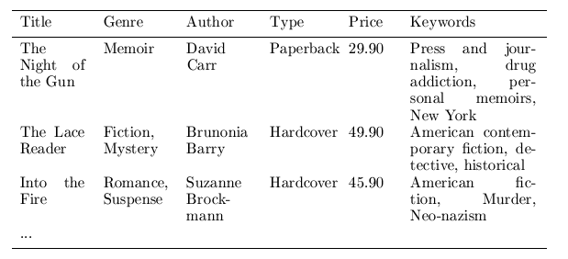
Content representation & item similarities
Represent items as vectors over features
  Features may be items attributes, keywords, tags, etc.
  Often items are represented as keyword vectors based on textual descriptions with TFxIDF or other weighting approaches
    applicable to any type of item (images, products, news stories) as long as a textual description is available or can be constructed
  Important consideration: feature selection
Notes:
Intersection

Slide 4
User Profiles
Represent items as vectors over features
User profiles are also represented as aggregate feature vectors
  Based on items in the user profile (e.g., items liked, purchased, viewed, clicked on, etc.)
  Ex: profile could be the sum or average of feature vectors for all items previously liked/selected by the user
  Or, it could be a vector representation based on the values of a specific feature or attribute (e.g., genre, category, etc.)
    If the user has liked star wars movies and Indiana Jones movies, then a vector representation with genres as dimensions will have high values for “sci-fi” and “action-adventure”, but low values for “drama” and “documentary”

Slide 5






Content-Based Recommenders
Predictions for unseen (target) items are computed based on their similarity (in terms of content) to items in the user profile.
E.g., user profile P_{u} contains
recommend highly: and recommend “mildly”:

Slide 6
Non-Personalized Content-Based Recommendation
Given a target item (represented as a feature vector over a feature set for all items)
 | F1 | F2 | F3 | F4 | F5 | F6 | F7 | F8
target | 3 | 1 | 0 | 4 | 1 | 0 | 2 | 1
Find the top k most similar items to the target item from the item database
 | F1 | F2 | F3 | F4 | F5 | F6 | F7 | F8
Item1 | 2 | 0 | 4 | 3 | 0 | 1 | 0 | 2
Item2 | 0 | 2 | 4 | 0 | 2 | 3 | 0 | 0
Item3 | 4 | 0 | 1 | 3 | 0 | 1 | 0 | 1
Item4 | 0 | 1 | 0 | 2 | 0 | 0 | 1 | 0
Item5 | 0 | 0 | 2 | 0 | 0 | 4 | 0 | 0
Item6 | 1 | 1 | 0 | 2 | 0 | 1 | 1 | 3
Item7 | 2 | 1 | 3 | 4 | 0 | 2 | 0 | 2

Slide 7
Non-Personalized Content-Based Recommendation
We can use standard KNN with Cosine Similarity
(Dice or Jaccard could be used if feature weights are binary)
 | F1 | F2 | F3 | F4 | F5 | F6 | F7 | F8 | Sim(Target, Di)
Item1 | 2 | 0 | 4 | 3 | 0 | 1 | 0 | 2 | 0.61
Item2 | 0 | 2 | 4 | 0 | 2 | 3 | 0 | 0 | 0.12
Item3 | 4 | 0 | 1 | 3 | 0 | 1 | 0 | 1 | 0.84
Item4 | 0 | 1 | 0 | 2 | 0 | 0 | 1 | 0 | 0.79
Item5 | 0 | 0 | 2 | 0 | 0 | 4 | 0 | 0 | 0.00
Item6 | 1 | 1 | 0 | 2 | 0 | 1 | 1 | 3 | 0.73
Item7 | 2 | 1 | 3 | 4 | 0 | 2 | 0 | 2 | 0.72
target | 3 | 1 | 0 | 4 | 1 | 0 | 2 | 1
With K = 3, Items 3, 4, and 6 will be recommended

Slide 8
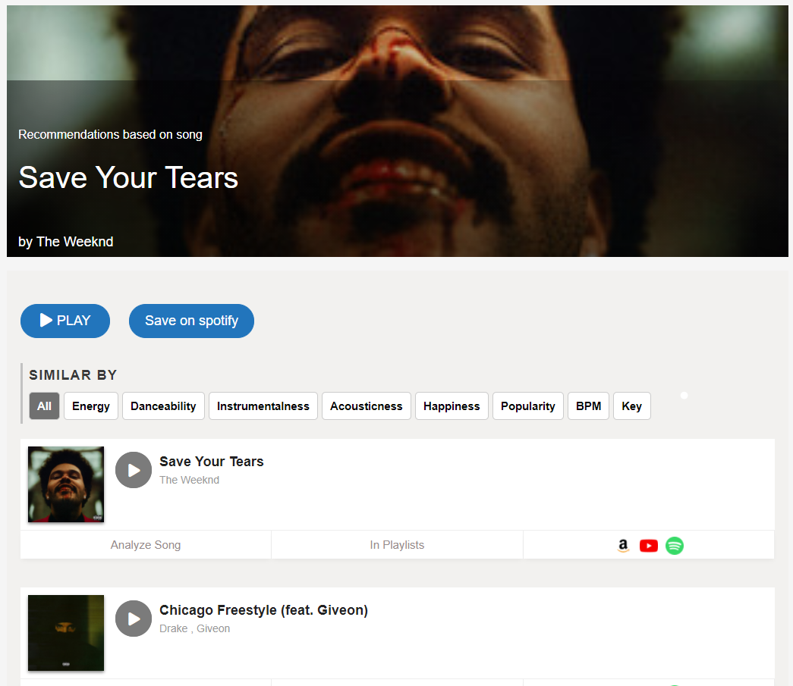
Non-Personalized Content-Based Recommendation
Could be used to give “more like this” type recommendations

Slide 9

Personalized Content-Based Recommendation
There is no target (or query) item. But suppose we have preference information (e.g., ratings) from user u on some items
 | F1 | F2 | F3 | F4 | F5 | F6 | F7 | F8 | User u’s Rating
Item1 | 2 | 0 | 4 | 3 | 0 | 1 | 0 | 2
Item2 | 0 | 2 | 4 | 0 | 2 | 3 | 0 | 0 | ?
Item3 | 4 | 0 | 1 | 3 | 0 | 1 | 0 | 1 | ?
Item4 | 0 | 1 | 0 | 2 | 0 | 0 | 1 | 0 | ?
Item5 | 0 | 0 | 2 | 0 | 0 | 4 | 0 | 0
Item6 | 1 | 1 | 0 | 2 | 0 | 1 | 1 | 3 | ?
Item7 | 2 | 1 | 3 | 4 | 0 | 2 | 0 | 2
User u’s profile could be the mean vector representing the rated documents, or simply the sum of those vectors (weighted by the rating)
Item1 + Item7 + (-Item5)
Note that this is basically Rocchio’s method with positive and negative feedback based on rated items
 | F1 | F2 | F3 | F4 | F5 | F6 | F7 | F8
Item1 | 2 | 0 | 4 | 3 | 0 | 1 | 0 | 2
Item5 | 0 | 0 | -2 | 0 | 0 | -4 | 0 | 0
Item7 | 2 | 1 | 3 | 4 | 0 | 2 | 0 | 2
U’s Profile | 4 | 1 | 5 | 7 | 0 | -1 | 0 | 0

Slide 10
Personalized Content-Based Recommendation
Now given u’s profile, we can recommend k most similar items not already rated by u
 | F1 | F2 | F3 | F4 | F5 | F6 | F7 | F8
U’s Profile | 4 | 1 | 5 | 7 | 0 | -1 | 0 | 0
Using Cosine similarity:
 | F1 | F2 | F3 | F4 | F5 | F6 | F7 | F8 | Sim(u, Item_i)
Item2 | 0 | 2 | 4 | 0 | 2 | 3 | 0 | 0 | 0.34
Item3 | 4 | 0 | 1 | 3 | 0 | 1 | 0 | 1 | 0.81
Item4 | 0 | 1 | 0 | 2 | 0 | 0 | 1 | 0 | 0.64
Item6 | 1 | 1 | 0 | 2 | 0 | 1 | 1 | 3 | 0.46
E.g., with k = 2, Items 3 and 4 should be recommended to user u

Slide 11
Content-Based Filtering and IR
Content-based recommendation is analogous to Information Retrieval
  Items are represented as vectors in n-dimensional space of features
  Inverted index could be used to store the sparse matrix representation of items
  Recommending the top n items amounts to computing similarities between a query and the items
Non-personalized content-based recommendation
  Query = vector representation of an item (or a pseudo item representing preferences on different features)
Personalized content-based recommendation
  Query = aggregate representation of feature vectors for items rated by the user (with ratings used as weights)

Slide 12
Content-Based Recommendation: Other Common Approaches
Bayesian Models
  Based on past liked items (with features x₁, …, x_{d}), find probability that user will like the item: p(c(X)=1|x₁, x₂, ... , x_{d})
  Essentially Bayesian classification – will look at this in more detail later
Regression-Based Models
  Learn weights for each feature by
  minimizing sum of squared errors
  w₁ x₁+w₂ x₂+ ...+ w_{d} x_{d} = b
Many Others
  Latent Variable Models
  Clustering-Based Models

Slide 13
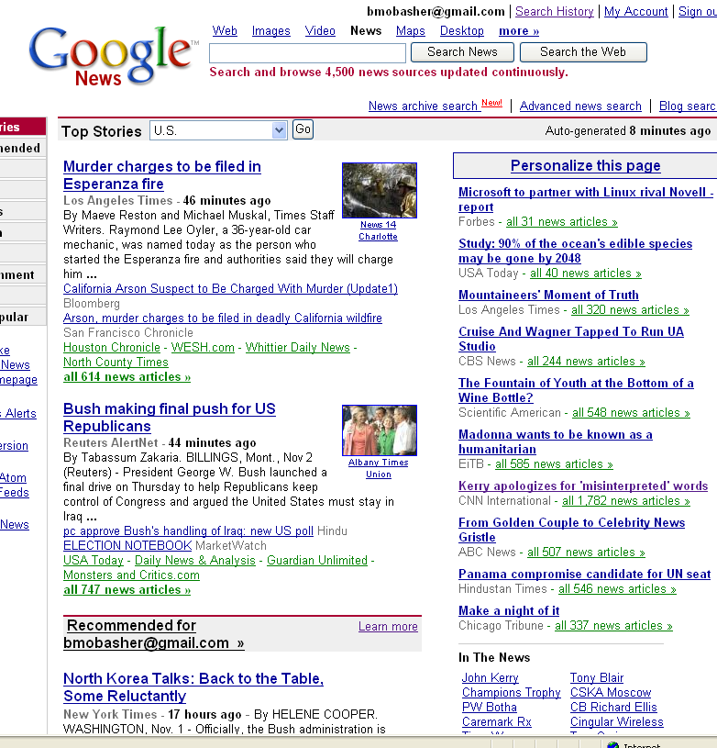
Content-Based Recommender Systems

Slide 14

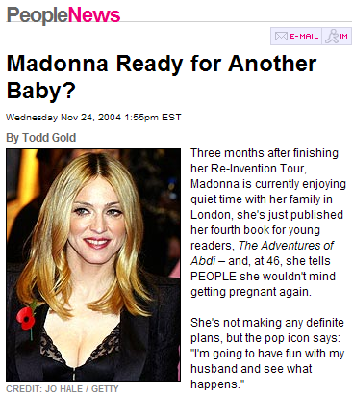
Content-Based Recommenders:
Personalized Search
How can the search engine determine the “user’s context”?
?
Query: “Madonna and Child”
?
Need to “learn” the user profile:
  User is an art historian?
  User is a pop music fan?

Slide 15
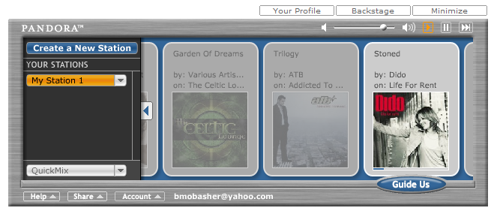
Content-Based Recommenders
Music recommendations
Play list generation
Example: Pandora

Slide 16
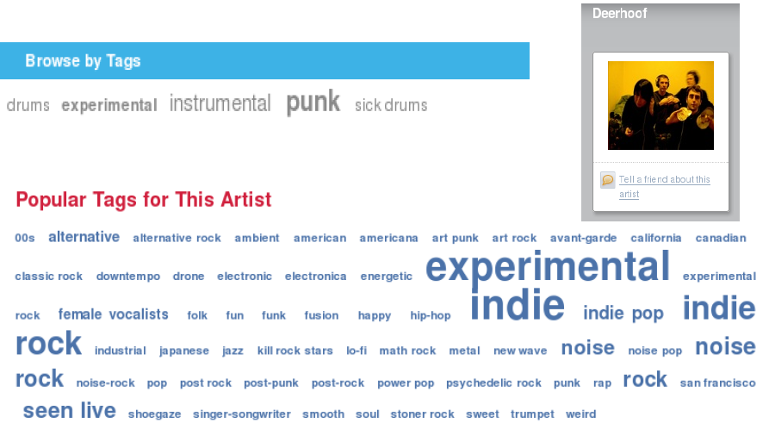
Social / Collaborative Tags

Slide 17
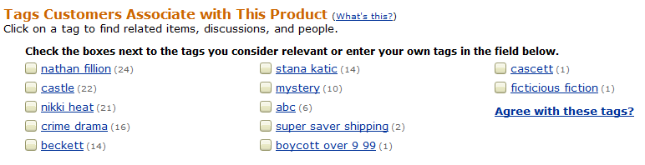

Example: Tags describe the Resource
Tags can describe
  The resource (genre, actors, etc)
  Organizational (toRead)
  Subjective (awesome)
  Ownership (abc)
  etc

Slide 18
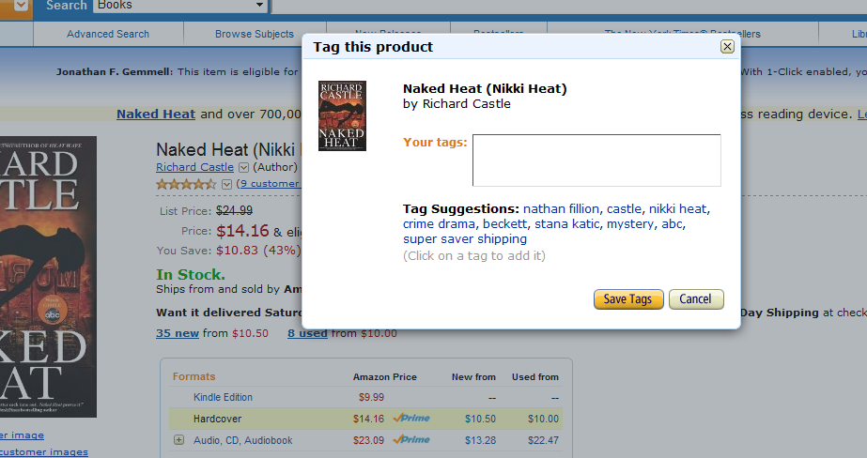
Tag Recommendation

Slide 19
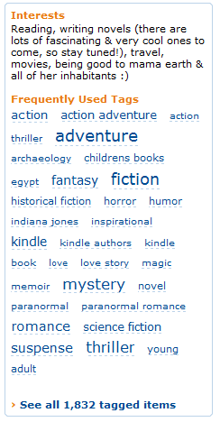
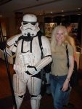

Tags describe the user
These systems are “collaborative.”
  Recommendation / Analytics based on the “wisdom of crowds.”
Rai Aren's profile
co-author
“Secret of the Sands"

Slide 20
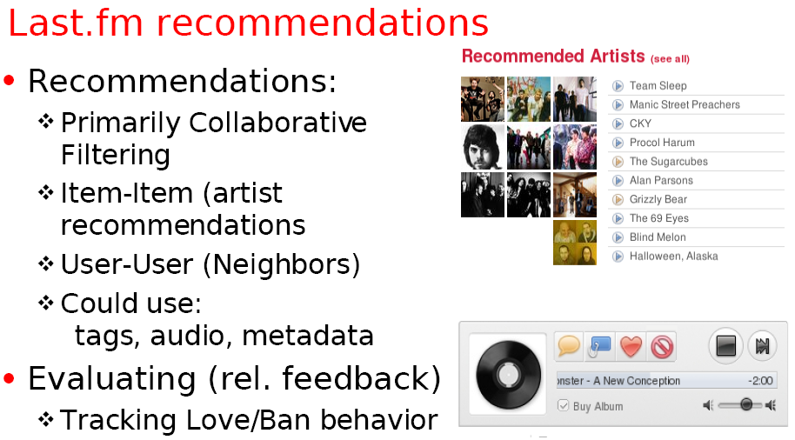
Example: Using Tags for Recommendation

Slide 21

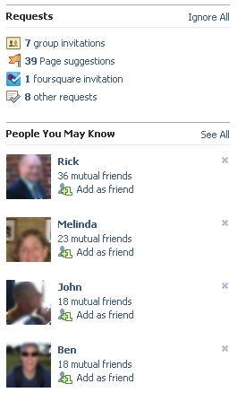
Social Recommendation
A form of collaborative filtering using social network data
  Users profiles represented as sets of links to other nodes (users or items) in the network
  Prediction problem: infer a currently non-existent link in the network

