Slide 1
Relevance Feedback and Personalization
Part I
CSC 575
Intelligent Information Retrieval

Slide 2
Topics
  Last Lecture: Query Expansion
    Thesaurus based
    Automatic global and local analysis
    Word Embeddings
  This Lecture:
    Relevance Feedback & Query modification
      Rocchio Method
    Personalization & Recommendation
      Collaborative & Content-Based Filtering

Slide 3
Query Modification & Relevance Feedback
Problem: how to reformulate the query?
  Thesaurus expansion:
    add terms similar to query terms (e.g., synonyms, cooccurrences)
  Relevance feedback:
    add terms that appear in retrieved documents that have been judged (by the user) to be relevant
Relevance Feedback
  Has been shown to significantly increase precision of retrieval
  Modify existing query based on relevance judgements
    extract terms from relevant documents and add them to the query
    possibly remove terms appear frequently in non-relevant documents
    and/or re-weight the terms already in the query
  Two main approaches:
    Users select relevant documents
    Automatic (pseudo) relevance feedback

Slide 4
Lexical analysis and stop words
Information
need
Collections
Pre-process
text input
Parse
Query
Index
Term Selection and
Weighting
Reformulated
Query
Rank
Matching / ranking algorithms
Relevance
Feedback
Result
Sets

Slide 5
Query Reformulation in
Vector Space Model
Change query vector using vector algebra.
Add the vectors for the relevant documents to the query vector.
Subtract the vectors for the irrelevant docs from the query vector.
This adds both positively and negatively weighted terms to the query as well as reweighting the initial terms.

Slide 6
Rocchio’s Method (1971)

Slide 7
Rocchio’s Method
Rocchio’s Method automatically
  re-weights terms
  adds in new terms (from relevant docs)
Positive v. Negative feedback
  Positive moves query closer to relevant documents
  Negative moves query away from non-relevant documents (but, not necessarily closer to relevant ones)
    negative feedback doesn’t always improve effectiveness
    some systems only use positive feedback
Some machine learning methods are proving to work better than standard IR approaches like Rocchio
Positive Feedback
Negative Feedback

Slide 8
Rocchio’s Method: Example
Term weights and relevance judgements for 3 documents returned after submitting the query Q₀
Assume β = 0.5 and γ = 0.25
Q₁ = (3, 0, 0, 2, 0) + [0.5*(2+1, 4+3, 0, 0, 2) ]/2 - 0.25*(0, 0, 4, 3, 3)
= (3.75, 1.75, 0, 1.25, 0)
(Note: negative entries are changed to zero)

Slide 9
Rocchio’s Method: Example
Q₀ = (3, 0, 0, 2, 0)
Q₁ = (3.75, 1.75, 0, 1.25, 0)
Using the new query and computing similarities using
Dot product, gives the following results
Some Observations:
  Note that initial query resulted in high score for D3, though it was not relevant to the user (due to the weight of term 4)
    In general, fewer terms in the query, the more likely a particular term could result in non-relevant results
    New query decreased score of D3 and increased those of D1 and D2
  Also note that new query added a weight for term 2
    Initially it may not have been in user’s vocabulary
    It was added because it appeared as significant in enough relevant documents

Slide 10
Pseudo Relevance Feedback
Use relevance feedback methods without explicit user input.
Just assume the top m retrieved documents are relevant and use them to reformulate the query.
Allows for query expansion that includes terms that are correlated with the query terms.
Found to improve performance on TREC competition ad-hoc retrieval task.
Works even better if top documents must also satisfy additional Boolean constraints in order to be used in feedback.

Slide 11
Alternative Notions of Relevance Feedback
With advent of WWW, many alternate notions have been proposed for information filtering
  Find people “similar” to you; return documents/items they found relevant
  Follow user’s activities (click-throughs, prior search queries, documents viewed, items liked/selected, etc.); then use their features/topics to find similar documents/items
Several different criteria to consider:
  Implicit vs. explicit judgements by users on items
  Individual vs. group judgements
  Standing vs. dynamic profiles
  Similarity of the items vs. similarity of users

Slide 12
Personalization
Alternative notions of relevance feedback have one thing in common - personalization
Personalization concerns adapting to the individual needs, interests, and preferences of each user
Includes:
  Recommending items
  Information filtering
  Predicting (e.g. form or sentence completion)
From a business perspective, it is viewed as part of Customer Relationship Management (CRM).

Slide 13
Machine Learning and Personalization
Machine Learning can allow learning a user model or profile of a particular user based on:
  History of interactions
  Rated examples
This model or profile can then be used to:
  Recommend items
  Filter information
  Predict behavior

Slide 14
The Recommendation Task
Basic formulation as a prediction problem
Typically, the profile P_{u} contains preference scores by u on some other items, {i₁, …, i_{k}} different from it
  preference scores on i₁, …, i_{k} may have been obtained explicitly (e.g., movie ratings) or implicitly (e.g., time spent on a product page, news article, etc.)
Given a profile P_{u} for a user u, and a target item i_{t}, predict the preference score of user u on item i_{t}

Slide 15




User Preferences
Ratings
Binary Feedback
Reviews
Behaviors
Explicit
Implicit

Slide 16
Preferences as Ratings
 | T1 | T2 | T3 | T4 | T5 | T6 | T7 | T8
U1 | 4 |  | 3 | 4 |  | 2 |  | 5
U2 |  | 3 | 4 | 2 | 5
U3 |  | 4 |  | 4 |  | 2 | 2 | 4
U4 | 3 |  | 5 |  | 2 | 4
U5 | 2 | 5 |  | 2 |  | 4 | ? | 4

Slide 17
Recommendation as Rating Prediction
Two types of entities: Users and Items
Utility of item i for user u is represented by some rating r (where r ∈ Rating) → could be explicit or implicit
Each user typically rates a subset of items
Recommender system then tries to estimate the unknown ratings, i.e., to extrapolate rating function R based on the known ratings:
  R: Users × Items → Rating
The recommendations to each user are made by offering items with highest predicted rating

Slide 18
Traditional Recommendation Approaches
Collaborative Filtering
  Give recommendations to a user based on preferences of “similar” users
Content-Based Filtering
  Give recommendations to a user based on items with “similar” content in the user’s profile
Rule-Based (Knowledge-Based) Filtering
  Provide recommendations to users based on predefined (or learned) rules
  age(x, 25-35) and income(x, 70-100K) and children(x, >=3) → recommend(x, Minivan)
Combined or Hybrid Approaches

Slide 19
Collaborative Recommenders
Neighborhood-Based Models
User-Based:
  For a target user u, find the top k most similar users (based on their rating profiles) who have rated the target item
  k-nearest-neighbor (knn) strategy
  Predicted rating on target item is weighted average of ratings by the neighbors.
Item-based Collaborative Filtering
  item-item similarities are computed in space of ratings
    two items are similar if they are rated similarly by users
  prediction for target item is computed based on user u’s own ratings on the k most similar items

Slide 20

Collaborative Recommender Systems

Slide 21

Collaborative Recommender Systems

Slide 22

Collaborative Recommender Systems

Slide 23

Collaborative Recommender Systems

Slide 24
Collaborative Filtering
“Social Learning”
  idea is to give recommendations to a user based on the “ratings” of objects by other users
  usually assumes that features in the data are similar objects (e.g., Web pages, music, movies, etc.)
  usually requires “explicit” ratings of objects by users based on a rating scale
  there have been some attempts to obtain ratings implicitly based on user behavior (mixed results; problem is that implicit ratings are often binary)
Will Karen like “Independence Day?”

Slide 25
Collaborative Filtering: Nearest-Neighbor Strategy
Basic Idea:
  find other users that are most similar preferences or tastes to the target user
  Need a metric to compute similarities among users (usually based on their ratings of items)
Pearson Correlation
  Similarity based on the degree of correlation between user U and user J
  1 means very similar, 0 means no correlation, -1 means dissimilar
Average rating of user J
on all items.

Slide 26
Collaborative Filtering: Making Predictions
When generating predictions from the nearest neighbors, neighbors can be weighted based on their distance to the target user
To generate predictions for a target user a on an item i:
  r_{a} = mean rating for user a
  u₁, …, u_{k} are the k-nearest-neighbors to a
  r_{u,i} = rating of user u on item I
  sim(a,u) = Pearson correlation between a and u
This is a weighted average of deviations from the neighbors’ mean ratings (and closer neighbors count more)

Slide 27

Example Collaborative System
Using k-nearest neighbor with k = 3
 | Item1 | Item 2 | Item 3 | Item 4 | Item 5 | Item 6 | Mean Rating | Correlation with Alice
Alice | 5 | 2 | 3 | 3 |  | ? | 3.25
User 1 | 2 |  | 4 |  | 4 | 1 | 2.75 | -1.00
User 2 | 2 | 1 | 3 |  | 1 | 2 | 1.8 | 0.33
User 3 | 4 | 2 | 3 | 2 |  | 1 | 2.4 | .90
User 4 | 3 | 3 | 2 |  | 3 | 1 | 2.4 | 0.19
User 5 |  | 3 |  | 2 | 2 | 2 | 2.25 | -1.00
User 6 | 5 | 3 |  | 1 | 3 | 2 | 2.8 | 0.65
User 7 |  | 5 |  | 1 | 5 | 1 | 3.0 | -1.00
$$\text{Pred}\text{(}\text{Alice}\text{,}\text{Item}\text{6}\text{) = 3.25 + }\frac{.9×(1−2.4)+.65×(2−2.8)+0.33×(2−1.8)}{\left|0.9+.65+.33\right|}$$
$=3.25+ \frac{−1.854}{1.88}$ = 3.25 – 0.986 = 2.26

Slide 28
Distance or Similarity Measures
Pearson Correlation
  Works well in case of user ratings (where there is at least a range of 1-5)
  Not always possible (in some situations we may only have implicit binary values, e.g., whether a user did or did not select a document)
  Alternatively, a variety of distance or similarity measures can be used
Common Distance Measures:
  Manhattan distance:
  Euclidean distance:
  Cosine similarity:

Slide 29
Item-based Collaborative Filtering
Find similarities among the items based on ratings across users
  Often measured based on a variation of Cosine measure
Prediction of item I for user a is based on the past ratings of user a on items similar to i.
Suppose:
Predicted rating for Karen on Indep. Day will be 7, because she rated Star Wars 7
  That is if we only use the most similar item
  Otherwise, we can use the k-most similar items and again use a weighted average
sim(Star Wars, Indep. Day) > sim(Jur. Park, Indep. Day) > sim(Termin., Indep. Day)

Slide 30
Item-based Collaborative Filtering
Compute item similarities based on user ratings
  Columns of the rating matrix
  Item-Item similarities computed offline
Find k most similar items to the target item
Compute predictions based on the target user’s own ratings of the peer items
  Weighted average based on similarity to the target item

Slide 31



Item-based Collaborative Filtering
Note that Pearson
normalized by
subtracting the
row (user) mean
Item-based definition would imply subtracting item mean
  “adjusted cosine”
Predictions:
mean-adjusted
rating for item j
top-k matching items to
item t, where user u has ratings

Slide 32
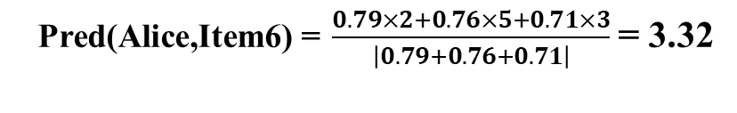
Item-Based Collaborative Filtering
 | Item1 | Item 2 | Item 3 | Item 4 | Item 5 | Item 6
Alice | 5 | 2 | 3 | 3 |  | ?
User 1 | 2 |  | 4 |  | 4 | 1
User 2 | 2 | 1 | 3 |  | 1 | 2
User 3 | 4 | 2 | 3 | 2 |  | 1
User 4 | 3 | 3 | 2 |  | 3 | 1
User 5 |  | 3 |  | 2 | 2 | 2
User 6 | 5 | 3 |  | 1 | 3 | 2
User 7 |  | 5 |  | 1 | 5 | 1
Cosine sim to Item 6 | 0.76 | 0.79 | 0.60 | 0.71 | 0.75
Item mean | 3.5 | 2.71 | 3 | 1.8 | 3 | 1.43
Example with standard Cosine similarity (k = 3)
Exercise: do this with adjusted Cosine
$\text{Pred}\text{(}\text{Alice}\text{,}\text{Item}\text{6}\text{) =} \frac{0.79×2+0.76×5+0.71×3}{\left|0.79+0.76+0.71\right|}$ = 3.32

Slide 33
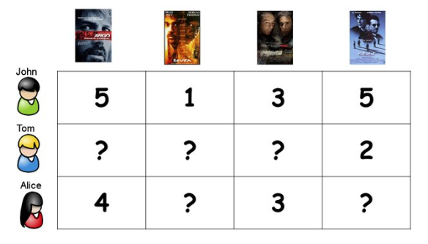

Model-Based Collaborative Filtering
Given observed (user, item) ratings, learn a model that predicts the missing ratings

Slide 34
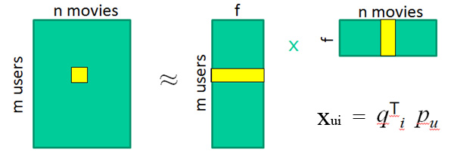
Model-Based Collaborative Filtering
Matrix Factorization (MF), Y. Koren, et al., 2009
User | HarryPotter | Batman | Spiderman
U1 | 5 | 3 | 4
U2 | ? | 2 | 4
U3 | 4 | 2 | ?
Identify latent (unobserved) factors that “explain” observations in the data (ratings).
The factors may represent combinations of features or characteristics of items and users that result in the ratings
R
P
Q

Slide 35
Matrix Factorization
R
P
Q
R = Rating Matrix, m users, n movies;
P = User Matrix, m users, f latent factors/features;
Q = Item Matrix, n movies, f latent factors/features;
pu indicates how much user likes f latent factors;
qi means how much an item is related to f latent factors;
The dot product indicates how much user likes item;

Slide 36
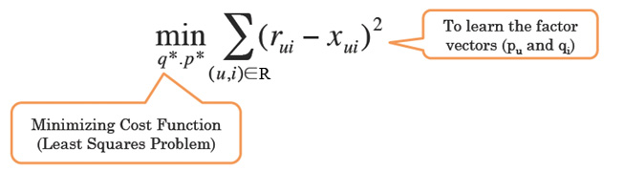
Matrix Factorization
Goal: learn P and Q by minimizing the squared error
goodness of fit
regularization
min_{q,p} Σ _{(u,i) ε R} ( r_{ui} - q^{t}_{i} p_{u} )² + λ (|q_{i}|² + |p_{u}|² )
Goodness of fit: to reduce the prediction errors;
Regularization term: to alleviate the overfitting;

Slide 37

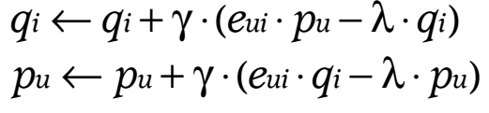
Matrix Factorization
Goal: learn P and Q by minimizing the squared error
goodness of fit
regularization
min_{q,p} Σ _{(u,i) ε R} ( r_{ui} - q^{t}_{i} p_{u} )² + λ (|q_{i}|² + |p_{u}|² )
By using Stochastic Gradient Descent (SGD) or Alternating Least
Squares (ALS), we are able to learn the P and Q iteratively.

Slide 38





Matrix Factorization
P_{k} | Dim1 | Dim2
Alice | 0.47 | -0.30
Bob | -0.44 | 0.23
Mary | 0.70 | -0.06
Sue | 0.31 | 0.93
Q_{k}^{T}
Dim1 | -0.44 | -0.57 | 0.06 | 0.38 | 0.57
Dim2 | 0.58 | -0.66 | 0.26 | 0.18 | -0.36
Rating Prediction:

Slide 39
Evaluation: Rating Prediction
Many evaluation metrics measure error rate
  Differences between actual ratings in a test set (a portion of ratings set aside a not used for training) and the predicted rating
Mean Absolute Error (MAE)
  computes the deviation between
  predicted and actual ratings
Root Mean Squared Error (RMSE)
  similar to MAE, but places more emphasis
  on larger deviation
Other evaluation metrics:
  Mean reciprocal rank, Precision/Recall, NDCG, Coverage
  many more …

Slide 40


Evaluation: Rating Prediction
User | Item | Rating
U1 | T1 | 4
U1 | T2 | 3
U1 | T3 | 3
U2 | T2 | 4
U2 | T3 | 5
U2 | T4 | 5
U3 | T4 | 4
U1 | T4 | 3
U2 | T1 | 2
U3 | T1 | 2
U3 | T2 | 3
U3 | T3 | 4
P(U, T) in testing set
Prediction error:
e = R(U, T) – P(U, T)
Mean Absolute Error (MAE) =
Other evaluation metrics:
RMSE
Mean reciprocal rank
Precision/Recall
NDCG
Coverage
many more …
Train
Test

