Slide 1
Implementation Issues in IR Indexing
CSC 575
Intelligent Information Retrieval

Slide 2
Lexical analysis and stop words
Information
need
Collections
Pre-process
text input
Parse
Query
Index
How is
the index
constructed?
Rank
Result
Sets

Slide 3
Indexing Implementation
Inverted Indexes
Primary data structure for text indexes
Source file: collection, organized by document
Inverted Index: collection organized by term (one record per term, listing locations where term occurs)
Query: traverse lists for each query term
OR: the union of component lists
AND: an intersection of component lists
Based on the view of documents as vectors in n-dimensional space
n = number of index terms used for indexing
Each document is a bag of words (vector) with a direction and a magnitude
The Vector-Space Model for IR

Slide 4
The Vector Space Model
Vocabulary V = the set of terms left after pre-processing the text (tokenization, stop-word removal, stemming, ...).
Each document or query is represented as a |V| = n dimensional vector:
d_{j} = [w_{1j}, w_{2j}, ..., w_{nj}].
w_{ij} is the weight of term i in document j.
the terms in V form the orthogonal dimensions of a vector space
Document = Bag of words:
Vector representation doesn’t consider the ordering of words:
John is quicker than Mary vs. Mary is quicker than John.

Slide 5
Document Vectors and Indexes
Conceptually, the index can be viewed as a document-term matrix
Each document is represented as an n-dimensional vector (n = no. of terms in the dictionary)
Term weights represent the scalar value of each dimension in a document
The inverted file structure is an “implementation model” used in practice to store the information captured in this conceptual representation
The dictionary
Document Ids
nova galaxy heat hollywood film role diet fur
A 1.0 0.5 0.3
B 0.5 1.0
C 1.0 0.8 0.7
D 0.9 1.0 0.5
E 1.0 1.0
F 0.9 1.0
G 0.5 0.7 0.9
H 0.6 1.0 0.3 0.2 0.8
I 0.7 0.5 0.1 0.3
Term Weights
(in this case
normalized)
a document
vector

Slide 6
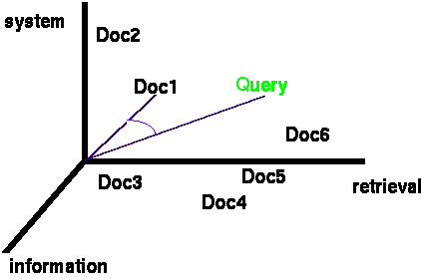
Example: Documents and Query in 3D Space
Documents in term space
Terms are usually stems
Documents (and the query) are represented as vectors of terms
Query and Document weights
based on length and direction of their vector
Why use this representation?
A vector distance measure between the query and documents can be used to rank retrieved documents

Slide 7
How Are Inverted Files Created
Sorted Array Implementation
Documents are parsed to extract tokens. These are saved with the Document ID.
Doc 1
Doc 2
Now is the time
for all good men
to come to the aid
of their country
It was a dark and
stormy night in
the country
manor. The time
was past midnight

Slide 8
How Inverted Files are Created
After all documents have been parsed and the inverted file is sorted (with duplicates retained for within document frequency stats)
If frequency information is not needed, then inverted file can be sorted with duplicates removed.

Slide 9
How Inverted Files are Created
Multiple term entries for a single document are merged
Within-document term frequency information is compiled
If proximity operators are needed, then the location of each occurrence of the term must also be stored.
Terms are usually represented by unique integers to fix and minimize storage space.

Slide 10
How Inverted Files are Created
Then the file can be split into a Dictionary and a Postings file
Dictionary
Postings

Slide 11
Inverted Indexes and Queries
Permit fast search for individual terms
For each term, you get a hit list consisting of:
document ID
frequency of term in doc
position of term in doc (optional)
These lists can be used to solve quickly Boolean queries:
country ==> {d1, d2}
manor ==> {d2}
country AND manor ==> {d2}
Full advantage of this structure can taken by statistical ranking algorithms such as the vector space model
in case of Boolean queries, term or document frequency information is not used (just set operations performed on hit lists)

Slide 12
Scalability Issues: Number of Postings
An Example: Reuters RCV1 Collection
Number of docs = m = 800,000
Average tokens per doc: 200
Number of distinct terms = n = 400K
100 million (non-positional) postings in the inverted index

Slide 13
Bottleneck
Parse and build postings entries one doc at a time
Sort postings entries by term (then by doc within each term)
Doing this with random disk seeks would be too slow – must sort N=100M records
If every comparison took 2 disk seeks (10 milliseconds
each), and N items could be sorted with N log₂N
comparisons, how long would this take?

Slide 14
Sorting with fewer disk seeks
12-byte (4+4+4) records (term, doc, freq)
These are generated as we parse docs
Must now sort these 12-byte records by term
Define a Block (e.g., ~ 10M) records
Blocks defined such that each block can fit in memory
Sort within blocks first (in memory) and write to disk, then merge the blocks into one long sorted order.
Blocked Sort-Based Indexing (BSBI)

Slide 15
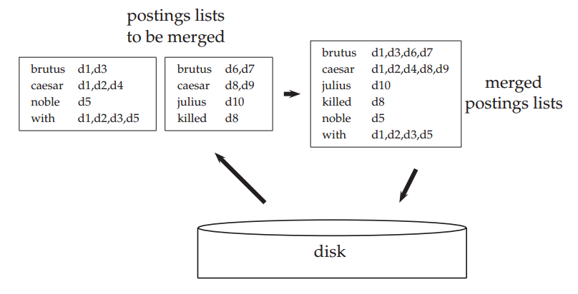
Blocked Sort-Based Indexing - Example
BSBI Example with two blocks: The two blocks (“postings lists to be merged”) are loaded from disk into memory, merged in memory (“merged postings lists”) and written back to disk. Terms are shown instead of termIDs for better readability.

Slide 16
Problem with Sort-Based Algorithm
Sec. 4.3
Assumption: we can keep the dictionary in memory.
We need the dictionary (which grows dynamically) in order to implement a term to termID mapping.
Actually, we could work with term, docID postings instead of termID, docID postings . . .
. . . but then intermediate files become very large. (We would end up with a scalable, but very slow index construction method.)

Slide 17
SPIMI: Single-pass in-memory indexing
Sec. 4.3
Key idea 1: Generate separate dictionaries for each block – no need to maintain term-termID mapping across blocks.
Key idea 2: Don’t sort. Accumulate postings in postings lists as they occur.
With these two ideas we can generate a complete inverted index for each block.
These separate indexes can then be merged into one big index.

Slide 18
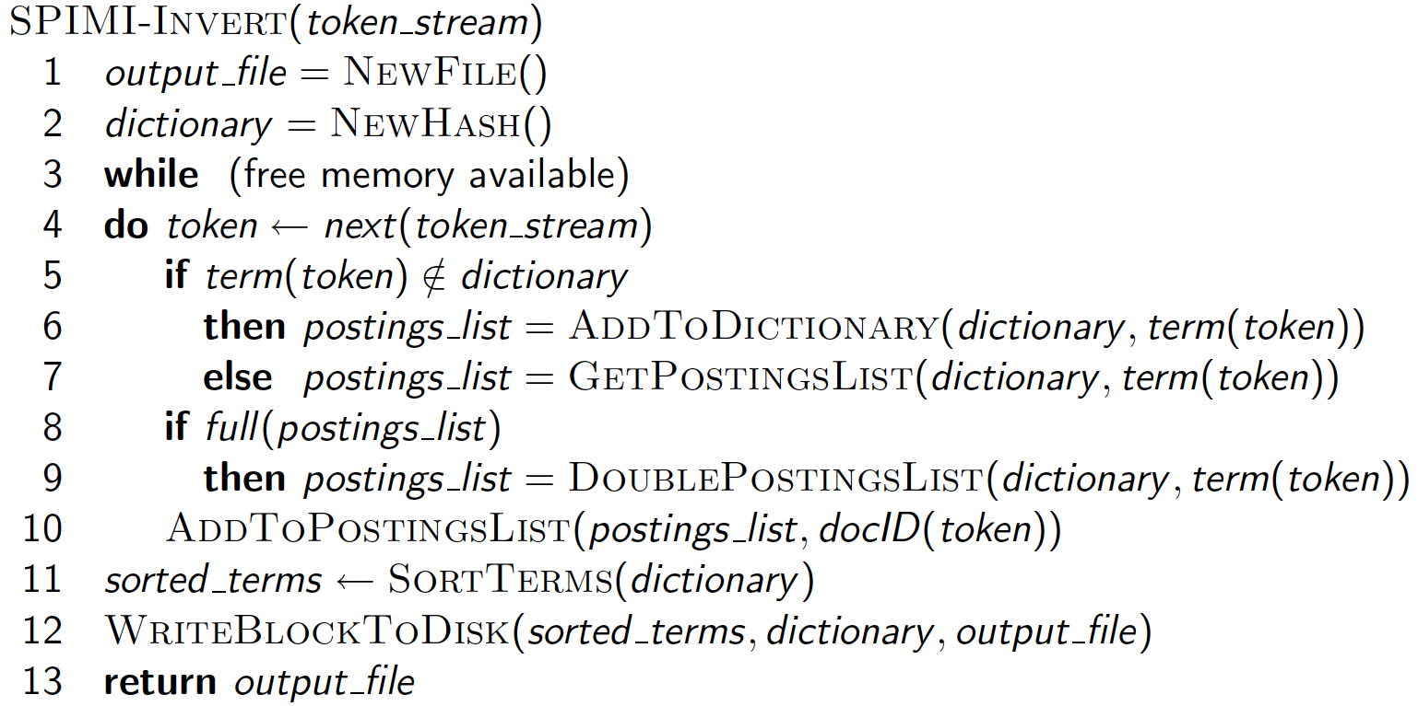
SPIMI-Invert
Sec. 4.3
Sec. 4.3, IR Book
Merging of blocks is analogous to BSBI.

Slide 19
Distributed indexing
For web-scale indexing
must use a distributed computing cluster
Individual machines are fault-prone
Can unpredictably slow down or fail
How do we exploit such a pool of machines?
Maintain a master machine directing the indexing job – considered “safe”.
Break up indexing into sets of (parallel) tasks.
Master machine assigns each task to an idle machine from a pool.

Slide 20
Parallel tasks
Use two sets of parallel tasks
Parsers
Inverters
Break the input document corpus into splits
Each split is a subset of documents
E.g., corresponding to blocks in BSBI
Master assigns a split to an idle parser machine
Parser reads a document at a time and emits (term, doc) pairs
writes pairs into j partitions
Each partition is for a range of terms’ first letters (e.g., a-f, g-p, q-z) – here j = 3.
Inverter collects all (term, doc) pairs for a partition; sorts and writes to postings list

Slide 21
Data flow
Sec. 4.4
assign
Master
assign
Postings
Parser
a-f
g-p
q-z
Inverter
a-f
Parser
a-f
g-p
q-z
Inverter
g-p
splits
Inverter
q-z
Parser
a-f
g-p
q-z
Map
phase
Reduce
phase
Segment files

Slide 22
Example for index construction
Caesar
Map:
d1 : C came, C c’ed.
d2 : C died.
→
<C,d1>, <came,d1>, <C,d1>, <c’ed, d1>, <C, d2>, <died,d2>
Reduce:
(<C,(d1,d1,d2)>, <died,(d2)>, <came,(d1)>, <c’ed,(d1)>)
→
(<C,(d1:2,d2:1)><died,(d2:1)>, <came,(d1:1)>,<c’ed,(d1:1)>)
conquered

Slide 23
Dynamic indexing
Problem:
Docs come in over time
postings updates for terms already in dictionary
new terms added to dictionary
Docs get deleted
Simplest Approach
Maintain a “big” main index
New docs go into a “small” auxiliary index
Search across both, merge results
Deletions
Invalidation bit-vector for deleted docs
Filter docs output on a search result by this invalidation bit-vector
Periodically, re-index into one main index

Slide 24
Index on disk vs. memory
Most retrieval systems keep the dictionary in memory and the postings on disk
Web search engines frequently keep both in memory
massive memory requirement
feasible for large web service installations
less so for commercial usage where query loads are lighter

Slide 25
Retrieval From Indexes
Given the large indexes in IR applications, searching for keys in the dictionaries becomes a dominant cost
Two main choices for dictionary data structures: Hashtables or Trees
Using Hashing
requires the derivation of a hash function mapping terms to locations
may require collision detection and resolution for non-unique hash values
Using Trees
Binary search trees
nice properties, easy to implement, and effective
enhancements such as B+ trees can improve search effectiveness
but, requires the storage of keys in each internal node

Slide 26
Hashtables
Sec. 3.1
Each vocabulary term is hashed to an integer
(We assume you’ve seen hashtables before)
Pros:
Lookup is faster than for a tree: O(1)
Cons:
No easy way to find minor variants:
judgment/judgement
No prefix search
If vocabulary keeps growing, need to occasionally do the expensive operation of rehashing everything

Slide 27
Trees
Sec. 3.1
Simplest: binary tree
More usual: B-trees
Trees require a standard ordering of characters and hence strings … but we typically have one
Pros:
Solves the prefix problem (e.g., terms starting with hyp)
Cons:
Slower: O(log M) [and this requires balanced tree]
Rebalancing binary trees is expensive
But B-trees mitigate the rebalancing problem

Slide 28
Tree: binary tree
Sec. 3.1
Root
a-m
n-z
a-hu
hy-m
n-sh
si-z
aardvark
huygens
sickle
zygot

Slide 29
Tree: B-tree
Sec. 3.1
a-hu
n-z
hy-m
Definition: Every internal node has a number of children in the interval [a,b] where a, b are appropriate natural numbers, e.g., [2,4].

Slide 30
Indexing Implementation
We will discuss some specific algorithms and constructs for implementing and searching Vector Space Inverted indexes later
But, First, we’ll look more closely at “indexing models” which refer to different models for associating weights to terms in the index

