Slide 1
Content Analysis &
Statistical Properties of Text
CSC 575
Intelligent Information Retrieval

Slide 2
Content Analysis
Automated indexing relies on some form of content analysis to identify index terms
Content analysis: automated transformation of raw text into a form that represent some aspect(s) of its meaning
Including, but not limited to:
  Automated Thesaurus Generation
  Phrase Detection
  Categorization
  Clustering
  Summarization

Slide 3
Techniques for Content Analysis
Statistical
  Single Document
  Full Collection
Linguistic
  Syntactic
    analyzing the syntactic structure of documents
  Semantic
    identifying the semantic meaning of concepts within documents
  Pragmatic
    using information about how the language is used (e.g., co-occurrence patterns among words and word classes)
Knowledge-Based (Artificial Intelligence)
Hybrid (Combinations)
Generally rely on the statistical properties of text such as term frequency and document frequency

Slide 4
Statistical Properties of Text
Zipf’s Law models the distribution of terms in a corpus:
  How many times does the kth most frequent word appears in a corpus of size N words?
  Important for determining index terms and properties of compression algorithms.
Heap’s Law models the number of words in the vocabulary as a function of the corpus size:
  What is the number of unique words appearing in a corpus of size N words?
  This determines how the size of the inverted index will scale with the size of the corpus .

Slide 5
Statistical Properties of Text
Token occurrences in text are not uniformly distributed
They are also not normally distributed
They do exhibit a Zipf distribution
What Kinds of Data Exhibit a
Zipf Distribution?
  Words in a text collection
  Library book checkout patterns
  Document Size on Web (Cunha & Crovella)
  Length of Web navigational sequences (Cooley, Mobasher, Srivastava)
  Item popularity in E-Commerce
  Number of movies/artists selected/rated in streaming services
frequency
rank

Slide 6
Zipf Distribution
The product of the frequency of words (f) and their rank (r) is approximately constant
  Rank = order of words in terms of decreasing frequency of occurrence
Main Characteristics
  a few elements occur very frequently
  many elements occur very infrequently
  frequency of words in the text falls very rapidly
frequency
where N is the total number of term occurrences
rank

Slide 7
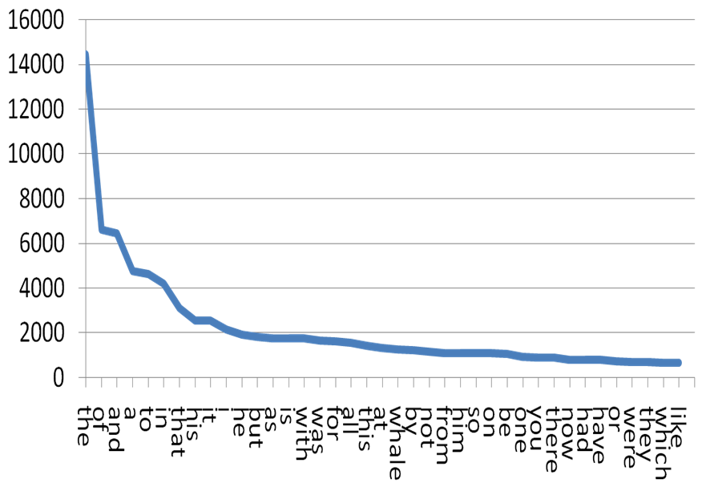
Word Distribution
Frequency vs. rank for top words in Moby Dick
Notes:
Heavy tail: many rare events.

Slide 8
Example of Frequent Words
Frequencies from 336,310 documents in the 1 GB TREC Volume 3 Corpus
  125,720,891 total word occurrences
  508,209 unique words

Slide 9
Zipf’s Law and Indexing
The most frequent words are poor index terms
  they occur in almost every document
  they usually have no relationship to the concepts and ideas represented in the document
Extremely infrequent words are poor index terms
  may be significant in representing the document
  but, very few documents will be retrieved when indexed by terms with the frequency of one or two
Index terms in between
  a high and a low frequency threshold are set
  only terms within the threshold limits are considered good candidates for index terms

Slide 10
Resolving Power
Zipf (and later H.P. Luhn) postulated that the resolving power of significant words reached a peak at a rank order position half way between the two cut-offs
  Resolving Power: the ability of words to discriminate content
Resolving power of
significant words
frequency
The actual cut-off
are determined by
trial and error, and
often depend on the
specific collection.
rank
upper
cut-off
lower
cut-off

Slide 11
Vocabulary vs. Collection Size
How big is the term vocabulary?
  That is, how many distinct words are there?
Can we assume an upper bound?
  Not really upper-bounded due to proper names, typos, etc.
In practice, the vocabulary will keep growing with the collection size.

Slide 12
Heap’s Law
Given:
  M, the size of the vocabulary.
  T, the number of distinct tokens in the collection.
Then:
  M = kT^{b}
  k, b depend on the collection type:
    typical values: 30 ≤ k ≤ 100 and b ≈ 0.5
    in a log-log plot of M vs. T, Heaps’ law predicts a line with slope of about ½.

Slide 13
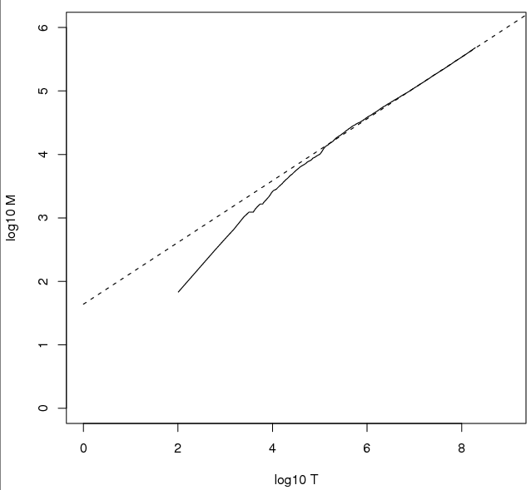
Heap’s Law Fit to Reuters RCV1
For RCV1, the dashed line
log₁₀M = 0.49 log₁₀T + 1.64 is the best least squares fit.
Thus, M = 10^{1.64}T^{0.49} so k = 10^{1.64} ≈ 44 and b = 0.49.
For first 1,000,020 tokens:
  Law predicts 38,323 terms;
  Actually, 38,365 terms.
  ⇒ Good empirical fit for RCV1!

Slide 14
Collocation (Co-Occurrence)
Co-occurrence patterns of words and word classes reveal significant information about how a language is used
  pragmatics
Used in building dictionaries (lexicography) and for IR tasks such as phrase detection, query expansion, etc.
Co-occurrence based on text windows
  typical window may be 100 words
  smaller windows used for lexicography, e.g. adjacent pairs or 5 words
Typical measure is the expected mutual information measure (EMIM)
  compares probability of occurrence assuming independence to probability of co-occurrence.

Slide 15
Statistical
Independence vs. Dependence
How likely is a red car to drive by given we’ve seen a black one?
How likely is word W to appear, given that we’ve seen word V?
Color of cars driving by are independent (although more frequent colors are more likely)
Words in text are (in general) not independent (although again more frequent words are more likely)

Slide 16
Probability of Co-Occurrence
Compute for a window of words
a b c d e f g h i j k l m n o p
w1
w11
w21

Slide 17
Lexical Associations
Subjects write first word that comes to mind
  doctor/nurse; black/white (Palermo & Jenkins 64)
Text Corpora yield similar associations
One measure: Mutual Information (Church and Hanks 89)
If word occurrences were independent, the numerator and denominator would be equal (if measured across a large collection)

Slide 18
Interesting Associations with “Doctor”
(AP Corpus, N=15 million, Church & Hanks 89)

Slide 19
Un-Interesting Associations with “Doctor”
(AP Corpus, N=15 million, Church & Hanks 89)
These associations were likely to happen because the non-doctor words shown here are very common and therefore likely to co-occur with any noun.

Slide 20
Content Analysis &
Statistical Properties of Text
CSC 575
Intelligent Information Retrieval

