Slide 1
Overview of Information Retrieval and Organization
CSC 575
Intelligent Information Retrieval

Slide 2
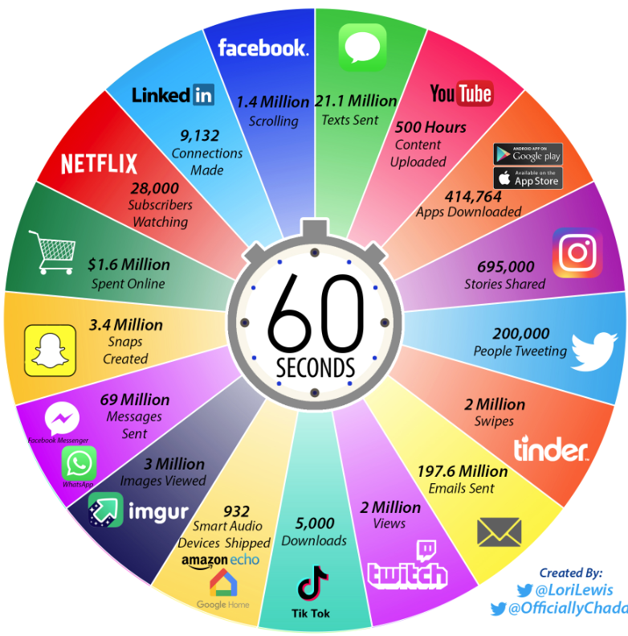
2021: What
Happens in An
Internet Minute
Notes:
This picture illustrates the scale and scope of data transmitted across the internet in one minute. And the future growth is staggering. Much of this data is generated as a result of user interactions with a variety of online applications. What distinguishes the current social web from the web in the 90s and early 2000’s is the ability of users to share content and resources, and to interact. All of this leads to the generation and collection of vast amounts of data.
The ability of all of these systems and companies to effectively serve their users depends on how successfully they mine, analyze, and leverage this data.

Slide 3
Information Overload
“The greatest problem of today is how to teach people to ignore the irrelevant, how to refuse to know things, before they are suffocated. For too many facts are as bad as none at all.” (W.H. Auden)

Slide 4
Information Retrieval
Information Retrieval (IR) is finding material (usually documents) of an unstructured nature (usually text) that satisfies an information need from within large collections (usually stored on computers).
Most prominent example: Web Search Engines

Slide 5
Web Search System
Web
Spider/Crawler
Document
corpus
IR
System
Query String
1. Page1
2. Page2
3. Page3
.
.
Ranked
Documents

Slide 6
IR v. Database Systems
Emphasis on effective, efficient retrieval of unstructured (or semi-structured) data
IR systems typically have very simple schemas
Query languages emphasize free text and Boolean combinations of keywords
Matching is more complex than with structured data (semantics is less obvious)
  easy to retrieve the wrong objects
  need to measure the accuracy of retrieval
Less focus on concurrency control and recovery (although update is very important).

Slide 7
IR on the Web vs. Classsic IR
Input: publicly accessible Web
Goal: retrieve high quality pages that are relevant to user’s need
  static (text, audio, images, etc.)
  dynamically generated (mostly database access)
What’s different about the Web:
  heterogeneity
  lack of stability
  high duplication
  high linkage
  lack of quality standard

Slide 8
Profile of Web Users
Make poor queries
  short (about 2 terms on average)
  imprecise queries
  sub-optimal syntax (80% of queries without operator)
Wide variance in:
  needs and expectations
  knowledge of domain
Impatience
  85% look over one result screen only
  78% of queries not modified

Slide 9
Web Search Systems
General-purpose search engines
  Direct: Google, Yahoo, Bing, Ask.
  Meta Search: WebCrawler, Search.com, etc.
Hierarchical directories
  Yahoo, and other “portals”
  databases mostly built by hand
Specialized Search Engines
Personalized Search Agents
Social Tagging Systems

Slide 10
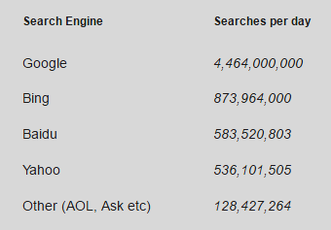
Web Search by the Numbers

Slide 11
Web Search by the Numbers
91% of users say they find what they are looking for when using search engines
73% of users stated that the information they found was trustworthy and accurate
66% of users said that search engines are fair and provide unbiased information
55% of users say that search engine results and search engine quality has gotten better over time
93% of online activities begin with a search engine
39% of customers come from a search engine (Source: MarketingCharts)
Over 100 billion searches being each month, globally
82.6% of internet users use search
70% to 80% of users ignore paid search ads and focus on the free organic results (Source: UserCentric)
18% of all clicks on the organic search results come from the number 1 position (Source: SlingShot SEO)
Source: Pew Research

Slide 12
Cognitive (Human) Aspects IR
Satisfying an “Information Need”
  types of information needs
  specifying information needs (queries)
  the process of information access
  search strategies
  “sensemaking”
Relevance
Modeling the User

Slide 13
Cognitive (Human) Aspects IR
Three phases:
  Asking of a question
  Construction of an answer
  Assessment of the answer
Part of an iterative process

Slide 14
Question Asking
Person asking = “user”
  In a frame of mind, a cognitive state
  Aware of a gap in their knowledge
  May not be able to fully define this gap
Paradox of IR:
  If user knew the question to ask, there would often be no work to do.
    “The need to describe that which you do not know in order to find it” Roland Hjerppe
Query
  External expression of this ill-defined state

Slide 15
Question Answering
Say question answerer is human.
  Can they translate the user’s ill-defined question into a better one?
  Do they know the answer themselves?
  Are they able to verbalize this answer?
  Will the user understand this verbalization?
  Can they provide the needed background?
What if answerer is a computer system?

Slide 16
Assessing the Answer
How well does it answer the question?
  Complete answer? Partial?
  Background Information?
  Hints for further exploration?
How relevant is it to the user?
Relevance Feedback
  for each document retrieved
    user responds with relevance assessment
    binary: + or -
    utility assessment (between 0 and 1)

Slide 17
Information Retrieval as a Process
Text Representation (Indexing)
  given a text document, identify the concepts that describe the content and how well they describe it
Representing Information Need (Query Formulation)
  describe and refine info. needs as explicit queries
Comparing Representations (Retrieval)
  compare text and query representations to determine which documents are potentially relevant
Evaluating Retrieved Text (Feedback)
  present documents to user and modify query based on feedback

Slide 18
Information Retrieval as a Process
Information Need
Document Objects
Representation
Representation
Query
Indexed Objects
Comparison
Relevant?
Evaluation/Feedback
Retrieved Objects

Slide 19
Query Languages
A way to express the question (information need)
Types:
  Boolean
  Natural Language
  Stylized Natural Language
  Form-Based (GUI)
  Spoken Language Interface
  Others?

Slide 20
Keyword Search
Simplest notion of relevance is that the query string appears verbatim in the document.
Slightly less strict notion is that the words in the query appear frequently in the document, in any order (bag of words).

Slide 21
Ordering/Ranking of Retrieved Documents
Pure Boolean retrieval model has no ordering
  Query is a Boolean expression which is either satisfied by the document or not
    e.g., “information” AND (“retrieval” OR “organization”)
  In practice:
    order chronologically
    order by total number of “hits” on query terms
Most systems use “best match” or “fuzzy” methods
  vector-space models
  probabilistic methods
  Pagerank
What about personalization?

Slide 22
Problems with Keywords
May not retrieve relevant documents that include synonymous terms.
  “restaurant” vs. “café”
  “PRC” vs. “China”
May retrieve irrelevant documents that include ambiguous terms.
  “bat” (baseball vs. mammal)
  “Apple” (company vs. fruit)
  “bit” (unit of data vs. act of eating)

Slide 23
Why Don’t Users Get What They Want?
Example:
User Need
Need to get rid of mice in the basement
Translation
Problem
User Request
What’s the best way to trap mice?
Query to IR
System
mouse trap
Polysemy
Synonymy
Results
Computer supplies, software, etc.

Slide 24
Example: Basic Retrieval Process
Sec. 1.1
Which plays of Shakespeare contain the words Brutus AND Caesar but NOT Calpurnia?
One could grep all of Shakespeare’s plays for Brutus and Caesar, then strip out lines containing Calpurnia?
Why is that not the answer?
  Slow (for large corpora)
  Other operations (e.g., find the word Romans near countrymen) not feasible
  Ranked retrieval (best documents to return)
    Later lectures
Notes:
Grep is line-oriented; IR is document oriented.

Slide 25
Term-document incidence
Sec. 1.1
1 if play contains word, 0 otherwise
Brutus AND Caesar BUT NOT Calpurnia

Slide 26
Incidence vectors
Sec. 1.1
Basic Boolean Retrieval Model
  we have a 0/1 vector for each term
  to answer query: take the vectors for Brutus, Caesar and Calpurnia (complemented) ➔ bitwise AND
  110100 AND 110111 AND 101111 = 100100
The more general Vector-Space Model
  allows for weights other that 1 and 0 for term occurrences
  provides the ability to do partial matching with query key words

Slide 27
IR System Architecture
User Interface
Text
User
Need
Text Operations
Logical View
User
Feedback
Query
Operations
Indexing
Database
Manager
Inverted
file
Query
Searching
Index
Text
Database
Ranked
Docs
Ranking
Retrieved
Docs

Slide 28
IR System Components
Text Operations forms index words (tokens).
  Stopword removal
  Stemming
  Ngrams
Indexing constructs an inverted index of word to document pointers.
Searching retrieves documents that contain a given query token from the inverted index.
Ranking scores all retrieved documents according to a relevance metric.

Slide 29
IR System Components (continued)
User Interface manages interaction with the user:
  Query input and document output.
  Relevance feedback.
  Visualization of results.
Query Operations transform the query to improve retrieval:
  Query expansion using a thesaurus.
  Query transformation using relevance feedback.

Slide 30
Initial stages of text processing
Tokenization
  Cut character sequence into word tokens
    Deal with “John’s”, a state-of-the-art solution
Normalization
  Map text and query term to same form
    You want U.S.A. and USA to match
Stemming
  We may wish different forms of a root to match
    authorize, authorization
Stop words
  We may omit very common words (or not)
    the, a, to, of

Slide 31
Organization/Indexing Challenges
Sec. 1.1
Consider N = 1 million documents, each with about 1000 words.
Avg 6 bytes/word including spaces/punctuation
  6GB of data in the documents.
Say there are M = 500K distinct terms among these.
500K x 1M matrix has half-a-trillion 0’s and 1’s
(so, practically we can’t build the matrix)
But it has no more than one billion 1’s (why?)
  i.e., matrix is extremely sparse
What’s a better representation?
  We only record the 1 positions (“sparse matrix representation”)

Slide 32
Inverted index
Sec. 1.2
For each term t, we must store a list of all documents that contain t.
  Identify each by a docID, a document serial number
Brutus
1
2
4
11
31
45
173
174
Caesar
1
2
4
5
6
16
57
132
Calpurnia
2
31
54
101
What happens if the word Caesar is added to document 14? What about repeated words?
More on Inverted Indexes Later!

Slide 33

Inverted index construction
Sec. 1.2
Documents to
be indexed
Friends, Romans, countrymen.
Tokenizer
Token stream
Friends
Romans
Countrymen
Linguistic modules
Modified tokens
friend
roman
countryman
Indexer
friend
2
4
roman
1
2
Inverted index
countryman
13
16
Notes:
Document icons from free icon set: http://www.icojoy.com/articles/44/

Slide 34
Some Features of Modern IR Systems
Relevance Ranking
Natural language (free text) query capability
Boolean or proximity operators
Term weighting
Query formulation assistance
Visual browsing interfaces
Query by example
Filtering
Distributed architecture

Slide 35
Intelligent IR
Taking into account the meaning of the words used.
Taking into account the context of the user’s request.
Adapting to the user based on direct or indirect feedback (search personalization).
Taking into account the authority and quality of the source.
Taking into account semantic relationships among objects (e.g., concept hierarchies, ontologies, etc.)
Intelligent IR interfaces
Intelligent Assistants (e.g., Alexa, Google Now, etc.)

Slide 36
Other Text Mining Tasks
Automated document categorization
Automated document clustering
Recommending information or products
Information extraction
Information integration
Question answering

Slide 37
Overview of Information Retrieval and Organization
CSC 575
Intelligent Information Retrieval

