Slide 1
Web IR: Recent Trends; Future of Web Search
CSC 575
Intelligent Information Retrieval

Slide 2
The Future of Web Search?
The web, it is a changing.
What will search look like, say in 2025?
Key words into a search box?
Use the Semantic Web to extract meaningful information from documents?
Ask questions in natural language?
Integrated intelligent interfaces and chatbots?
Social or collaborative search?
The trends of the past few years provides clues (at least for the near future)

Slide 3
What’s been happening now (Google)?
“Pigeon” update (July 2014):
For U.S. English results, the “Pigeon Update” is a new algorithm to provide more useful, relevant and accurate local search results that are tied more closely to traditional web search ranking signals
More use of distance and location in ranking signals
“Mobilegeddon” (Apr 21, 2015):
“Mobile friendliness” as a major ranking signal
“App Indexing” (Android, iOS support May 2015)
Search results can take you to an app
Why?
About half of all searches are now from mobile
Making/wanting good changes, but obvious self-interest in trying to keep people using mobile web rather than apps

Slide 4
What’s been happening now (Google)?
Mobile-friendly 2 (May 12, 2016):
More than half of all searches are now from mobile
“Fred” (1st quarter 2017)
Various changes discounting spam, clickbait, fake? Sites
Longer snippets in results pages (Nov 2017)
Mobile-first Index (Mar 2018)
Index mobile version of websites in preference to desktop!
“Medic” update (Aug 2018)
More emphasis on expertise, authoritativeness, trust
Big changes for diet, nutrition, medical products sites
Core Algorithm Update (Mar 2019)
Seems kind of like “Medic 2”

Slide 5
What’s been happening now?
New search index at Google: “Hummingbird”
http://www.forbes.com/sites/roberthof/2013/09/26/google-just-revamped-search-to-handle-your-long-questions/
Answering long, “natural language” questions better
Partly to deal with spoken queries on mobile
More use of the Google Knowledge Graph
Concepts versus words

Slide 6
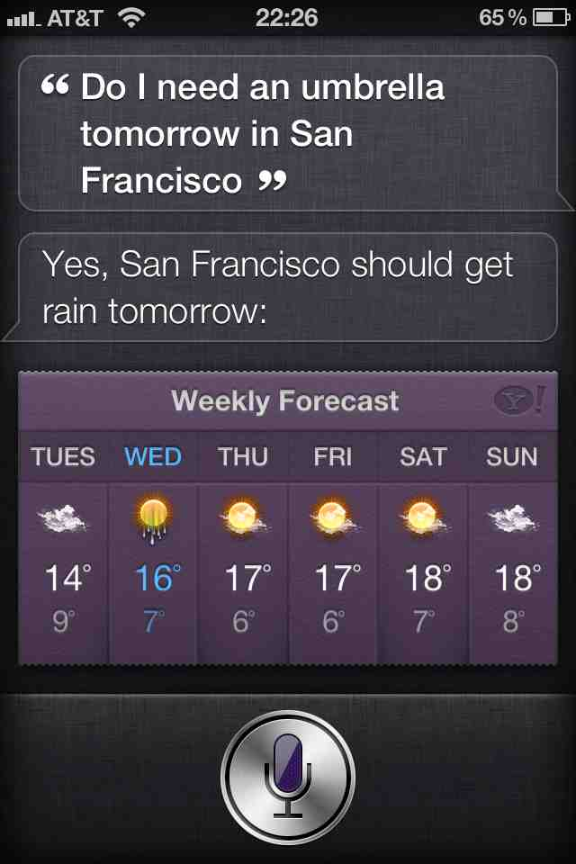
What’s been happening now?
Move to mobile favors a move to speech which favors “natural language information search”
Will we move to a time when over half of searches are spoken?

Slide 7
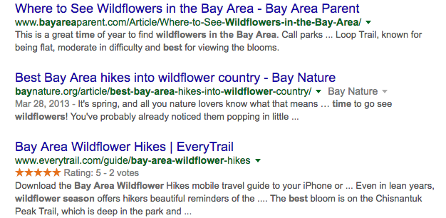
What’s been happening now?
Mobile proved importance of NLP/QA
[What is the best time for wildflowers in the bay area]

Slide 8
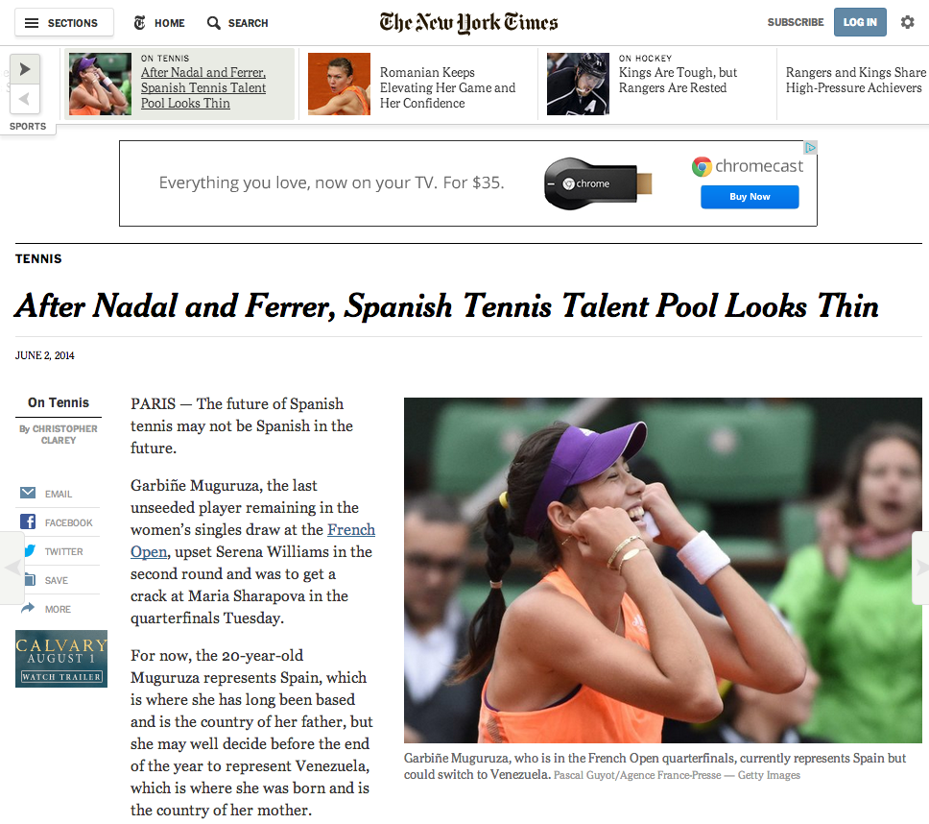
What’s been happening now?
More semi-structured information embedded in web pages
schema.org

Slide 9
What’s been happening now?
Move towards integrating structured semantic knowlege
Google Knowledge Graph
Facebook Graph Search
Bing’s Satori
Things like Wolfram Alpha
Common theme: Doing graph search over structured knowledge rather than traditional text search
Two Goals:
Things not strings
Inference not search

Slide 10
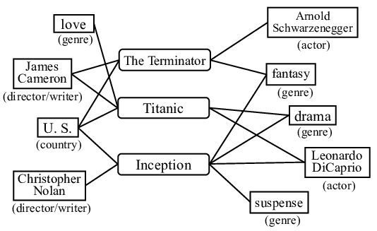
Knowledge Graphs

Slide 11
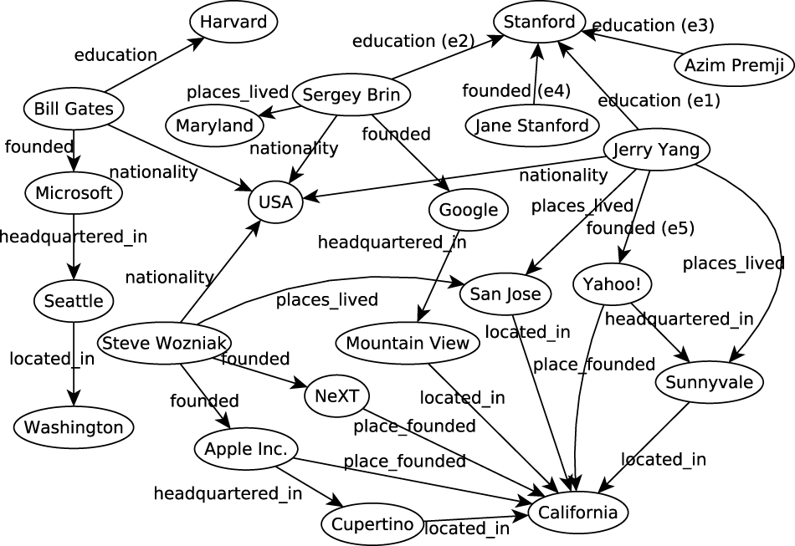
Knowledge Graphs

Slide 12
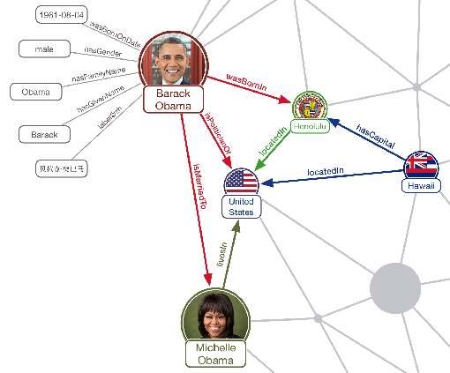
Knowledge Graphs

Slide 13
3 approaches to question answering:
Knowledge-Based Approaches
Text-Based Approaches
Hybrid Approaches

Slide 14
Knowledge-based approaches (Siri)
Build a semantic representation of the query
Times, dates, locations, entities, numeric quantities
Map from this semantics to query structured data or resources
Geospatial databases
Ontologies (Wikipedia infoboxes, dbPedia, WordNet, Yago)
Restaurant review sources and reservation services
Scientific databases
Wolfram Alpha

Slide 15
Text-based (mainly factoid) QA
Question Processing
Detect question type, answer type, focus, relations
Formulate queries to send to a search engine
Passage Retrieval
Retrieve ranked documents
Break into suitable passages and re-rank
Answer Processing
Extract candidate answers (as named entities)
Rank candidates
using evidence from relations in the text and external sources
Notes:
Do analysis on the fly. Have exact context.
Not good for aggregate questions or information integration.

Slide 16
Hybrid approaches (IBM Watson)
Build a shallow semantic representation of the query
Generate answer candidates using IR methods
Augmented with ontologies and semi-structured data
Score each candidate using richer knowledge sources
Geospatial databases
Temporal reasoning
Taxonomical classification
Knowledge graphs

Slide 17
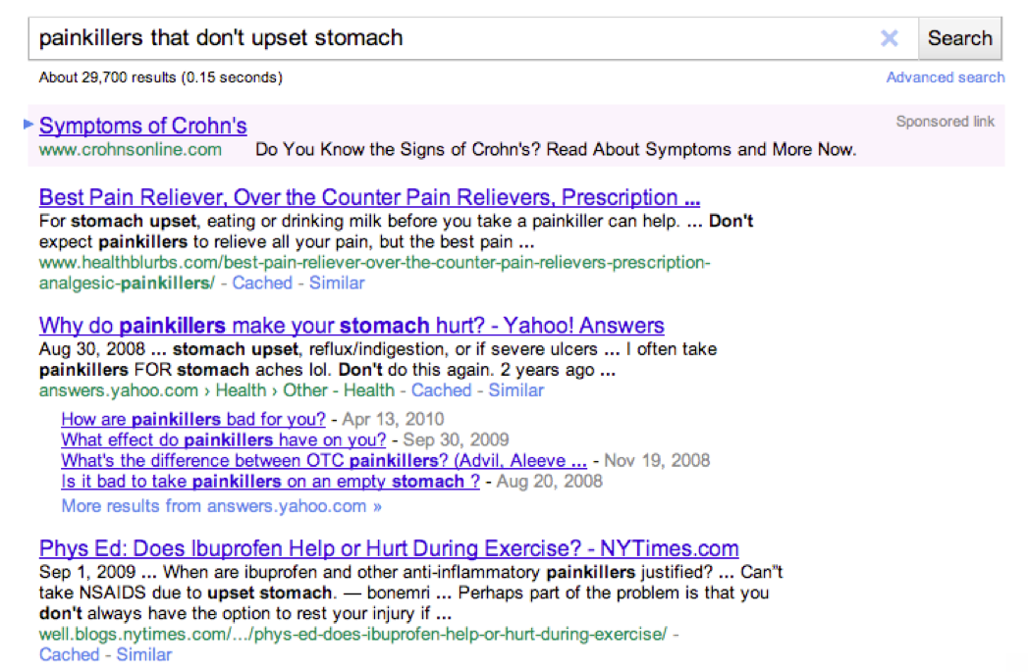
Example from Fernando Pereira (Google)

Slide 18
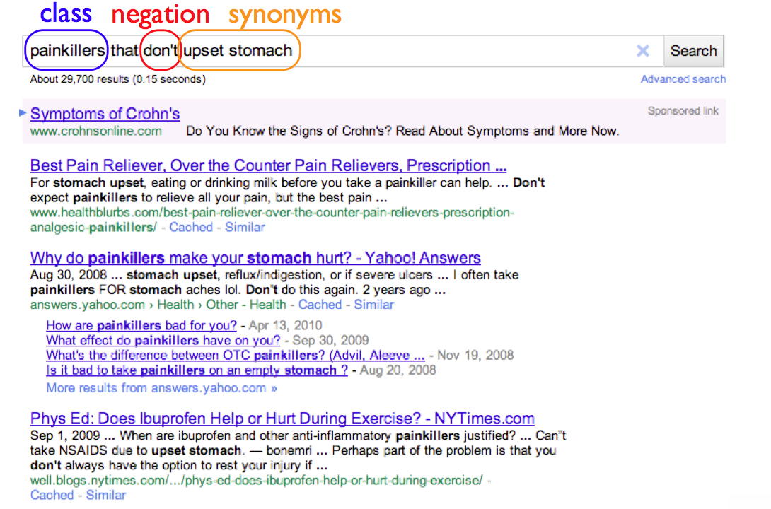

Slide 19
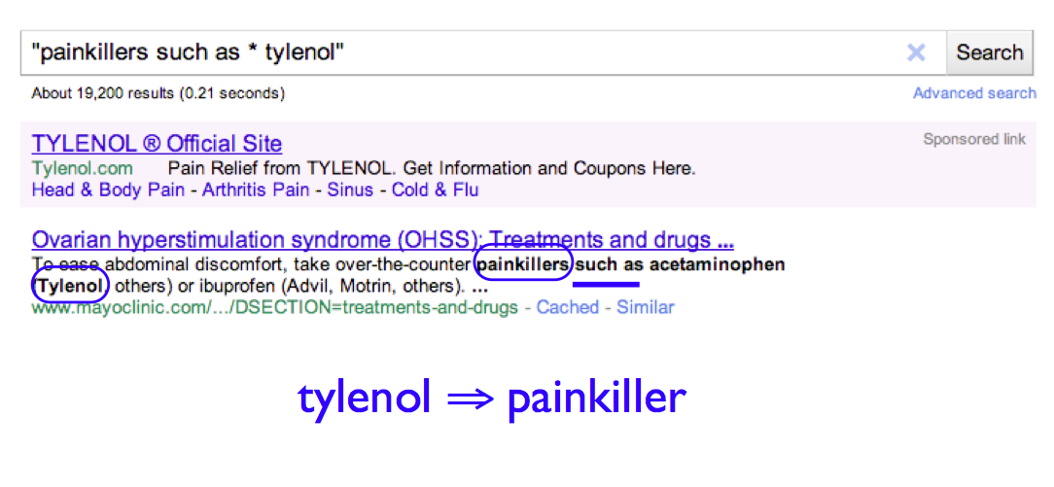

Slide 20
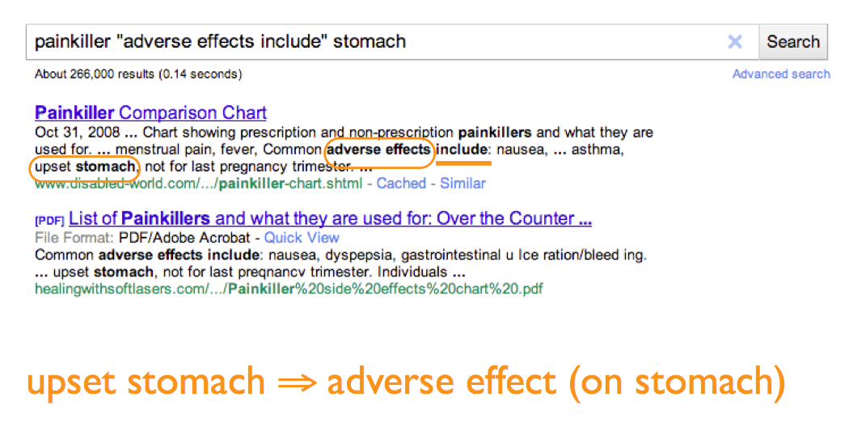

Slide 23
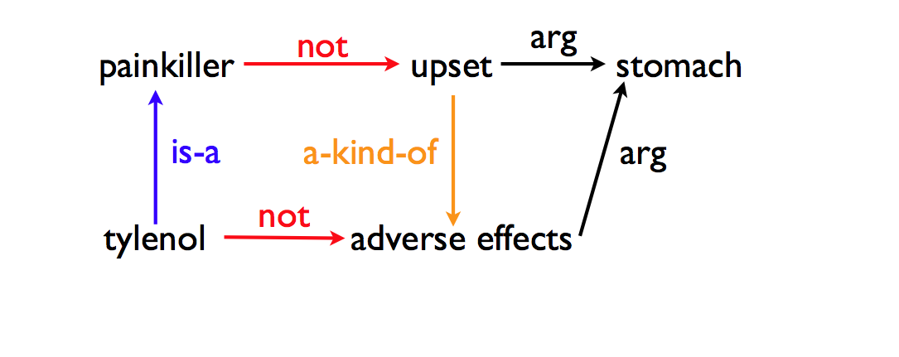

Slide 25
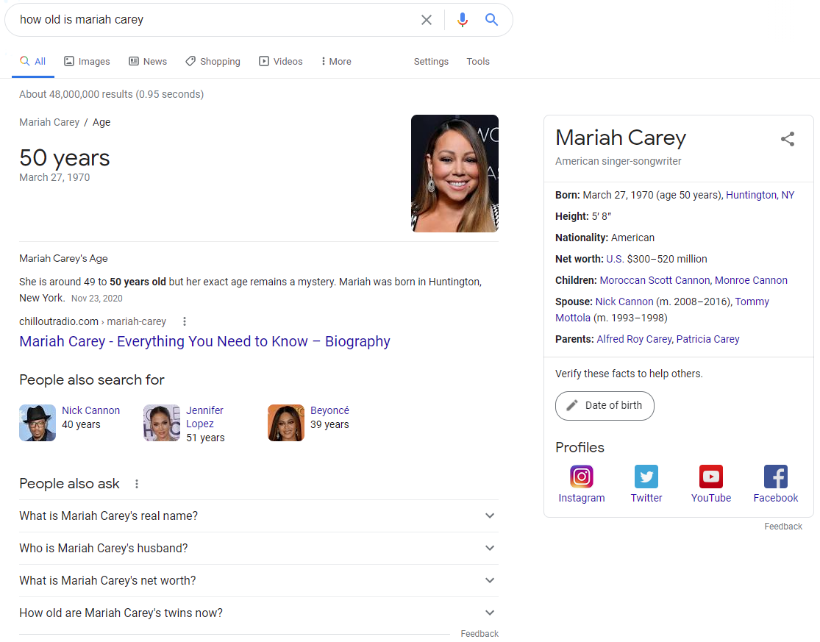
Structured Data
Direct Answer
Collaborative Data

Slide 26
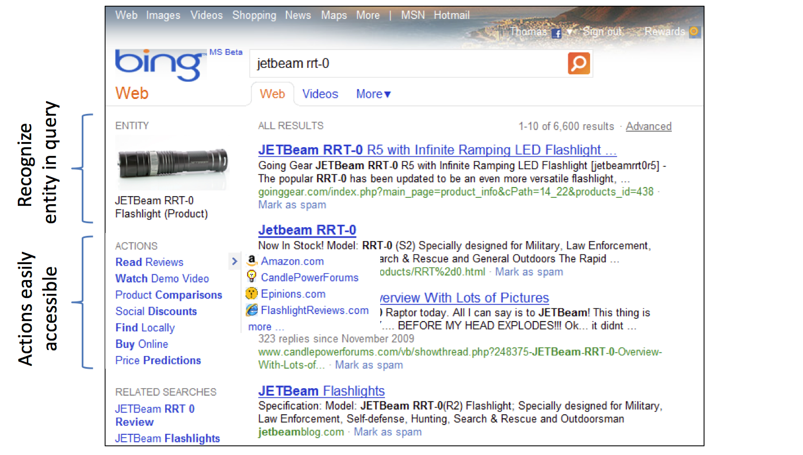
Desired experience: Towards actions (Patrick Pantel, et al., Microsoft Research)

Slide 27
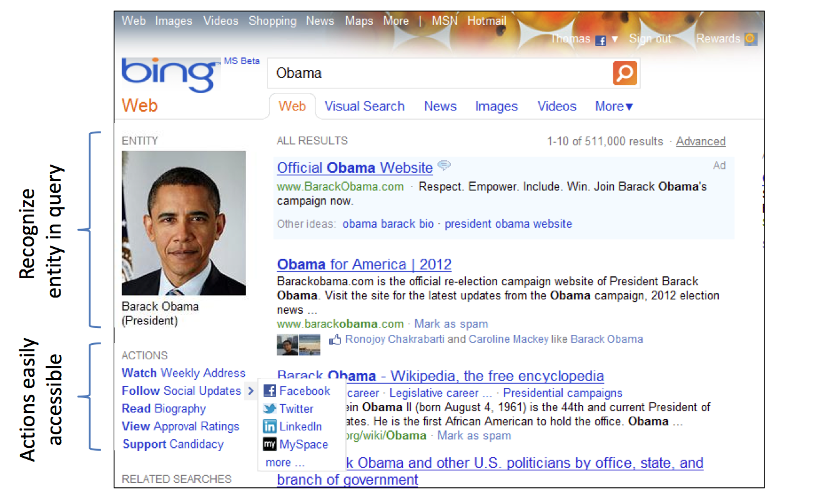
Desired experience: Towards actions

Slide 28
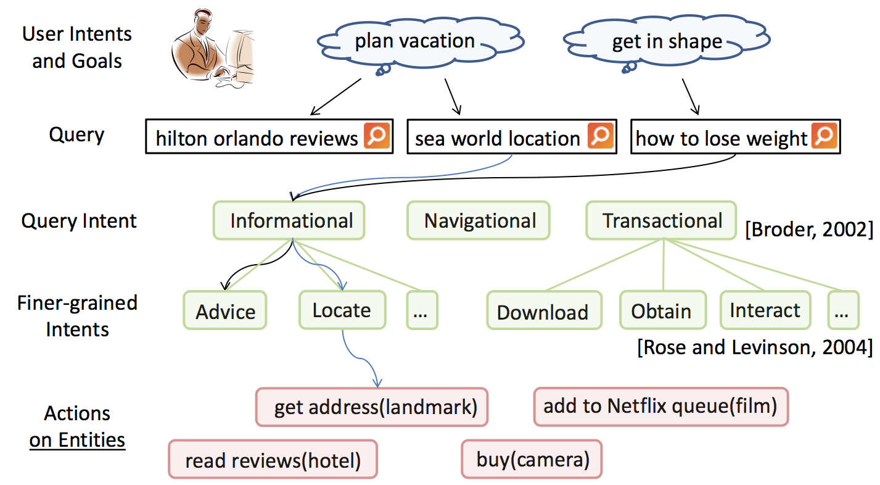
Actions vs. Intents

Slide 29
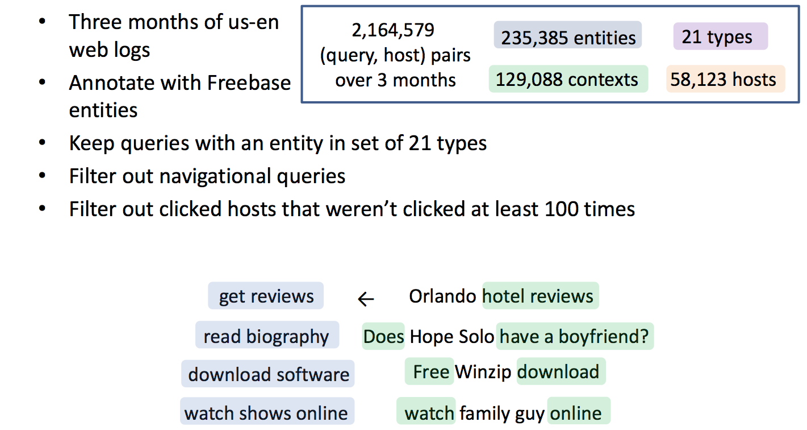
Learning actions from web usage logs
Notes:
Goes off to build probabilistic models that I won’t show….

Slide 30
The Facebook Graph
Collection of entities and their relationships
Entities (users, pages, photos, etc.) are nodes
Relationships (friendship, checkins, tagging, etc.) are edges
Nodes and edges have metadata
Nodes have a unique id – the fbid

Slide 31
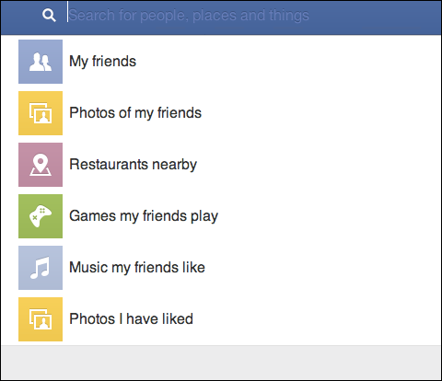
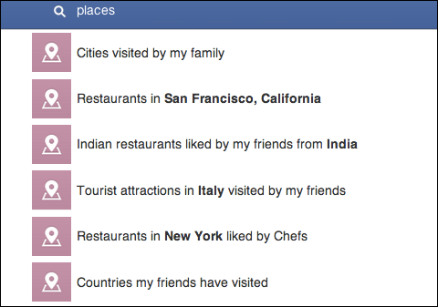
Facebook Graph Search

Slide 32
Facebook Graph Snippet
EVENT
fbid: 213708728685 type: PAGE name: Breville mission: To design the best … …
LIKES
FRIEND
TAGGED
fbid: 586206840 type: USER name: Sriram Sankar …
PHOTO

Slide 33
Social search/QA

Slide 34
Facebook Graph Search
Uses a weighted context free grammar (WCFG) to represent the Graph Search query language:
[start] => [users] $1
[users] => my friend friends(me)
[users] => friends of [users] friends($1)
[users] => {user} $1
[start] => [photos] $1
[photos] => photos of [users] photos($1)
A terminal symbol can be an entity, e.g., {user}, {city}, {employer}, {group}; it can also be a word/phrase, e.g., friends, live in, work at, members, etc. A parse tree is produced by starting from [start] and expanding the production rules until it reaches terminal symbols.
https://www.facebook.com/notes/facebook-engineering/under-the-hood-the-natural-language-interface-of-graph-search/10151432733048920
http://spectrum.ieee.org/telecom/internet/the-making-of-facebooks-graph-search

Slide 35
Notes:
If outside grammar, you fall back to a Bing search

Slide 36
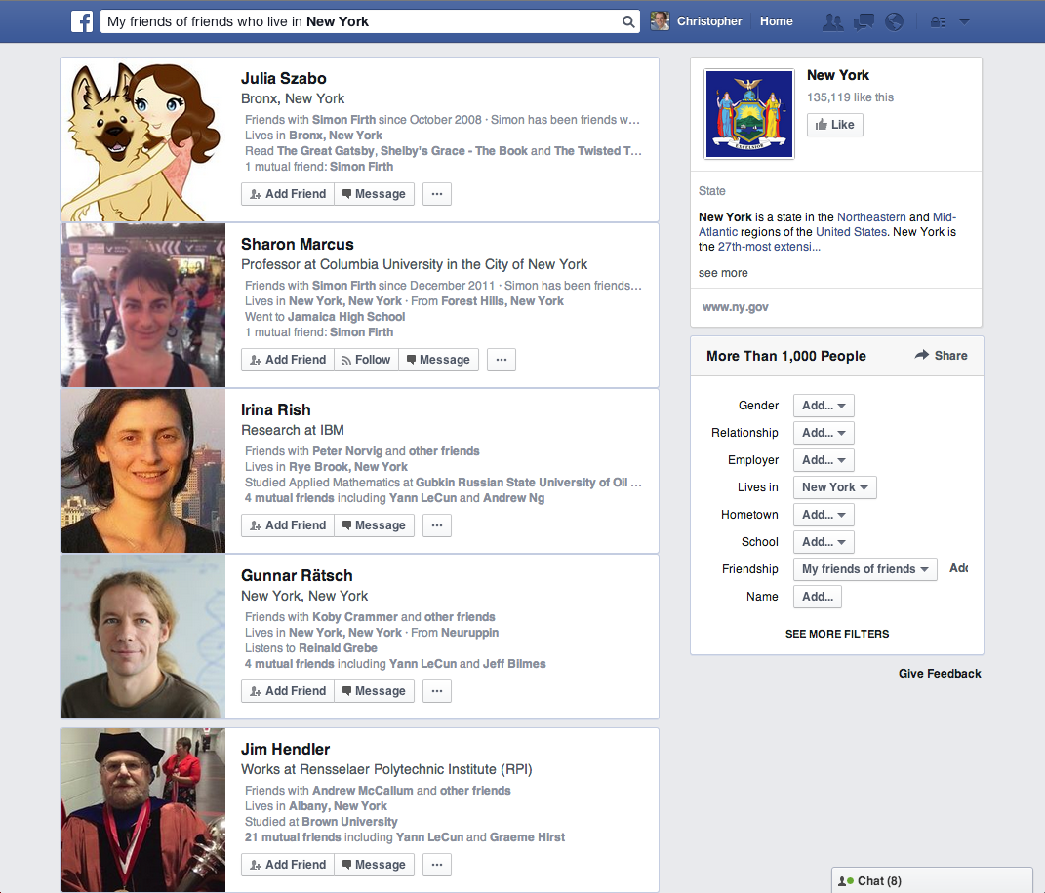

Slide 37
DrQA: Open-domain Question Answering (Chen, et al. ACL 2017) https://arxiv.org/abs/1704.00051
Using Wikipedia as the main knowledge source

Slide 38
Open-domain Question Answering
SQuAD
Q: How many of Warsaw's inhabitants spoke Polish in 1933? ^{A: 833,500}
TREC
Q: What U.S. state’s motto is “Live free or Die”? ^{A: New Hampshire}
WebQuestions (Berant et al, 2013)
Q: What part of the atom did
Chadwick discover? ^{A: neutron}
WikiMovies (Miller et al, 2016)
Q: Who wrote the film Gigli? ^{A: Martin Brest}

Slide 39
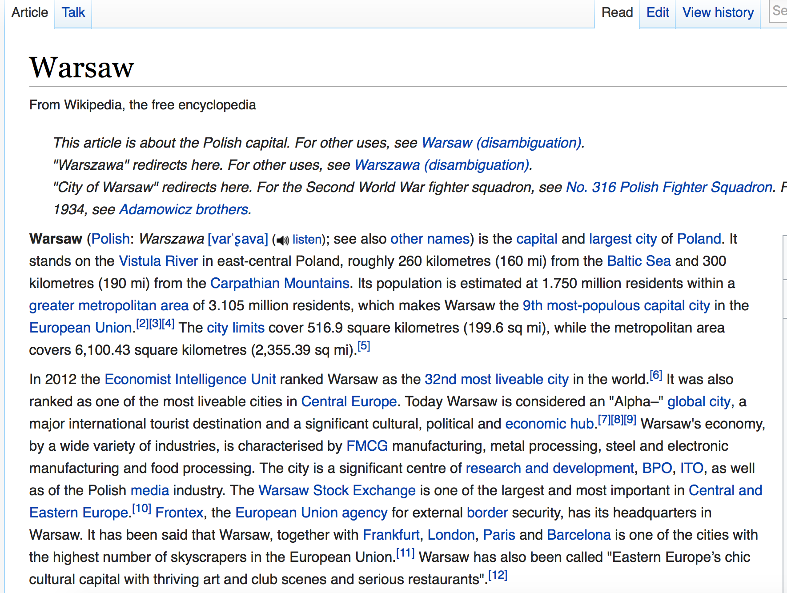
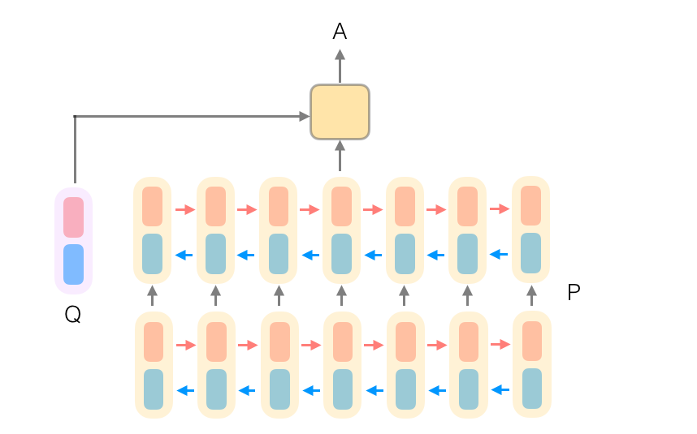
Q: How many of Warsaw's inhabitants spoke Polish in 1933?
Document
Retriever
Document
Reader
833,500
Represent paragraphs as feature vectors and pass to a Recurrent Neural Network to generate encodings for tokens
Feature vectors include binary (exact match features), token features such as part of speech tags, frequency information, Glove word embeddings learned from Web crawl data, and aligned question embedding that captures relationships between tokens and the query.

Slide 40
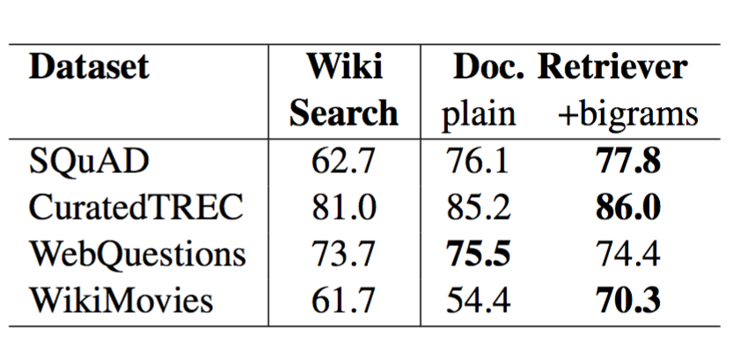
Document Retriever
(Chen et al, 2017)
Traditional tf.idf inverted index + efficient bigram hash
70-86% of questions: the answer segment appears in the top 5 articles

Slide 41
DrQA: Open-domain Question Answering
Output
Input
Passage (P)
Answer (A)
Question (Q)

Slide 42
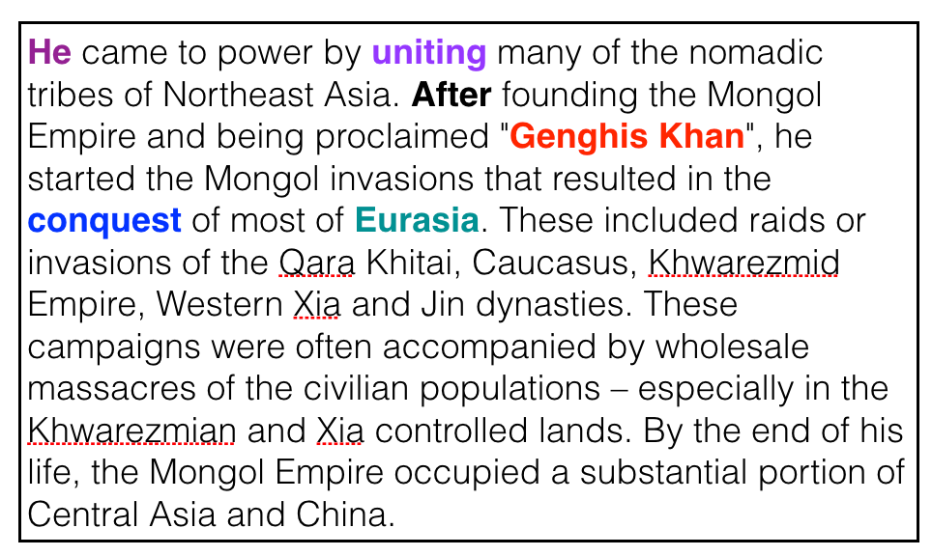
DrQA: Open-domain Question Answering
Q
Who did Genghis Khan unite before he began conquering the rest of Eurasia?
Bidirectional LSTMs
P
…
…
…
Attention
Attention
predict start token
predict end token

Slide 43
SQuAD Results (single model)
 | F1
Logistic regression | 51.0
Fine-Grained Gating (Carnegie Mellon U) | 73.3
Match-LSTM (Singapore Management U) | 73.7
DCN (Salesforce) | 75.9
BiDAF (UW & Allen Institute) | 77.3
Multi-Perspective Matching (IBM) | 78.7
ReasoNet (MSR Redmond) | 79.4
DrQA (Chen et al. 2017) | 79.4
r-net (MSR Asia) [Wang et al., ACL 2017] | 79.7
Google Brain / CMU (Feb 2018) | 88.0
Human performance | 91.2

Slide 44
General questions
Combined with Web search, can answer 57.5% of trivia questions correctly
Q: The Dodecanese Campaign of WWII that was an attempt by the Allied forces to capture islands in the Aegean Sea was the inspiration for which acclaimed 1961 commando film?
A: The Guns of Navarone
Q: American Callan Pinckney’s eponymously named system became a best-selling (1980s-2000s) book/video franchise in what genre?
^{A: Fitness}
A: Fitness

Slide 45
Demo

Slide 46
Web IR: Recent Trends; Future of Web Search
CSC 575
Intelligent Information Retrieval

