Slide 1
Data Mining, Machine Learning
&
The Knowledge Discovery Process
Bamshad Mobasher
DePaul University

Slide 2
Why Data Mining?
The Explosive Growth of Data: from terabytes to petabytes
  Data collection and data availability
    Automated data collection tools, database systems, Web, computerized society
  Major sources of abundant data
    Business: Web, e-commerce, transactions, stocks, …
    Science: Remote sensing, bioinformatics, scientific simulation, …
    Society and everyone: news, images, video, documents, ….
Notes:
In today’s digital universe we have a fundamentally different scale in data availability than even about a decade ago.
The explosive growth of data is because of myriad ways in which we are automatically collecting data, especially on the Web.

Slide 3
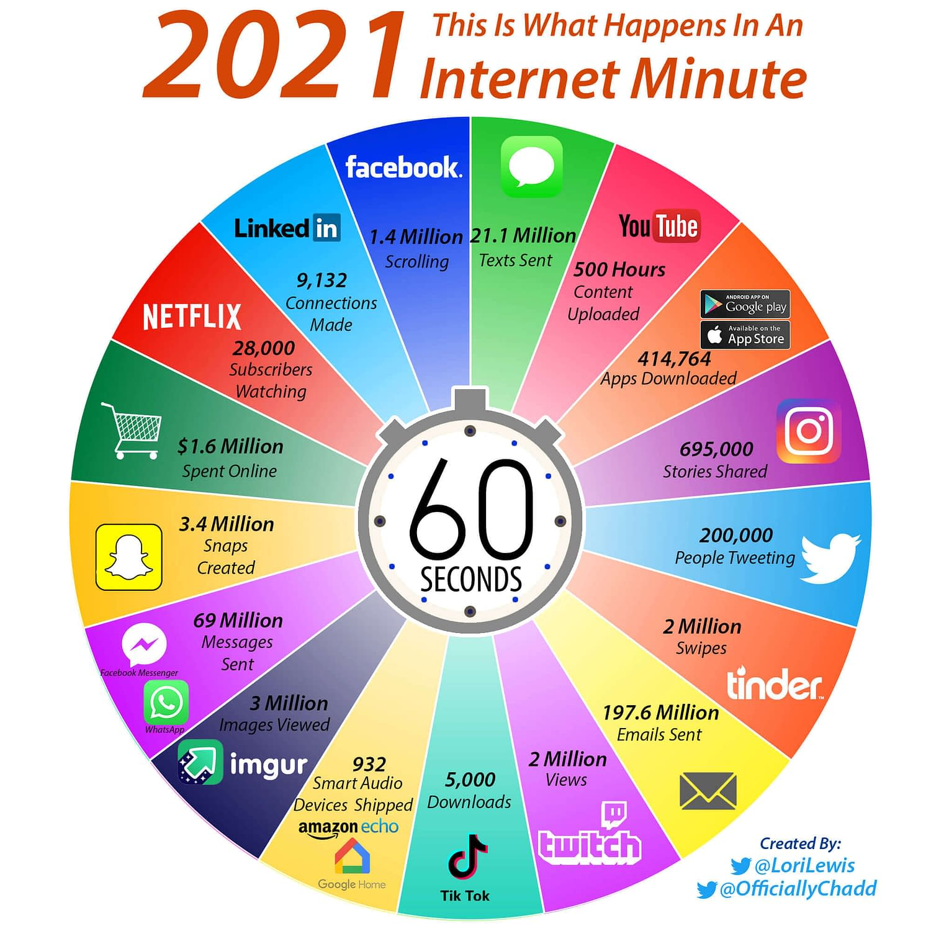
Notes:
This picture illustrates the scale and scope of data created and transmitted across the internet in one minute. And the future growth is staggering. Much of this data is generated as a result of user interactions with a variety of online applications. What distinguishes the current social web from the web in the 90s and early 2000’s is the ability of users to share content and resources, and to interact. All of this leads to the generation and collection of vast amounts of data. Leveraging this data is critical to the success of many of today’s online applications, businesses, and organizations.
The ability of all of these systems and companies to effectively serve their users depends on how successfully they mine, analyze, and leverage this data.

Slide 4
From Data to Wisdom
Data
  The raw material of information
Information
  Data organized and presented by someone
Knowledge
  Information read, heard or seen and understood and integrated
Wisdom
  Distilled knowledge and understanding which can lead to decisions
Wisdom
Knowledge
Information
Data
The Information Hierarchy
Notes:
This is where data mining and knowledge discovery come in. The goal is to process and distill raw data into knowledge that can be harnessed and used for decision making.
This goal is illustrated by what’s known as the information hierarchy. At the bottom of this pyramid, we have raw data collected from real world observations. This data must be processed and organized to become information. Once this information is further processed, integrated with other sources of information and put into a context, it may lead to knowledge that we previously not available. Of course, ultimately, we want the gained knowledge to be harnessed and put into effective use in a particular setting or domain.

Slide 5
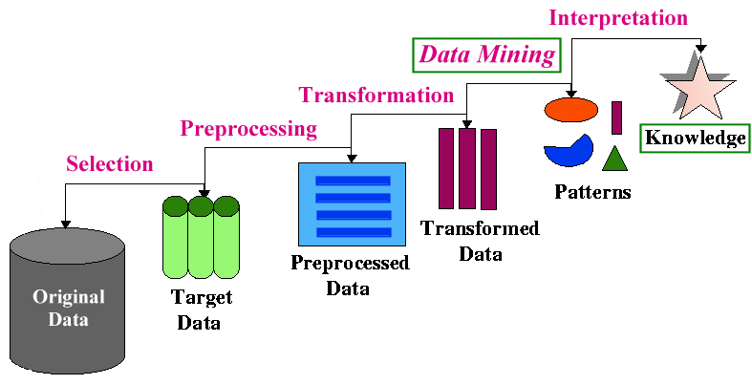
The Knowledge Discovery Process
  DM is only part of the KDD process
  DM phase generally employs machine learning and statistical techniques
- The KDD Process

Slide 7
Types of Knowledge Discovery
Two kinds of knowledge discovery: directed and undirected
Directed Knowledge Discovery
  Purpose: Explain value of some field in terms of all the others (goal-oriented)
  Method: select the target field based on some hypothesis about the data; ask the algorithm to tell us how to predict or classify new instances
  Examples:
    what products show increased sale when cream cheese is discounted
    which banner ad to use on a web page for a given user coming to the site
Undirected Knowledge Discovery
  Purpose: Find patterns in the data that may be interesting (no target field)
  Method: clustering, affinity grouping
  Examples:
    which products in the catalog often sell together
    market segmentation (find groups of customers/users with similar characteristics or behavioral patterns)

Slide 8
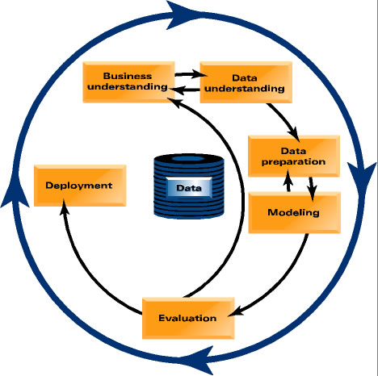
From Data Mining to Data Science
Notes:
Of course, data mining must be understood in the context of problem solving in real world. In recent years, people have started to use the term data science. This term emphasizes that data mining is a set of tools and techniques that are used as part of a scientific approach to solving problems. One must always start with a problem formulation is a specific application or business domain. A data-driven solution to this problem involves understanding the data that provide the observations relevant to the problem. These observations and preliminary analysis lead to a formulation of one or more hypotheses. The knowledge discovery process is guided by the hypotheses, including the data preparation and transformation, and well as the derivation of various models. The models must then be evaluated with appropriate test data. This evaluation, including the accuracy of predictive models, tells us whether we must go back and revise our hypotheses, or to modify our procedures. Eventually, the successful models must be deployed and tested in real-world situations.

Slide 9
What Kinds of Data?
Database-oriented data sets and applications
  Relational database, data warehouse, transactional database
  Object-relational databases, Heterogeneous databases and legacy databases
Advanced data sets and advanced applications
  Data streams and sensor data
  Time-series data, temporal data, sequence data (incl. bio-sequences)
  Structure data, graphs, social networks and information networks
  Spatial data and spatiotemporal data
  Multimedia database
  Text data and other semi-structured data
  The World-Wide Web

Slide 10
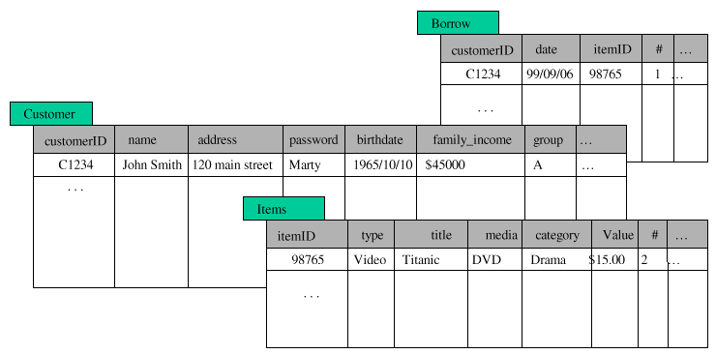
What Kinds of Data?
Structured Databases
  relational, object-relational, etc.
  can use SQL to perform parts of the process
  e.g., SELECT count(*) FROM Items WHERE
  type=video GROUP BY category

Slide 11
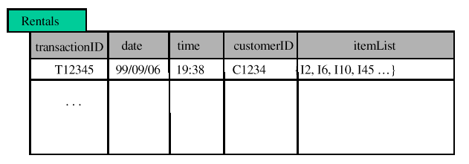
What Kinds of Data?
Flat Files
  most common data source
  can be text (or HTML) or binary
  may contain transactions, statistical data, measurements, etc.
Transactional databases
  set of records each with a transaction id, time stamp, and a set of items
  may have an associated “description” file for the items
  typical source of data used in market basket analysis

Slide 12
What Kinds of Data?
Other Types of Databases
  legacy databases
  multimedia databases (usually very high-dimensional)
  spatial databases (containing geographical information, such as maps, or satellite imaging data, etc.)
  Time Series Temporal Data (time dependent information such as stock market data; usually very dynamic)
World Wide Web
  basically a large, heterogeneous, distributed database
  need for new or additional tools and techniques
    information retrieval, filtering and extraction
    agents to assist in browsing and filtering
    Web content, usage, and structure (linkage) mining tools
  The “social Web”
    User generated meta-data, social networks, shared resources, etc.

Slide 13
What Can DM / ML Do?
Many Data Mining/Machine Learning Tasks
  often inter-related
  often need to try different techniques/algorithms for each task
  each tasks may require different types of knowledge discovery
Typical Tasks
  Exploratory data analysis
  Classification
  Prediction
  Clustering
  Affinity grouping / Association discovery
  Sequence Analysis
  Characterization
  Discrimination

Slide 14
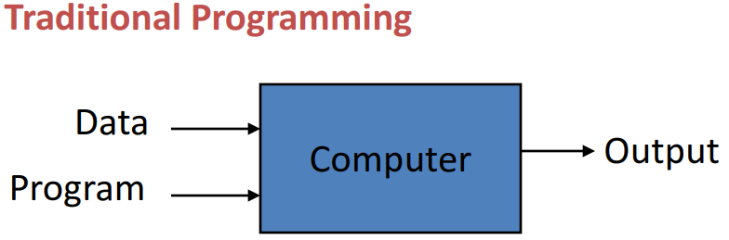
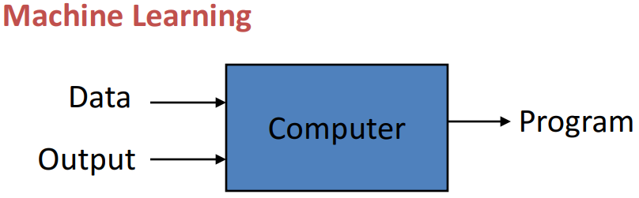
What is Machine Learning
“Learning is any process by which a system improves performance from experience.”
- Herbert Simon
“Machine Learning is the study of algorithms that improve their performance P at some task T with experience E.”
        - Tom Mitchell

Slide 15
Types of Machine Learning
Supervised (inductive) learning
  Given: training data + specified target variable or attribute
  Predict: the values of the target variable on unseen/test data
  Examples: classification (predicting a categorical target variable); regression (predicting a numeric/continuous target variable)
Unsupervised learning
  Given: training data (without any target variable)
  Identify previously unknown patterns in the data
  Examples: clustering; association analysis
Reinforcement learning
  Given: Rewards/feedback from sequence of actions
  Incrementally learn/optimize a model to maximize utility

Slide 16

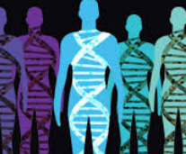
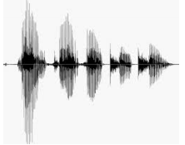
examples of tasks best solved by ML
Recognizing patterns / Classifying objects
  Facial identities or facial expressions
  Handwritten or spoken words
  Medical / satellite images analysis
  Text/document categorization
Generating patterns
  Generating images or motion sequences
  Generating spoken / written narratives
Recognizing anomalies
  Unusual credit card transactions
  Unusual patterns of sensor readings in a nuclear power plant
Prediction
  Future stock prices or currency exchange rates
  Predicting customer preferences on items

Slide 17
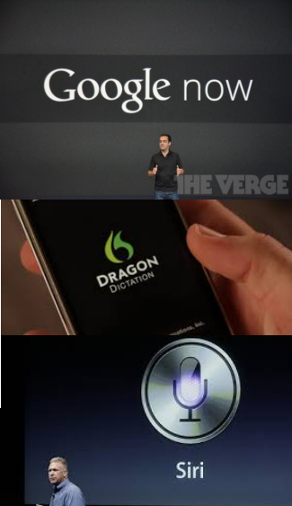
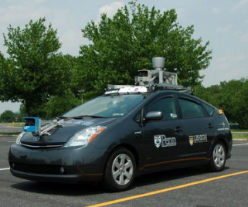
Many application areas
Web search
Text / Web mining
Recommender systems / Personalization
Computational biology
Computational Finance
E-commerce / Target marketing
Market segmentation and focalization
Space exploration
Robotics
Autonomous vehicles
Information extraction
Social network analysis
Natural language understanding
Fraud detection
….

Slide 18
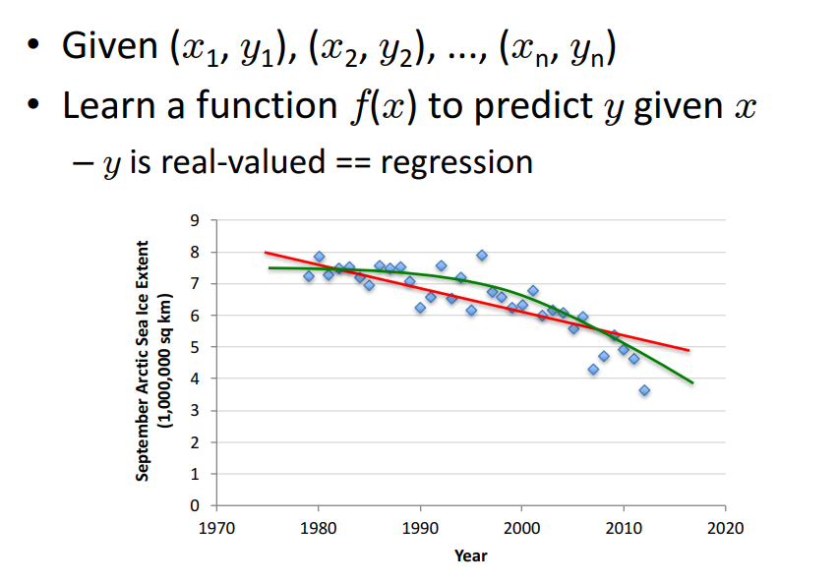
Supervised Learning: Regression

Slide 19
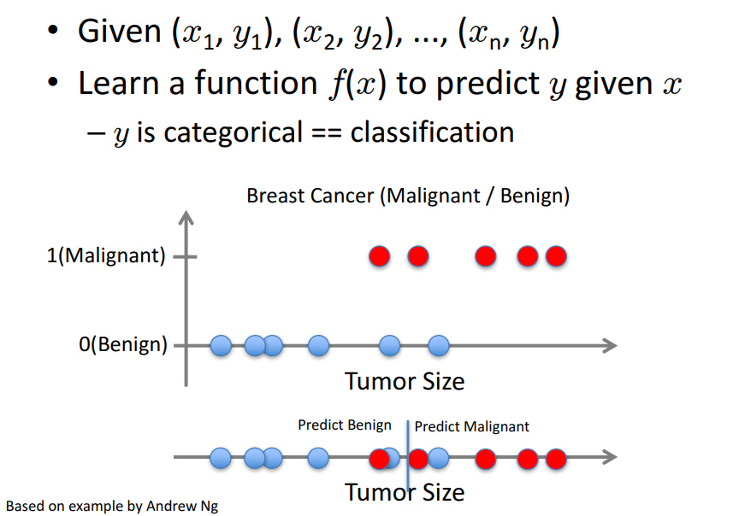
Supervised Learning: Classification

Slide 20
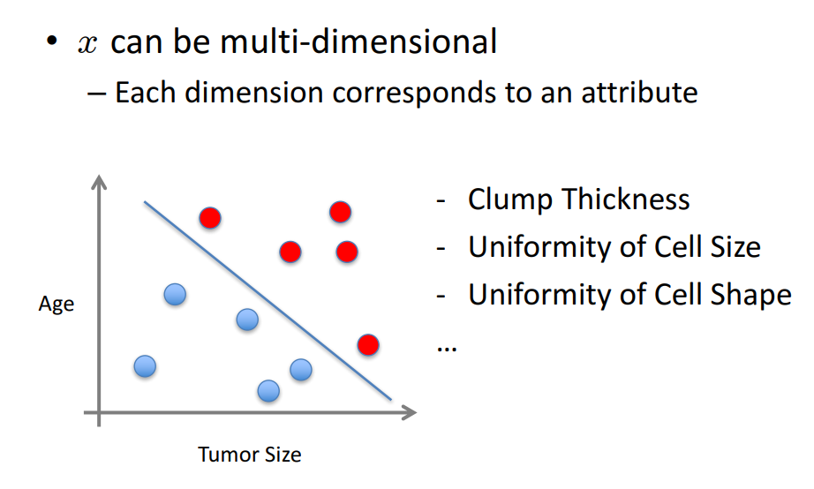
Supervised Learning: Classification

Slide 21
Classification Example: Spam Filter
Input: an email
Output: spam/ham
Setup:
  Get a large collection of example emails, each labeled “spam” or “ham”
  Note: someone has to hand label all this data!
  Want to learn to predict labels of new, future emails
Features: The attributes used to make the ham / spam decision
  Words: FREE!
  Text Patterns: $dd, CAPS
  Non-text: SenderInContacts
  …
Dear Sir.
First, I must solicit your confidence in this transaction, this is by virture of its nature as being utterly confidencial and top secret. …
TO BE REMOVED FROM FUTURE MAILINGS, SIMPLY REPLY TO THIS MESSAGE AND PUT "REMOVE" IN THE SUBJECT.
99 MILLION EMAIL ADDRESSES
FOR ONLY $99
Ok, Iknow this is blatantly OT but I'm beginning to go insane. Had an old Dell Dimension XPS sitting in the corner and decided to put it to use, I know it was working pre being stuck in the corner, but when I plugged it in, hit the power nothing happened.

Slide 22




Classification Example: Digit Recognition
Input: images / pixel grids
Output: a digit 0-9
Setup:
  Get a large collection of example images, each labeled with a digit
  Note: someone has to hand label all this data!
  Want to learn to predict labels of new, future digit images
Features: The attributes used to make the digit decision
  Pixels: (6,8)=ON
  Shape Patterns: NumComponents, AspectRatio, NumLoops
  …
0
1
2
1
??

Slide 23
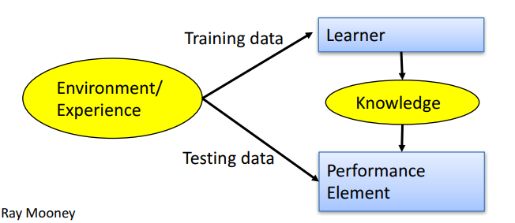
Designing a Supervised Learning System
Choose the training data
Choose exactly what is to be learned
  i.e. the target function
Choose how to represent the target function
Choose a learning algorithm to infer the target function from the experience

Slide 24
Supervised Learning Summary: 3 Step Process
1. Model construction (Learning):
  Each record (instance, example) is assumed to belong to a predefined class, as determined by one of the attributes
    This attribute is call the target attribute
    The values of the target attribute are the class labels (classification) or numeric values (regression)
  The set of all instances used for learning the model is called training set
  The model may be represented in many forms: decision trees, probabilities, neural networks, ….
  Tune hyperparameters (typically through cross-validation)
2. Model Evaluation (Accuracy):
  Estimate accuracy rate or error rate of the model based on a test set
  The known labels of test instances are compared with the predicted labels/values from model
  Test set is independent of training set otherwise over-fitting will occur
3. Model Use (Classification):
  The model is used to classify unseen instances (e.g., to predict the class labels for new unclassified instances)

Slide 25
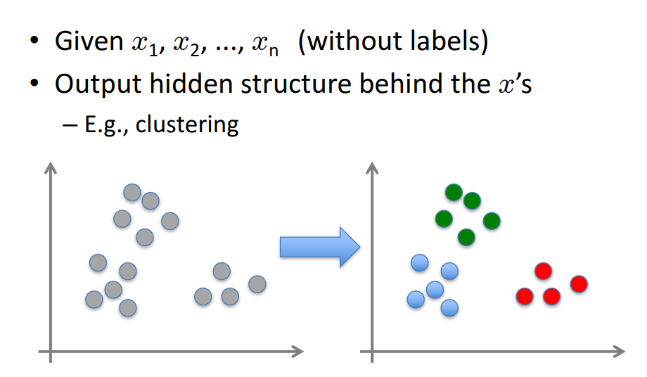
Un-Supervised Learning

Slide 26
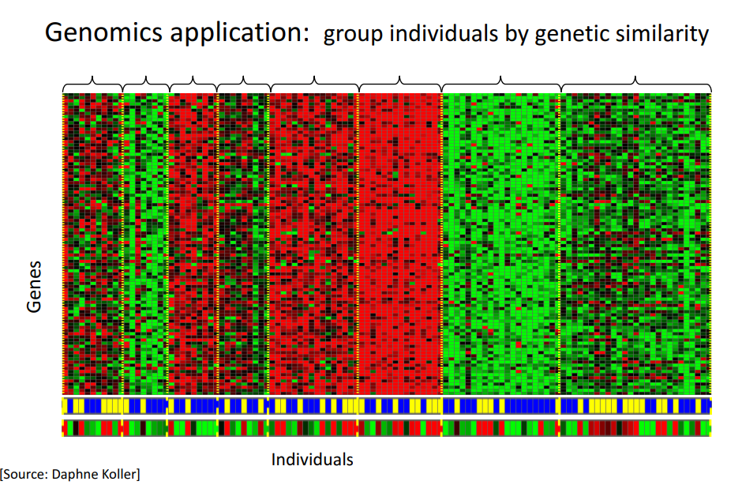
Un-Supervised Learning

Slide 27
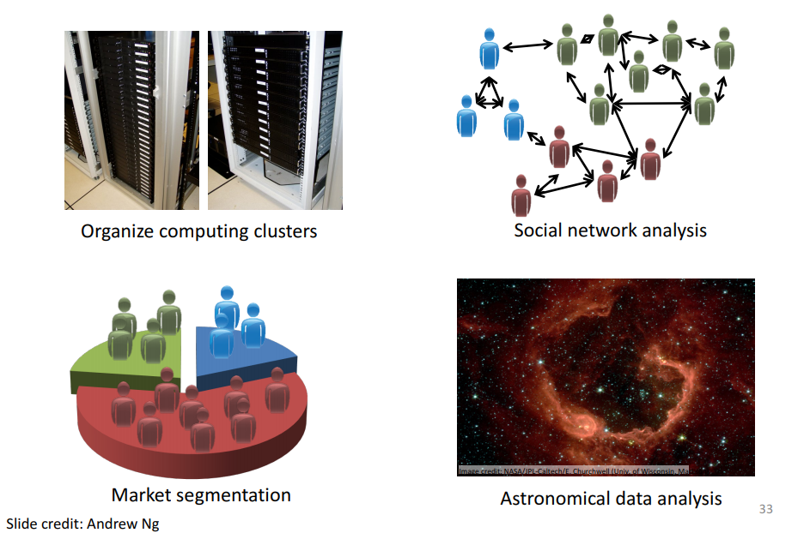
Un-Supervised Learning

Slide 28
Data Mining, Machine Learning
&
The Knowledge Discovery Process
Bamshad Mobasher
DePaul University

