Slide 1
Clustering
Basic Concepts and Algorithms
Bamshad Mobasher
DePaul University

Slide 2
Clustering
Agenda
  Clustering Problem and Clustering Applications
  Clustering Methodologies and Techniques
    Graph-based clustering methods
    K-Means and allocation-based methods
    Hierarchical Agglomerative Clustering
    Evaluating clustering
  Applications of Clustering in IR and Recommender systems

Slide 3
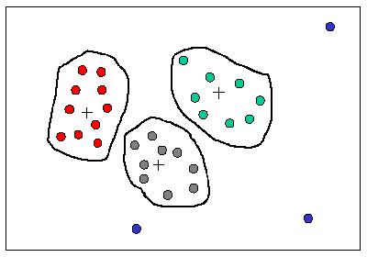
What is Clustering?
Clustering is the (unsupervised) process of partitioning a set of data objects into a set of meaningful sub-classes, called clusters
Goal is to understand the natural groupings or structures in a data set
Cluster:
  a collection of data objects that are “similar” to one another and thus can be treated collectively as one group
  but as a collection, they are sufficiently different from other groups

Slide 4
Applications of Clustering
Clustering has wide applications in Pattern Recognition
Spatial Data Analysis / Image processing:
  create thematic maps in GIS by clustering feature spaces
  detect spatial clusters and explain them in spatial data mining
Market Research: Market/User segmentation
Information Retrieval
  Document or term categorization
  automatic thesaurus generation by clustering related terms
  Information visualization and IR interfaces
Personalization/Recommendation
  Cluster users and use the clusters as prototypes corresponding to user groups with similar tastes; for new users, measure similarity to prototypes as their “neighborhood”
  Cluster items (based on feature similarities); measure similarity to new user to recommend a group of items

Slide 5
Clustering Methodologies
Two general methodologies
  Partitioning Based Algorithms
  Hierarchical Algorithms
Partitioning Based
  Divide a set of N items into K clusters (top-down)
  Reallocation methods (e.g., K-means, K-medoids)
  Density or model-based methods (e.g., DBSCAN, EM)
Hierarchical
  Agglomerative: pairs of items or clusters are successively linked to produce larger clusters
  Divisive: start with the whole set as a cluster and successively divide sets into smaller partitions

Slide 6
Recall: Distance or Similarity Measures
Many clustering algorithms rely on measuring similarities or distances among items
  Consider two vectors:
  Manhattan distance:
  Euclidean distance:
  Cosine similarity:

Slide 7
Recall: Other Similarity Measures
In vector-space model any of the similarity measures discussed before can be used in clustering
Dice’s Coefficient
Dot Product
Cosine Coefficient
Jaccard’s Coefficient

Slide 8
Distance (Similarity) Matrix
Similarity (Distance) Matrix
  based on the distance or similarity measure we can construct a symmetric matrix of distance (or similarity) values
  (i, j) entry in the matrix is the distance (similarity) between items i and j
Note that d_{ij} = d_{ji} (i.e., the matrix is symmetric. So, we only need the lower triangle part of the matrix.
The diagonal is all 1’s (similarity) or all 0’s (distance)

Slide 9
Example: Term Similarities in Documents
Suppose we want to cluster terms that appear in a collection of documents with different frequencies
We need to compute a term-term similarity matrix
  For simplicity we use the dot product as similarity measure (in practice you should use a normalized measure such as Cosine similarity)
  Example:
Each term can be viewed as a vector over documents
N = total number of dimensions (in this case documents)
w_{ik} = weight of term i in document k.
Sim(T1,T2) = <0,3,3,0,2> * <4,1,0,1,2>
0x4 + 3x1 + 3x0 + 0x1 + 2x2 = 7

Slide 10
Similarity Matrix - Example
A =
Term-Term
Similarity Matrix
Note that this similarity matrix can be obtained by multiplying the transposes of the above doc x term matrix with itself: A^{T}.A

Slide 11
Similarity Thresholds
A similarity threshold can be used to mark pairs that are “sufficiently” similar: the threshold value is highly application and data dependent
Using a threshold value of 10 in the previous example

Slide 12
Graph Representation
The similarity matrix can be visualized as an undirected graph
  each item is represented by a node, and edges represent the fact that two items are similar (a one in the similarity threshold matrix)
T1
T3
T5
T4
T2
If no threshold is used, then
matrix can be represented as
a weighted graph
T7
T6
T8

Slide 13
Graph-Based Clustering Algorithms
If we are interested only in threshold (and not the degree of similarity or distance), we can use the similarity graph directly for clustering
Clique Method (complete link)
  all items within a cluster must be within the similarity threshold of all other items in that cluster
  clusters may overlap
  generally produces small but very tight clusters
Single Link Method
  any item in a cluster must be within the similarity threshold of at least one other item in that cluster
  produces larger but weaker clusters
Other methods
  star method - start with an item and place all related items in that cluster
  string method - start with an item; place one related item in that cluster; then place anther item related to the last item entered, and so on

Slide 14
Graph-Based Clustering Algorithms
Clique Method
  a clique is a completely connected subgraph of a graph
  in the clique method, each maximal clique in the graph becomes a cluster
T1
T3
Maximal cliques (and therefore the clusters) in the previous example are:
{T1, T3, T4, T6}
{T2, T4, T6}
{T2, T6, T8}
{T1, T5}
{T7}
Note that, for example, {T1, T3, T4} is also a clique, but is not maximal.
T5
T4
T2
T7
T6
T8

Slide 15
Graph-Based Clustering Algorithms
Single Link Method
  selected an item not in a cluster and place it in a new cluster
  place all other similar item in that cluster
  repeat step 2 for each item in the cluster until nothing more can be added
  repeat steps 1-3 for each item that remains unclustered
T1
T3
In this case the single link method produces only two clusters:
{T1, T3, T4, T5, T6, T2, T8}
{T7}
Note that the single link method does not allow overlapping clusters, thus partitioning the set of items.
T5
T4
T2
T7
T6
T8

Slide 16
Clustering with Existing Clusters
The notion of comparing item similarities can be extended to clusters themselves, by focusing on a representative vector for each cluster
  cluster representatives can be actual items in the cluster or other “virtual” representatives such as the centroid
  this methodology reduces the number of similarity computations in clustering
  clusters are revised successively until a stopping condition is satisfied, or until no more changes to clusters can be made
Partitioning Methods
  reallocation method - start with an initial assignment of items to clusters and then move items from cluster to cluster to obtain an improved partitioning
  Single pass method - simple and efficient, but produces large clusters, and depends on order in which items are processed
Hierarchical Agglomerative Methods
  starts with individual items and combines into clusters
  then successively combine smaller clusters to form larger ones
  grouping of individual items can be based on any of the methods discussed earlier

Slide 17
The K-Means Clustering Method
Given the number of desired clusters k, the K-means algorithm follows four steps:
  Randomly assign objects to create k nonempty initial partitions (clusters)
  Compute the centroids of the clusters of the current partitioning (the centroid is the center, i.e., mean point, of the cluster)
  Assign each object to the cluster with the nearest centroid (reallocation step)
  Go back to Step 2, stop when the assignment does not change

Slide 18
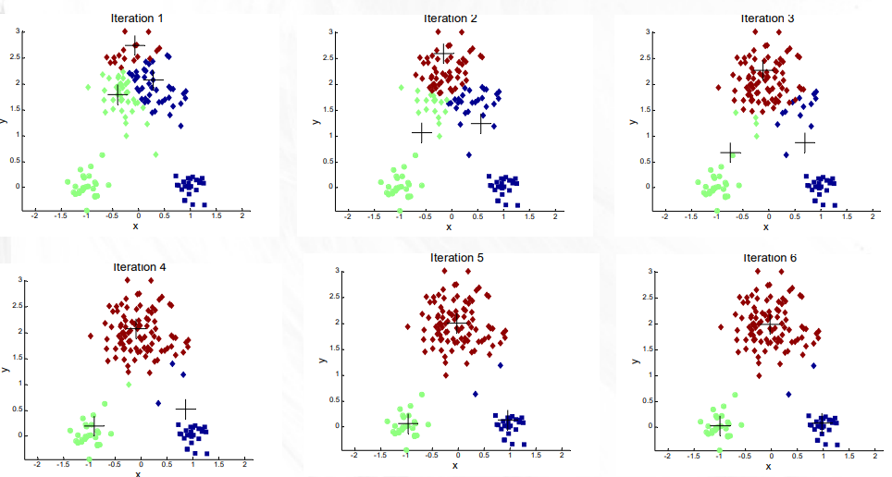
The K-Means Clustering Method

Slide 19
K-Means Example: Document Clustering
Initial (arbitrary) assignment:
C1 = {D1,D2},
C2 = {D3,D4},
C3 = {D5,D6}
Cluster Centroids
Now compute the similarity (or distance) of each item to each cluster, resulting a cluster-document similarity matrix (here we use dot product as the similarity measure).

Slide 20
Example (Continued)
For each document, reallocate the document to the cluster to which it has the highest similarity (shown in red in the above table). After the reallocation we have the following new clusters. Note that the previously unassigned D7 and D8 have been assigned, and that D1 and D6 have been reallocated from their original assignment.
C1 = {D2,D7,D8}, C2 = {D1,D3,D4,D6}, C3 = {D5}
This is the end of first iteration (i.e., the first reallocation). Next, we repeat the process for another reallocation…

Slide 21
Example (Continued)
Now compute new cluster centroids using the original document-term matrix
C1 = {D2,D7,D8}, C2 = {D1,D3,D4,D6}, C3 = {D5}
This will lead to a new cluster-doc similarity matrix similar to previous slide. Again, the items are reallocated to clusters with highest similarity.
New assignment →
C1 = {D2,D6,D8}, C2 = {D1,D3,D4}, C3 = {D5,D7}
Note: This process is now repeated with new clusters. However, the next iteration in this example
Will show no change to the clusters, thus terminating the algorithm.

Slide 22
K-Means Algorithm
Strength of the k-means:
  Relatively efficient: O(tkn), where n is # of objects, k is # of clusters, and t is # of iterations. Normally, k, t << n
  Often terminates at a local optimum
Weakness of the k-means:
  Applicable only when mean is defined; what about categorical data?
  Need to specify k, the number of clusters, in advance
  Unable to handle noisy data and outliers
Variations of K-Means usually differ in:
  Selection of the initial k means
  Dissimilarity calculations
  Strategies to calculate cluster means

Slide 23
Single Pass Method
The basic algorithm:
  1. Assign the first item T₁ as representative for C₁
  2. for item T_{i} calculate similarity S with centroid for each existing cluster
  3. If S_{max} is greater than threshold value, add item to corresponding cluster and recalculate centroid; otherwise use item to initiate new cluster
  4. If another item remains unclustered, go to step 2
  See: Example of Single Pass Clustering Technique
This algorithm is simple and efficient, but has some problems
  generally does not produce optimum clusters
  order dependent - using a different order of processing items will result in a different clustering

Slide 24
Clustering
Hierarchical Clustering

Slide 25
Hierarchical Clustering Algorithms
Two main types of hierarchical clustering
  Agglomerative:
    Start with the points as individual clusters
    At each step, merge the closest pair of clusters until only one cluster (or k clusters) left
  Divisive:
    Start with one, all-inclusive cluster
    At each step, split a cluster until each cluster contains a point (or there are k clusters)
Traditional hierarchical algorithms use a similarity or distance matrix
  Merge or split one cluster at a time

Slide 26
Hierarchical Algorithms
Use distance matrix as clustering criteria
  does not require the no. of clusters as input, but needs a termination condition
Step 0
Step 1
Step 2
Step 3
Step 4
Agglomerative
a
ab
b
abcde
c
cd
d
cde
e
Divisive
Step 4
Step 3
Step 2
Step 1
Step 0

Slide 27
Hierarchical Agglomerative Clustering
HAC starts with unclustered data and performs successive pairwise joins among items (or previous clusters) to form larger ones
  this results in a hierarchy of clusters which can be viewed as a dendrogram
  useful in pruning search in a clustered item set, or in browsing clustering results
A B C D E F G H I

Slide 28
Hierarchical Agglomerative Clustering
Basic procedure
  1. Place each of N documents into a class of its own.
  2. Compute all pairwise document-document similarity coefficients
    Total of N(N-1)/2 coefficients
  3. Form a new cluster by combining the most similar pair of current clusters i and j
    [there are different methods, discussed next, to compute inter-cluster similarities, e.g., single link, complete link, Ward’s, etc.]
    update similarity matrix by deleting the rows and columns corresponding to i and j;
    calculate the entries in the row corresponding to the new cluster i+j.
  4. Repeat step 3 if the number of clusters left is great than 1.

Slide 29
Hierarchical Agglomerative Clustering
:: Example
4
1
2
5
5
2
3
6
distance
3
1
4
Nested Clusters
Dendrogram

Slide 30
Distance Between Two Clusters
The basic procedure varies based on the method used to determine inter-cluster distances or similarities
Different methods results in different variants of the algorithm
  Single link
  Complete link
  Average link
  Ward’s method
  Etc.

Slide 31
HAC: Starting Situation
Start with clusters of individual points and a proximity matrix
p1
p2
p3
p4
p5
. . .
p1
p2
p3
p4
p5
.
.
.
Proximity Matrix

Slide 32
HAC: Intermediate Situation
After some merging steps, we have some clusters
C1
C2
C3
C4
C5
C1
C2
C3
C3
C4
C4
C5
Proximity Matrix
C1
C2
C5

Slide 33
HAC: Join Step
We want to merge the two closest clusters (C2 and C5) and update the proximity matrix.
C1
C2
C3
C4
C5
C1
C2
C3
C4
C3
C5
C4
Proximity Matrix
C1
C2
C5

Slide 34
After Merging
The question is “How do we update the proximity matrix?”
C2
U C5
C1
C3
C4
C1
?
C2 U C5
? ? ?
C3
C3
?
C4
C4
?
Proximity Matrix
C1
C2 U C5

Slide 35
How to Define Inter-Cluster Similarity
p1
p2
p3
p4
p5
. . .
Similarity?
p1
p2
p3
p4
p5
.
.
.
MIN Distance (Single Link)
MAX Distance (Complete Link)
Group Average
Distance Between Centroids
Proximity Matrix

Slide 36
How to Define Inter-Cluster Similarity
p1
p2
p3
p4
p5
. . .
p1
p2
p3
p4
Single Link
Similarity of two clusters is the similarity of the two closest points (the two points with min distance or max similarity) between the clusters
  Determined by one pair of points, i.e., by one link in the proximity graph.
p5
.
.
.
Proximity Matrix

Slide 37
Distance between two clusters
Single-link:
Example Scenario: Clusters {I1,I2} and {I4,I5} have already been formed. Next consider which cluster should {I3} join.
1
2
3
4
5
Note that max similarity of I3 is with I2 in cluster {I1,I2} and with I4 in {I4,I5}. But I3 is more similar to I2 than to I4, so {I3} will join {I1,I2}.

Slide 38
How to Define Inter-Cluster Similarity
p1
p2
p3
p4
p5
. . .
p1
p2
p3
p4
Complete Link
Similarity of two clusters is based on the similarity of the two least similar (most distant) points between the clusters
p5
.
.
.
Proximity Matrix

Slide 39
Distance between two clusters
Complete Link:
Example: Clusters {I1,I2} and {I4,I5} have already been formed. Again, let’s consider whether {3} should be joined with {I1,I2} or with {I4,I5} .
1
2
3
4
5
Note that min similarity of I3 is with I5 in {I4,I5} and with I1 in {I1,I2}. But, I3 is more similar to I5 than to I1.

Slide 40
How to Define Inter-Cluster Similarity
p1
p2
p3
p4
p5
. . .
p1
p2
p3
p4
Group Average
Similarity of two clusters is the average of pairwise similarity between points in the two clusters
p5
.
.
.
Proximity Matrix

Slide 41
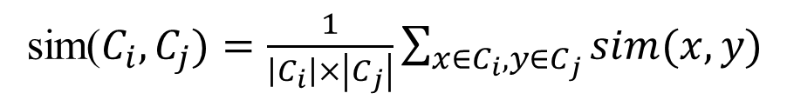
Distance between two clusters
sim($C_{i},C_{j})=\frac{1}{\left|C_{i}\right|×\left|C_{j}\right|}\sum_{x∈C_{i},y∈C_{j}}{sim(x,y)}$
Group average:
1
2
3
4
5

Slide 42
How to Define Inter-Cluster Similarity
p1
p2
p3
p4
p5
. . .
×
×
p1
p2
p3
p4
Distance between Centroids
Similarity between the centroid vectors of the two clusters
p5
.
.
.
Proximity Matrix

Slide 43
Clustering
Evaluating Clustering; Clustering Applications

Slide 44
Quality: What Is Good Clustering?
A good clustering method will produce high quality clusters
  high intra-class similarity: cohesive within clusters
  low inter-class similarity: distinctive between clusters
The quality of a clustering method depends on
  the similarity measure used
  its implementation, and
  its ability to discover some or all of the hidden patterns

Slide 45
Measures of Cluster Quality
Numerical measures that are applied to judge various aspects of cluster quality:
  External Criteria: Used to measure the extent to which cluster labels match externally supplied class labels.
    entropy, completeness/homogeneity
  Internal Criteria: Used to measure the goodness of a clustering structure without respect to external information.
    Sum of Squared Error (SSE)
    Cohesion/Separation

Slide 46
Internal Measures: Cohesion & Separation
Cluster Cohesion: Measures how closely related are objects in a cluster
Cluster Separation: Measures how distinct or well-separated a cluster is from other clusters
Example: Sum of Squared Errors (SSE)
  Cohesion can be measured by the within cluster sum of squared distances to the cluster centroid:
  Separation can be measured by the between cluster sum of squared distances
      where |C_{i}| is the size of cluster i

Slide 47
Internal Measures: Cohesion & Separation
A proximity graph based approach can also be used for cohesion and separation.
  Cluster cohesion is the sum of the weight of all links within a cluster.
  Cluster separation is the sum of the weights between nodes in the cluster and nodes outside the cluster.
cohesion
separation

Slide 48
Internal Measures: SSE
SSE can also be used to estimate the number of clusters
  For each value of k, measure overall SSE across all clusters
  Use the elbow method (Scree plot) to determine best value of k

Slide 49

Internal Measures: Silhouette Coefficient
Silhouette Coefficient combines cohesion and separation, but for individual points, as well as clusters
For an individual point, i
  Calculate a(i) = average distance of i to the points in its cluster
  Calculate b(i) = min (average distance of i to points in another cluster)
  The silhouette coefficient for a point is then given by:
  Typically between 0 and 1
  The closer to 1 the better
Can calculate the Average Silhouette width for a cluster or a clustering as a whole

Slide 50
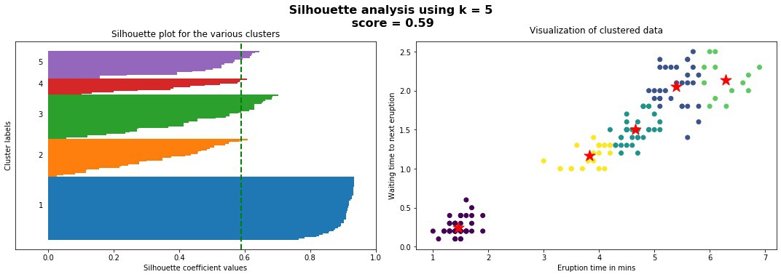
Internal Measures: Silhouette Coefficient
a(i) = average distance of i to the points in its cluster
b(i) = min (average distance of i to points in another cluster)

Slide 51
Clustering Application:
Discovery of Content Profiles
Content Profiles
  Goal: automatically group together docs which partially deal with similar concepts
  Method:
    identify concepts by clustering features (terms) based on their common occurrences among docs (can also be done using association/correlation measures, or word embeddings)
    cluster centroids represent docs in which features in the cluster appear frequently
  Content profiles are derived from centroids after filtering out low-weight docs in each centroid
  The weight of a doc in a profile represents the degree to which features in the corresponding cluster appear in that doc.

Slide 52
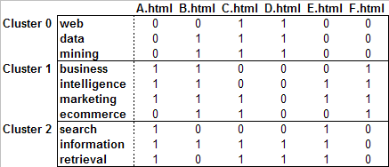
Content Profiles – An Example
Filtering threshold = 0.5
PROFILE 0 (Cluster Size = 3)
--------------------------------------------------------------------------------------------------------------
1.00 C.html (web, data, mining)
1.00 D.html (web, data, mining)
0.67 B.html (data, mining)
PROFILE 1 (Cluster Size = 4)
-------------------------------------------------------------------------------------------------------------
1.00 B.html (business, intelligence, marketing, ecommerce)
1.00 F.html (business, intelligence, marketing, ecommerce)
0.75 A.html (business, intelligence, marketing)
0.50 C.html (marketing, ecommerce)
0.50 E.html (intelligence, marketing)
PROFILE 2 (Cluster Size = 3)
-------------------------------------------------------------------------------------------------------------
1.00 A.html (search, information, retrieval)
1.00 E.html (search, information, retrieval)
0.67 C.html (information, retrieval)
0.67 D.html (information, retireval)

Slide 53
Clustering for Collaborative Recommendation
Basic Idea
  Generate aggregate user models by clustering user profiles
    Each cluster centroid will represent a user group with similar interests
  Match a user’s profile against the discovered models (centroids) to provide dynamic content (online process)
  Similar to the Rocchio method for classification, but now users are matched with automatically discovered clusters
Advantages
  Can be applied to different types of user data (ratings, click-throughs, items purchased, etc.)
  Helps enhance the scalability of collaborative filtering (e.g., user-based Knn)

Slide 54
Conceptual Representation of User Profile Data
Items
User Profiles

Slide 55
Example: Clustering for Web Personalization
User navigation sessions
Given an active session A ➔ B, the best matching profile is Profile 1. This may result in a recommendation for page F.html, since it appears with high weight in that profile.
Result of
Clustering
PROFILE 0 (Cluster Size = 3)
--------------------------------------
1.00 C.html
1.00 D.html
PROFILE 1 (Cluster Size = 4)
--------------------------------------
1.00 B.html
1.00 F.html
0.75 A.html
0.25 C.html
PROFILE 2 (Cluster Size = 3)
--------------------------------------
1.00 A.html
1.00 D.html
1.00 E.html
0.33 C.html

Slide 56
Clustering and Collaborative Filtering
:: Example - clustering based on ratings
Consider the following book ratings data (Scale: 1-5)
 | TRUE BELIEVER | THE DA VINCI CODE | THE WORLD IS FLAT | MY LIFE SO FAR | THE TAKING | THE KITE RUNNER | RUNNY BABBIT | HARRY POTTER
U1 | 1 | 5 |  | 3 |  |  | 3 | 5
U2 | 5 | 4 |  |  | 3 | 2 | 1
U3 | 3 |  | 1 | 2 | 2 |  |  | 5
U4 |  | 3 |  |  | 4 | 1 |  | 3
U5 | 2 | 4 | 3 |  |  | 2 | 2
U6 | 5 |  |  | 3 | 1 |  | 3 | 1
U7 | 1 | 4 | 5 | 5 | 2 |  |  | 4
U8 | 2 | 1 |  |  | 4 | 5 | 1
U9 |  |  | 3 | 2 | 2 |  |  | 5
U10 | 3 | 5 | 1 |  |  |  | 4 | 4
U11 |  |  | 2 | 1 |  | 2 |  | 3
U12 | 4 | 4 |  | 2 |  | 1 | 1 | 4
U13 |  |  | 2 |  | 4 |  | 4 | 5
U14 |  | 5 | 3 | 3 | 2 |  | 1 | 1
U15 |  | 2 |  |  | 3 | 3 |  | 2
U16 |  | 3 | 2 | 1 | 1 |  | 4 | 4
U17 | 1 | 5 | 1 | 2 |  | 4 |  | 4
U18 | 5 |  | 4 |  | 3 | 3 | 4 | 5
U19 |  | 4 |  | 2 |  | 5 | 1 | 5
U20 | 2 | 5 | 1 | 1 | 5 | 3 |  | 4

Slide 57
Clustering and Collaborative Filtering
:: Example - clustering based on ratings
Cluster centroids after k-means clustering with k=4
In this case, each centroid represented the
average rating (in that cluster of users) for each item
The first column shows the centroid of the whole data
set, i.e., the overall item average ratings across all users
 | Full Data | Cluster 0 | Cluster 1 | Cluster 2 | Cluster 3
 | Size=20 | Size=4 | Size=7 | Size=4 | Size=5
TRUE BELIEVER | 2.83 | 4.21 | 1.81 | 2.83 | 3.17
THE DA VINCI CODE | 3.86 | 4.21 | 3.84 | 2.96 | 4.31
THE WORLD IS FLAT | 2.33 | 2.50 | 2.71 | 2.17 | 1.80
MY LIFE SO FAR | 2.25 | 2.56 | 2.64 | 1.63 | 1.95
THE TAKING | 2.77 | 2.19 | 2.73 | 2.69 | 3.35
THE KITE RUNNER | 2.82 | 2.16 | 3.49 | 2.20 | 2.89
RUNNY BABBIT | 2.42 | 1.50 | 2.04 | 2.81 | 3.37
HARRY POTTER | 3.76 | 2.44 | 4.36 | 3.00 | 4.60
How do we compute predicted rating for “The Da Vinci Code” for a user NU1:
NU1 = {“The Believer”: 3; “The Taking”: 3.5; “Runny Babbit”: 3}?

Slide 58
Clustering and Collaborative Filtering
:: Example - clustering based on ratings
This approach provides a model-based (and more scalable) version
of user-based collaborative filtering, compared to k-nearest-neighbor
 | Full Data | Cluster 0 | Cluster 1 | Cluster 2 | Cluster 3 |  | New User NU1
 | Size=20 | Size=4 | Size=7 | Size=4 | Size=5
TRUE BELIEVER | 2.83 | 4.21 | 1.81 | 2.83 | 3.17 |  | 3.00
THE DA VINCI CODE | 3.86 | 4.21 | 3.84 | 2.96 | 4.31
THE WORLD IS FLAT | 2.33 | 2.50 | 2.71 | 2.17 | 1.80 |  | 3.00
MY LIFE SO FAR | 2.25 | 2.56 | 2.64 | 1.63 | 1.95
THE TAKING | 2.77 | 2.19 | 2.73 | 2.69 | 3.35 |  | 4.00
THE KITE RUNNER | 2.82 | 2.16 | 3.49 | 2.20 | 2.89 |  | 3.00
RUNNY BABBIT | 2.42 | 1.50 | 2.04 | 2.81 | 3.37
HARRY POTTER | 3.76 | 2.44 | 4.36 | 3.00 | 4.60 |  | 4.00
Correlation w/ NU1 | 0.63 | -0.41 | 0.50 | 0.65 | 0.74
NU1 has highest similarity to cluster 3 centroid. The whole cluster could
be used as the “neighborhood” for NU1.

Slide 59
User Segments Based on Content
Essentially combines the collaborative and content profiling techniques discussed earlier
Basic Idea:
  for each user, extract important features of the selected documents/items
  based on the global dictionary create a user-feature matrix
  each row (user) is a feature vector representing significant terms associated with documents/items selected/rated by the user
  weight can be determined as discussed earlier (e.g., tf.idf, etc.)
  next, cluster users using features (instead of items) as dimensions
Profile generation:
  from the user clusters centroids are now represented as feature vectors
  the weights associated with features in each centroid represents the significance of that feature for the corresponding group of users

Slide 60
 | A | B | C | D | E
user1 | 1 | 0 | 1 | 0 | 1
user2 | 1 | 1 | 0 | 0 | 1
user3 | 0 | 1 | 1 | 1 | 0
user4 | 1 | 0 | 1 | 1 | 1
user5 | 1 | 1 | 0 | 0 | 1
user6 | 1 | 0 | 1 | 1 | 1
User-Item profile matrix U
 | A | B | C | D | E
web | 0 | 0 | 1 | 1 | 1
data | 0 | 1 | 1 | 1 | 0
mining | 0 | 1 | 1 | 1 | 0
business | 1 | 1 | 0 | 0 | 0
intelligence | 1 | 1 | 0 | 0 | 1
marketing | 1 | 1 | 0 | 0 | 1
ecommerce | 0 | 1 | 1 | 0 | 0
search | 1 | 0 | 1 | 0 | 0
information | 1 | 0 | 1 | 1 | 1
retrieval | 1 | 0 | 1 | 1 | 1
Feature-Item
Matrix F

Slide 61
Content Enhanced Profiles
User-Feature
Matrix UF
UF = U x F^{T}
 | web | data | mining | business | intelligence | marketing | ecommerce | search | information | retrieval
user1 | 2 | 1 | 1 | 1 | 2 | 2 | 1 | 2 | 3 | 3
user2 | 1 | 1 | 1 | 2 | 3 | 3 | 1 | 1 | 2 | 2
user3 | 2 | 3 | 3 | 1 | 1 | 1 | 2 | 1 | 2 | 2
user4 | 3 | 2 | 2 | 1 | 2 | 2 | 1 | 2 | 4 | 4
user5 | 1 | 1 | 1 | 2 | 3 | 3 | 1 | 1 | 2 | 2
user6 | 3 | 2 | 2 | 1 | 2 | 2 | 1 | 2 | 4 | 4
Example: users 4 and 6 are more interested in concepts related to Web information retrieval, while user 3 is more interested in data mining.
We can now cluster users as before to generate user segments, but now clustering is based on users’ interests in content features.

Slide 62
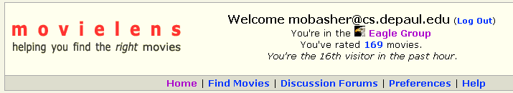
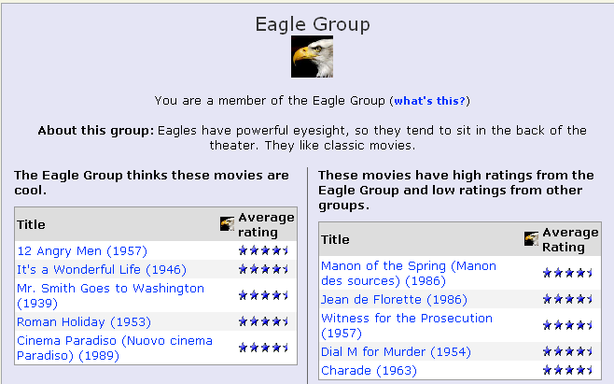
Clustering and Collaborative Filtering
:: clustering based on ratings: movielens

Slide 63
Scatter/Gather:
Early Use of Clustering in IR
Cutting, Pedersen, Tukey & Karger 92, 93, Hearst & Pedersen 95
Cluster-based browsing technique for large text collections
  Cluster sets of documents into general “themes”, like a table of contents
  Display the contents of the clusters by showing topical terms and typical titles
  The user may then select (gather) clusters that seem interesting
  These clusters can then be re-clustered (scattered) to reveal more fine-grained clusters of documents
  With each successive iteration of scattering and gathering, the clusters become smaller and more detailed, eventually bottoming out at the level of individual documents
  Clustering and re-clustering is entirely automated
Originally used to give collection overview
Evidence suggests more appropriate for displaying retrieval results in context

Slide 64
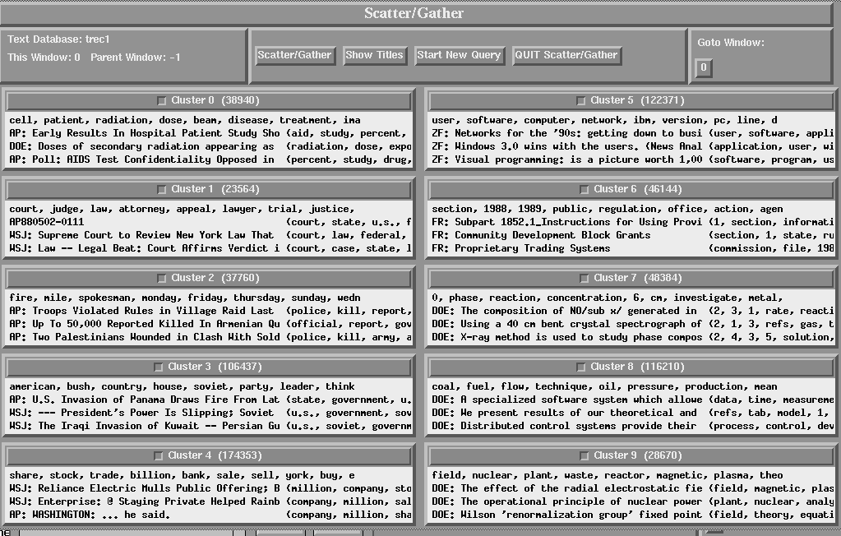
Scatter/Gather Interface

Slide 65
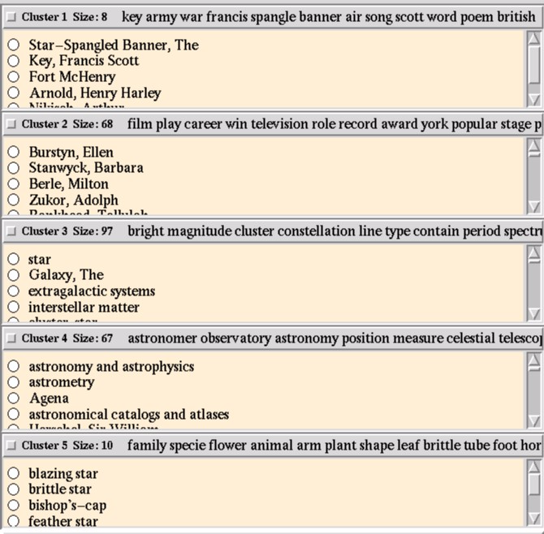
Scatter/Gather Clusters

Slide 66
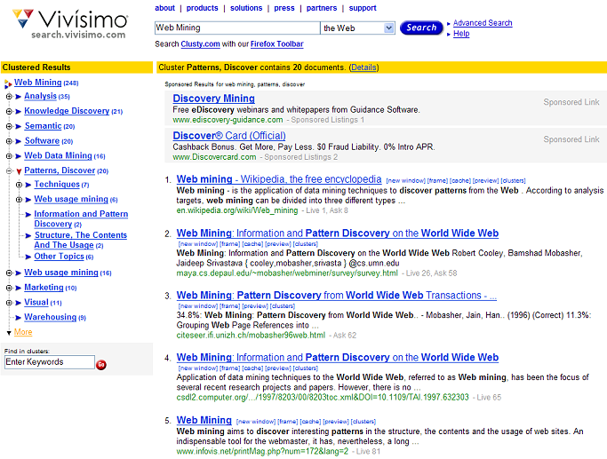
Hierarchical Clustering
:: example – clustered search results
Can drill down within clusters to view sub-topics or to view the relevant subset of results

Slide 67
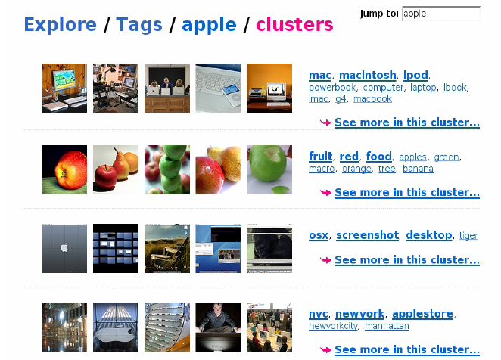
Clustering and Collaborative Filtering
:: tag clustering example

Slide 68
Clustering
Basic Concepts and Algorithms
Bamshad Mobasher
DePaul University

