Slide 1
CSC 480 Artificial Intelligence I Bamshad Mobasher Depaul University
Adversarial Search & Games

Slide 2
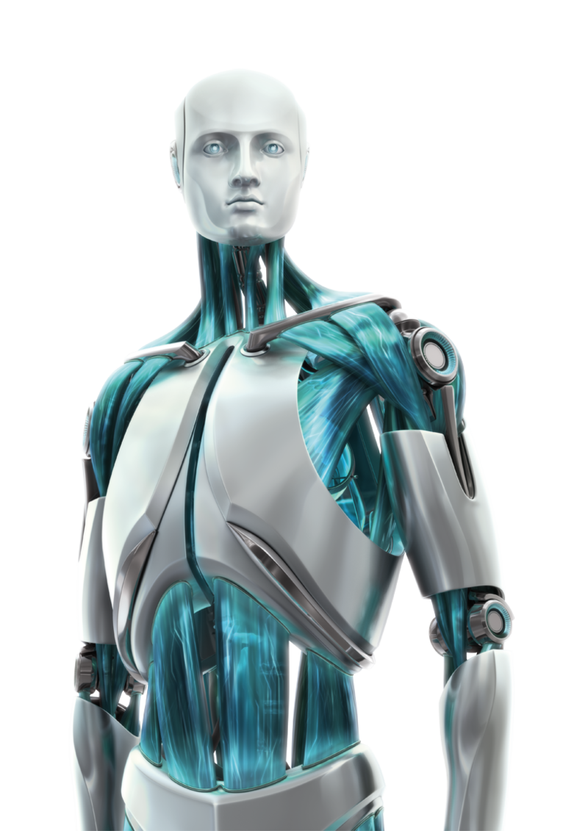
Games and AI
Why games?
Games like Chess or Go are compact settings that mimic the uncertainty of interacting with the natural world involving other rational agents
For centuries humans have used them to exert their intelligence
Recently, there has been great success in building game programs that challenge human supremacy
Interesting, hard problems which require minimal “initial structure”
Clear criteria for success
Offer an opportunity to study problems involving {hostile, adversarial, competing} agents and the uncertainty of interacting with the natural world
Games often involve very large search spaces

Slide 3
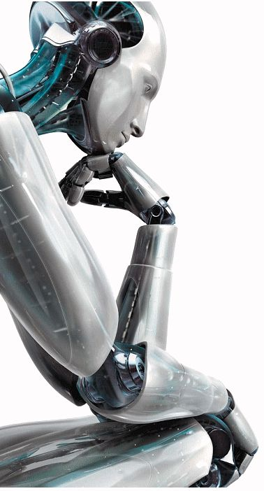
Games vs. Standard Search
"Unpredictable" opponent
Solution is a strategy
Must specify a move for every possible opponent reply
Time limits
Generally intractable search space, so agents cannot enumerate all possible winning moves
Unlikely to find goal, must approximate

Slide 4
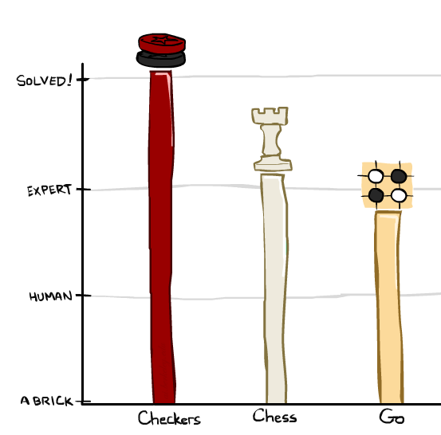
Game Playing State-of-the-Art
Checkers: 1950: First computer player. 1994: First computer champion: Chinook ended 40-year-reign of human champion Marion Tinsley using complete 8-piece endgame. 2007: Checkers solved!
Chess: 1997: Deep Blue defeats human champion Gary Kasparov in a six-game match. Deep Blue examined 200M positions per second, used very sophisticated evaluation and undisclosed methods for extending some lines of search up to 40 ply. Current programs are even better, if less historic.
Go: In go, b > 300! Classic programs use pattern knowledge bases. 2016: Alpha GO defeats human champion. Uses Monte Carlo Tree Search, learned evaluation function using deep learning.

Slide 5
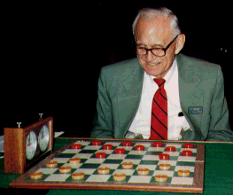
Checkers: Tinsley vs. Chinook
Name: Marion Tinsley
Profession: Teach mathematics
Hobby: Checkers
Record: Over 42 years, loses only 3 games of checkers, World champion for over 40 years
1994: Mr. Tinsley suffered his 4th and 5th losses against Chinook

Slide 6
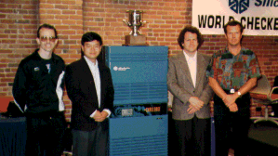
Chinook
Chinook is the World Man-Machine Checkers Champion, developed by researchers at the University of Alberta
It earned this title by competing in human tournaments, winning the right to play for the (human) world championship, and eventually defeating the best players in the world
Visit http://www.cs.ualberta.ca/~chinook/ to play a version of Chinook over the Internet.

Slide 7
Chess: Kasparov vs. Deep Blue
Kasparov
5’10”
176 lbs
34 years
50 billion neurons
2 pos/sec
Extensive
Electrical/chemical
Enormous
Height
Weight
Age
Computers
Speed
Knowledge
Power Source
Ego
Deep Blue
6’ 5”
2,400 lbs
4 years
32 RISC processors + 256 VLSI chess engines
200,000,000 pos/sec
Primitive
Electrical
None
1997: Deep Blue wins by 3 wins, 1 loss, and 2 draws

Slide 8
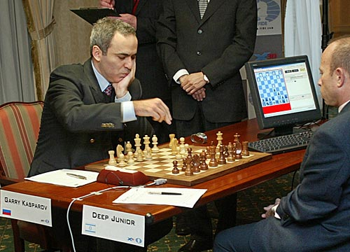
Chess: Kasparov vs. Deep Junior
Deep Junior
8 CPU, 8 GB RAM, Win 2000
2,000,000 pos/sec
Available at $100
August 2, 2003: Match ends in a 3/3 tie!

Slide 9
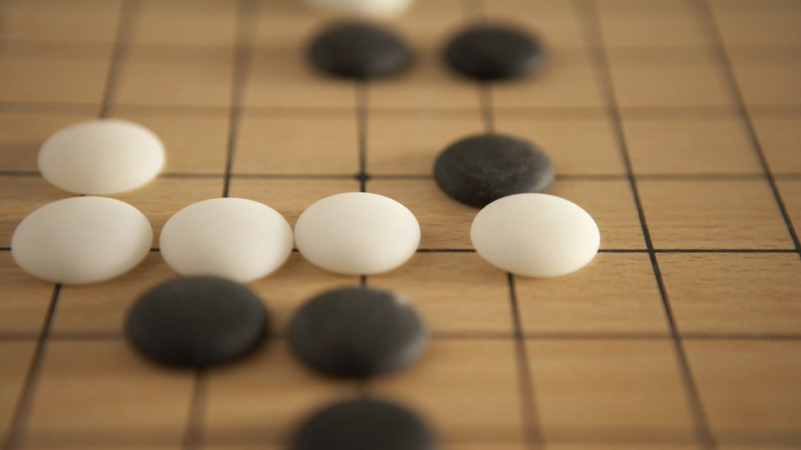
Go
AlphaGo is a computer program developed by Google DeepMind in London to play the board game Go. In October 2015, it became the first Computer Go program to beat a professional human Go player without handicaps on a full-sized 19×19 board. In March 2016, it beat Lee Sedol in a five-game match, the first time a computer Go program has beaten a 9-dan professional without handicaps. Although it lost to Lee Sedol in the fourth game, Lee resigned the final game, giving a final score of 4 games to 1 in favour of AlphaGo. In recognition of beating Lee Sedol, AlphaGo was awarded an honorary 9-dan by the Korea Baduk Association. It was chosen by Science as one of the Breakthrough of the Year runners-up on 22 December 2016.
AlphaGo's algorithm uses a Monte Carlo tree search to find its moves based on knowledge previously "learned" by machine learning, specifically by an artificial neural network (a deep learning method) by extensive training, both from human and computer play.

Slide 10
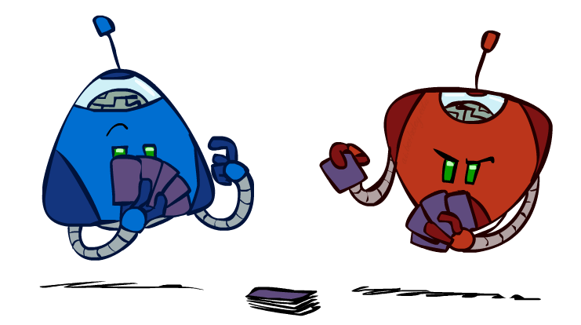
Types of Games
Many different kinds of games!
Deterministic or stochastic?
One, two, or more players?
Zero sum?
Perfect information (can you see the state)?
Want algorithms for calculating a strategy (policy) which recommends a move from each state

Slide 11
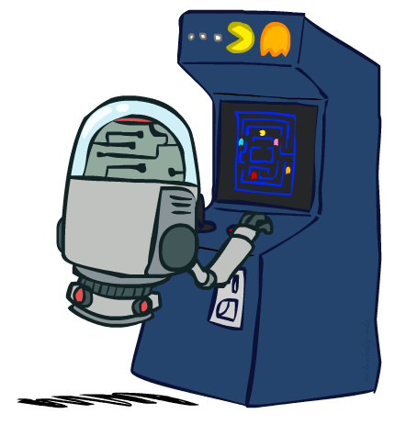
Deterministic Games
Many possible formalizations, one is:
States: S (start at s₀)
Players: P={1...N} (usually take turns)
Actions: A (may depend on player / state)
Transition Function: SxA → S
Terminal Test: S → {t,f}
Terminal Utilities: SxP → R
Solution for a player is a policy: S → A

Slide 12
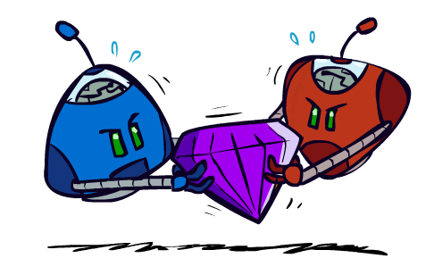
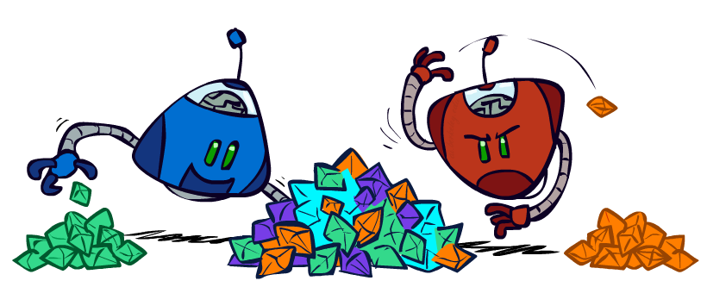
Zero-Sum Games
Zero-Sum Games
Agents have opposite utilities (values on outcomes)
Lets us think of a single value that one maximizes and the other minimizes
Adversarial, pure competition
General Games
Agents have independent utilities (values on outcomes)
Cooperation, indifference, competition, and more are all possible
More later on non-zero-sum games

Slide 13
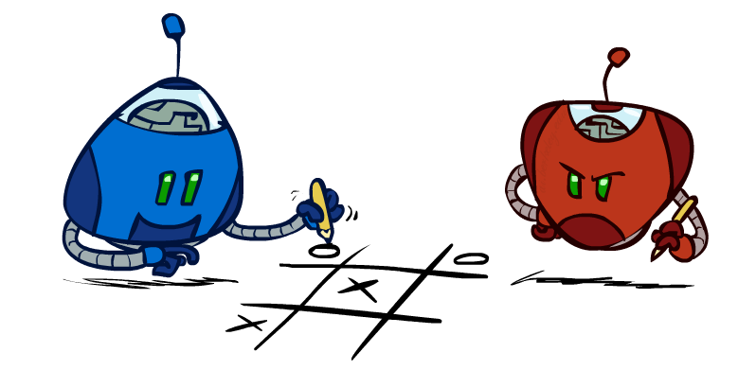
Min and Max
We focus on two-player perfect information games:
Uncertainty is caused by the actions of another agent (MIN), which competes with our agent (MAX)
MIN wants MAX to fail (and vice versa)
No plan exists that guarantees MAX’s success regardless of which actions MIN executes (the same is true for MIN)
At each turn, the choice of which action to perform must be made within a specified time limit
The state space is enormous: only a tiny fraction of this space can be explored within the time limit

Slide 14
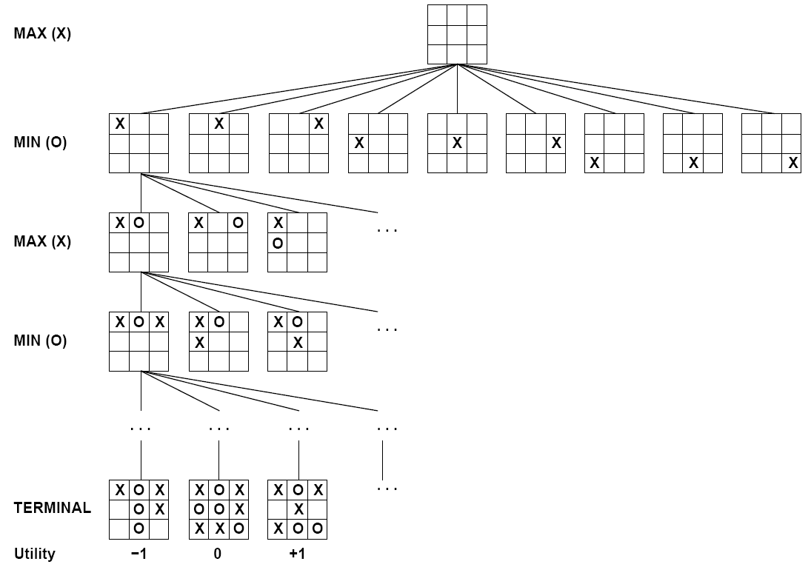
Tic-Tac-Toe Game Tree
Root node represents the initial board configuration; MAX must decide the best single move to make next
Children represent the possible legal moves for a player
Each level of the tree has nodes that are all MAX or all MIN
A utility function determines the value of a terminal node (e.g., +1 for win, -1 for loose, ….)

Slide 15
Game Tree (using symmetries)
MAX nodes
MAX’s play →
MIN nodes
MIN’s play →
Here, symmetries have been used to reduce the branching factor
Terminal state (win for MAX) →

Slide 16
That’s not how people play
People use “look ahead”
i.e. enumerate actions, consider opponent’s possible responses (a few moves ahead), REPEAT
Producing a complete game tree is only possible for simple games
So, generate a partial game tree for some number of plys
Move = each player takes a turn
Ply = one player’s turn
What do we do with the game tree?
Notes:
The minimax algorithm generates the entire game search space to search all the way
to terminal states for at least a portion of the search space. This depth is usually not practical,
because moves must be made in a reasonable amount of time—typically a few minutes at
most. Claude Shannon’s paper Programming a Computer for Playing Chess (1950) proposed
instead that programs should cut off the search earlier and apply a heuristic evaluation function
to states in the search, effectively EVALUATION turning nonterminal nodes into terminal leaves. In
other words, the suggestion is to alter minimax in two ways: replace the utility
function by a heuristic evaluation function EVAL, which estimates the position’s utility, and
replace the terminal test by a cutoff test that decides when to apply EVAL.

Slide 17
Choosing an Action: Minimax Algorithm
In general, the branching factor and the depth of terminal states are too large to be able to enumerate all possible actions
Chess:
Number of states: ~10⁴⁰
Branching factor: ~35
Number of total moves in a game: ~100
Solutions
Using the current state as the initial state, build the game tree uniformly to the maximal depth h (called horizon) feasible within the time limit
Evaluate the states of the leaf nodes (this requires an evaluation function the estimate the utilities of these nodes)
Back up the results from the leaves to the root and pick the best action assuming the best play by MIN (and worst for MAX)
This is called the Minimax algorithm

Slide 18
Minimax procedure
Create start node as a MAX node with current board configuration
Expand nodes down to some depth (a.k.a. ply) of look-ahead in the game
Apply the evaluation function at each of the leaf nodes
“Back up” values for each of the non-leaf nodes until a value is computed for the root node
At MIN nodes, the backed-up value is the minimum of the values associated with its children.
At MAX nodes, the backed-up value is the maximum of the values associated with its children.
Pick the move associated with the child node whose backed-up value determined the value at the root

Slide 19
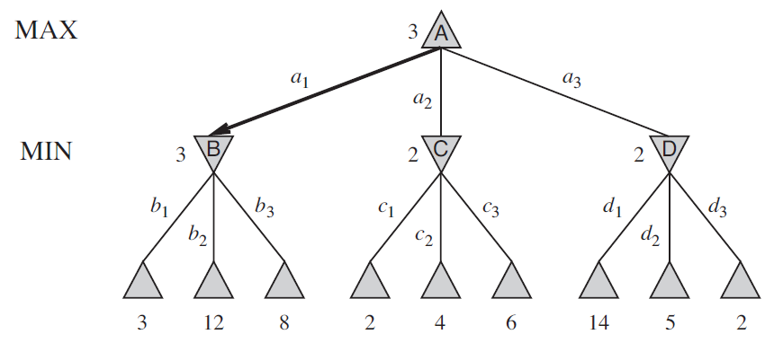
Minimax
Perfect play for deterministic games
Idea: choose move to position with highest minimax value = the best achievable utility against a rational (optimal) adversary
Example: 2-ply game (i.e., look ahead two moves):
The terminal nodes show the utility values for MAX; the other nodes are labeled with their minimax values.
MAX’s best move at the root is a1, because it leads to the state with the highest minimax value, and MIN’s best reply is b1, because it leads to the state with the lowest minimax value.

Slide 20
Evaluation function
Utility values of terminal nodes are determined based on a heuristic evaluation function
An evaluation function returns an estimate of the expected utility of the game from a given position, just as the heuristic functions in search algorithms return an estimate of the distance to (or cost of reaching) the goal.
Zero-sum assumption lets us use a single evaluation function to describe goodness of a board wrt both players

Slide 21
Evaluation Function
Function E: state s → number E(s)
E(s) is a heuristics: estimates how favorable s is for MAX
E(s) > 0 → s is favorable to MAX (the larger the better)
E(s) < 0 → s is favorable to MIN
E(s) = 0 → s is neutral
Why using backed-up values?
At each non-leaf node n, the backed-up value is the value of the best state that MAX can reach at depth h if MIN plays well (by the same criterion as MAX applies to itself)
If E is to be trusted in the first place, then the backed-up value is a better estimate of how favorable STATE(n) is than E(STATE(n))

Slide 22
Evaluation function examples
Example of an evaluation function for Tic-Tac-Toe
E(n) = [# of 3-lengths open for me] - [# of 3-lengths open for you]
where a 3-length is a complete row, column, or diagonal (a possible wining line)
Alan Turing’s function for chess
f(n) = w(n)/b(n) where w(n) = sum of the point value of white’s pieces and b(n) = sum of black’s
Most evaluation functions specified as a weighted sum of position features
f(n) = w₁*feat₁(n) + w₂*feat₂(n) + ... + w_{n}*feat_{k}(n)
Example features for chess are piece count, piece placement, squares controlled, etc.
Deep Blue had >8K features in its evaluation function

Slide 23
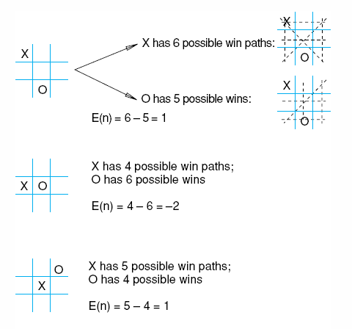
Evaluation Function for Tic-Tac-Toe
Heuristic: E(n) = M(n) – O(n)
M(n) = Total possible wining
lines for MAX
O(n) = Total possible wining
lines for the opponent

Slide 24
Evaluation Function for Chess Games

Slide 25
Minimax Implementation
def value(state):
if the state is a terminal state: return the state’s utility
if the next agent is MAX: return max-value(state)
if the next agent is MIN: return min-value(state)
def max-value(state):
initialize v = -∞
for each successor of state:
v = max(v, value(successor))
return v
def min-value(state):
initialize v = +∞
for each successor of state:
v = min(v, value(successor))
return v
Notes:
Pick an order for two reasons: sequential processor and pruning

Slide 26
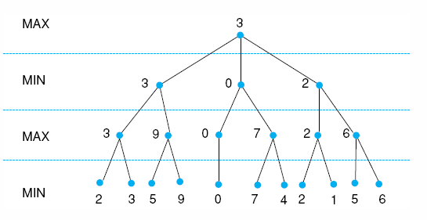
Minimax Example
Example: Minimax in a 3-ply game. Leaf states show heuristic values determined by an evaluation function; internal states show backed-up values.
Notes:
Insert fig 4.21

Slide 27
Minimax Example
Example: Minimax in a 3-ply game. Leaf states show heuristic values determined by an evaluation function; internal states show backed-up values.
Notes:
Insert fig 4.21

Slide 28
Minimax Example
Example: Minimax in a 3-ply game. Leaf states show heuristic values determined by an evaluation function; internal states show backed-up values.
Notes:
Insert fig 4.21

Slide 29
Minimax Example
Example: Minimax in a 3-ply game. Leaf states show heuristic values determined by an evaluation function; internal states show backed-up values.
Notes:
Insert fig 4.21

Slide 30
Minimax Example
Example: Minimax in a 3-ply game. Leaf states show heuristic values determined by an evaluation function; internal states show backed-up values.
Next move for max
Notes:
Insert fig 4.21

Slide 31
Game Playing (for MAX)
Repeat until a terminal state is reached
Select move using Minimax (with a specified depth h)
Execute move
Observe MIN’s move
Note that at each cycle the large game tree built to horizon h is used to select only one move for Max
All is repeated again at the next cycle
(a sub-tree of depth h-2 can be re-used)

Slide 32
Tic-Tac-Toe Revisited
Heuristic: E(n) = M(n) – O(n)
M(n) = Total possible wining
lines for MAX
O(n) = Total possible wining
lines for the opponent

Slide 33
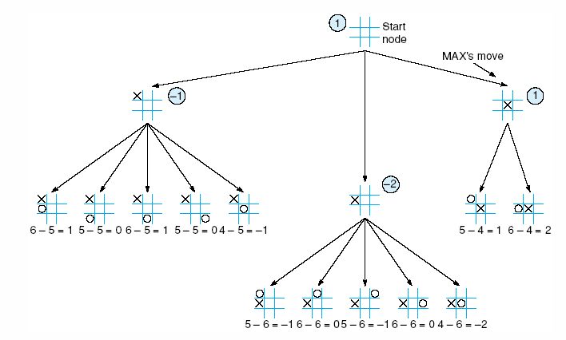
Tic-Tac-Toe Tree at horizon 2 shows the backed up Minimax values

Slide 34
2-ply Minimax applied to one of two possible MAX second moves

Slide 35
2-ply Minimax applied to X’s move near the end of the game

Slide 36
Can we do better?
Yes ! Much better !
≥ 3
3
≤ -1
← Pruning
This part of the tree can’t have any effect on the value that will be backed up to the root
-1

Slide 37
Alpha-beta pruning
We can improve on the performance of the minimax algorithm through alpha-beta pruning
Basic idea: “If you have an idea that is surely bad, don't take the time to see how truly awful it is.” -- Pat Winston (MIT)
MAX
>=2
We don’t need to compute the value at this node.
No matter what it is, it can’t affect the value of the root node.
MIN
=2
<=1
MAX
2
7
1
?

Slide 38
Alpha-beta pruning
Traverse the search tree in depth-first order
At each MAX node n, alpha(n) = maximum value found so far
At each MIN node n, beta(n) = minimum value found so far
The alpha values start at -∞ and only increase, while beta values start at +∞ and only decrease
Beta cutoff: Given MAX node n, cut off search below n (i.e., don’t generate/examine any more of n’s children) if alpha(n) >= beta(i) for some MIN node ancestor i of n.
Alpha cutoff: stop searching below MIN node n if beta(n) <= alpha(i) for some MAX node ancestor i of n.

Slide 40
β = 2
The beta value of a MIN
node is an upper bound on
the final backed-up value.
It can never increase
2

Slide 41
β = 1
The beta value of a MIN
node is an upper bound on
the final backed-up value.
It can never increase
2
1

Slide 42
α = 1
The alpha value of a MAX
node is a lower bound on
the final backed-up value.
It can never decrease
β = 1
2
1

Slide 43
α = 1
β = 1
β = -1
2
1
-1

Slide 44
α = 1
β = 1
β = -1
?
2
1
-1
Search can be discontinued below any MIN node whose beta value is less than or equal to the alpha value of one of its MAX ancestors

Slide 45
Alpha-beta general example
MAX
3
MIN
3
2 - prune
14
1 - prune
3
12
8
2
14
1

Slide 46
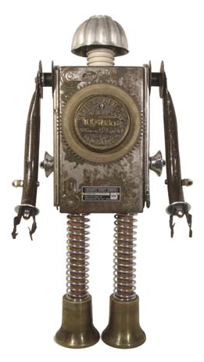
Alpha – Beta Pruning
Simple Example

Slide 52
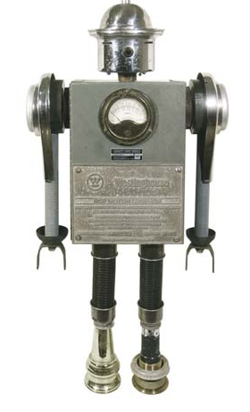
Alpha – Beta Pruning
Larger Example

Slide 53
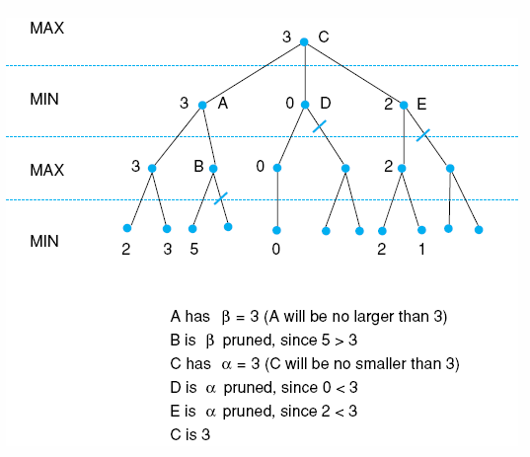
States without numbers are not evaluated.

Slide 54
Alpha-Beta Tic-Tac-Toe Example 2
MAX
MIN
MAX
MIN
MAX
MIN
0
5
-3
3
3
-3
0
2
-2
3
5
2
5
-5
0
1
5
1
-3
0
-5
5
-3
3
2

Slide 55
MAX
MIN
MAX
MIN
MAX
MIN
0
0
5
-3
3
3
-3
0
2
-2
3
5
2
5
-5
0
1
5
1
-3
0
-5
5
-3
3
2

Slide 56
MAX
MIN
MAX
MIN
MAX
0
MIN
0
0
5
-3
3
3
-3
0
2
-2
3
5
2
5
-5
0
1
5
1
-3
0
-5
5
-3
3
2

Slide 57
MAX
MIN
MAX
MIN
MAX
0
MIN
0
-3
0
5
-3
3
3
-3
0
2
-2
3
5
2
5
-5
0
1
5
1
-3
0
-5
5
-3
3
2

Slide 58
MAX
= Pruned
MIN
MAX
MIN
MAX
0
MIN
0
-3
0
5
-3
3
3
-3
0
2
-2
3
5
2
5
-5
0
1
5
1
-3
0
-5
5
-3
3
2

Slide 59
MAX
= Pruned
MIN
MAX
MIN
0
MAX
0
MIN
0
-3
0
5
-3
3
3
-3
0
2
-2
3
5
2
5
-5
0
1
5
1
-3
0
-5
5
-3
3
2

Slide 60
MAX
= Pruned
MIN
MAX
MIN
0
MAX
0
3
MIN
0
-3
3
0
5
-3
3
3
-3
0
2
-2
3
5
2
5
-5
0
1
5
1
-3
0
-5
5
-3
3
2

Slide 61
MAX
= Pruned
MIN
MAX
MIN
0
MAX
0
3
MIN
0
-3
3
0
5
-3
3
3
-3
0
2
-2
3
5
2
5
-5
0
1
5
1
-3
0
-5
5
-3
3
2

Slide 62
MAX
= Pruned
MIN
0
MAX
0
MIN
0
MAX
0
3
MIN
0
-3
3
0
5
-3
3
3
-3
0
2
-2
3
5
2
5
-5
0
1
5
1
-3
0
-5
5
-3
3
2

Slide 63
MAX
= Pruned
MIN
0
MAX
0
MIN
0
MAX
0
3
MIN
0
-3
3
5
0
5
-3
3
3
-3
0
2
-2
3
5
2
5
-5
0
1
5
1
-3
0
-5
5
-3
3
2

Slide 64
MAX
= Pruned
MIN
0
MAX
0
MIN
0
MAX
0
3
2
MIN
0
-3
3
2
0
5
-3
3
3
-3
0
2
-2
3
5
2
5
-5
0
1
5
1
-3
0
-5
5
-3
3
2

Slide 65
MAX
= Pruned
MIN
0
MAX
0
MIN
0
MAX
0
3
2
MIN
0
-3
3
2
0
5
-3
3
3
-3
0
2
-2
3
5
2
5
-5
0
1
5
1
-3
0
-5
5
-3
3
2

Slide 66
MAX
= Pruned
MIN
0
MAX
0
2
MIN
0
2
MAX
0
3
2
MIN
0
-3
3
2
0
5
-3
3
3
-3
0
2
-2
3
5
2
5
-5
0
1
5
1
-3
0
-5
5
-3
3
2

Slide 67
MAX
= Pruned
MIN
0
MAX
0
2
MIN
0
2
MAX
0
3
2
MIN
0
-3
3
2
0
5
-3
3
3
-3
0
2
-2
3
5
2
5
-5
0
1
5
1
-3
0
-5
5
-3
3
2

Slide 68
MAX
0
= Pruned
MIN
0
MAX
0
2
MIN
0
2
MAX
0
3
2
MIN
0
-3
3
2
0
5
-3
3
3
-3
0
2
-2
3
5
2
5
-5
0
1
5
1
-3
0
-5
5
-3
3
2

Slide 69
MAX
0
= Pruned
MIN
0
MAX
0
2
MIN
0
2
MAX
0
3
2
MIN
0
-3
3
2
5
0
5
-3
3
3
-3
0
2
-2
3
5
2
5
-5
0
1
5
1
-3
0
-5
5
-3
3
2

Slide 70
MAX
0
= Pruned
MIN
0
MAX
0
2
MIN
0
2
MAX
0
3
2
1
MIN
0
-3
3
2
1
0
5
-3
3
3
-3
0
2
-2
3
5
2
5
-5
0
1
5
1
-3
0
-5
5
-3
3
2

Slide 71
MAX
0
= Pruned
MIN
0
MAX
0
2
MIN
0
2
MAX
0
3
2
1
MIN
0
-3
3
2
1
-3
0
5
-3
3
3
-3
0
2
-2
3
5
2
5
-5
0
1
5
1
-3
0
-5
5
-3
3
2

Slide 72
MAX
0
= Pruned
MIN
0
MAX
0
2
MIN
0
2
MAX
0
3
2
1
MIN
0
-3
3
2
1
-3
0
5
-3
3
3
-3
0
2
-2
3
5
2
5
-5
0
1
5
1
-3
0
-5
5
-3
3
2

Slide 73
MAX
0
= Pruned
MIN
0
MAX
0
2
1
MIN
0
2
1
MAX
0
3
2
1
MIN
0
-3
3
2
1
-3
0
5
-3
3
3
-3
0
2
-2
3
5
2
5
-5
0
1
5
1
-3
0
-5
5
-3
3
2

Slide 74
MAX
0
= Pruned
MIN
0
MAX
0
2
1
MIN
0
2
1
MAX
0
3
2
1
MIN
0
-3
3
2
1
-3
-5
0
5
-3
3
3
-3
0
2
-2
3
5
2
5
-5
0
1
5
1
-3
0
-5
5
-3
3
2

Slide 75
MAX
0
= Pruned
MIN
0
MAX
0
2
1
MIN
0
2
1
MAX
0
3
2
1
MIN
0
-3
3
2
1
-3
-5
0
5
-3
3
3
-3
0
2
-2
3
5
2
5
-5
0
1
5
1
-3
0
-5
5
-3
3
2

Slide 76
MAX
0
= Pruned
MIN
0
MAX
0
2
1
MIN
0
2
1
-5
MAX
0
3
2
1
-5
MIN
0
-3
3
2
1
-3
-5
0
5
-3
3
3
-3
0
2
-2
3
5
2
5
-5
0
1
5
1
-3
0
-5
5
-3
3
2

Slide 77
MAX
0
= Pruned
MIN
0
MAX
0
2
1
MIN
0
2
1
-5
MAX
0
3
2
1
-5
MIN
0
-3
3
2
1
-3
-5
0
5
-3
3
3
-3
0
2
-2
3
5
2
5
-5
0
1
5
1
-3
0
-5
5
-3
3
2

Slide 78
MAX
1
= Pruned
MIN
0
1
MAX
0
2
1
MIN
0
2
1
-5
MAX
0
3
2
1
-5
MIN
0
-3
3
2
1
-3
-5
0
5
-3
3
3
-3
0
2
-2
3
5
2
5
-5
0
1
5
1
-3
0
-5
5
-3
3
2

Slide 79
MAX
1
= Pruned
MIN
0
1
MAX
0
2
1
2
MIN
0
2
1
-5
2
MAX
0
3
2
1
-5
2
MIN
0
-3
3
2
1
-3
-5
2
0
5
-3
3
3
-3
0
2
-2
3
5
2
5
-5
0
1
5
1
-3
0
-5
5
-3
3
2

Slide 80
MAX
1
= Pruned
MIN
0
1
MAX
0
2
1
2
MIN
0
2
1
-5
2
MAX
0
3
2
1
-5
2
MIN
0
-3
3
2
1
-3
-5
2
0
5
-3
3
3
-3
0
2
-2
3
5
2
5
-5
0
1
5
1
-3
0
-5
5
-3
3
2

Slide 81
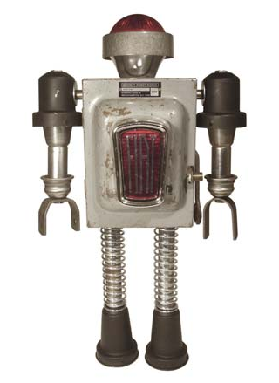
Alpha – Beta Pruning
Conclusions

Slide 82
How much do we gain?
Consider these two cases:
α = 3
α = 3
3
β=-1
3
β=4
-1
(4)
4
-1

Slide 83
How much do we gain?
Alpha-beta is guaranteed to compute the same value for the root node as computed by minimax, with less or equal computation
Assume a game tree of uniform branching factor b
Minimax examines O(b^{h}) nodes, so does alpha-beta in the worst-case
The gain for alpha-beta is maximum when:
The MIN children of a MAX node are ordered in increasing backed up values
The MAX children of a MIN node are ordered in decreasing backed up values
Then alpha-beta examines O(b^{h/2}) nodes
[Knuth and Moore, 1975]
But this requires an oracle (if we knew how to order nodes perfectly, we would not need to search the game tree)
If nodes are ordered at random, then the average number of nodes examined by alpha-beta is ~O(b^{3h/4})
In Deep Blue, they found empirically that alpha-beta pruning meant that the average branching factor at each node was about 6 instead of about 35!

Slide 84
Improvements on Alpha-Beta
Heuristic Ordering of Nodes
Order the nodes below the root according to the values backed-up at the previous iteration
Order MIN (resp. MAX) nodes by decreasing (increasing) values of the evaluation function E computed at these nodes
Other Improvements:
Adaptive horizon + iterative deepening
Extended search: Retain k>1 best paths, instead of just one, and extend the tree at greater depth below their leaf nodes to (help dealing with the “horizon effect”)
Singular extension: If a move is obviously better than the others in a node at horizon h, then expand this node along this move
Use transposition tables to deal with repeated states

Slide 85
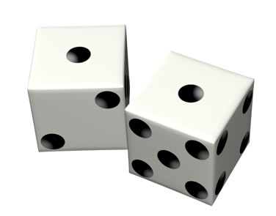
Stochastic Games

Slide 86
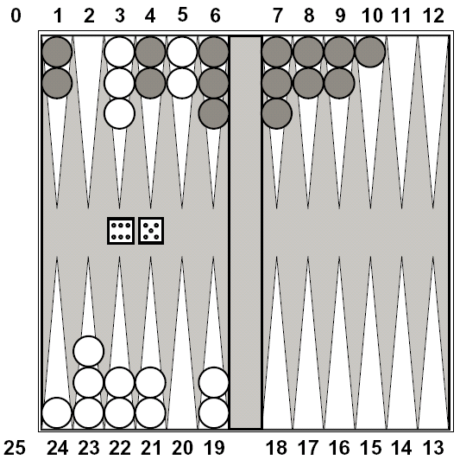
Stochastic Games
In real life, unpredictable external events can put us into unforeseen situations
Many games introduce unpredictability through a random element, such as the throwing of dice
These offer simple scenarios for problem solving with adversaries and uncertainty where we don’t always know what the next actions might be

Slide 87
Expectimax Search
Why wouldn’t we know what the result of an action will be?
Explicit randomness: rolling dice
Unpredictable opponents
Actions can fail: when moving a robot, wheels might slip
Values should now reflect average-case (expectimax) outcomes, not worst-case (minimax) outcomes
Expectimax search: compute the average score under optimal play
Max/Min nodes as in minimax search
Chance nodes in between but the outcome is uncertain
Calculate their expected utilities (weighted average (expectation) of children
max
chance
10
10
4
10
5
9
7
100

Slide 88
Expectimax Pseudocode
def value(state):
if the state is a terminal state: return the state’s utility
if the next agent is MAX: return max-value(state)
if the next agent is MIN: return min-value(state)
if the next agent is CHANCE: return exp-value(state)
def exp-value(state):
initialize v = 0
for each successor of state:
p = probability(successor)
v += p * value(successor)
return v
Notes:
Pick an order for two reasons: sequential processor and pruning

Slide 89
Expectimax Pseudocode
def exp-value(state):
initialize v = 0
for each successor of state:
p = probability(successor)
v += p * value(successor)
return v
1/2
1/6
1/3
5
8
7
24
-12
v = (1/2) (8) + (1/3) (24) + (1/6) (-12) = 10

Slide 90
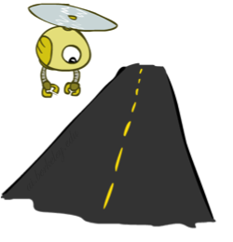
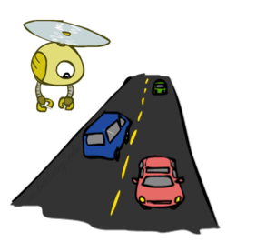
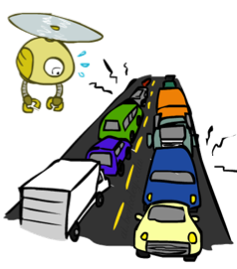
Reminder: Probabilities
A random variable represents an event whose outcome is unknown
A probability distribution is an assignment of weights to outcomes
Example: Traffic on freeway
Random variable: T = whether there’s traffic
Outcomes: T in {none, light, heavy}
Distribution: P(T=none) = 0.25, P(T=light) = 0.50, P(T=heavy) = 0.25
Some laws of probability:
Probabilities are always non-negative
Probabilities over all possible outcomes sum to one
0.25
0.50
0.25

Slide 91
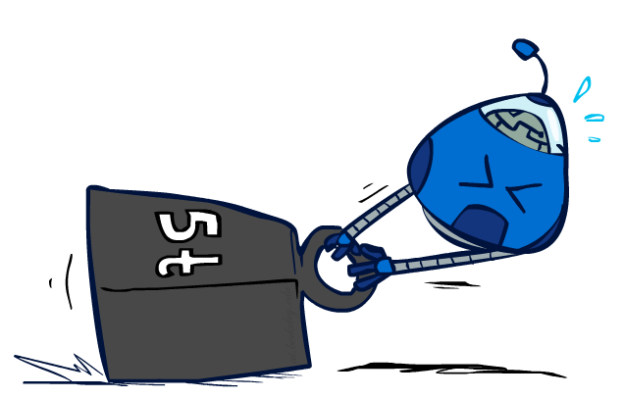
Reminder: Expectations
The expected value of a function of a random variable is the average, weighted by the probability distribution over outcomes
Example: How long to get to the airport?
Time:
20 min
30 min
60 min
+
+
35 min
x
x
x
Probability:
0.25
0.50
0.25

Slide 92
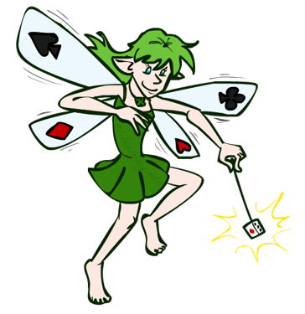
What Probabilities to Use?
In expectimax search, we have a probabilistic model of how the opponent (or environment) will behave in any state
Model could be a simple uniform distribution (roll a die)
Model could be sophisticated and require a great deal of computation
We have a chance node for any outcome out of our control: opponent or environment
The model might say that adversarial actions are likely!
For now, assume each chance node magically comes along with probabilities that specify the distribution over its outcomes
Having a pobabilistic belief about another agent’s action does not mean that the agent is flipping any coins!

Slide 93
Expectimax Example (Coin Toss)
Max’s move 1
Max’s move 2
Min flips coin
Min knows possible moves
The state includes the chance outcome determining what moves are available

Slide 94
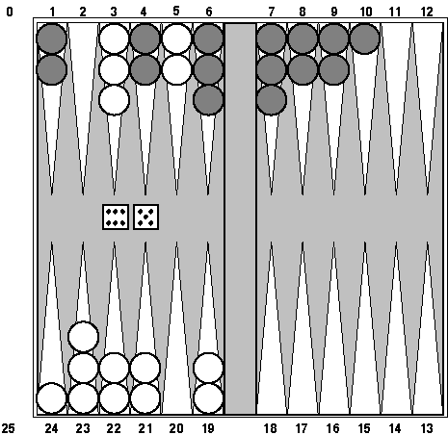
Example: Backgammon
Backgammon is a two-player game with uncertainty.
Players roll dice to determine what moves to make.
White has just rolled 5 and 6 and has four legal moves:
5-10, 5-11
5-11, 19-24
5-10, 10-16
5-11, 11-16
Such games are good for exploring decision making in adversarial problems involving skill and luck

Slide 95
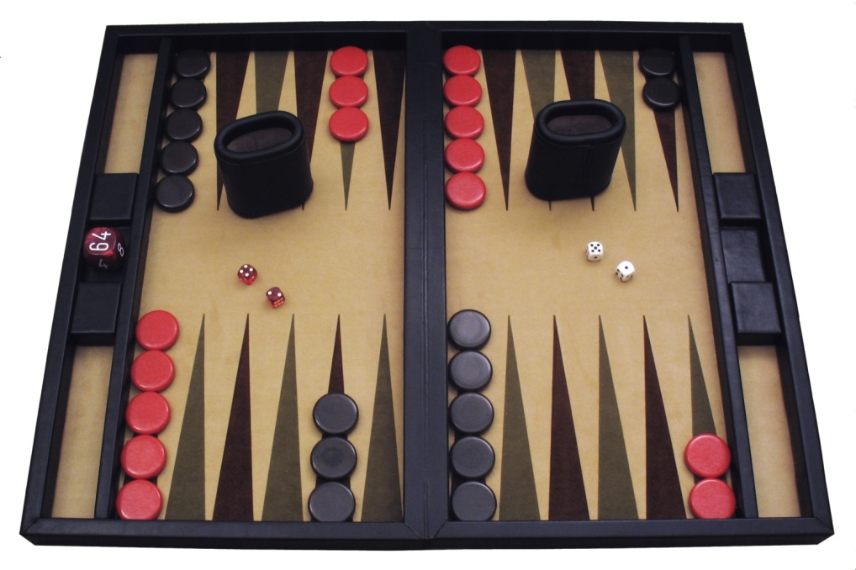
Example: Backgammon
Dice rolls increase b: 21 possible rolls with 2 dice
Backgammon ≈ 20 legal moves
Depth 2 = 20 x (21 x 20)³ = 1.2 x 10⁹
As depth increases, probability of reaching a given search node shrinks
So usefulness of search is diminished
So limiting depth is less damaging
But pruning is trickier…
Historic AI: TDGammon uses depth-2 search + very good evaluation function + reinforcement learning: world-champion level play
1st AI world champion in any game!
Image: Wikipedia

Slide 96
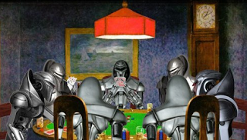
Games of imperfect information
Example: card games, where opponent's initial cards are unknown
We can calculate a probability for each possible deal
Like having one big dice roll at the beginning of the game
Possible approach: compute minimax value of each action in each deal, then choose the action with highest expected value over all deals
GIB, a top bridge program, approximates this idea by
1) generating 100 deals consistent with bidding information
2) picking the action that wins most tricks on average

Slide 97
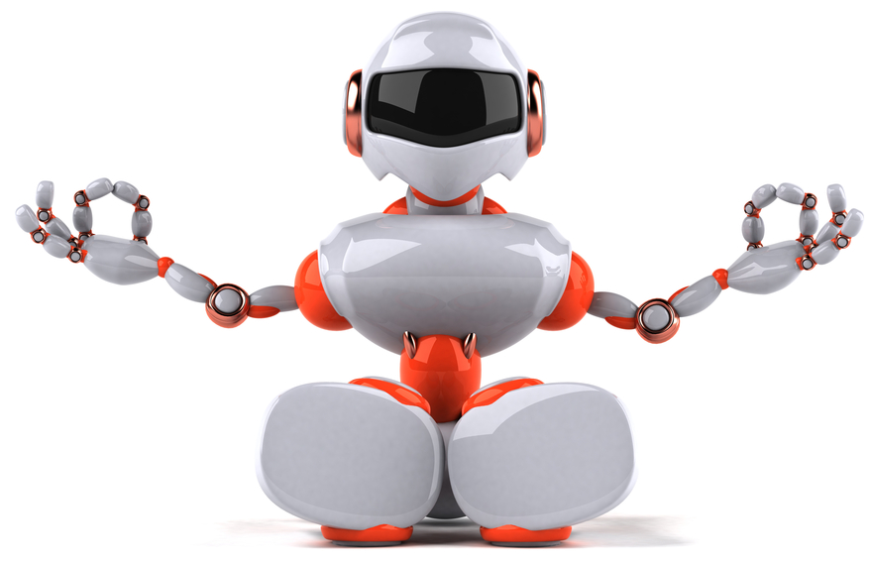
Perspective on Games: Con and Pro
“Chess is the Drosophila of artificial intelligence. However, computer chess has developed much as genetics might have if the geneticists had concentrated their efforts starting in 1910 on breeding racing Drosophila. We would have some science, but mainly we would have very fast fruit flies.”
John McCarthy, Stanford
“Saying Deep Blue doesn’t really think about chess is like saying an airplane doesn't really fly because it doesn't flap its wings.”
Drew McDermott, Yale

