Slide 1
CSC 480 Artificial Intelligence I Problem solving as Search
Bamshad Mobasher

Slide 2
Part II
Search Strategies

Slide 3
Simple Problem-Solving Agent Algorithm
s0 ← sense/read initial state
GOAL ← select/read goal test
Succ ← select/read successor function
solution ← search(s0, GOAL, Succ)
perform(solution)

Slide 4
Implementation of Search Algorithms
function General-Search(problem, Queuing-Fn) returns a solution, or failure
nodes ← Make-Queue(Make-Node(Initial-State[problem]))
loop do
if nodes = empty then
return failure
nodes ← Remove-Front(nodes)
if Goal-Test[problem] applied to State[node] succeeds then
return node
else
nodes ← Queuing-Fn(nodes, Expand(node, Operators[problem]))
return
A state is a representation of a physical configuration
A node is a data structure capturing local information in the search tree
includes parent, children, depth, path cost
States don’t have parents, children, depth, or path cost
The Expand function creates new nodes, filling in various fields and using operators (or SucessorFn) of the problem to create the children nodes

Slide 5
Search Strategies
A strategy is defined by picking the order of node expansion
i.e., how expanded nodes are inserted into the queue
Strategies are evaluated along the following dimensions
completeness - does it always find a solution if one exists
time complexity - number of nodes generated / expanded
space complexity - maximum number of nodes in memory
optimality - does it always find a least-cost solution
Time and space complexity are measured in terms of:
b - maximum branching factor of the search tree
d - depth of the least-cost solution
m - maximum depth of the state space (may be ∞)

Slide 6
Search Strategies
Uninformed (blind, exhaustive) strategies use only the information available in the problem definition
Search strategies differ based on the order in which new successor nodes are added to the queue
Breadth-first → add nodes to the end of the queue
Depth-first → add nodes to the front
Uniform cost → sort the nodes on the queue based on the cost of reaching the node from start node
Heuristic strategies use “rules of thumb” based on the knowledge of domain to pick between alternatives at each step

Slide 7
Breadth-First Search

Slide 8
Always expand the shallowest unexpanded node
QueuingFN = insert successor at the end of the queue
1
2
3
4
5
6
7
8
9
10
11
12
13
14
goal

Slide 9
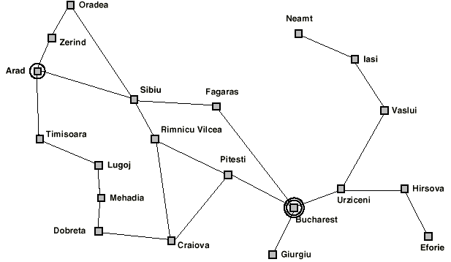
Example (Romania)

Slide 10
Arad
<== Arad<==

Slide 11
Arad
Zerind
Sibiu
Timisoara
<== Zerind, Sibiu, Timisoara <==

Slide 12
Arad
Zerind
Sibiu
Timisoara
Arad
Oradea
<== Sibiu, Timisoara, Arad, Oradea <==

Slide 13
Arad
Zerind
Sibiu
Timisoara
Arad
Oradea
Arad
Oradea
Fagaras
Rimnicu
Vilcea
<== Timisoara, Arad, Oradea, Arad, Oradea, Fagaras, Rimnicu <==

Slide 14
Arad
Zerind
Sibiu
Timisoara
Arad
Oradea
Fagaras
Rimnicu
Vilcea
Arad
Oradea
Arad
Lugoi
<== Arad, Oradea, Arad, Oradea, Fagaras, Rimnicu, Arad, Lugoi <==

Slide 15
Depth d = 4
Branching factor b = 2
goal
No. of nodes examined through level 3 (d-1) = 1 + 2 + 2² + 2³ = 1 + 2 + 4 + 8 = 15
Avg. no. of nodes examined at level 4 = (1 + 2⁴) / 2 (min = 1, max = 2⁴)

Slide 16
Breadth-First Search
Space complexity:
Full tree at depth d uses b^{d} memory nodes
If you know there is a goal at depth d, you are done; otherwise have to store the nodes at depth d+1 as you generate them; so might need b^{d+1} memory nodes
for large b, this is O(b^{d}) (the fringe dominates)

Slide 17
Properties of Breadth-First Search
Complete?
Yes, if b is finite, it will find the goal node eventually
Time Complexity?
1 + b + b² + b³ + . . . + b^{d} = O(b^{d})
Space Complexity?
O(b^{d}) (keeps every node in memory)
Optimal?
Yes (if cost = 1 per step); but, not optimal in general
Note: biggest problem in BFS is the space complexity

Slide 18
Breadth-First Search: Time and Space Complexity
Assume
branching factor b=10;
1000 nodes/second;
100 bytes/node

Slide 19
Depth-First Search

Slide 20
Always expand the deepestest unexpanded node
QueuingFN = insert successor at the front of the queue
1
2
8
13
3
7
9
12
14
4
10
11
15
goal
5
6

Slide 21
Arad
Zerind
Sibiu
Timisoara
Arad
Oradea
<== Arad, Oradea, Sibiu, Timisoara <==

Slide 22
Arad
Zerind
Sibiu
Timisoara
Note that DFS can perform infinite cyclic excursions. Need a finite, non-cyclic search space, or repeated state-checking.
Arad
Oradea
Zerind
Sibiu
Timisoara
<== Zerind, Sibiu, Timisoara, Oradea, Sibiu, Timisoara <==

Slide 23
Depth d = 4
Max depth m = 4
Branching factor b = 2
Goal:
Best Case
Goal:
Worst Case
In best case, we examine d + 1 = 5 nodes.
In worst case, need all the nodes = 1 + 2 + 4 + 8 + 16 (b^{d}) = 31

Slide 24
Properties of Depth-First Search
Complete?
No; fails in infinite-depth spaces or spaces with loops
need to modify the algorithm to avoid repeated states along paths
Time Complexity?
O(b^{m}): terrible if m is much larger than d
but, if solutions are dense, may be much faster that BFS
Space Complexity?
O(m) (i.e., linear space)
Optimal?
No

Slide 25
Iterative Deepening

Slide 26
Iterative Deepening
Depth-Limited Search
= depth-first search with depth limit l
Nodes at depth l have no successors
Goal: keep space efficiency of depth-first search, but avoid going down infinite branches
function Iterative-Deepening-Search(problem, Queuing-Fn) returns a solution sequence
inputs: problem
for depth ← 0 to ∞ do
result ← Depth-Limited-Search(problem, depth)
if result ≠ cutoff then
return result
end

Slide 27
Iterative Deepening
Arad
l = 0

Slide 28
Iterative Deepening
l = 1
step 1
Arad
l = 1
step 2
Arad
Zerind
Sibiu
Timisoara

Slide 29
Iterative Deepening
Arad
Zerind
Sibiu
Timisoara
l = 2
steps 1, 2, and 3
Arad
Oradea

Slide 30
Iterative Deepening
l = 2
step 5
Arad
Zerind
Sibiu
Timisoara
Arad
Oradea
Arad
Oradea
Fagaras
Rimnicu
Vilcea
Arad
Lugoi
Order of node expansions so far:
Arad, Arad, Zerind, Sibiu, Timisoara, Arad, Zerind, Arad, Oradea, Sibiu, …
l =0
l =1
l =2

Slide 31
Properties of Iterative Deepening
Complete?
Yes
Time Complexity?
Space Complexity?
O(bd)
Optimal?
Yes (if cost = 1 per step)
O(b^{d})

Slide 32
Uniform-Cost Search

Slide 33
Uniform-Cost Search
Each move has some cost
The cost of the path to each node N is
g(N) = sum of the move costs
The goal is to generate a solution path of minimal cost
The queue is sorted in increasing cost order
So, lower cost nodes go to the front
Note that if each move has unit costs, uniform cost search is equivalent to breadth-first search
S
0
A
1
10
1
S
5
B
5
G
A
B
C
5
15
5
15
C
G
G
11
10

Slide 34
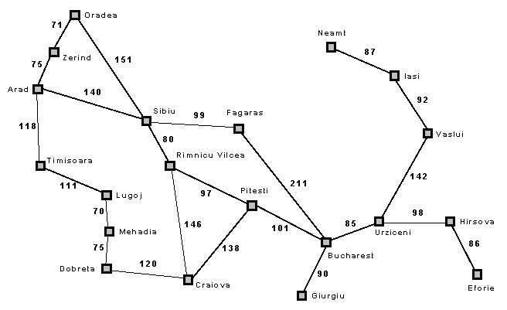
Always expand the least-cost unexpanded node
Queue = insert in order of increasing path cost
Arad
g(n) = total distance from Arad to n
75
140
118
Zerind
Sibiu
Timisoara
<== Zerind, Timisoara, Sibiu <==

Slide 35
Arad
75
140
118
Zerind
Sibiu
Timisoara
75+75
71+75
Arad
Oradea
<== Timisoara, Sibiu, Oradea, Arad <==

Slide 36
Arad
75
140
118
Zerind
Sibiu
Timisoara
75+75
71+75
118+118
111+118
Arad
Oradea
Arad
Lugoi
<== Sibiu, Oradea, Arad, Lugoi, Arad <==

Slide 37
Uniform Cost Search
For the rest of the example, let us assume repeated state checking:
If a newly generated state was previously expanded, then discard the new state
If multiple (unexpanded) instances of a state end up on the queue, we only keep the instance that has the least path cost from the start node and eliminate the other instances.

Slide 38
Arad
75
140
118
Zerind
Sibiu
Timisoara
71+75
111+118
Oradea
Lugoi
<== Sibiu, Oradea, Lugoi <==

Slide 39
Arad
75
140
118
Zerind
Sibiu
Timisoara
239
220
146
229
Oradea
Fagaras
Rimnicu
Lugoi
<== Oradea, Rimnicu, Lugoi, Fagaras <==

Slide 40
Note: Oradea only leads to
repeated states.
Arad
75
140
118
Zerind
Sibiu
Timisoara
239
220
146
229
Oradea
Fagaras
Rimnicu
Lugoi
<== Rimnicu, Lugoi, Fagaras <==

Slide 41
Arad
75
140
118
Zerind
Sibiu
Timisoara
146
239
220
229
Oradea
Fagaras
Rimnicu
Lugoi
367
317
Craiova
Pitesti
<== Lugoi, Fagaras, Pitesti, Craiova <==

Slide 42
Arad
75
140
118
Zerind
Sibiu
Timisoara
146
239
220
229
Oradea
Fagaras
Rimnicu
Lugoi
367
317
299
Craiova
Pitesti
Mehadia
<== Fagaras, Mehadia, Pitesti, Craiova <==

Slide 43
Arad
75
140
118
Zerind
Sibiu
Timisoara
146
239
220
229
Oradea
Fagaras
Rimnicu
Lugoi
367
317
450
299
Craiova
Pitesti
Bucharest
Mehadia
<== Mehadia, Pitesti, Craiova, Bucharest <==

Slide 44
Arad
75
140
118
Zerind
Sibiu
Timisoara
146
239
220
229
Oradea
Fagaras
Rimnicu
Lugoi
450
367
317
Bucharest
Craiova
Pitesti
Mehadia
299
Dobreta
374
<== Pitesti, Craiova, Dobreta, Bucharest <==

Slide 45
Arad
75
140
118
Zerind
Sibiu
Timisoara
146
239
220
229
Oradea
Fagaras
Rimnicu
Lugoi
450
367
317
Bucharest
Craiova
Pitesti
Mehadia
299
418
455
Bucharest
Craiova
Dobreta
374
<== Craiova, Dobreta, Bucharest <==

Slide 46
Arad
75
140
118
Zerind
Sibiu
Timisoara
146
239
220
229
Oradea
Fagaras
Rimnicu
Lugoi
450
367
317
Bucharest
Craiova
Pitesti
Mehadia
299
418
455
Bucharest
Craiova
Dobreta
374
<== Craiova, Dobreta, Bucharest <==

Slide 47
Arad
75
140
118
Zerind
Sibiu
Timisoara
146
239
220
229
Oradea
Fagaras
Rimnicu
Lugoi
367
317
Craiova
Pitesti
Mehadia
299
Bucharest
418
Dobreta
374
Goes to repeated states with
higher path costs than previous
visits to those states
<== Bucharest <==

Slide 48
Arad
75
140
118
Zerind
Sibiu
Timisoara
146
239
220
229
Oradea
Fagaras
Rimnicu
Lugoi
367
317
Craiova
Pitesti
Mehadia
299
Bucharest
418
Dobreta
374
<== Bucharest <==

Slide 49
Uniform-Cost Search
Arad
75
140
118
Zerind
Sibiu
Timisoara
146
239
220
229
Oradea
Fagaras
Rimnicu
Lugoi
367
317
Craiova
Pitesti
Mehadia
299
Bucharest
418
Dobreta
374
Solution Path: Arad → Sibiu → Rimnicu → Pitesti → Bucharest
Total cost: 418
Compare this to: Arad → Sibiu → Fagaras → Bucharest with total cost of 450

Slide 50
Properties of Uniform-Cost Search
Complete?
Yes, if b is finite (similar to Breadth-First search)
Time Complexity?
Number of nodes with g(n) ≤ cost of optimal solution
Space Complexity?
Number of nodes with g(n) ≤ cost of optimal solution
Optimal?
Yes, if the path cost never decreases along any path
i.e., if g(Successor(n)) ≥ g(n), for all nodes n

Slide 51
Problem with uniform cost search
We are only considering the cost so far, not the expected cost of getting to the goal node
But, we don’t know before hand the cost of getting to the goal from a previous state
Solution: use heuristics (rules of thumb based on the knowledge of the domain) to estimate the cost of getting to a goal node

