Slide 1
CSC 480: Artificial Intelligence I Course Introduction Bamshad Mobasher School of Computing DePaul University

Slide 2
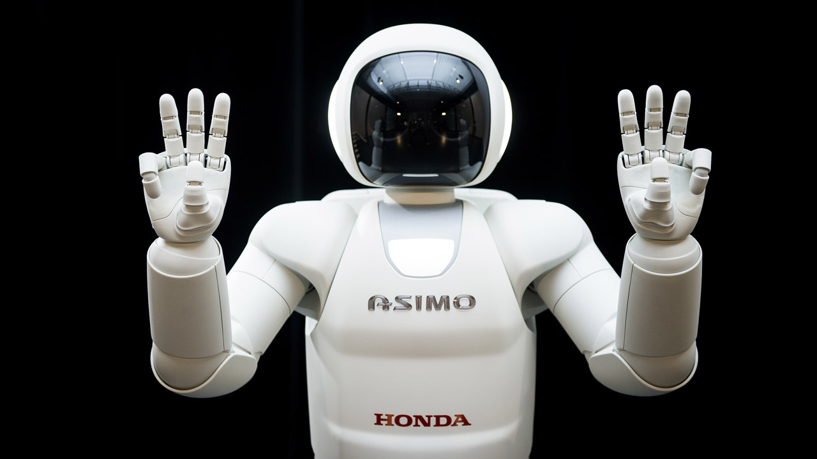
Course Introduction

Slide 3
Why you should take this class?
You want to learn about the building blocks of intelligent agents.
You want to learn how to model problems.
You want to learn how to model solutions.
You want to learn how to think.

Slide 4
Why you should not take this class?
You do not have the prerequisites.
You do not enjoy spending hours (or days) at a time writing code.
You do not have the motivation to expand the way you think about problem solving & programming.

Slide 5
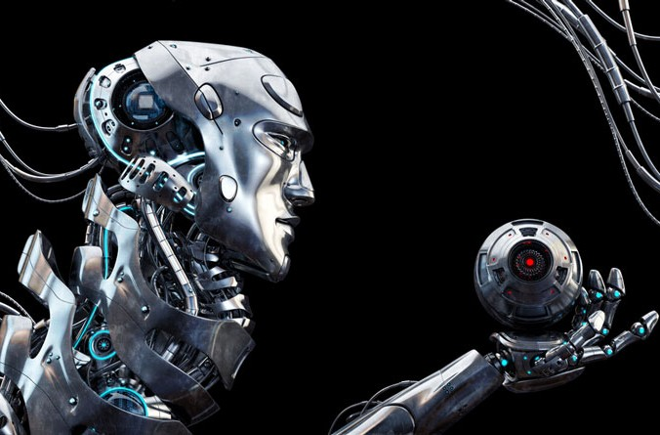
Class Outline
Week 1 Introduction to AI
Week 2 Search
Week 3 Adversarial Search
Week 4 Constraint Satisfaction
Week 5 Logic Reasoning
Week 6 Probabilistic Reasoning
Week 7 Probabilistic Reasoning
Week 8 Machine Learning
Week 9 Machine Learning
Week 10 Reinforcement Learning

Slide 6
Textbook

Slide 7
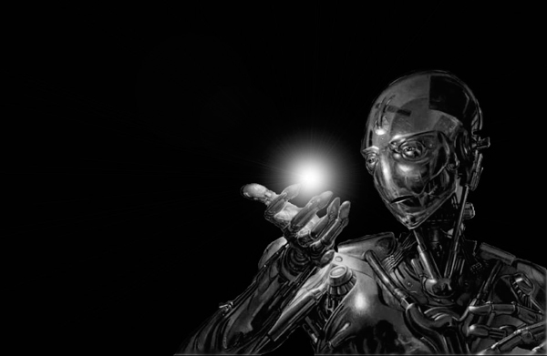
Grading
Theory
Online quizzes 15 %
Final Exam 25%
Practice
4 Assignments 60 %

Slide 8
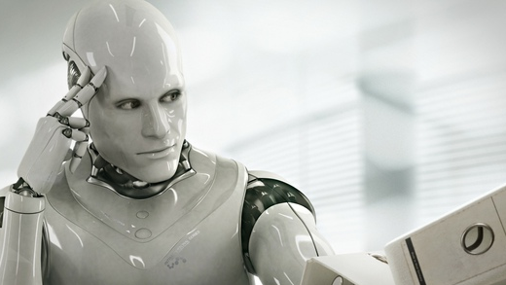
Quizzes
Quizzes are taken online through the D2L.
They are usually immediately graded.
They are due
Quizzes are worth 15% of your final grade.
You may take each quiz as many as 3 times. The highest grade is used.
You may post questions or discuss the quizzes on the class forums (but should not post solutions).

Slide 9
Final Exam
The propose of the final exam is to test your knowledge of the material covered throughout the course.
Questions on the exam will be similar to those on the quizzes.
The exam will be administered online during the finals week.

Slide 10
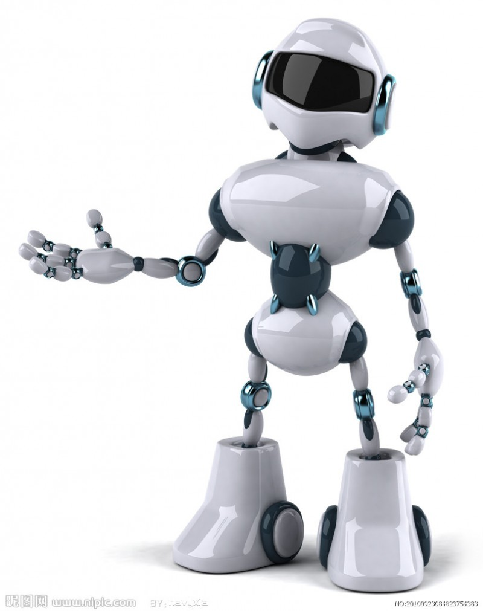
Assignments/Projects
Four assignments/mini-projects will be assigned this quarter, collectively worth 60% of the final grade.
The purpose of these assignments is to put the theory you have learned into practice.
You should expect these assignments to take a significant amount of time.
Student fail this class because they do not budget enough time to work on these assignments.
10% penalty per day late.

Slide 11
Introductions
Log onto the D2L
Navigate to the Discussions page
Go to the “Getting Acquainted” forum.
Introduce yourself
Give an example of how you use artificial intelligence on a daily basis. (Believe me. You do.)

Slide 12
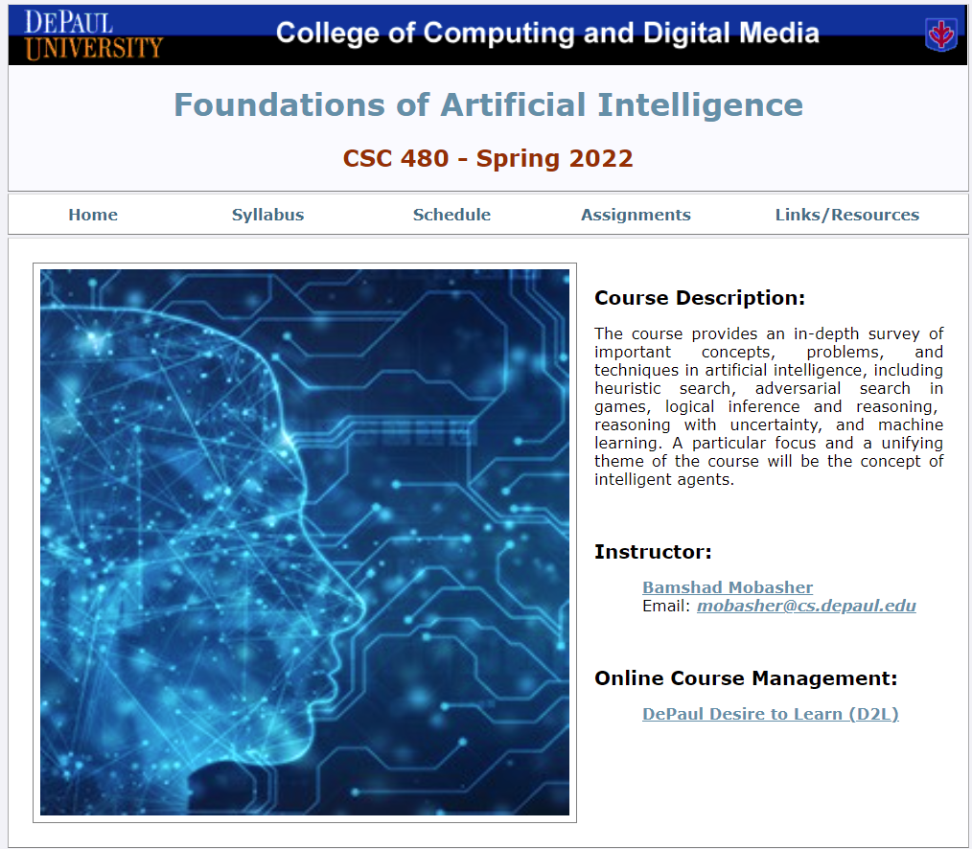
Supplementary class Web site
http://facweb.cs.depaul.edu/mobasher/classes/CSC480/

