Slide 1
CSC 480: Artificial Intelligence I
Assignment 2: Dots and Boxes
Bamshad mobasher
School of Computing
DePaul University

Slide 2
Dots and Boxes
Dots and Boxes is a pencil-and-paper game for two players (sometimes more). It was first published in the 19th century by Édouard Lucas, who called it la pipopipette. It has gone by many other names, including the game of dots, boxes, dot to dot grid, and pigs in a pen.
Starting with an empty grid of dots, two players take turns adding a single horizontal or vertical line between two unjoined adjacent dots. The player who completes the fourth side of a 1×1 box earns one point and takes another turn. (A point is typically recorded by placing a mark that identifies the player in the box, such as an initial.) The game ends when no more lines can be placed. The winner is the player with the most points. The board may be of any size. When short on time, a 2×2 board (a square of 9 dots) is good for beginners. A 5×5 is good for experts.

Slide 3
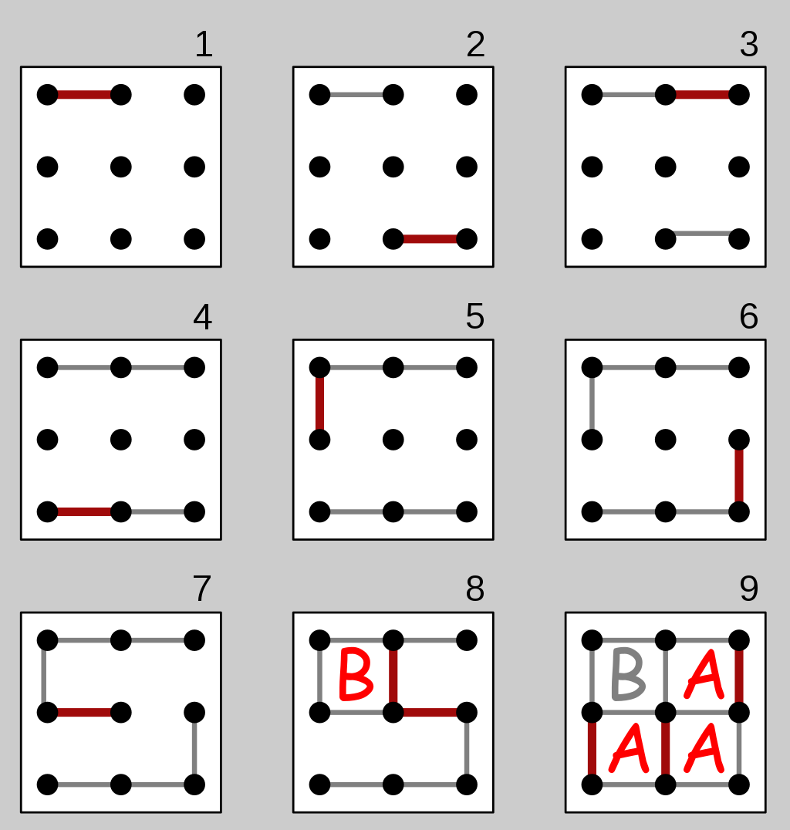
Dots and Boxes
The diagram on the right shows a game being played on the 2×2 board. The second player (B) plays the mirror image of the first player's move, hoping to divide the board into two pieces and tie the game. But the first player (A) makes a sacrifice at move 7 and B accepts the sacrifice, getting one box. However, B must now add another line, and connects the center dot to the center-right dot, causing the remaining boxes to be joined together in a chain (shown at the end of move 8). With A's next move, player A gets them all and wins 3–1.

Slide 4
Weighted Dots and Boxes
The game you implement will be slightly different than the traditional dots-and-boxes.
A player will **not** move again after completing a box. Instead, the players take turns.
When the game board is generated, each box will be given a random value between 1 and 5. When a player completes a box, her score will increase by the value of the box.
A player’s final score will be the sum of the values of the boxes claimed.
1 | 2 | 5 | 2
3 | 2 | 1 | 3
5 | 4 | 3 | 1
3 | 4 | 4 | 5

Slide 5
The AI
The AI will rely on the minimax algorithm to choose which dots to connect at each step.
  When the game starts the human player will specify
    The size of the board;
    how many plys the AI will search (i.e., the horizon for the minimax).
  Use the following scoring function to evaluate the leaves of the tree:
    score(AI) – score(Human)
  Use alpha-beta pruning to allow the AI to search deeper into the tree by pruning unnecessary branches.

Slide 6
Deliverables
You will deliver
  Code
  YouTube video (include the link at the top of your write up)
  Write up
  Submissions that do not include all three deliverables WILL NOT be graded
  DO NOT ZIP YOUR CODE OR WRITE UP. SUBMIT EACH FILE SEPERATELY.

Slide 7
Code (60 points)
Function (20 points)
  The code works as intended
  A pleasant user interface (Just a readable text interface is fine)
Implementation (20 points)
  Code demonstrates the author’s understanding of the algorithms
  Code should be efficient
  No spaghetti code
Code aesthetics (20 points)
  Proper use of white space, structure, variable names, etc.
  Code is appropriately commented
    Every method/function/script should be commented
    I will return assignments to you ungraded if I cannot read your code
  Code should be well organized and adhere to good programming standards

Slide 8
Video (20 points)
YouTube video
  5 minutes. No more! I will stop watching after five minute.
Video capture of your desktop with voice over
Demonstrate your code running (about 1 minute)
    Play through parts of a couple of games (different sized boards) explaining your strategy.
  Present your code
    Describe/show how you modeled Weighted Dots-and-Boxes
      Gameboard, moves, scoring, etc.
    Describe/show how you implemented minimax
      I need to see how your values percolate up the tree.
    Describe/show how you implemented alpha-beta pruning
      I need to see the structure of your nodes and how you store alphas and betas.
      I need to see how you compare alphas and betas to prune a branch.
Leave the analysis for the written report. The video is about showing me your code works and that mastered the concepts needed to implement the game.

Slide 9
Write up (20 points)
At the top of the document, include the link for the YouTube video
  DOUBLE CHECK THE VIDEO IS ACCESSABLE
Play the game several times experimenting with different values for the number of plys and board sizes.
  Give a subjective evaluation…
    What values for the number of plys or board size makes the game easy, challenging, too challenging? Explain how this would impact the human’s experience with the game.
    What values for the number of plys or board size makes the game run too slow? Is there a tradeoff between creating a challenging experience and the time it takes for the AI to make a move.
    How much deeper into the tree can the AI explore using alpha-beta pruning?

Slide 10
POST
Forums
  Post early
  Post often
  Post ideas
  Post questions
  Post helpful answers
  Post good humored jokes
  !!!!! Do not post code or solutions !!!!!

