Slide 1
Notes on Assignment 2
DSC 478
Programming Machine Learning Applications

Slide 2
Problem 1 – Text Categorization
Modified subset of the 20 newsgroup corpus
Docs from two newsgroups only {Windows, Hockey}. Text preprocessing already performed.
Data divided into test and train (20%, 80%) subsets.
trainMatrixModified.txt:
term-document frequency matrix for the training documents
Each row corresponds one unique term (stem) and each column corresponds to one documents
(i,j)th element of the matrix shows the frequency of the ith term in the jth document.
5500 rows (terms) and 800 columns (docs).
testMatrixModified.txt:
term-document frequency for the test documents.
5500 rows and 200 columns.
trainClasses.txt:
labels associated with each training document
format of documentIndex \t classId
documentIndex: [0,800) → index of document in the training term-document frequency matrix.
classId: 0 (for Windows) or 1 (for Hockey).
testClasses.txt:
labels associated with each of the 200 test document.
modifiedterms.txt:
List of 5500 terms in the vocabulary
Each line contains a term corresponding a row in term-document frequency matrices.

Slide 3
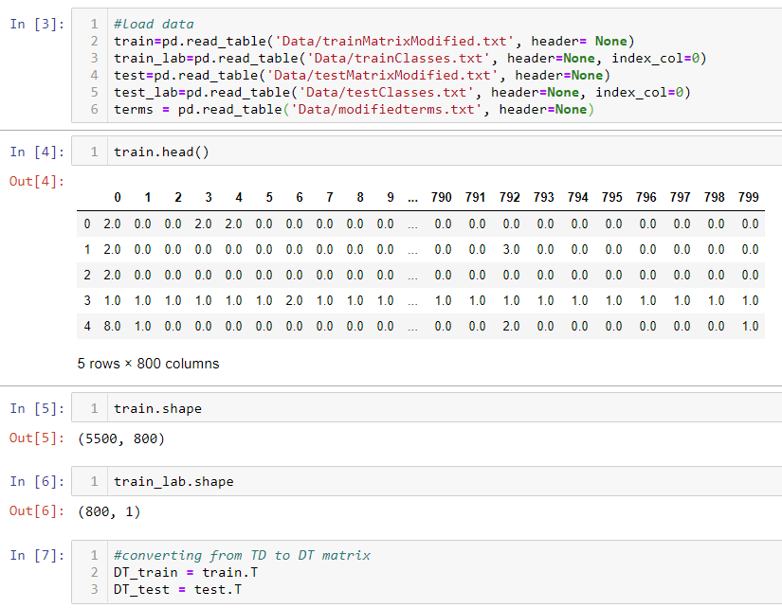

Slide 4
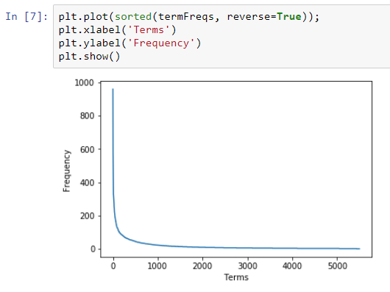
Zipf Distribution in Training Data

Slide 5
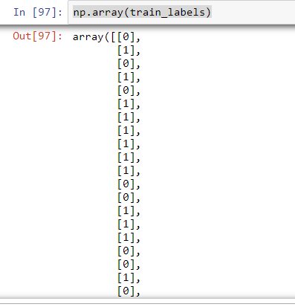
train_labels=pd.read_table('Data/trainClasses.txt', header=None, index_col=0)

Slide 6
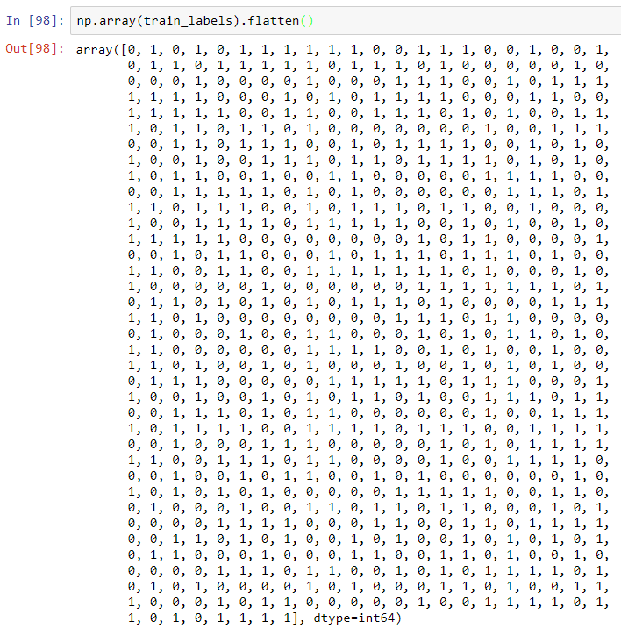
train_labels=pd.read_table('Data/trainClasses.txt', header=None, index_col=0)

Slide 7
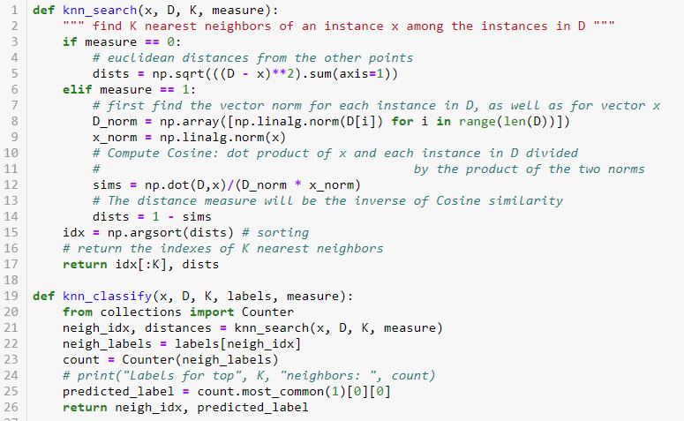
See the Class Notebook: TF*IDF and Document Categorization

Slide 9
Knn Classification & Evaluation
knn_search(x, DT_train, K, measure):
knn_classify(x, DT_train, K, train_labels, measure):
knn_evaluate(DT_test, test_labels, DT_train, train_labels, K, measure)
Note: knn_evaluate iterates through rows in DT_test matrix of test instances, and for each Instance, calls knn_classify to predict the label. It compares the predicted label for each test instance to the actual labels and then returns classification accuracy.

Slide 10
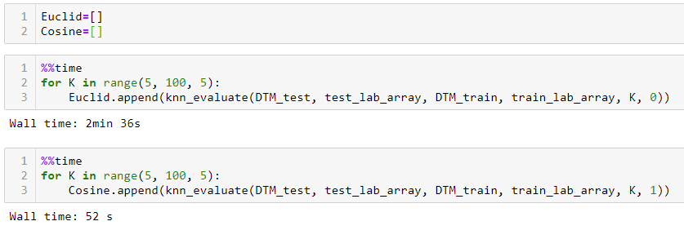
Knn Classification & Evaluation

Slide 11
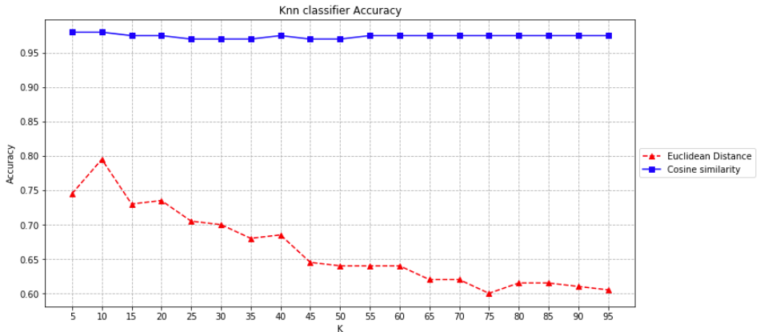
Knn Classification & Evaluation
knn_evaluate(DT_test, test_labels, DT_train, train_labels, K, measure)

Slide 12
Rocchio Text Categorization Algorithm (Training)
Assume the set of categories is {c₁, c₂,…c_{n}}
For i from 1 to n let p_{i} = <0, 0,…,0> (init. prototype vectors)
For each training example <x, c(x)> ∈ D
Let d be the TF/IDF term vector for doc x
Let i = j where c_{j} = c(x)
(sum all the document vectors in c_{i} to get p_{i})
Let p_{i} = p_{i} + d

Slide 13
Rocchio Text Categorization Algorithm (Test)
Given test document x
Let d be the TF/IDF term vector for x
Let m = –2 (init. maximum cosSim)
For i from 1 to n:
(compute similarity to prototype vector)
Let s = cosSim(d, p_{i})
if s > m
let m = s
let r = c_{i} (update most similar class prototype)
Return class r

Slide 14
Rocchio-Based Categorization - Example
 | t1 | t2 | t3 | t4 | t5 | Spam
D1 | 2 | 1 | 0 | 1 | 0 | no
D2 | 0 | 3 | 1 | 0 | 0 | no
D3 | 1 | 0 | 2 | 0 | 2 | yes
D4 | 1 | 0 | 1 | 2 | 0 | yes
D5 | 0 | 1 | 0 | 1 | 0 | yes
D6 | 1 | 2 | 0 | 0 | 2 | no
D7 | 0 | 1 | 0 | 2 | 0 | yes
D8 | 1 | 1 | 0 | 1 | 0 | yes
D9 | 3 | 0 | 1 | 1 | 1 | no
D10 | 1 | 0 | 1 | 0 | 1 | yes
 |  |  |  |  |  |  | Norm | Cos Sim with New Doc
Prototype: "no" | 6 | 6 | 2 | 2 | 3 |  | 9.434 | 0.673
Prototype: "yes" | 4 | 3 | 4 | 6 | 3 |  | 9.274 | 0.809
New Doc | 1 | 0 | 0 | 1 | 1 |  | 1.732
For simplicity, in this example we will use raw term frequencies (normally full TFxIDF weights should be used).
So, the new document/email should it be classified as spam = “yes” because it is more similar to the prototype for the “yes” category.

Slide 15
Rocchio Classification
def Rocchio_Train(train, labels):
. . .
return prototype
def Rocchio_classifier(prototype, instance):
. . .
return predicted_label, sims
def rocchio_evaluate(test, test_lab, prototype):
. . .
return accuracy
Note: prototype could be a dictionary with unique class labels as keys and one dimensional arrays representing the prototype vectors for the class as values

Slide 16
tf x idf Transformation
 | Doc 1 | Doc 2 | Doc 3 | Doc 4 | Doc 5 | Doc 6 |  | df | idf = log2(N/df)
T1 | 0 | 2 | 4 | 0 | 1 | 0 |  | 3 | 1.00
T2 | 1 | 3 | 0 | 0 | 0 | 2 |  | 3 | 1.00
T3 | 0 | 1 | 0 | 2 | 0 | 0 |  | 2 | 1.58
T4 | 3 | 0 | 1 | 5 | 4 | 0 |  | 4 | 0.58
T5 | 0 | 4 | 0 | 0 | 0 | 1 |  | 2 | 1.58
T6 | 2 | 7 | 2 | 1 | 3 | 0 |  | 5 | 0.26
T7 | 1 | 0 | 0 | 5 | 5 | 1 |  | 4 | 0.58
T8 | 0 | 1 | 1 | 0 | 0 | 3 |  | 3 | 1.00
The initial Term x Doc matrix (Inverted Index)
Documents represented as vectors of words
 | Doc 1 | Doc 2 | Doc 3 | Doc 4 | Doc 5 | Doc 6
T1 | 0.00 | 2.00 | 4.00 | 0.00 | 1.00 | 0.00
T2 | 1.00 | 3.00 | 0.00 | 0.00 | 0.00 | 2.00
T3 | 0.00 | 1.58 | 0.00 | 3.17 | 0.00 | 0.00
T4 | 1.74 | 0.00 | 0.58 | 2.90 | 2.32 | 0.00
T5 | 0.00 | 6.34 | 0.00 | 0.00 | 0.00 | 1.58
T6 | 0.53 | 1.84 | 0.53 | 0.26 | 0.79 | 0.00
T7 | 0.58 | 0.00 | 0.00 | 2.92 | 2.92 | 0.58
T8 | 0.00 | 1.00 | 1.00 | 0.00 | 0.00 | 3.00
tf x idf Term x Doc matrix

Slide 17
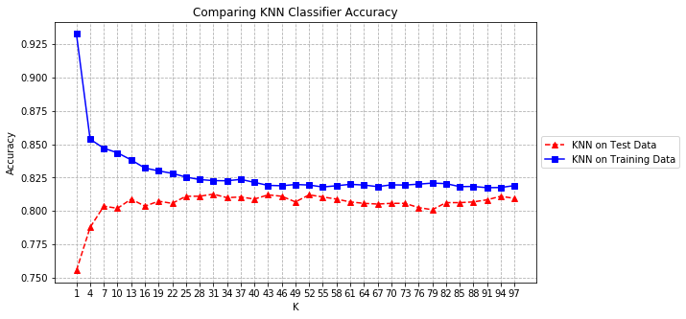
Problem 2 - Parameter Optimization

