Slide 1
Scientific Research in Computing
Sources: D. Jensen. “Research Methods for Empirical Computer Science.”
Paul R. Cohen. “Empirical Methods for Artificial Intelligence”
Smithsonian Institute
The Library of Congress
William M.K. Trochim. “Research Methods Knowledgebase”

Slide 2
Why practice CS as science?
Scientific practice provides a limited type of external verification that grounds our work in something other than mere consensual hallucination
Scientific practice enables more rapid progress toward things we wish to produce
Explanations — How does that IR system work? Why did the social network behave in that way?
Guidance — What should we do if we want our data center to have a higher percentage of uptime?
Technologies — How can we build a better integrated development environment? What networking protocol offers the highest performance for real P2P networks?

Slide 3
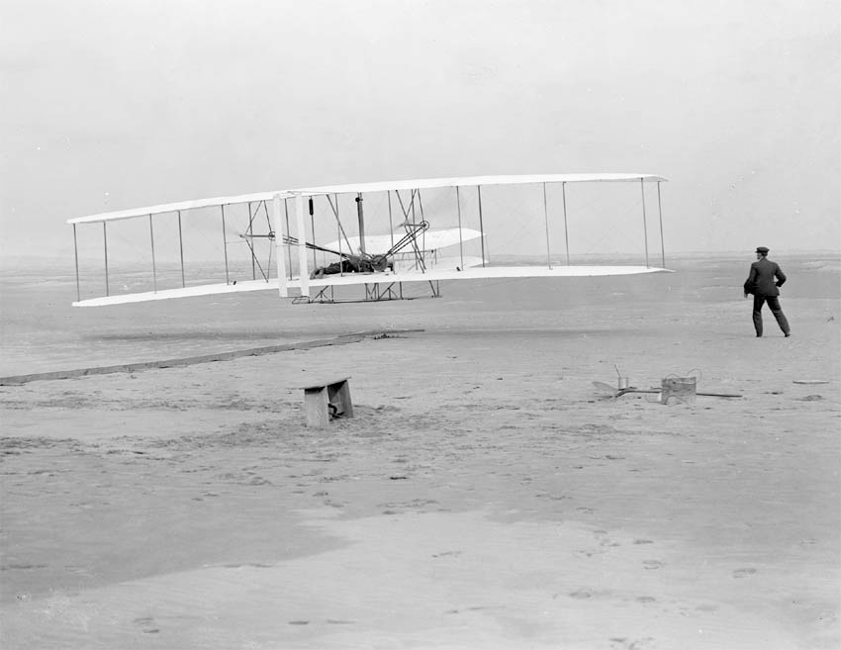

Slide 4
A brief research communication…

Slide 5
Who would you expect to succeed first?
Samuel Pierpont Langley

Slide 6
What did the Wrights do right?

Slide 7
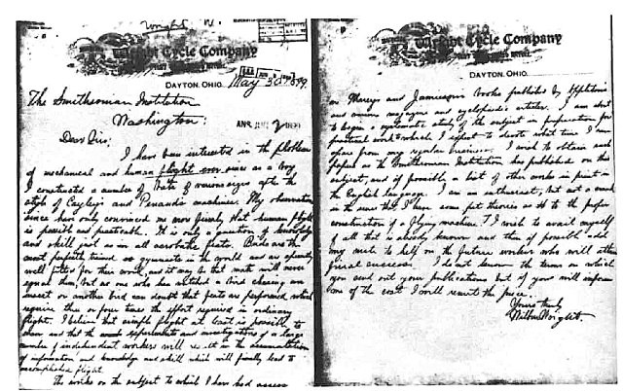
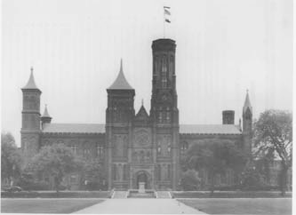
Reviewed what was already known
“I wish to obtain such papers as the Smithsonian Institution has published on this subject, and if possible a list of other works in print in the English language. I am an enthusiast, but not a crank in the sense that I have some pet theories as to the proper construction of a flying machine. I wish to avail myself of all that is already known and then if possible add my mite to help on the future worker who will attain final success.”

Slide 8
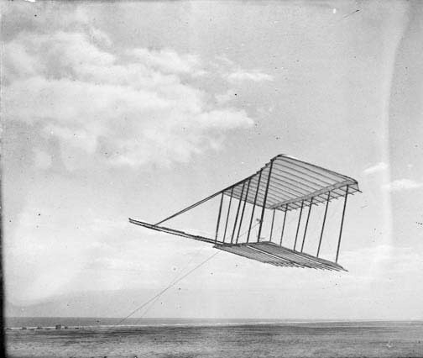
Constructed a test prototype

Slide 9
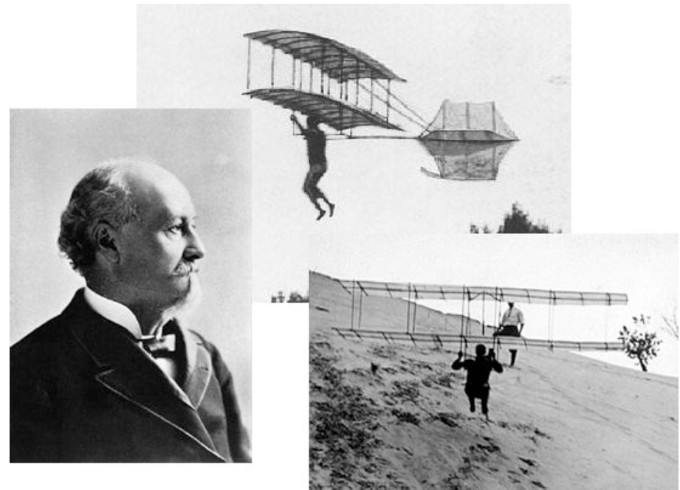
Corresponded with other researchers

Slide 10
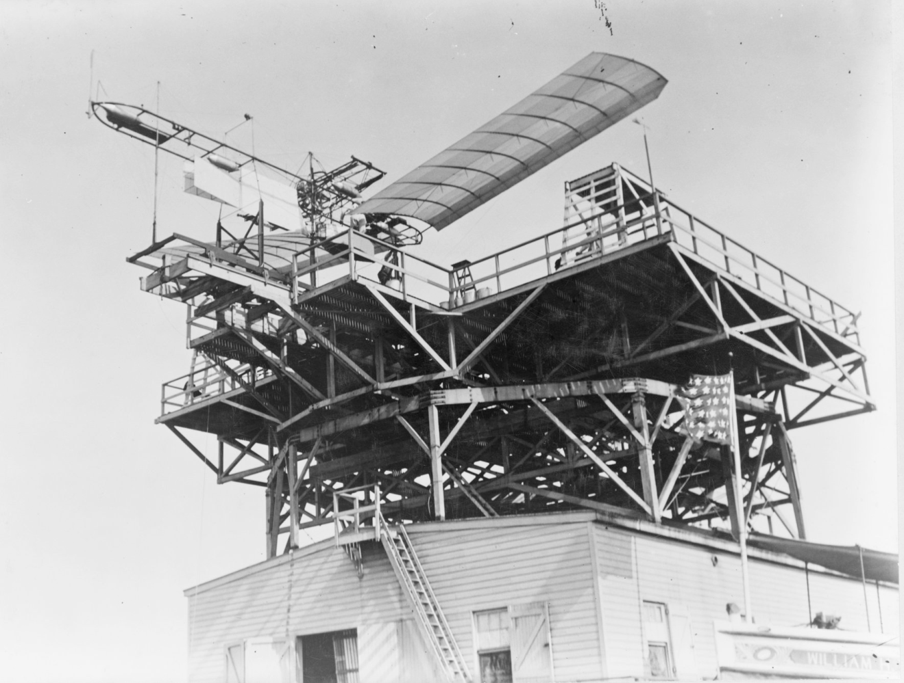
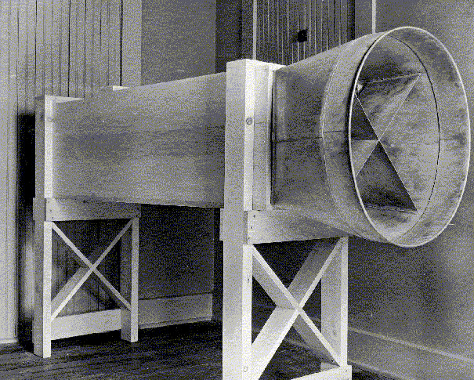
Conducted Experiments

Slide 11
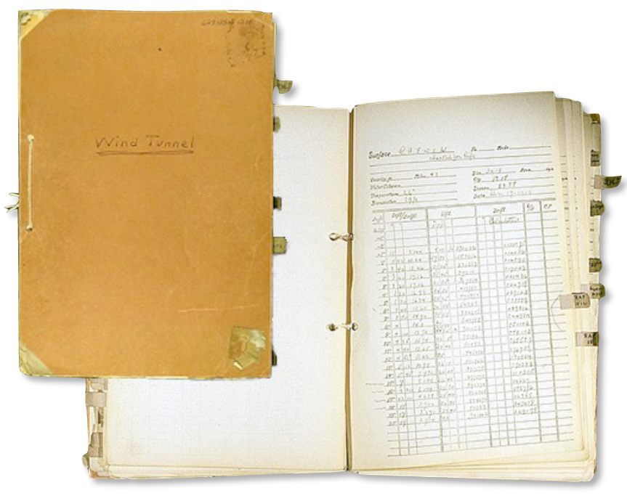
Gathered and analyzed experimental data

Slide 12
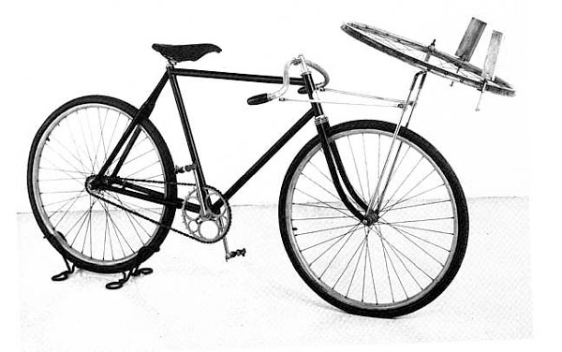
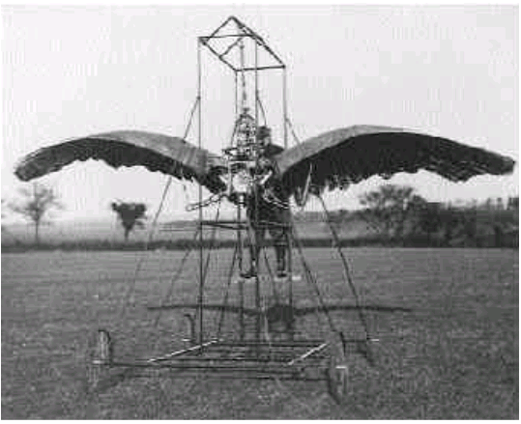
Falsified Prior Results

Slide 13
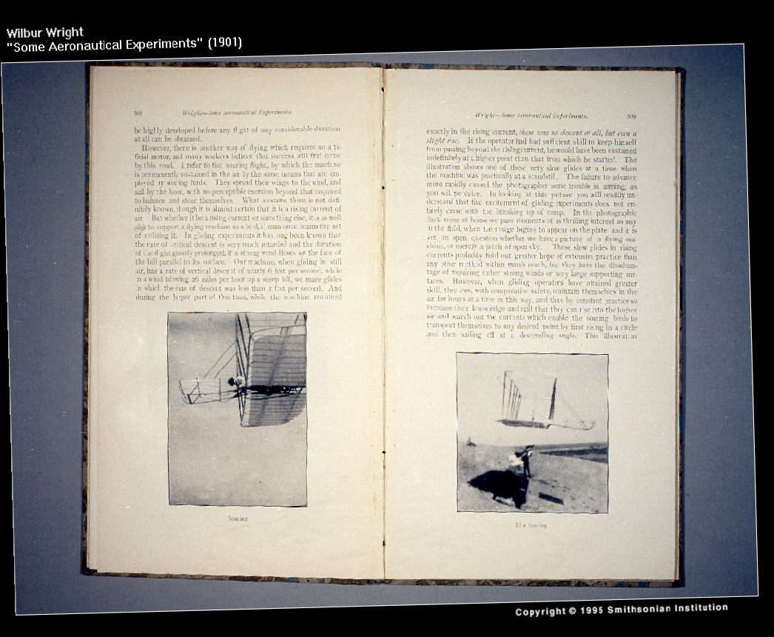
Published intermediate results

Slide 14
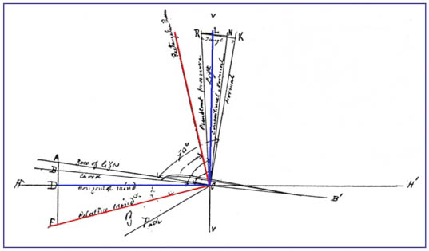
Overall Approach
1. Identify key technical challenges that were on the critical path to constructing the desired technology (e.g., control)
2. Systematically investigate the underlying principles necessary to address those challenges
3. Apply those principles to construct prototypes
4. Systematically evaluate those prototypes
5. Iterate

Slide 15
What didn’t the Wrights do?
“Just build it” -- Construct or modify systems without the aim of understanding the basic principles of flight
Construct systems in rough analogy to “what’s known to already work”

Slide 16
The bottom line …
Science is not science fiction. We evaluate our work by correspondence to physical reality. Experiments formally evaluate that correspondence.
Naming, describing, or giving context are less useful than providing causal explanations of underlying function.
More rapid technical progress can be achieved by seeking an understanding of fundamental principles than by using a “just build it” approach.

Slide 17
Finding Interesting Problems in Computing
Explore or explain the behavior of algorithms, systems, protocols, and other computational artifacts
Typical form of research questions:
“Why...”
“How...”
“Under what circumstances...”
“What are the necessary and sufficient conditions for...”
Answers — not yes/no, but paragraphs, mathematical or statistical models, simulations, etc.

Slide 18
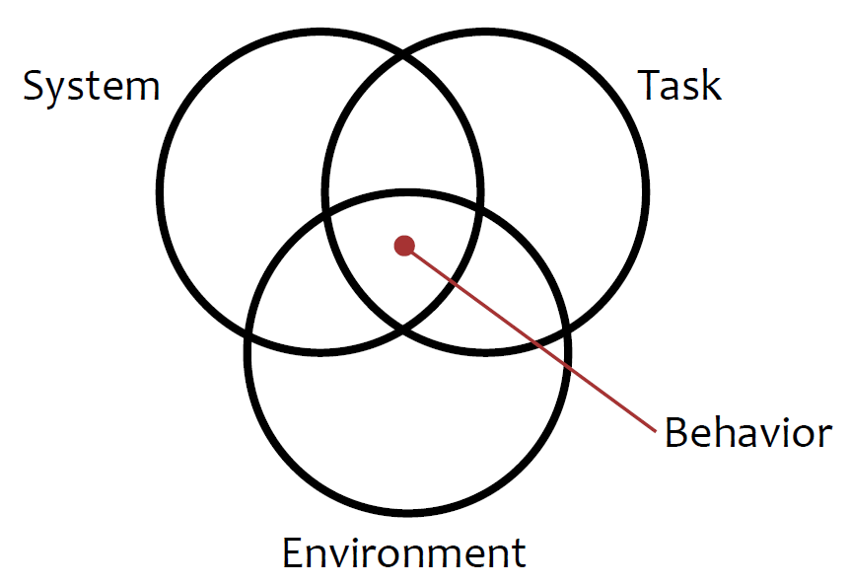
A framework for CS research problems
Source: Paul R. Cohen (1995). Empirical Methods for Artificial Intelligence. MIT Press.

Slide 19
A framework for CS research problems
System — Aspects influenced by a system designer
Specific algorithm used, system architecture, data structures, parameter settings, etc.
Task — Aspects influenced by a prospective users
Specific queries, requests, input data, etc.
Environment — Aspects influenced by neither a designer nor a user
Network environment, available cycles or memory, etc.
Behavior — Performance of the task by the system within the environment

Slide 20
System?
PageRank, Knowledge graph, indices
Task?
Queries, user profiles, language
Environment?
Document distribution, network load, user profiles
Behavior?
Retrieval performance

Slide 21
Factors to Consider
Importance
How important is the research topic within the larger research and application community?
State of knowledge
What do we know already? What is the position of the research with respect to “the frontier”?
Unique competence
Are you uniquely qualified to address this research? What is your “secret weapon”?
Interest
How much does this research problem interest you personally? Do you have a passion for this problem?

Slide 22
Importance
Audience
Who will care about the answer?
Impact
Will different answers change...
what research gets done next?
what is done by practitioners?
Longevity
How long will the answer be relevant and important?

Slide 23
Notes:
Famous Austrian management consultant, educator, and author.

Slide 24
The “Frontier”
Important work typically takes place at the frontier of a field
The frontier in CS has two components:
Changing face of computing knowledge (a problem common to all fields of science)
Changing environment of computing technology
Changing landscape of applications of computing
particularly challenging
in computer science

Slide 25
Methods for Identifying Frontiers
New observations or findings that need explanation
New opportunities provided by instruments, methods of study, or theoretical frameworks
Converging lines of research that combine to provide new opportunities
Emerging needs from outside the field (e.g., Web search, bioinformatics, scientific computing, social media, autonomous vehicles)
New questions or conjectures by researchers with good track records

Slide 26
Properties of good research projects
Located at the frontier
Identifies an unexplored (or underexplored) question
Experts have significant questions about the outcome
Involves experiments
Identifies independent and dependent variables
Involves understanding behavior, not just design
Practical issues (for short-term or exploratory projects)
Existing implemented algorithm, protocol, or system; or well-described algorithm with very low re‐implementation cost
Existing experimental infrastructure (simulator, data sets, etc.)
No human subjects

