Slide 1



Quantitative Analysis

Slide 2

Why Quantitative Data Analysis Matters
Quantitative analysis is the process of using numbers, statistics, and mathematical methods to understand data.
Numbers are meaningless unless we can discern the patterns that lie within them
These days, we’re flooded by overwhelming amounts of data noise or signal?
With quantitative analysis, we can find hidden patterns from noisy data,
But here’s the thing:
Can we just jump into data and start analyzing it right away?
Google. (2025). Image generated using Gemini based on user prompt.

Slide 3
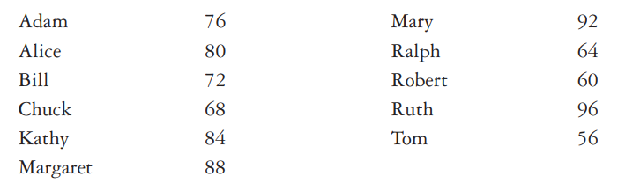
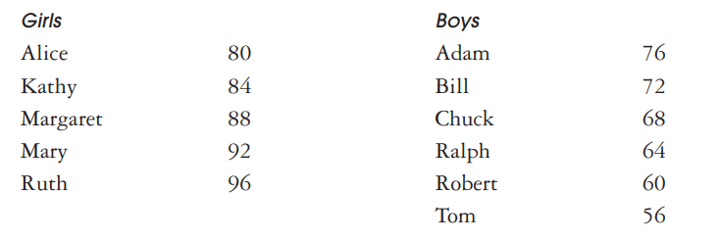
1-Organizing Data
Our minds can only handle a limited amount of information at once.
A dataset with 5,000+ items is overwhelming for human cognition.
We must organize it to make sense of it.

Slide 4

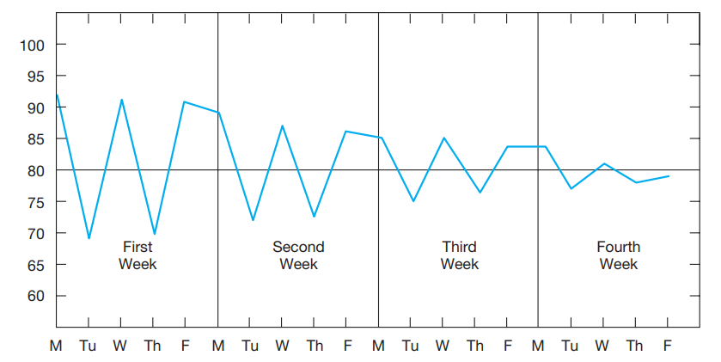
Tables and graphs also uncover hidden patterns in data
Raw Data Example: Joe’s Quiz Grades
His grades (in the order received):
92, 69, 91, 70, 90, 89, 72, 87, 73, 86, 85, 75, 84, 76, 83, 83, 77, 81, 78, 79
This linear list is hard to interpret.
A line graph reveals an insightful pattern:

Slide 5
2-From Organizing to Understanding: Choosing appropriate statistics
Once data is thoughtfully organized, the next step is to extract deeper meaning and more consistent patterns using statistics.
Two Main Functions of Statistics:
1. Descriptive Statistics
Help us summarize and describe key features of a dataset. Examples: Mean, Median, Range, Standard Deviation, Correlation
2. Inferential Statistics
Let us make generalizations about a population from a sample. Examples: Making predictions or testing hypotheses

Slide 6

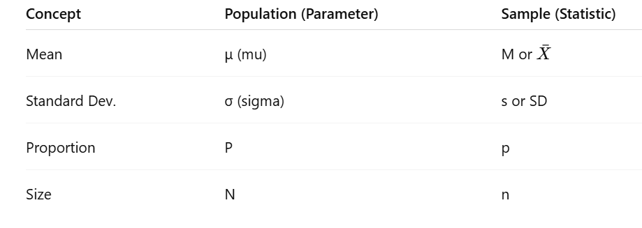
Good to Know!
Parameter: Is a characteristic of entire population(like mean, standard deviation)
Statistics: Any calculation we perform for the sample(like sample mean, standard deviation)
Note: We use Greek letters for parameters and Latin letters for statistics.

Slide 7

Descriptive Analysis(The Story Behind Your Data!)
What Are Descriptive Statistics? Descriptive statistics describe and summarize data.
It helps answer three key questions:
Where’s the center of the data?
How spread out is the data?
How do variables relate to each other?

Slide 8
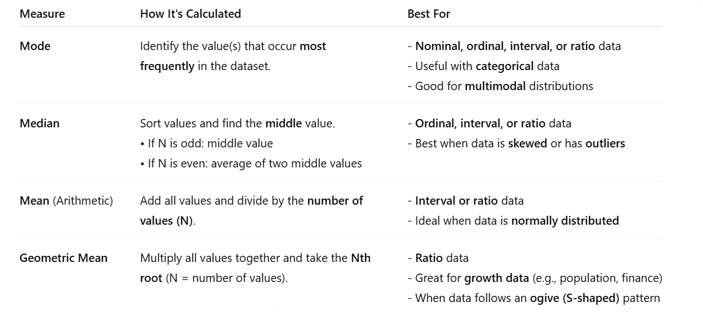
Measures of Central Tendency
-This is where measures of central tendency come in , they help us find the “best guess” or the “center” of the data.
Think of this as the heart or balance point of your data

Slide 9
Variability ( How Spread Out is the Data?)
So far, we’ve talked about the best guess (the average or central tendency)
Now, let’s flip it: What are the worst odds?
Variability tells us how much the data points scatter or cluster around the average
If data points are close to the average, we can predict new values with confidence. When data points spread out, predictions become less certain.

Slide 10
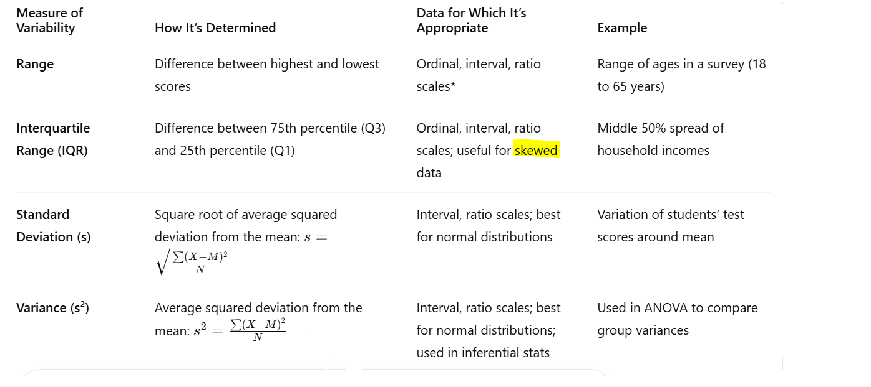

Slide 11


Standard Score
What Does a Score Really Mean?
"Mary scored 35 on a test of extroversion… so what? “How typical or unusual is that score?
Standard scores are a bridge between a single person’s score and the overall distribution, telling us how far from the norm they really are.
The simplest standard score is Z-score: show how far a raw score is from the mean, in units of standard deviation:
So, for Mary:
She scored 35, mean score is 25 , and standard deviation is 5

Slide 12

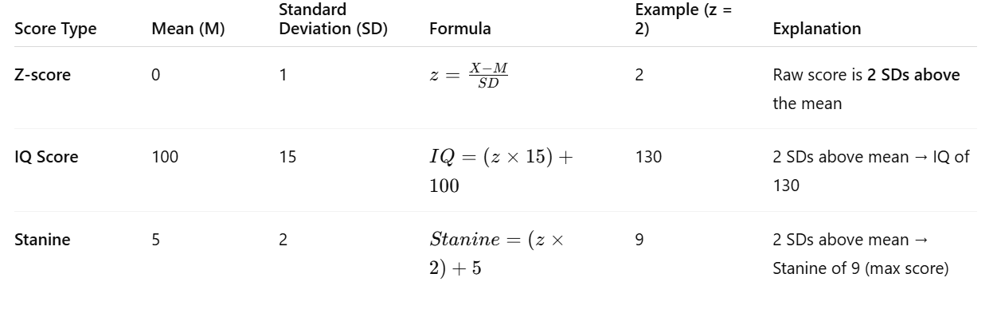
Other Standard Scores
The z-score tells us how many standard deviations a score is from the mean.
But z-scores include negative numbers, which can be hard to interpret for some audiences.

Slide 13
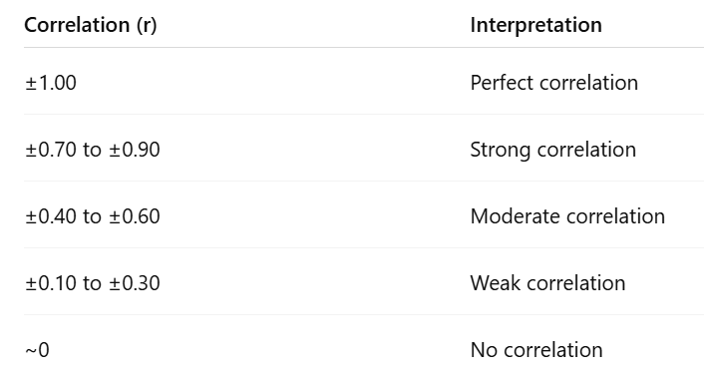
Measure of Association
The statistics described so far (central tendency , variability) focus on a single variable. we want to know whether two or more variables are associated in some meaningful way?
What Is a Correlation Coefficient?
A number ranges from -1 to +1
Tells us:
  Direction of relationship (positive or negative)
  Strength of relationship (how closely related variables are)

Slide 14
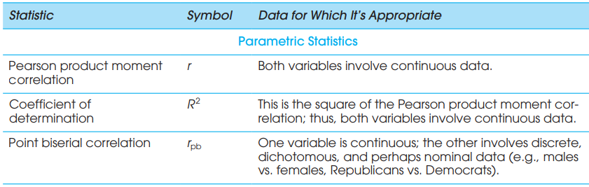
R² (Coefficient of Determination): R² is the square of the Pearson correlation coefficient (r).
It indicates the proportion of variance in one variable that is explained and predicted by its relationship with another variable. how well one variable predicts the other.
For example, R² = 0.30 means 30% the variation in one variable can be statistically predicted or explained by other factor

Slide 15

Correlation ≠ Causation
Just because two variables are related doesn’t mean one causes the other. Correlation shows association!
Example: A study shows a positive correlation between Self-Esteem and Annual Salary.
Wrong Conclusion: Self-esteem causes higher salary
Right Interpretation: The two are associated, but other factors might influence both.

Slide 16

Inferential statistics
So far, we have used 3 key descriptive tools to summarize and understand a sample dataset
But remember:
A sample is just a small part of a larger population, and we usually don’t know much about that population.
This is where Inferential Statistics come in:
They allow us to go beyond the sample and make educated guesses about the entire population.
goals of Inferential Statistics:
Estimate population parameters from sample statistics
Test hypotheses about relationships or differences in the population

Slide 17

Estimating Population Parameters
Using sample statistics (like sample mean) to estimate population parameters (like population mean μ)
Suppose we want to find out the average height of all DePaul students. Should we measure everyone?
Probably not, it takes too much time and energy
Instead of measuring everyone...
Collect a random sample of students.
Calculate the average height from that sample.
But estimates vary!
One sample might give 66.2 inches.
Another might give 67.1 inches.
So, how do we estimate the population mean?

Slide 18
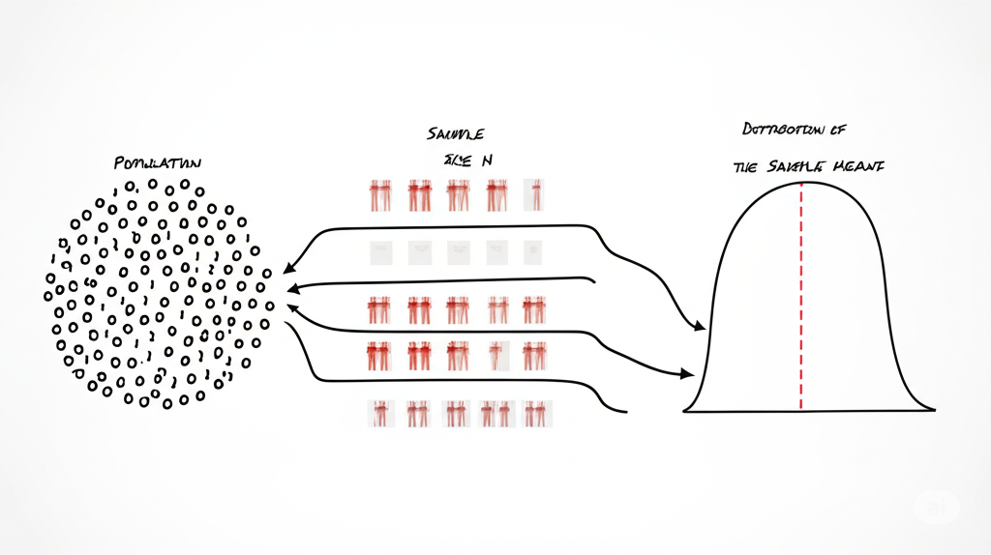
Central Limit Theorem (CLT)
What is the Central Limit Theorem (CLT)?
CLT tells us:
If we collect lots of random samples of the same size from any population, the distribution of their means will form a Normal distribution.
Even if the population itself is not bell-shaped!
The average of these sample means = population mean (μ)
Depaul population
Sample
Distribution of sample mean

Slide 19
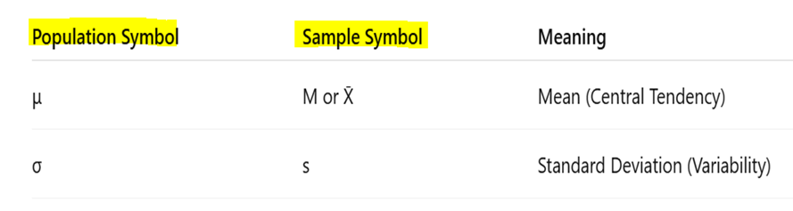
Why CLT Matters
Sample means cluster around the true population mean.
This allows us to make inferences about the population using just a sample.
Once we accept that sample means vary, we ask: "How much do they usually vary?"
This is where Standard Error of the Mean comes in.
Remember!

Slide 20

Standard Error of the Mean (SEM):
Standard Error of the Mean (SEM): Measure how much the sample mean varies from sample to sample (the dispersion of sample means)
Smaller SEM → Sample mean is closer to the population mean
SEM depends on: Population variability (σ or s) Sample size (n)
SEM Formulas (if population SD is known):
σ = population SD , n=sample size
Larger samples reduce SEM, meaning you're likely to get closer to the true average height of all DePaul students.

Slide 21

Problem?
But the formula for standard error uses the population standard deviation (σ), which we often don’t know.
Solution: Use Sample Standard Deviation (s)
Statisticians created a formula to estimate SEM using the sample:
s = sample standard deviation
n = sample size

Slide 22

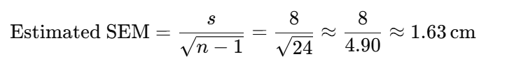
Example
Suppose we randomly sample 25 DePaul students and record their heights (in cm):
Sample mean height = 172 cm
Sample standard deviation (s) = 8 cm
Sample size (n) = 25
If we took many random samples of 25 students and calculated the average height for each, those sample averages would typically fall within ±1.63 cm of the true population mean.

Slide 23
Confidence Interval
When we use the sample mean (172 cm) to estimate the population mean, this is a point estimate. While point estimates give us a single number, they don’t tell us how uncertain or confident we should be in that estimate.
A Better Option: Interval Estimates (Confidence Intervals)
A confidence interval (CI) gives us a range where we believe the true population mean lies, based on our sample. It gives us a level of confidence (usually 95%) that the interval contains the true value.

Slide 24
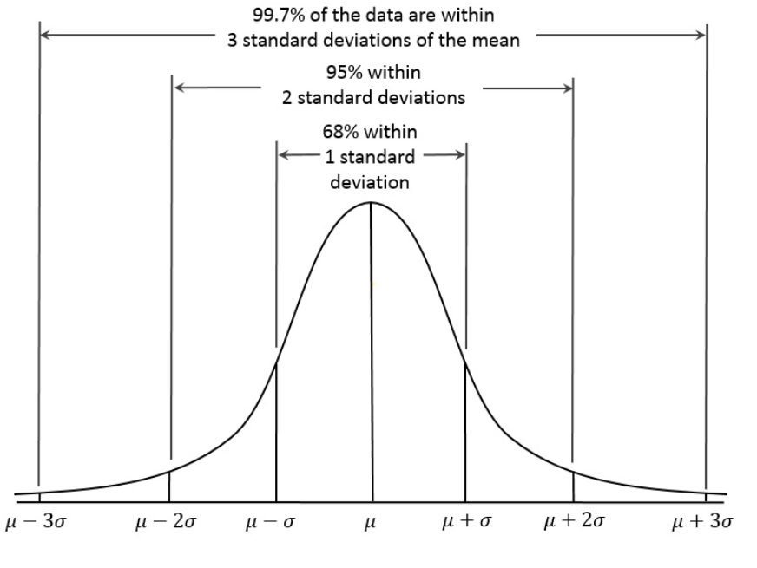
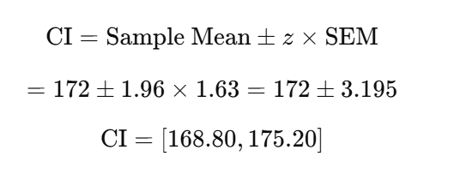
95% Confidence Interval for DePaul Student Heights
From our earlier example:
Sample mean: 172 cm
Standard error (SEM): 1.63 cm
Sample size: 25
Confidence level: 95% → Use z = 1.96
We are 95% confident that the true average height of all DePaul students lies between 168.8 cm and 175.2 cm, based on this sample. This means that if we repeated this sampling process many times, 95% of the intervals we make would have the true population mean.

Slide 25
Testing hypothesis
We can only gather evidence that supports a theory, or find evidence that contradicts it
falsifiability We test ideas by trying to prove them wrong, not right
In statistics, we don’t directly test whether our research idea is true.
Instead, we assume the opposite and test whether the data give us a good reason to reject that assumption.

Slide 26
The Null and Alternative Hypothesis
Null Hypothesis: Assumes no effect or no difference, and any observed pattern is due to chance
Alternative Hypotheses : Assumes a real effect or true difference exists. Suggests the pattern is not due to chance.
The null hypothesis is the falsifiable idea.
We assume it's true, and only if there’s strong evidence, we reject it(If results are too unlikely to happen by chance).

Slide 27
Statistical Significance
When Do We Reject the Null Hypothesis?
We look at the probability that our result happened just by chance.(p-value)
If that probability is lower than a set threshold, called the significance level (α):→ → We reject the null hypothesis (H₀) → We say the result is statistically significant
Common α values: (α = 0.05 & α = 0.01 )
p < 0.01 → Less than 1 in 100 chance the result is random.
p < 0.05 → Less than 1 in 20 chance the result is random.

Slide 28

Example
Scenario:
We test whether a new study method improves exam scores.
Group A (traditional method): mean score = 75
Group B (new method): mean score = 82
Null Hypothesis: The new study method does not improve exam scores
Alternative Hypothesis : The new study method does improve exam scores
We perform a t-test and get: p = 0.02 and α = 0.05
Interpretation:
p = 0.02 means there's a 2% chance this difference is due to chance.
Since 0.02 < 0.05, we reject the null hypothesis.
We conclude the new method likely improves exam scores.

Slide 29
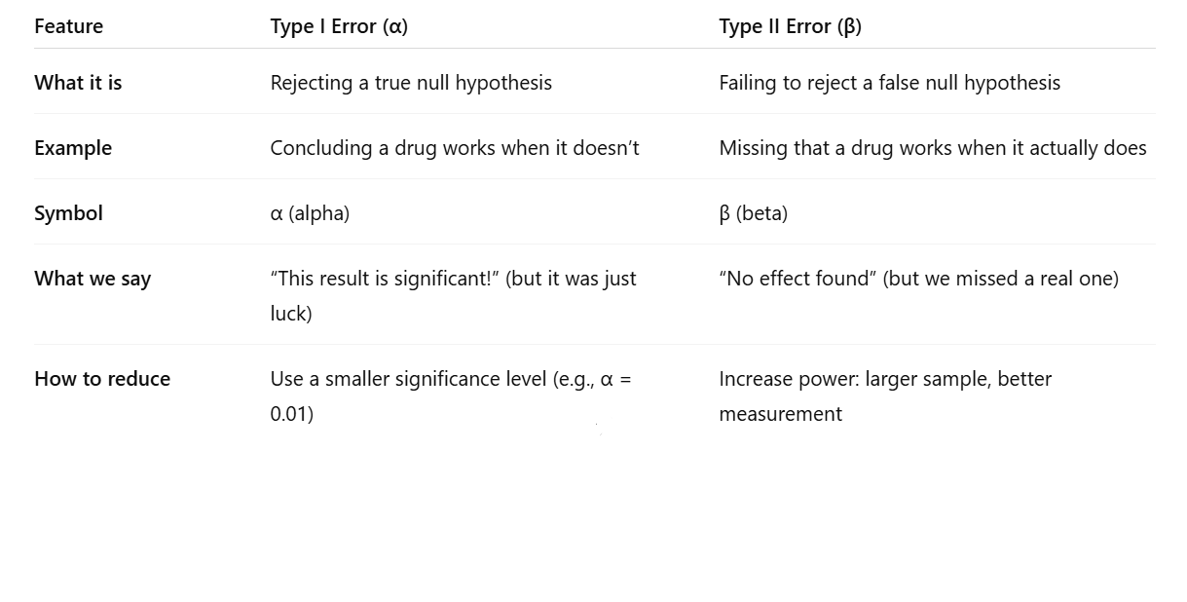
Making Errors in Hypothesis Testing
Hypothesis testing is based on probability, not certainty. Even with random sampling, there's always a chance of error.
Two types of mistakes can occur:
Type I Error (False Positive) and Type II Error (False Negative)

Slide 30
Multiple Testing Warning!
Testing many hypotheses increases Type I error risk!
Example: Run 15 tests at α = 0.05 → 53.67% chance of at least one Type I error!
Always report all findings, including total number of tests and their results, honestly and transparently.

Slide 31
Question
Now that we've discussed Type I and Type II errors, let's look at how variability and sampling choices in experiments can influence the likelihood of making these errors

Slide 32
Aggregation and Variability and Randomness
Aggregating results:
Usually report the average (mean) of multiple runs
Median or trimmed mean preferred if data is skewed or has outliers
Why average?
Reporting an average score across multiple runs smooths random noise, making it less likely that a random fluctuation triggers a false alarm (Type I error).
But if bias or systematic error exists (like non-random sampling), aggregation may not help,, leading to false conclusion use random sampling or stratified sampling

Slide 33

To assess whether a result is significant (and not due to chance), we need to understand the natural variability in outcomes.
Standard deviation, quantiles, and confidence intervals help us understand how uncertain a result is, critical for avoiding both Type I and II errors. Reporting only a mean without variability hides the range of outcomes and can lead to overconfidence in the result, potentially misleading hypothesis testing
Always remember:
To reduce both Type I and Type II errors, we must design experiments carefully, using big, diverse and representative samples, running multiple trials, and reporting variability, not just not just cherry-picked averages.

Slide 34
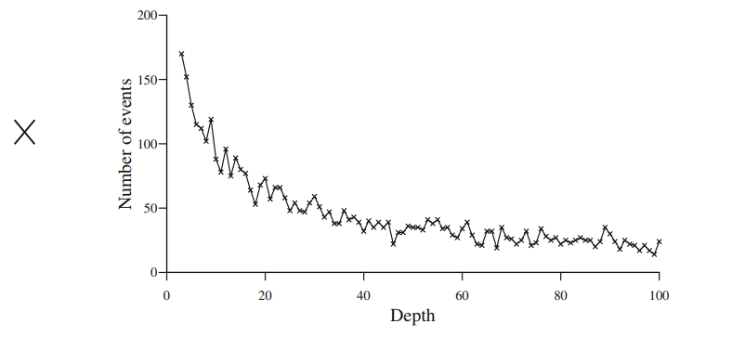
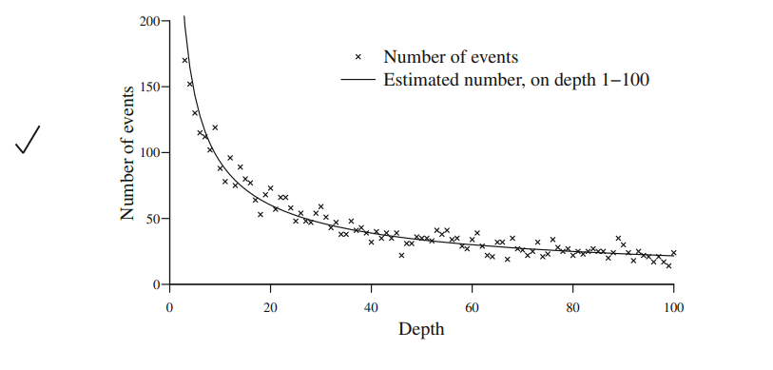
Visualization of Results: Why It Matters
Computers generate data, visualization helps us understand it. Visualization complements statistic
Even simple graphs reveal trends and patterns hidden in numbers.
We need to be careful with graphs:
Example: Connecting points with lines can mislead; curve fitting shows true trends.
The jagged line can falsely show a trend between individual points

Slide 35



Questions

