Slide 1
Descriptive Research
(Chapter 6 of LO textbook)
Zonglin Yang
May 13, 2025

Slide 2
Outline:
Descriptive Research Designs
correlation research; developmental designs; experience-sampling methods; observation studies; survey
Practical Application, Planning for Data Collection in a Descriptive Study
Choosing a Sample in a Descriptive Study
sampling design (prob & nonprob), practical applications
Common Sources of Bias in Descriptive Studies
sampling bias; instrumental bias; response bias; researcher bias
Summary

Slide 3
Descriptive Research Designs
Correlation Research
Developmental Designs
Experience-Sampling Methods
Observation Studies
Survey

Slide 4
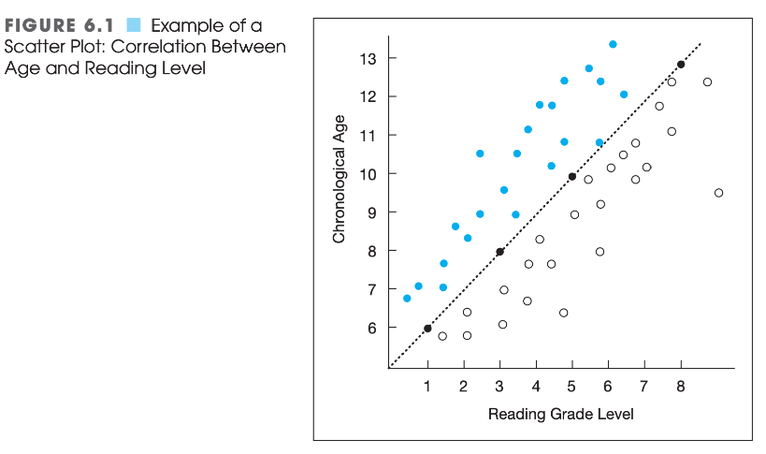
Descriptive Research Designs - Correlation Research
A correlational study examines the extent to which differences in one variable are associated with differences in one or more other variables. A correlation exists if, when one variable increases, another variable either increases or decreases in a somewhat predictable fashion.
Homogeneity V.S. Heterogeneity
Correlation != Causation

Slide 5
Descriptive Research Designs - Developmental Designs
Oftentimes, when researchers want to study how a particular characteristic changes as people grow older, they use one of two developmental designs: either a cross-sectional study or a longitudinal study.
  In a cross-sectional study, people from several different age groups are sampled and compared.
  In a longitudinal study, a single group of people is followed over the course of several months or years, and data related to the characteristic(s) under investigation are collected at various times.
Mediating and Moderating Variables in Correlational Relationships.

Slide 6
Descriptive Research Designs - Experience_Sampling Methods
An experience-sampling method (ESM) is an approach in which a researcher collects frequent and ongoing data about people as they live their normal, everyday lives.
Many ESM studies require some kind of technological device that people wear or carry with them, e.g. small electronic devices, smartphones, etc.
Shernoff Example
  Goal: possible relationships between (a) the quality of instructional activities in high school classes and (b) students’ interest and mental engagement in those activities.
  Method: recruited students in seven different classrooms, and, at 25-minute intervals during a class period, prompted the participating students to complete a brief rating-scale-based survey regarding their interest and engage- ment in the activity just prior to the signal, as well as their perceptions of the activity and their general mood at the time.

Slide 7
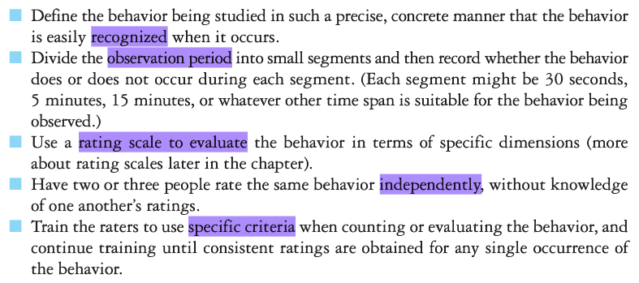
Descriptive Research Designs - Observation Studies
Observation study in quantitative research might be conducted with plants rather than animals, or it might involve nonliving objects.
A quantitative observation study tends to have a limited, prespecified focus.
Objective
Example: Kontos (1999)
  What roles do preschool teachers adopt during children’s free-play periods?
  Interviewer, stage manager, play enhancer/playmate, safety/behavior monitor, uninvolved

Slide 8
Descriptive Research Designs - Survey
In survey research, a researcher obtains information about one or more groups of people— perhaps about their behaviors, opinions, attitudes, or previous experiences—by asking them questions and either directly tabulating or systematically coding their answers.
Sample <= Population
Categories:
  Face-to-Face Interview
  Telephone Interview
  Written Questionnaire
  Internet/Online Methods of Data Collection

Slide 9
Descriptive Research Designs - Survey : Face-to-Face and Telephone Interview
Interviews tend to be standardized—that is, everyone is asked the same set of questions.
Structured Interview and Semistructured Interview.
Response Rate
Comparison

Slide 10
Descriptive Research Designs - Survey : Questionnaires
Written questionnaires can be distributed to a large number of people, including those who live in faraway locations, potentially saving a researcher travel expenses or lengthy long- distance telephone calls. Also, participants can respond to questions with anonymity—and thus with some assurance that their responses won’t come back to haunt them. Accordingly, some participants may be more truthful than they would be in a personal interview, especially when addressing sensitive or controversial issues.
Drawback: low return rate and

Slide 11
Descriptive Research Designs - Survey : Internet
Will talk in the second section.

Slide 12
Where we are now:
:
Descriptive Research Designs
correlation research; developmental designs; experience-sampling methods; observation studies; survey
Practical Application, Planning for Data Collection in a Descriptive Study
Choosing a Sample in a Descriptive Study
sampling design (prob & nonprob), practical applications
Common Sources of Bias in Descriptive Studies
sampling bias; instrumental bias; response bias; researcher bias
Summary

Slide 13
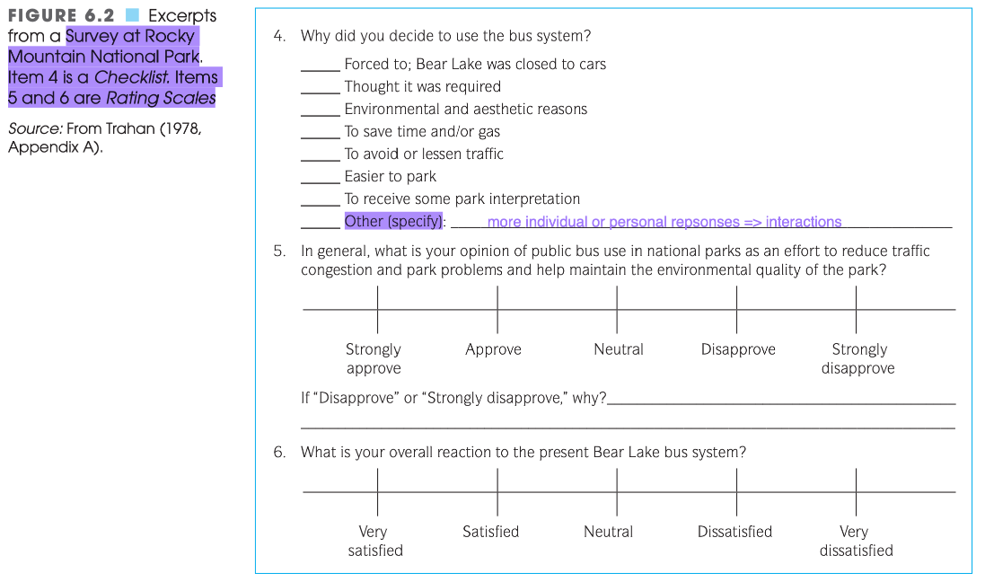
Practical Application, Planning for Data Collection in a Descriptive Study
Using Checklists, Rating Scales, and Rubics

Slide 14
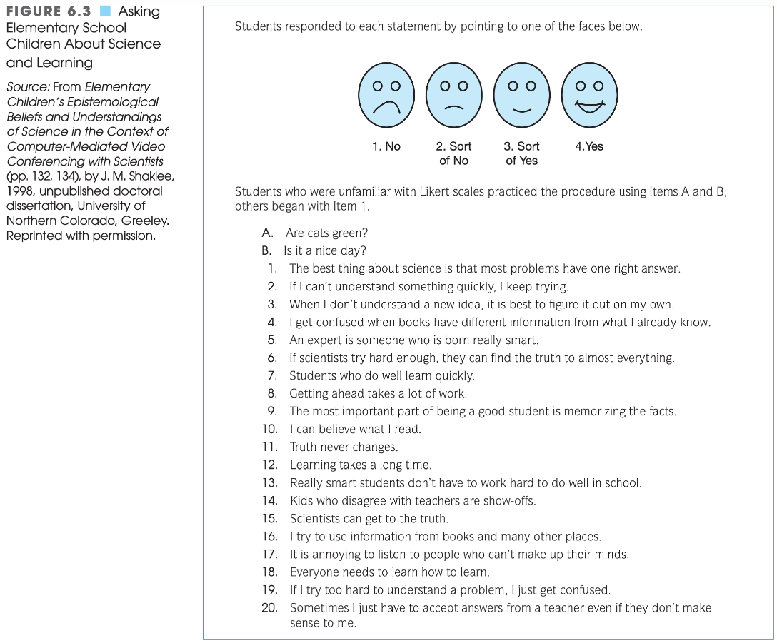
Practical Application, Planning for Data Collection in a Descriptive Study
Using Checklists, Rating Scales, and Rubics [Contig]

Slide 15
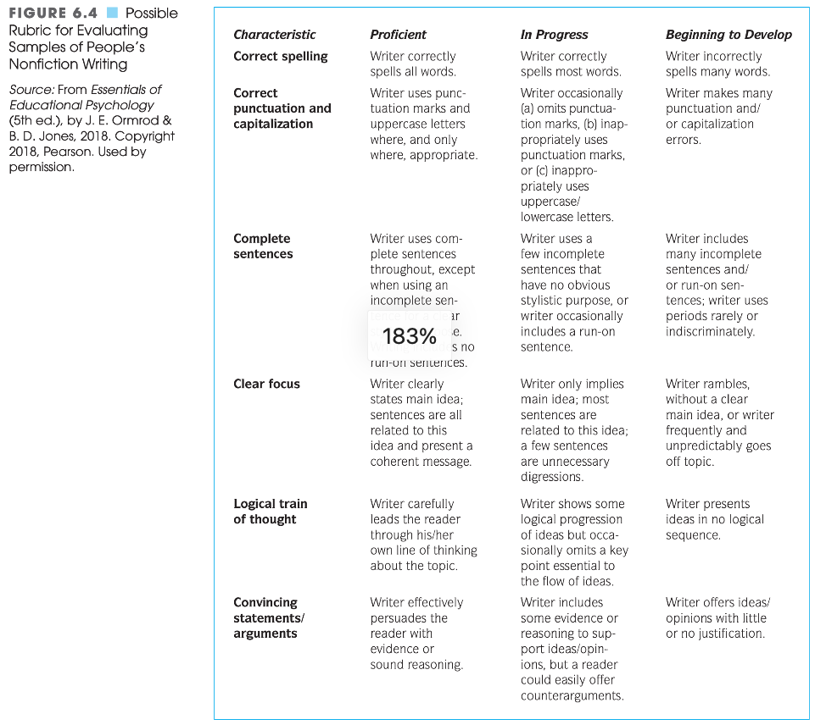
Practical Application, Planning for Data Collection in a Descriptive Study
Using Checklists, Rating Scales, and Rubics [Contig]

Slide 16
Practical Application, Planning for Data Collection in a Descriptive Study
Computerizing Observations
One good way of enhancing your efficiency in data collection is to record your observations on a laptop, computer tablet, or smartphone as you’re making them. For example, when using a checklist, you might create a spreadsheet with a small number of columns—one for each item on the checklist—and a row for every entity you will observe. Then, as you conduct your observations, you can enter an “X” or other symbol into the appropriate cell whenever you see an item in the checklist. Alternatively, you might download free or inexpensive data-collection software for your smartphone or computer tablet; examples are Magpi (magpi.com), Open Data Kit (opendatakit.org), and QuickTapSurvey (quicktapsurvey.com).

Slide 17
Practical Application, Planning for Data Collection in a Descriptive Study
Planning and Conducting Interviews in a Quantitative Study - Guidelines of Conducting Interviews:
Limit questions to those that will directly or indirectly help you answer your research question.
As you write the interview questions, consider how you can quantify the responses, and modify the questions accordingly.
Restrict each question to a single idea.
Consider asking a few questions that will elicit qualitative information.
Consider how you might use a computer to streamline the process.
Pilot-test the questions.
Courteously introduce yourself to potential participants, and explain the general purpose of your study.
Get written permission.
Save controversial questions for the latter part of the interview.
Seek clarifying information when necessary.

Slide 18
Practical Application, Planning for Data Collection in a Descriptive Study
Constructing and Administering a Questionnaire - Guidelines
Keep it short.
Keep the respondent’s task simple and concrete.
Provide straightforward, specific instructions.
Use simple, clear, unambiguous language.
Give a rationale for any items whose purposes may be unclear.
Check for unwarranted assumptions implicit in your questions.
Word your questions in ways that don’t give clues about preferred or more desirable responses.
Determine in advance how you will code the responses.
Check for consistency.
Conduct one or more pilot tests to determine the validity of your questionnaire.
Scrutinize the almost-final product one more time to make sure it addresses your needs.
Make the questionnaire attractive and professional looking.

Slide 19
Practical Application, Planning for Data Collection in a Descriptive Study
Constructing and Administering a Questionnaire - Guidelines of Using Technology to Faciliate Questionnaire Administration and Data Analysis
When participants are in the same location that you are, have them respond to the questionnaire directly on a laptop or tablet.
When participants are at diverse locations, use e-mail to request participation and obtain participants’ responses.
If you use paper mail delivery rather than e-mail, use a word-processing program to personalize your correspondence.
If you use paper mail delivery rather than e-mail, use a word-processing program to personalize your correspondence.
Use a computer database to keep track of who has responded and who has not.

Slide 20
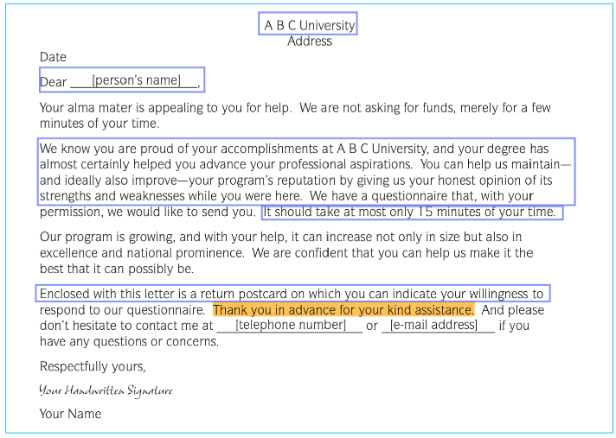
Practical Application, Planning for Data Collection in a Descriptive Study
Constructing and Administering a Questionnaire - Guidelines of Maximizing Return Rate for a Questionnaire [Contig]
Example: A Letter of Inquiry

Slide 21
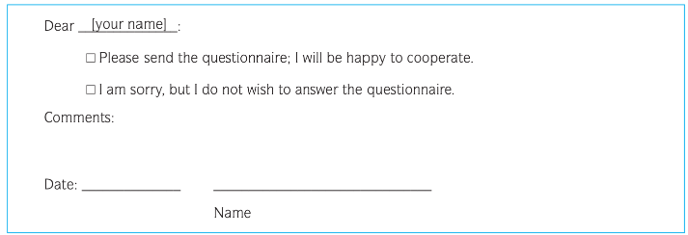
Practical Application, Planning for Data Collection in a Descriptive Study
Constructing and Administering a Questionnaire - Guidelines of Maximizing Return Rate for a Questionnaire [Contig]
Example: Questionnaire Reponse Card

Slide 22
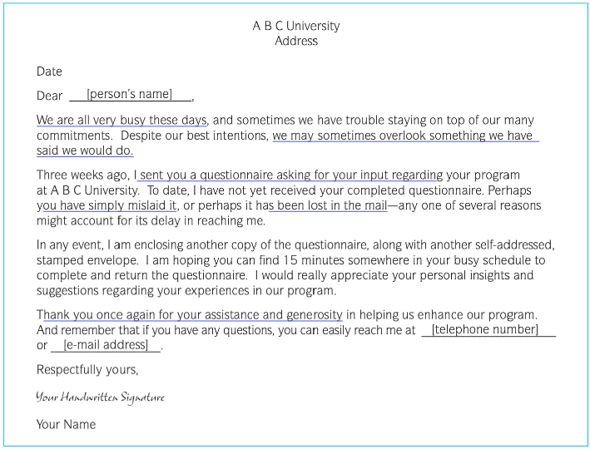
Practical Application, Planning for Data Collection in a Descriptive Study
Constructing and Administering a Questionnaire - Guidelines of Maximizing Return Rate for a Questionnaire [Contig]
Example: A Follow-Up Letter

Slide 23
Practical Application, Planning for Data Collection in a Descriptive Study
One site providing links to a wide variety of online research projects is Psychological Research on the Net. No fee.
Commercial websites for data collection are available as well.
Probably the most popular one is SurveyMonkey (surveymonkey.com), which charges a modest monthly fee. This website provides templates that make questionnaire design easy and enable a researcher to present a variety of item types (e.g., multiple-choice items, rating scales). Commercial data- collection websites typically also include features for (a) communicating with a preselected sample of participants (e.g., through e-mail invitations), (b) ensuring participants’ anonymity, (c) statistically analyzing the data collected, and (d) downloading the results.

Slide 24
Where we are now:
Descriptive Research Designs
correlation research; developmental designs; experience-sampling methods; observation studies; survey
Practical Application, Planning for Data Collection in a Descriptive Study
Choosing a Sample in a Descriptive Study
sampling design (prob & nonprob), practical applications
Common Sources of Bias in Descriptive Studies
sampling bias; instrumental bias; response bias; researcher bias
Summary

Slide 25
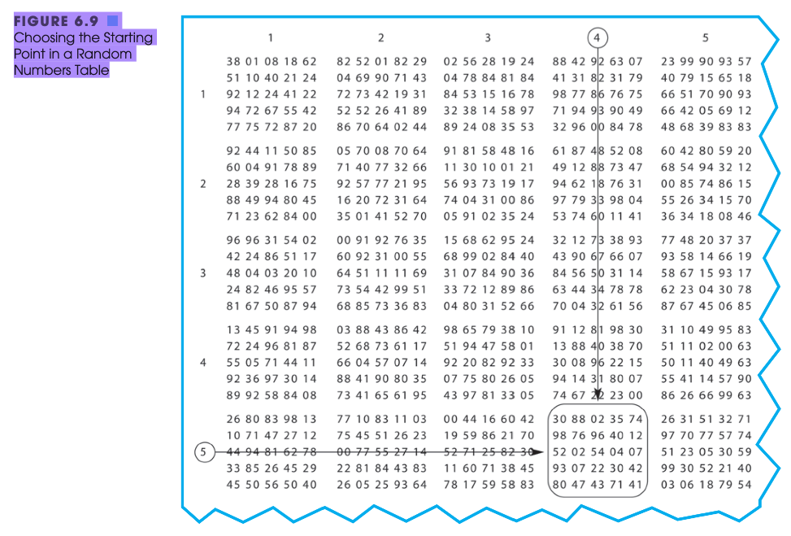
Choosing a Sample in Descriptive Study
Sampling Designs
  Probability Sampling => Random
    Example

Slide 26
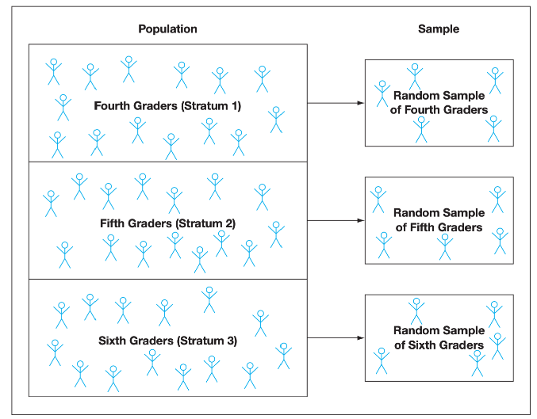
Choosing a Sample in Descriptive Study
Sampling Designs
  Probability Sampling => Random
    Example
    Simple Random Sampling
    Stratified Random Sampling

Slide 27
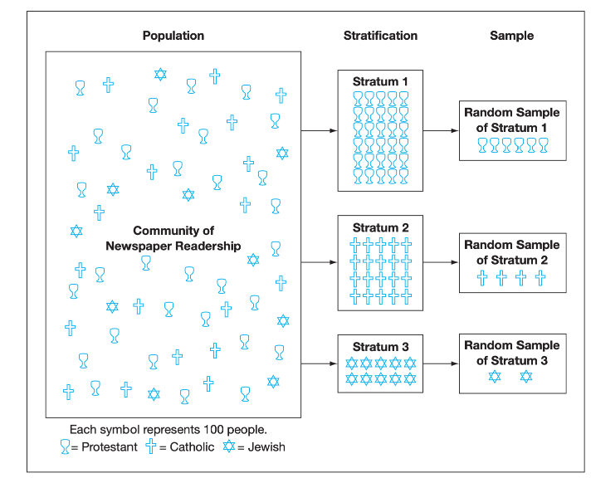
Choosing a Sample in Descriptive Study
Sampling Designs
  Probability Sampling => Random
    Example
    Simple Random Sampling
    Stratified Random Sampling
    Proportional Stratified Sampling

Slide 28
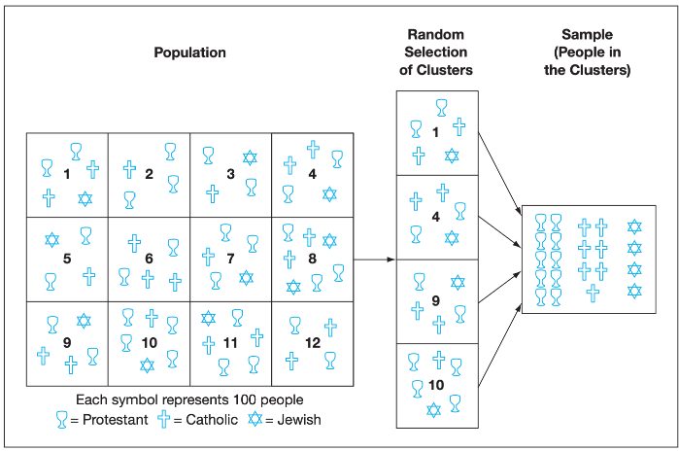
Choosing a Sample in Descriptive Study
Sampling Designs
  Probability Sampling => Random
    Example
    Simple Random Sampling
    Stratified Random Sampling
    Proportional Stratified Sampling
    Cluster Sampling

Slide 29
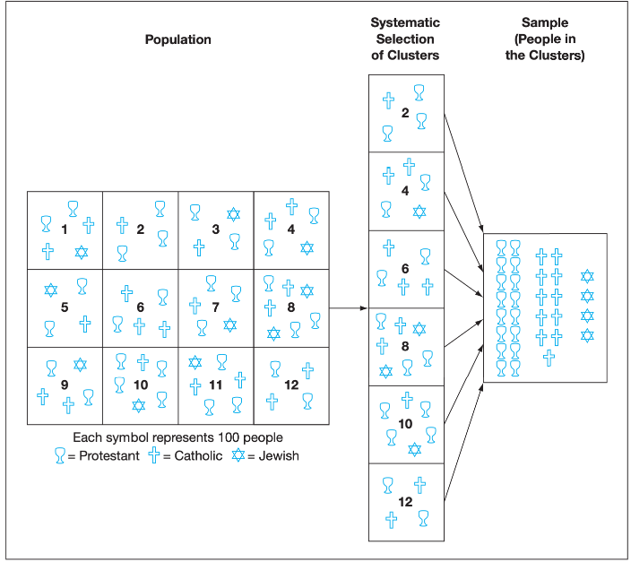
Choosing a Sample in Descriptive Study
Sampling Designs
  Probability Sampling => Random
    Example
    Simple Random Sampling
    Stratified Random Sampling
    Proportional Stratified Sampling
    Cluster Sampling
    Systematic Sampling

Slide 30
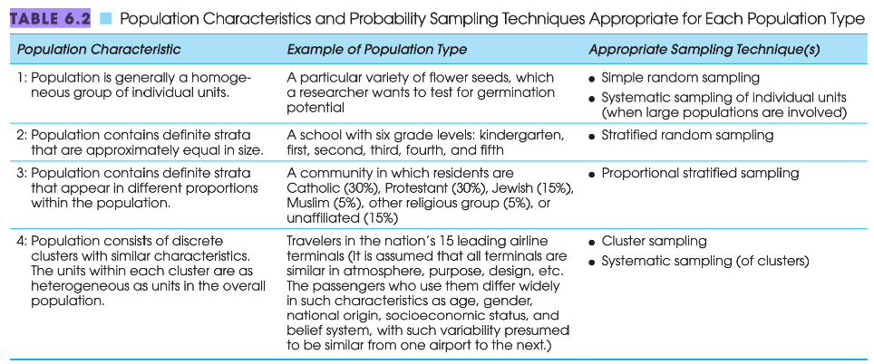
Choosing a Sample in Descriptive Study
Sampling Designs
  Probability Sampling => Random
    Example
    Simple Random Sampling
    Stratified Random Sampling
    Proportional Stratified Sampling
    Cluster Sampling
    Systematic Sampling

Slide 31
Choosing a Sample in Descriptive Study
Sampling Designs
  Probability Sampling => Random
    Example
    Simple Random Sampling
    Stratified Random Sampling
    Proportional Stratified Sampling
    Cluster Sampling
    Systematic Sampling
  Nonprobability Sampling
    Convenience sampling
    Quota sampling
    Purposive sampling

Slide 32
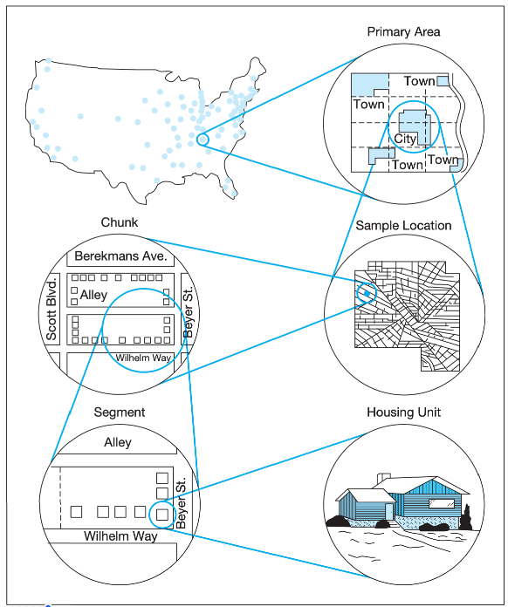
Choosing a Sample in Descriptive Study
Sampling in Surveys of Very LARGE Populations
Instructions:
Primary area selection.
Sample location selection.
Chunk selection.
Segment selection.
Housing unit selection.

Slide 33
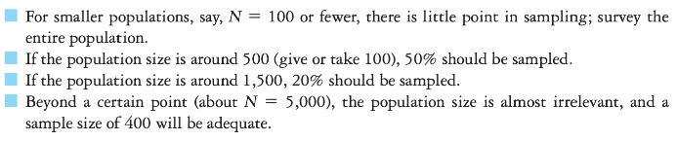
Choosing a Sample in Descriptive Study
Two Practical Application
Identifying a Sufficient Sample Size
Choosing an Appropriate Sample in Descriptive Research

Slide 34
Where we are now:
Descriptive Research Designs
correlation research; developmental designs; experience-sampling methods; observation studies; survey
Practical Application, Planning for Data Collection in a Descriptive Study
Choosing a Sample in a Descriptive Study
sampling design (prob & nonprob), practical applications
Common Sources of Bias in Descriptive Studies
sampling bias; instrumental bias; response bias; researcher bias
Summary

Slide 35
Common Sources of Bias in Descriptive Studies
Sampling bias
instrumental bias
response bias
researcher bias
Practical Application: Acknowledging the Probable Presence of Bias in Descriptive Research
  Identifying Possible Sampling Bias in Questionnaire Research

Slide 36
Common Sources of Bias in Descriptive Studies
Practical Application: Acknowledging the Probable Presence of Bias in Descriptive Research
  Identifying Possible Sampling Bias in Questionnaire Research
Carefully scrutinize the questionnaire for items that might be influenced by factors that frequently distinguish respondents from nonrespondents.
Compare the responses on questionnaires that were returned quickly with responses on those that were returned later, perhaps after a second reminder letter or after the dead- line you imposed.
Randomly select a small number of nonrespondents, and try to contact them by mail or telephone.

Slide 37
Where we are now:
Descriptive Research Designs
correlation research; developmental designs; experience-sampling methods; observation studies; survey
Practical Application, Planning for Data Collection in a Descriptive Study
Choosing a Sample in a Descriptive Study
sampling design (prob & nonprob), practical applications
Common Sources of Bias in Descriptive Studies
sampling bias; instrumental bias; response bias; researcher bias
Summary

Slide 38
Summary
two basic principles of research:
1. The purpose of research is to seek the answer to a problem or question in light of data that relate to the problem or question.
2. Although collecting data for study and organizing it for inspection require care and precision, extracting meaning from the data—the interpretation of the data—is paramount and should never be neglected.

Slide 39
Thanks!

