Slide 1
Statistical Techniques: Data Preparation, Descriptive & Inferential Statistics
Adrian Cornely
Charmi Patel

Slide 2
What’s the first step?
Data is useless unless we can extract patterns
Before doing anything, the integrity of the data has to be verified
Bad data can cause many issues
But sometimes it’s not as easy to spot as the one in the example!
Name | Grade
Adam | D
Jessica | E
Victoria | A

Slide 3
How to handle bad data?
Bad data can take several forms
Out of range/invalid data
Missing data
Mis-entered data
Outliers
How can we fix these?
Exclude the entire entry
Fill in/correct the value with something like a mean
Correct the data, if possible (typo, wrong type)
Good choice of statistical methods, in the case of outliers

Slide 4
Data Documentation
When collecting data, there should be a documented format
Name of field
Description of field
Format of field
Allowable values/ranges
This kind of documentation can assist in finding data inaccuracies, particularly when working in a team
Field | Description
Latitude | Double, ranges from -90.0 to 90.0
Longitude | Double, ranges from -180.0 to 180.0
Tail number | String, 6 characters long, must start with N, N must be followed by 4 numbers and 1 letter, or 3 numbers and 2 letters, letters I and O not allowed

Slide 5
Extracting patterns
Extracting patterns can often drive further analysis
Looking at raw, unordered data rarely yields anything useful
Several techniques to help
Ordering
Augmentation
Visualization

Slide 6
Ordering
What can we discern from this alphabetical ordering?

Slide 7
Augmentation
We augment with gender here now, which allows us to start seeing a pattern

Slide 8
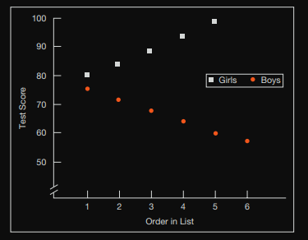
Visualization
Now, after visualizing, we can confirm our gender augmentation assumption bore fruit

Slide 9
Red herring!
While the previous techniques are helpful, they are NOT law!
We may make an observation that winds up being completely irrelevant to our specific problem, but is still an important observation to make!
Additionally, how we choose to prepare data has a SIGNIFICANT impact on the outcome, so thought should be put into doing so
“How the researcher prepares the data for inspection or interpretation will affect the meaning that those data reveal. Therefore, every researcher should be able to provide a clear, logical rationale for the procedure used to arrange and organize the data” –Leedy and Omrrod

Slide 10
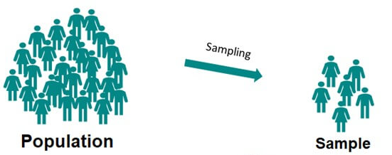
Descriptive Statistics
What is descriptive statistics?
Descriptive statistics merely describes and summarizes collected data
Descriptive statistics can be broken down into three categories:
Measures of Central Tendency
Measures of Variability: Dispersion and Deviation
Measures of Association: Correlation

Slide 11
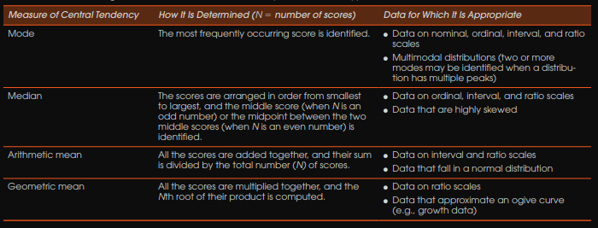
Measures of Central Tendency
A point of central tendency is a point around which data revolves
Mean
Median
Mode
These are often used for predictions

Slide 12
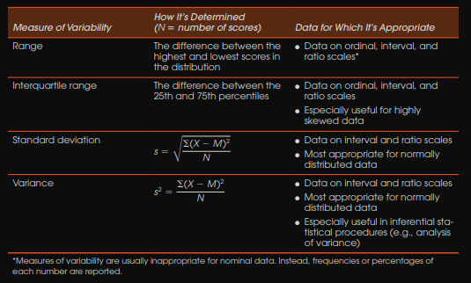
Measures of Variability: Dispersion and Deviation
These are used to answer “What are the worst odds” and to describe spread
Range
Standard deviation
Variance

Slide 13
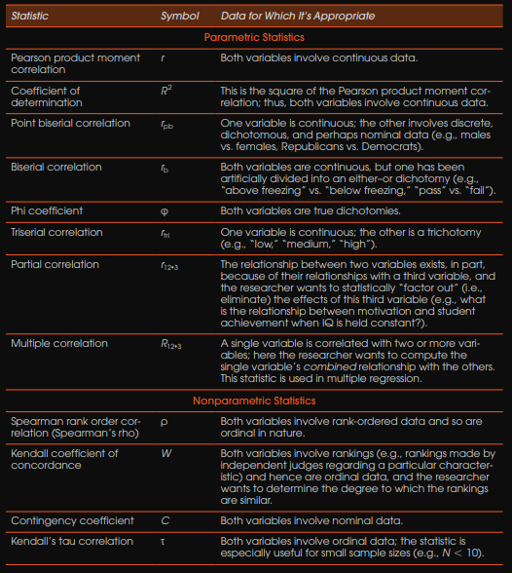
Measures of Association: Correlation
These tell if two or more variables are correlated
Correlation coefficient, between -1 and 1
Tells direction (the sign of the coefficient)
Strength (the magnitude of the coefficient)
Correlation is dependent on validity/reliability
CORRELATION != CAUSATION

Slide 14
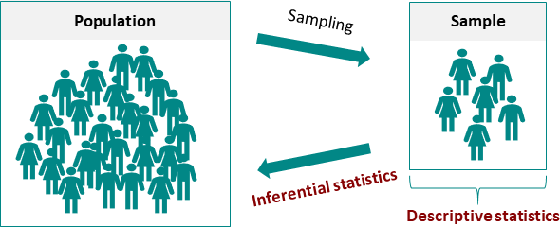
Inferential Statistics
What is Inferential Statistics?
Inferential statistics uses random sample data to make conclusions about the population.
Inferential statistics have two main functions:
To estimate a population parameter from a random sample
To test statistically based hypotheses
Notes:
Inferential statistics help you come to conclusions and make predictions based on your data.
When you have collected data from a sample, you can use inferential statistics to understand the larger population from which the sample is taken.
Inferential statistics have two main uses:
making estimates about populations (for example, the mean SAT score of all 11th graders in the US).
testing hypotheses to draw conclusions about populations (for example, the relationship between SAT scores and family income).

Slide 15
Estimating population parameters from sample statistics
Statistical estimates of population parameters are based on the assumption that the sample is randomly chosen and representative of the total population
The characteristics of samples and populations are described by numbers called statistics and parameters:
A statistic is a measure that describes the sample (e.g., sample mean)
A parameter is a measure that describes the whole population (e.g., population mean)

Slide 16
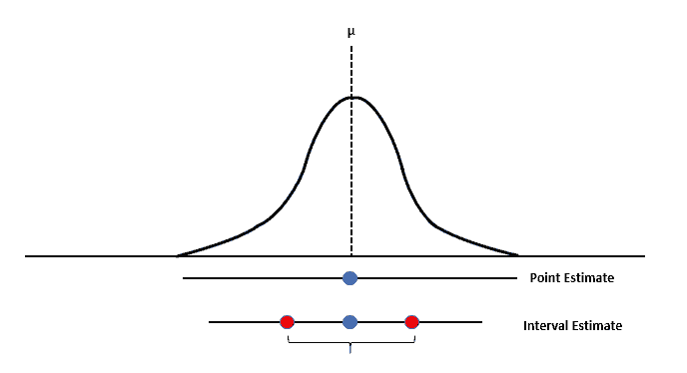
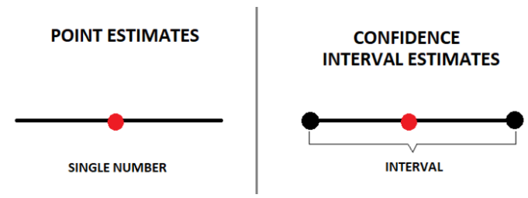
Point vs Interval Estimates
There are two important types of estimates about the population:
Point estimates
A point estimate is a single value estimate of a parameter. For instance, a sample mean is a point estimate of a population mean.
Interval estimates
An interval estimate gives you a range of values where the parameter is expected to lie. A confidence interval is the most common type of interval estimate.

Slide 17
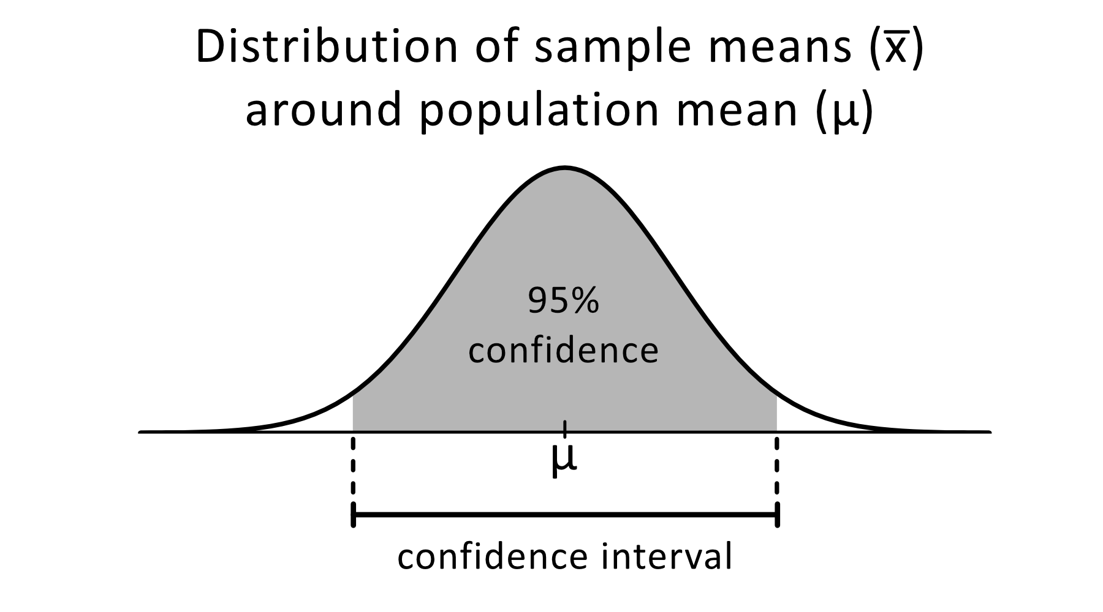
Confidence Interval
Confidence interval: Uses variability around a statistic to estimate a parameter within a range
Point estimate gives a precise value for the parameter interested in whereas a confidence interval tells the uncertainty of point estimate
95% confidence interval: Indicates that if the study is repeated 100 times with new samples, the estimate will fall within the specified range approximately 95 times

Slide 18
Example: Point estimate and Interval estimate
We want to know the average number of vacation days that students at DePaul receive. After collecting survey responses from a random sample, we calculate a point estimate and an interval estimate
Point estimate of the population mean paid vacation days - sample mean of 19 paid vacation days
95% confidence interval of [16 22] means you can be reasonably confident that the average number of vacation days is between 16 and 22

Slide 19
Hypothesis Testing
Statistical technique for confirming or refuting statements about a population using sample data
Multiple tests available for hypothesis testing, selection based on data and test objective
Important aspect of inferential statistics
Allows to draw meaningful conclusions from sample data
It helps bridge the gap between observed data and population parameters
Notes:
We can think of hypothesis testing as an experiment, an hypothesis is made before the experiment starts. After experimentation, we would confirm if the results agree with the statement or not.

Slide 20
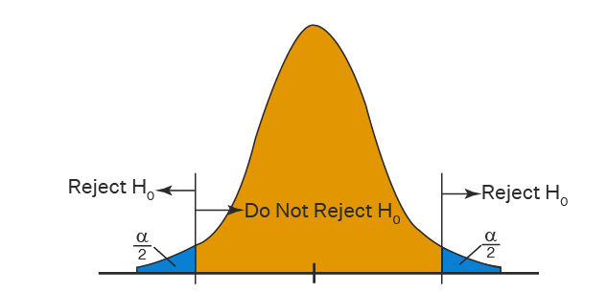
Null Hypothesis (H₀)
It is the default position or assumption in hypothesis testing
It states that there is no significant difference, effect, or relationship in the population
Goal of hypothesis testing is to evaluate the evidence against the null hypothesis and determine if it should be rejected in favor of the alternative hypothesis
Rejecting the null hypothesis implies that there is evidence for an effect, difference, or relationship in the population

Slide 21
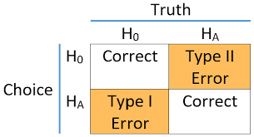
Errors in Hypothesis Testing
Type I Error
It occurs when the null hypothesis is rejected, even though it is true
It means that statistical test incorrectly concludes that there is a significant effect in the population when, in reality, there isn’t
Type I error is denoted as α (alpha)
Type II Error
It occurs when the null hypothesis is accepted, even though it is false
It means that statistical test fails to detect that there is a significant effect in the population when, in reality, there is one
Type II error is denoted as β (beta)

Slide 22
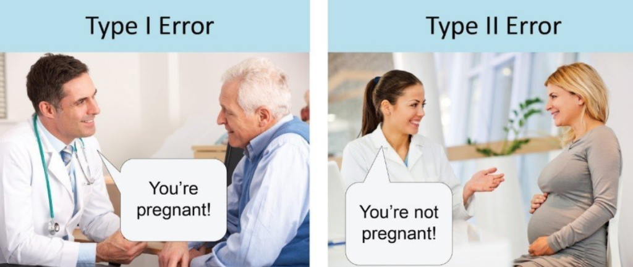
Example of Type I and Type II Error
Medical Testing:
Type I error: Incorrectly identifying a person as having the disease when they are disease-free
Type II error: Failing to detect the disease in a person who actually has it

Slide 23
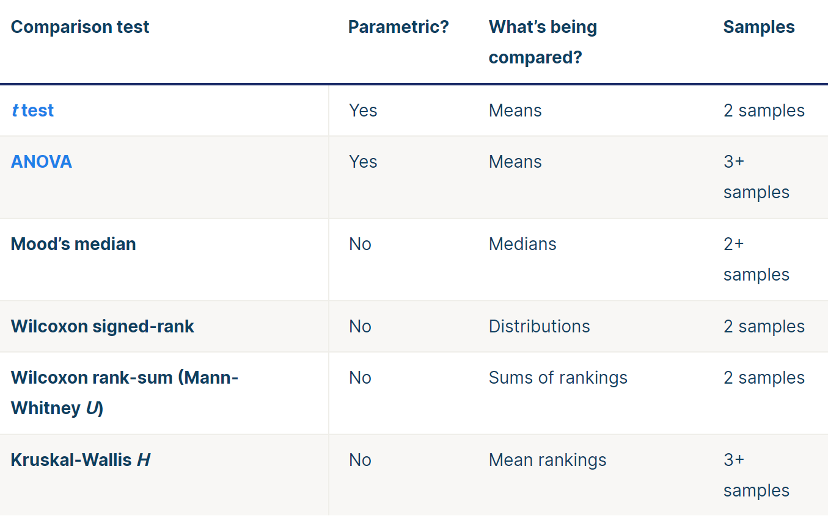
Parametric and Non-parametric Tests
Parametric Test: Data being analyzed follows a specific probability distribution, most commonly the normal distribution
Non-parametric Test: Distribution-free tests, do not assume any specific distribution for the data

Slide 24
Any Questions ?

