Slide 1
Evaluation Methodologies and Measurement/Reliability
Erin Murphy & Jesus Duran

Slide 2
Overview
Reading Discussion
Construct Validity
Reliability
Levels of Measurement

Slide 3
Wake Up and Smell the Coffee: Evaluation Methodologies for the 21st Century
Methodology is the foundation for judging innovation in experimental computer science. Sound methodology includes using appropriate workloads, principled experimental design, and rigorous analysis.
The Standard Performance Evaluation Corporation (SPEC) aims to "produce, establish, maintain and endorse a standardized set" of performance benchmarks for computers. The benchmarks test Java scenarios (simple computations to database, disk, and network, and cloud storage).
“SPEC Frequently Asked Questions.” Standard Performance Evaluation Corporation, 2019, www.spec.org/spec/faq/#01SPEC.General.10whatis.
Notes:
This paper explores the consequences of our collective inattention to methodology on innovation, makes recommendations for addressing this problem in one domain, and provides guidelines for other domains.
- Callback to articles on lack of reproducability
- General responsibility on data retention via Scientific practice standards

Slide 4
Discussion Questions
The author implies that all research should run against benchmarks. Do you agree with this? Even if the benchmarks are diverse, could it result in biased work (i.e. Are researchers forced to create work with benchmarks in mind or should they create their own benchmarks)?
Is there an argument to be made around creating benchmarks that are similar to one another and not just creating diverse benchmarks?
The authors say benchmarks shouldn't be the responsibility of the researcher. Whose responsibility is it to ensure benchmarks are created, maintained and "good"?
Do we need consortiums or groups to create standardized benchmarks? Could a site like Kaggle (aggregator of datasets for the public) act in lieu of that? Should researchers create their own benchmarks?
The article discusses experimental design and analysis in the context of evaluating a new garbage collector (reclaim memory from objects no longer in use) by doing things like varying the architecture and holding garbage collection constant, and running multiple iterations of experiments.
What are examples in your field on how to control experimental design? Are there standards for experimental design in your field?
What kinds of analyses are done to ensure completeness/accuracy in your work/field?

Slide 5
Construct Validity
A reflection of the truth.
Notes:
- Callback to articles on lack of reproducability
- General responsibility on data retention via Scientific practice standards

Slide 6
A Few Definitions
Operationalization – the translation of a concept or construct into a functioning and operating reality
Construct validity – the degree to which inferences can legitimately be made from the operationalizations in your study to the theoretical constructs on which those operationalizations were based
Example: Construct validity ≈ sampling a population
The population is the “construct”
The sample is the operationalization
How well does the sample represent the population?

Slide 7
Construct Validity
Land of Theory
An attempt to explain or articulate to others what goes on inside your mind
Ideas, theories, hunches and hypotheses about the world
Land of Observation
The actual program or treatment, and actual measures or observational procedures
The program/measures are based on what you had in mind

Slide 8
Construct Validity
How well ideas or theories are translated into actual programs or measures—when you think about the world or talk about it with others (land of theory) you are using words that represent concepts
To establish construct validity
Explain the constructs
Provide evidence the operationalization of the construct is controlled
Provide evidence that outcomes are supported by the operationalization of the constructs
E.g. a math tutoring program
Discuss the format (1:1 teaching, application-based), the intended outcomes (increased test scores)
These are constructs, not going into detail of the actual program
Notes:
Construct validity claims that an observed pattern – how things operate in reality – corresponds with a theoretical pattern – how we think the world works
involves generalizing from your program or measures to the concept of your program or measures

Slide 9
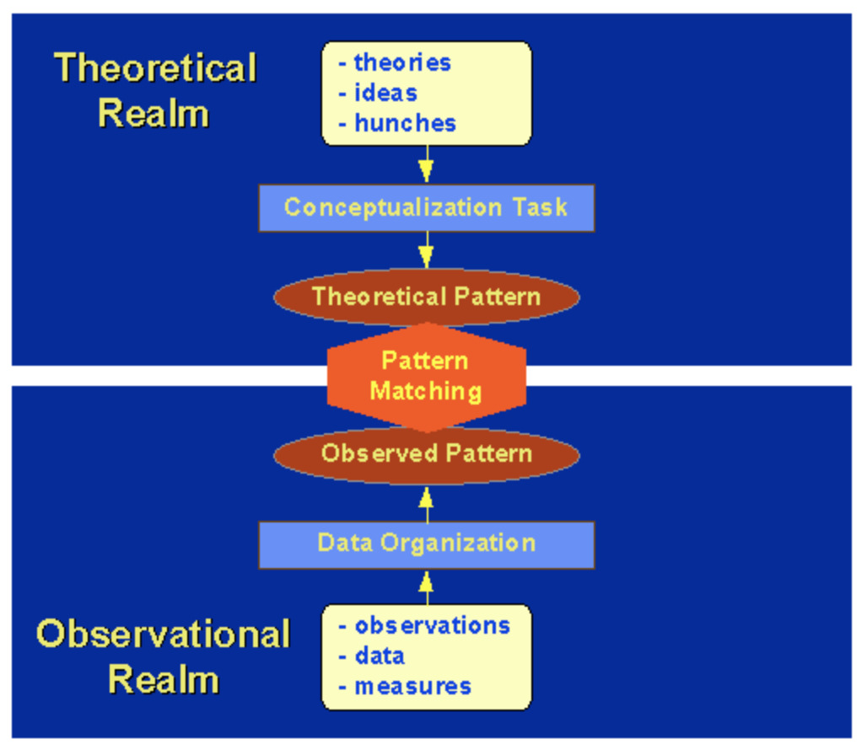
Pattern Matching
An attempt to link two patterns: one is theoretical, the other is observed or operational

Slide 10
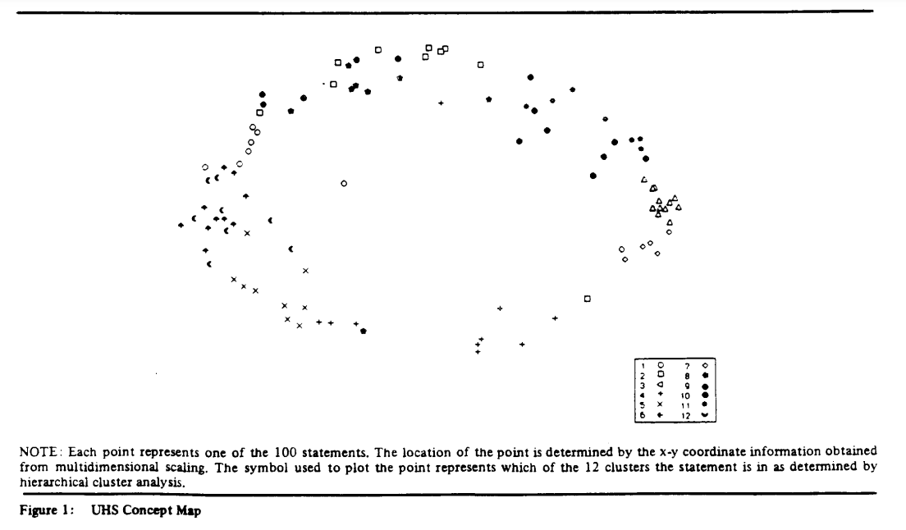
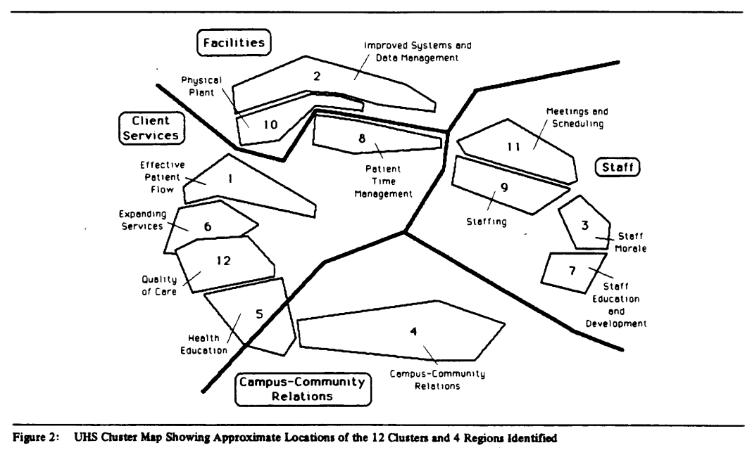
Pattern Matching
Compares the theoretical pattern to the observed pattern
Statements from employees about how they view their organization
Figure 1. Each point represents 1 of 100 statements
Figure 2. The statements are then clustered by their statement-type
Implementing a new computer system aligns with statements in cluster 2
Trochim, William MK. "Pattern matching, validity, and conceptualization in program evaluation." Evaluation review 9.5 (1985): 575-604.

Slide 11
Pattern Matching (ground truth vs output)
Rosebrock, Adrian. “Labeling Superpixel Colorfulness with OpenCV and Python.” PyImageSearch, 17 Apr. 2021, www.pyimagesearch.com/2017/06/26/labeling-superpixel-colorfulness-opencv-python.

Slide 12
A Note on the Input Dataset... ...stepping away from the Social Sciences
Baselines/gold standard/ground truth are needed to compare your results to show how well the construct worked
How can you compare you if it is different than what has already been discussed in the literature?
Do you have to adapt the baseline/gold standard/ground truth data to work with your dataset?
You need to really understand your input data, [prevent overfitting,] and look particularly close at hard cases
Afterall, this data is what will represent the operationalization of your model's constructs

Slide 13
Threats to Construct Validity
Helps to demonstrate the limitations of the treatment/algorithm
Inadequate Preoperational Explication of Constructs: didn’t do a good enough job of defining (operationally) your method/algorithm
Maybe you didn't explain what was novel about your approach
Mono-Operation Bias: using a single algorithm on a single set of data (maybe a small set of training data), it might not be generalizable
try using multiple algorithms
Mono-Method Bias: refers to your measurements
Looking at accuracy with unbalanced data and determining that 98% reflects the model is doing well, but should really look at recall and precision
Interaction of Different Treatments: a latent feature / combination of features that result in the outcome
slow traffic times in a city = 2-lane roads, many traffic lights, everyone needing to be at work and school at the same time, and train tracks crossing the roads
Interaction of Testing and Treatment: Covid vaccines are 72-96% effective, but <1% are reporting infection after being vaccinated
people assume they don’t have it because they’ve been vaccinated?
Restricted Generalizability Across Constructs: the treatment works but has unintended consequences
J&J/Astrazeneca vaccine, it’s vaccinated people against Covid, but resulted in serious side effects of blood clots (albeit, extremely rare)
Confounding Constructs and Levels of Constructs: need to test dosing levels of the vaccine
Small dose = no cure
High dose = treats w/ bad side effects
Need to test variations in the parameters

Slide 14
Convergent and Discriminant Validity
Convergent
Theoretically similar constructs should be more correlated
E.g. Measuring one's cardiac health
heart rate, blood pressure, cholesterol levels
A high correlation among these increases convergent validity
Measured with different instruments
Discriminant
Theoretically different constructs should be less correlated
E.g. Weather and a city’s population
LA = nice all the time
Chicago = nice maybe ½ the time
A low correlation among these measures would increase discriminant validity
Both are measured with 2 different instruments

Slide 15
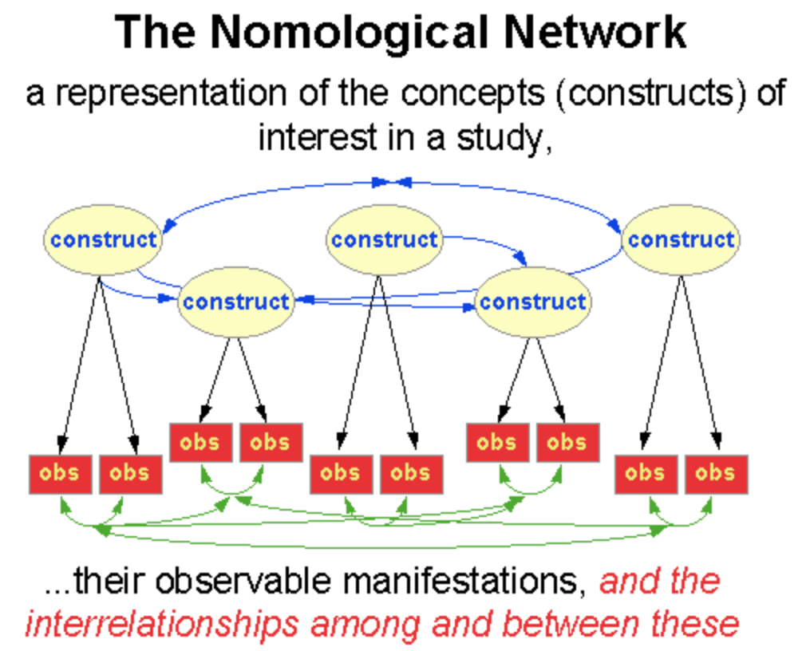
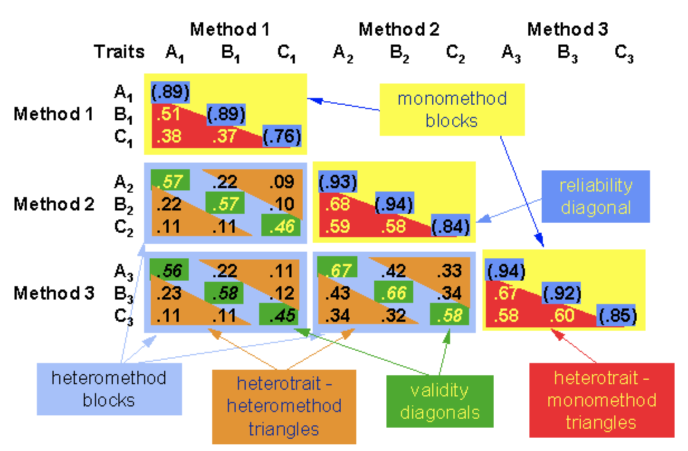
Assessing Construct Validity
Method: Same dataset, different ML algorithm to classify data (KNN vs Decision Trees vs Support Vector Machines)
Trait: Classification groups withing a dataset (Iris setosa, Iris virginica and Iris versicolor from theIris dataset)
These numbers won't be perfect, but can be supported enough to prove you have construct validity
Notes:
Validity diagonals (should be highest in the columns) --> Convergent
Heterotrait --> Discriminant
Each triangle should have the same pattern of traits

Slide 16
Measurement Validity Types
Convergent and discriminant validity don’t really measure the construct(s), they just measure how the constructs are correlated. You might need a number of validity measures to measure the constructs.
Translation validity
Face validity “on its face” it seems like a good translation of the construct
It's not a tested measure, it's taken at face-value
Weak and subjective
Content validity check the operationalization against the relevant content domain for the construct
Compare your program to what else has been done
What is considered a "good program"?
If criteria exists for a good program, that should be included
Criterion-related validity
Predictive validity assess the operationalization’s ability to predict something it should theoretically be able to predict
A lot of extracurricular activities = you're more likely a well-rounded student
Concurrent validity the operationalization’s ability to distinguish between groups that it should theoretically be able to distinguish between
discriminate between two groups that are very similar (clustering analysis)
Convergent validity
Discriminant validity

Slide 17
Questions?

Slide 18
Reliability
Evaluating the quality of a measurement.
Notes:
- Callback to articles on lack of reproducability
- General responsibility on data retention via Scientific practice standards

Slide 19
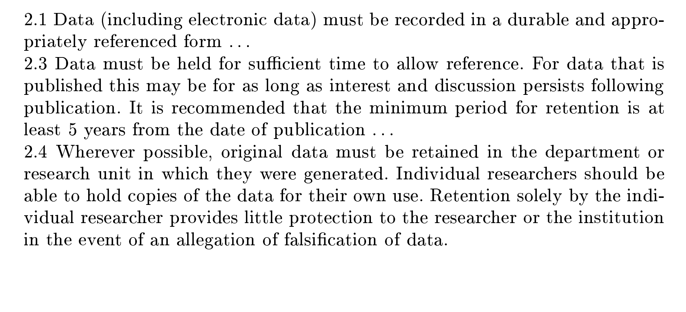
Context
Considered experiment designs
Addressed evaluating that the measures align with our constructs
Need to addressing the problem of reproducibility
Let's evaluate the measurement

Slide 20
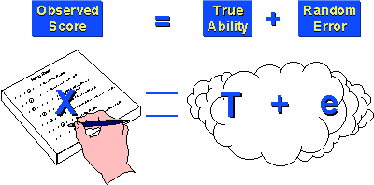
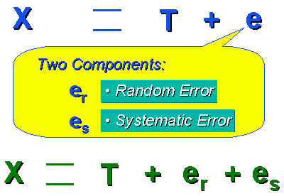
True Score Theory
Measurement is composite
True Ability/Level
Random Error
Simple model
Can use for automated simulations
Extension evaluates error further
Adds Systematic Error
Notes:
X is our measurement
T is the true value/score of what we are measuring
Ex is the error (random + systematic)

Slide 21
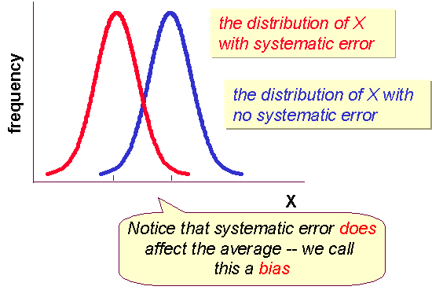
Characteristics of Error

Slide 22
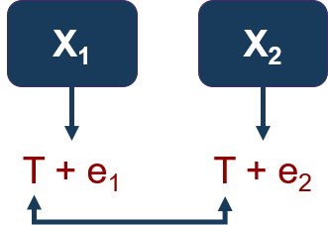
Theory of Reliability
We have observations/measurements with inherent error(possibly)
Reliability = True value Observed value
how do we get T ?
Let's estimate it instead through the correlation of observations
cov(X₁, X₂)
sd(X₁) sd(X₂)
Ranges from 0 – 1
Reliability measure of 0 implies what?
Measure of 1 implies what?
Measure of 0.7 implies what?

Slide 23
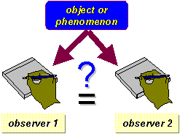
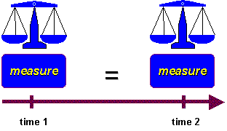
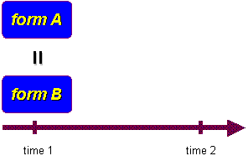
Types of Reliability
Inter-Rater/Observer
the percent of agreement between the raters
correlation between the ratings of the two observers
Test-Retest
assumes that there is no substantial change in the construct being measured between the two occasions
Time interval is critical
Correlation is the reliability estimate
Parallel-Forms
Split large set of questions
correlation between the two parallel forms is the estimate of reliability.

Slide 24
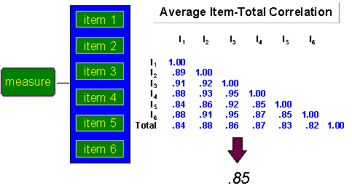
Internal Consistency Reliability
Average Inter-item Correlation
Average of all correlations
Average Item total Correlation
Additional score calculated per item
Average total scores

Slide 25
Split Half Correlations
Items are randomly grouped into 2 sets
Score calculated for each set
Correlation between scores is reliability

Slide 26
Cronbach's Alpha
average of all possible split-half estimates
popular
controversial (alternatives recommended)

Slide 27
Reliability & Validity

Slide 28
Levels of Measurement

Slide 29
Relationship between values for an attribute
Helps you decide how to interpret the data from that variable
Helps you decide what statistical analysis is appropriate
At lower levels assumptions tend to be less restrictive and data analyses tend to be less sensitive
Notes:
It’s important to recognize that there is a hierarchy implied in the level of measurement idea. At lower levels of measurement, assumptions tend to be less restrictive and data analyses tend to be less sensitive. At each level up the hierarchy, the current level includes all of the qualities of the one below it and adds something new. In general, it is desirable to have a higher level of measurement (e.g., interval or ratio) rather than a lower one (nominal or ordinal).

Slide 30
Examples
How does this hierarchy apply to your field?
Robotics
Cybersecurity
Computational Linguistics
Education

Slide 31
Questions?

Slide 32
References
Blackburn, S. M., McKinley, K. S., Garner, R., Hoffmann, C., Khan, A. M., Bentzur, R., ... & Wiedermann, B. (2008). Wake up and smell the coffee: Evaluation methodology for the 21st century. Communications of the ACM, 51(8), 83-89.
Trochim, William MK. "Pattern matching, validity, and conceptualization in program evaluation." Evaluation review 9.5 (1985): 575-604.
Trochim, William MK, and James P. Donnelly. Research methods knowledge base. Vol. 2. Atomic Dog Pub., 2001.
Zobel, Justin. Writing for computer science. Vol. 8. New York NY: Springer, 2004.

