Slide 1
Ethics & Responsible Conduct in Research
Kathryn Wozniak
CSC 426
5/17/2011

Slide 2
Overview
Ethics Definition
Brief History on Ethics in Research
Basic Tenets & Principles
Training to Conduct Research
IRB Protocol, Human Subjects
Treatment of Data
Mistakes, Negligence, Misconduct
Sharing, Authorship, Property, Plagiarism

Slide 3
Ethics Definition
Good vs. Evil (intentions)?
Is information being gathered, analyzed, and shared in a truthful, accurate way?
Does conduct minimize risk to individuals, organizations, and/or institutions involved?
Is researcher showing responsible conduct?
What are contributions and benefits to society?

Slide 4
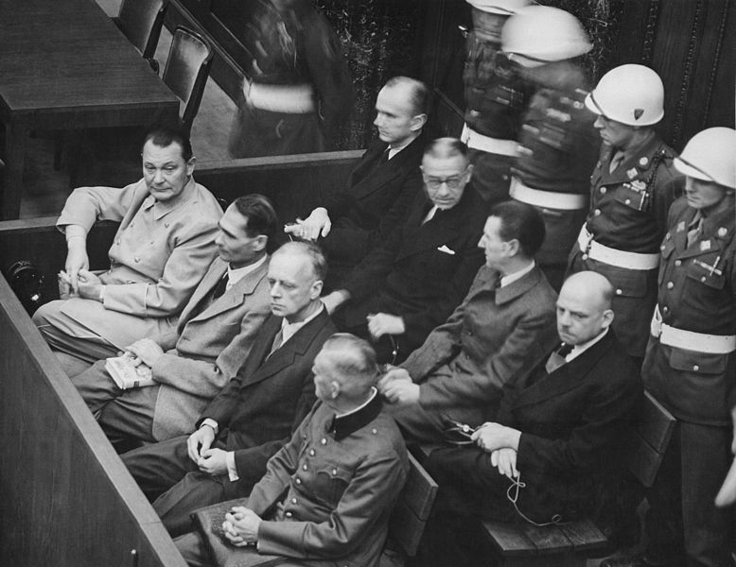
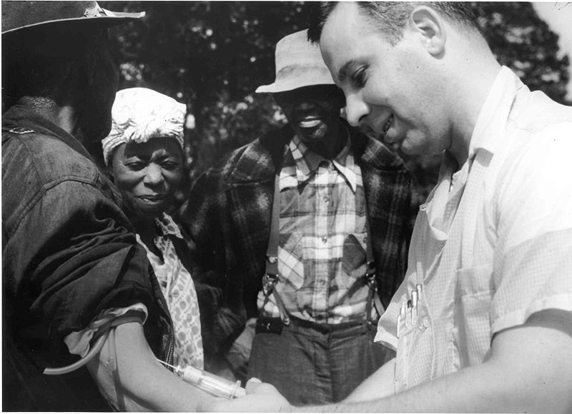
Brief History on Ethics in Research
Nuremberg Trials:
Experiments in Nazi camps
Tuskegee Trials
Men injected with syphilis
University of Virginia, internal medicine doc

Slide 5
Basic Tenets & Principles
Honesty
Objectivity
Integrity
Carefulness
Openness
Respect for Intellectual Property
Confidentiality
Responsible Publishing
Human Subjects Protection
Animal Care
http://www.acm.org/about/code-of-ethics

Slide 6
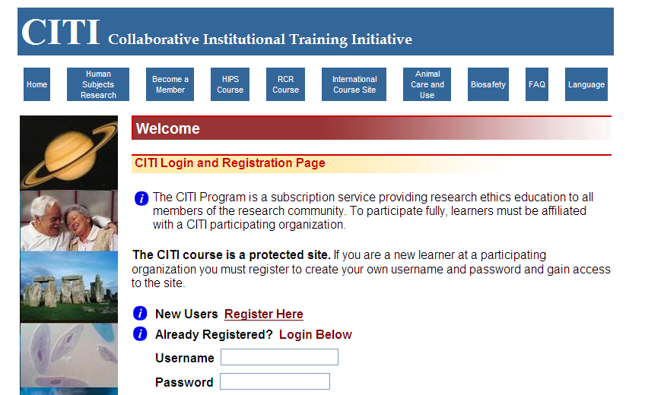
Training to Conduct Research
http://www.citiprogram.org

Slide 7
IRB Protocol, Human Subjects
http://research.depaul.edu/
Types of Review:
Non-reviewable: student, some archival
Exempt: educational settings, surveys/interviews/observations, aptitude tests (non-identifiable)
Expedited: minimal risk in clinical studies, collection of biological specimens, noninvasive
Full Board: if doesn’t meet exempt or expedited categories
Working with children, prisoners, pregnant women

Slide 8
Treatment of Data
Fraudulent manipulation of data
Effect on conclusions of study
Effect on reputation
Effect on progress of field
Record procedure in great detail
Maintain accurate, accessible, permanent record
Sharing data

Slide 9
Scenario
Deborah, a third-year graduate student, and Kathleen, a postdoc, have made a series of measurements on a new experimental semiconductor material using an expensive neutron source at a national laboratory.
During the measurements at the national laboratory, Deborah and Kathleen observed that there were power fluctuations they could not control or predict. Furthermore, they discussed their work with another group doing similar experiments, and they knew that the other group had gotten results confirming the theoretical prediction and was writing a manuscript describing their results.
In writing up their own results for publication, Kathleen suggests dropping the two anomalous data points near the abscissa from the published graph and from a statistical analysis. She proposes that the existence of the data points be mentioned in the paper as possibly due to power fluctuations and being outside the expected standard deviation calculated from the remaining data points. "These two runs," she argues to Deborah, "were obviously wrong."
How should the data from the two suspected runs be handled?
Should the data be included in tests of statistical significance and why?
What other sources of information, in addition to their faculty advisor, can Deborah and Kathleen use to help decide?

Slide 10
Mistakes & Negligence
Experiments are complicated
Need to take risks
Mistakes happen, but there’s a difference in how…
Honest errors
Mistakes caused by negligence, carelessness, inattention
All need to be noted/corrected if published

Slide 11
Misconduct
Fabrication: “making up data”
Falsification: inaccurately representing data, procedure
Plagiarism: appropriating others’ ideas and not giving credit
Significant departure from common practice
Committed intentionally, knowingly

Slide 12
Scenario
Don is a first-year graduate student applying to the National Science Foundation for a predoctoral fellowship. His work in a lab where he did a rotation project was later carried on successfully by others, and it appears that a manuscript will be prepared for publication by the end of the summer. However, the fellowship application deadline is June 1, and Don decides it would be advantageous to list a publication as "submitted." Without consulting the faculty member or other colleagues involved, Don makes up a title and author list for a "submitted" paper and cites it in his application.
After the application has been mailed, a lab member sees it and goes to the faculty member to ask about the "submitted" manuscript. Don admits to fabricating the submission of the paper but explains his actions by saying that he thought the practice was not uncommon in science.
The faculty members in Don's department demand that he withdraw his grant application and dismiss him from the graduate program. After leaving the university, Don applies for a master's degree, since he has fulfilled the course requirements. Although the department votes not to grant him a degree, the university administration does so because it is not stated in the university graduate bulletin that a student in Don's department must be in "good standing" to receive a degree. They fear that Don will bring suit against the university if the degree is denied. Likewise, nothing will appear in Don's university transcript regarding his dismissal.
Do you agree with Don that scientists often exaggerate the publication status of their work in written materials?
Do you think the department acted too harshly in dismissing Don from the graduate program?
Do you believe that being in ''good standing" should be a prerequisite for obtaining an advanced degree in science? If Don later applied to a graduate program at another institution, does that institution have the right to know what happened?

Slide 13
Sharing
Contributing to the field
Peer reviewed journals
Conference papers & workshops
Moving broader research forward
Getting feedback – before and after submission

Slide 14
Authorship
Who contributed?
What was contributed?
Assigning & fulfilling responsibilities
Division of credit
Order of authors

Slide 15
Scenario
Paula, a young assistant professor, and two graduate students have been working on a series of related experiments for the past several years. During that time, the experiments have been written up in various posters, abstracts, and meeting presentations. Now it is time to write up the experiments for publication, but the students and Paula must first make an important decision. They could write a single paper with one first author that would describe the experiments in a comprehensive manner, or they could write a series of shorter, less complete papers so that each student could be a first author.
Paula favors the first option, arguing that a single publication in a more visible journal would better suit all of their purposes. Paula's students, on the other hand, strongly suggest that a series of papers be prepared. They argue that one paper encompassing all the results would be too long and complex and might damage their career opportunities because they would not be able to point to a paper on which they were first authors.
If the experiments are part of a series, are Paula and her students justified in not publishing them together?
If they decided to publish a single paper, how should the listing of authors be handled?
If a single paper is published, how can they emphasize to the review committees and funding agencies their various roles and the importance of the paper?

Slide 16
Intellectual Property & Plagiarism
“Owning” our ideas
Giving credit to others
Copying language
Copying ideas
Proper citation and references list

Slide 17
Scenario
May is a second-year graduate student preparing the written portion of her qualifying exam. She incorporates whole sentences and paragraphs verbatim from several published papers. She does not use quotation marks, but the sources are suggested by statements like "(see . . . for more details)." The faculty on the qualifying exam committee note inconsistencies in the writing styles of different paragraphs of the text and check the sources, uncovering May's plagiarism.
After discussion with the faculty, May's plagiarism is brought to the attention of the dean of the graduate school, whose responsibility it is to review such incidents. The graduate school regulations state that "plagiarism, that is, the failure in a dissertation, essay, or other written exercise to acknowledge ideas, research or language taken from others" is specifically prohibited. The dean expels May from the program with the stipulation that she can reapply for the next academic year.
Is plagiarism like this a common practice?
Are there circumstances that should have led to May's being forgiven for plagiarizing?
Should May be allowed to reapply to the program?

