Slide 1
Statistical Analysis & Techniques
Ali Alkhafaji & Brian Grey

Slide 2
Outline
Analysis
How to understand your results
Data Preparation
Log, check, store and transform the data
Exploring and Organizing
Detect patterns in your data
Conclusion Validity
Degree to which results are valid
Descriptive Statistics
Distribution, tendencies & dispersion
Inferential Statistics
Statistical models

Slide 3
Analysis
What is “Analysis”?
What do you make of this data?
What are the major steps of Analysis?
Data Preparation, Descriptive Statistics & Inferential Statistics
How do we relate the analysis section to the research problems?

Slide 4
Data Preparation
Logging the data
Multiple sources
Procedure in place
Checking the data
Readable responses?
Important questions answered?
Complete responses?
Contextual information correct?

Slide 5
Data Preparation
Store the data
DB or statistical program (SAS, Minitab)
Easily accessible
Codebook (what, where, how)
Double entry procedure
Transform the data
Missing values
Item reversal
Categories

Slide 6
Exploring and Organizing
What does it mean to explore and organize?
Pattern Detection
Why is that important?
Helps find patterns an automated procedure wouldn’t

Slide 7
Pattern Detection Exercise
We have these test scores as our results for 11 children:
Ruth : 96, Robert: 60, Chuck: 68, Margaret: 88, Tom: 56, Mary: 92, Ralph: 64, Bill: 72, Alice: 80, Adam: 76, Kathy: 84.

Slide 8
Pattern Detection Exercise
Now let’s try it together:

Slide 9
Observations
Symmetrical pattern:
B G B B G G G B B G B
Now look at the scores:
Adam 76 Mary 92
Alice 80 Ralph 64
Bill 72 Robert 60
Chuck 68 Ruth 96
Kathy 84 Tom 56
Margaret 88

Slide 10
Observations
Now let’s break them down by gender and keep the alphabetical ordering:
Boys Girls
Adam 76 Alice 80
Bill 72 Kathy 84
Chuck 68 Margaret 88
Ralph 64 Mary 92
Robert 60 Ruth 96
Tom 56

Slide 11
Observations

Slide 12
Conclusion Validity
What is Validity?
Degree or extent our study measures what it intends to measure
What are the types of Validity?
Conclusion Validity
Construct Validity
Internal Validity
External Validity

Slide 13
Threats to
Conclusion Validity
What is a threat?
Factor leading to an incorrect conclusion
What is the most common threat to Conclusion Validity?
Not finding an existing relationship
Finding a non-existing relationship
How to improve Conclusion Validity?
More Data
More Reliability (e.g. more questions)
Better Implementation (e.g. better protocol)

Slide 14
Questions?

Slide 15
Statistical Tools
Statistics 101 in 40 minutes
What is Statistics?
Descriptive vs. Inferential Statistics
Key Descriptive Statistics
Key Inferential Statistics

Slide 16
What is Statistics?
“The science of collecting, organizing, and interpreting numerical facts [data]”
Moore & McCabe. (1999). Introduction to the Practice of Statistics, Third Edition.
A tool for making sense of a large population of data which would be otherwise difficult to comprehend.

Slide 17
4 Types of Data
Nominal
Ordinal
Interval
Ratio

Slide 18
4 Types of Data
Nominal
Gender, Party affiliation
Ordinal
Interval
Ratio

Slide 19
4 Types of Data
Nominal
Gender, Party affiliation
Ordinal
Any ranking of any kind
Interval
Ratio

Slide 20
4 Types of Data
Nominal
Gender, Party affiliation
Ordinal
Any ranking of any kind
Interval
Temperature (excluding Kelvin)
Ratio

Slide 21
4 Types of Data
Nominal
Gender, Party affiliation
Ordinal
Any ranking of any kind
Interval
Temperature (excluding Kelvin)
Ratio
Income, GPA, Kelvin Scale, Length

Slide 22
4 Types of Data
Nominal
Gender, Party affiliation
Ordinal
Any ranking of any kind
Interval
Temperature (excluding Kelvin)
Ratio
Income, GPA, Kelvin Scale, Length

Slide 23
Descriptive vs. Inferential
Descriptive Statistics
Describe a body of data
Inferential Statistics
Allows us to make inferences about populations of data
Allows estimations of populations from samples
Hypothesis testing

Slide 24
Descriptive Statistics
How can we describe a population?
Center
Spread
Shape
Correlation between variables

Slide 25
Average: A Digression
Center point is often described as the “average”
Mean?
Median?
Mode?
Which Mean?

Slide 26
Average: A Digression
Mode
Most frequently occurring
Median
“Center” value of an ordered list

Slide 27
Average: A Digression
Mean (Arithmetic Mean)

Slide 28
Average: A Digression
Mean (Arithmetic Mean)

Slide 29
Average: A Digression
Mean (Arithmetic Mean)
Geometric Mean

Slide 30
Average: A Digression
Mean (Arithmetic Mean)
Geometric Mean
Used for Growth Curves

Slide 31
Center
1 2 3 4 5 6 7 8 9 10 11.
56 56 64 68 72 76 80 84 88 92 96 .
Mode
Median
Arithmetic Mean
Geometric Mean

Slide 32
Center
1 2 3 4 5 6 7 8 9 10 11.
56 56 64 68 72 76 80 84 88 92 96 .
Mode
56
Median
Arithmetic Mean
Geometric Mean

Slide 33
Center
1 2 3 4 5 6 7 8 9 10 11.
56 56 64 68 72 76 80 84 88 92 96 .
Mode
56
Median
76
Arithmetic Mean
Geometric Mean

Slide 34
Center
1 2 3 4 5 6 7 8 9 10 11.
56 56 64 68 72 76 80 84 88 92 96 .
Mode
56
Median
76
Arithmetic Mean
≈75.64
Geometric Mean

Slide 35
Center
1 2 3 4 5 6 7 8 9 10 11.
56 56 64 68 72 76 80 84 88 92 96 .
Mode
56
Median
76
Arithmetic Mean
≈75.64
Geometric Mean
≈74.45

Slide 36
Spread
Range
High Value – Low Value
IQR
Quartile 3 – Quartile 1
Quartile is “Median of the Median”

Slide 37
Spread
Variance

Slide 38
Spread
Variance

Slide 39
Spread
Variance
Standard Deviation

Slide 40
Variance & St Dev
1 2 3 4 5 6 7 8 9 10 11.
10 10 10 10 10 10 10 10 10 10 10 .
Mean
Variance
Standard Deviation

Slide 41
Variance & St Dev
1 2 3 4 5 6 7 8 9 10 11.
10 10 10 10 10 10 10 10 10 10 10 .
Mean
10
Variance
Standard Deviation

Slide 42
Variance & St Dev
1 2 3 4 5 6 7 8 9 10 11.
10 10 10 10 10 10 10 10 10 10 10 .
Mean
10
Variance
0
Standard Deviation
0

Slide 43
Variance & St Dev
1 2 3 4 5 6 7 8 9 10 11.
8 12 8 12 8 12 8 12 8 12 10 .
Mean
10
Variance
Standard Deviation

Slide 44
Variance & St Dev
1 2 3 4 5 6 7 8 9 10 11.
8 12 8 12 8 12 8 12 8 12 10 .
Mean
10
Variance
Standard Deviation

Slide 45
Variance & St Dev
1 2 3 4 5 6 7 8 9 10 11.
8 12 8 12 8 12 8 12 8 12 10 .
Mean
10
Variance
Standard Deviation

Slide 46
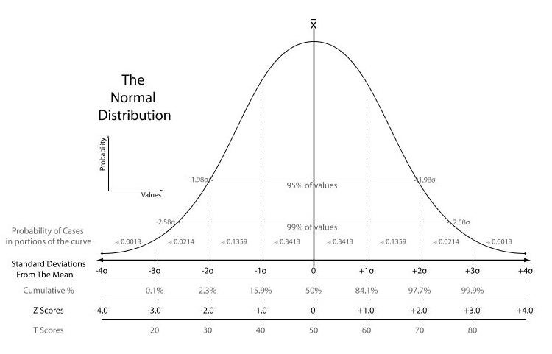
Shape
from wikipedia.org

Slide 47
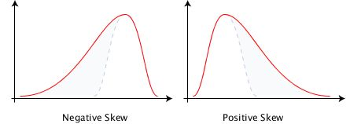
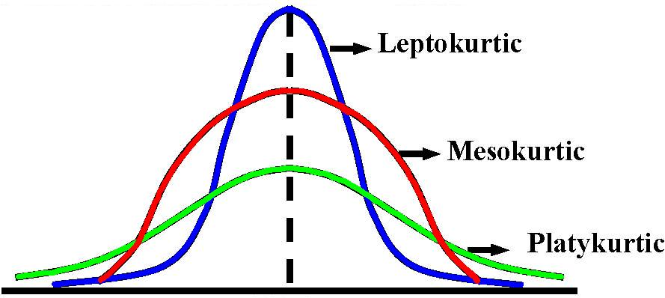
Shape
from wikipedia.org
from free-books-online.org

Slide 48
Correlation

Slide 49
Correlation
Measure of how two (or more) variables vary together
Holds a value from -1 to 1

Slide 50
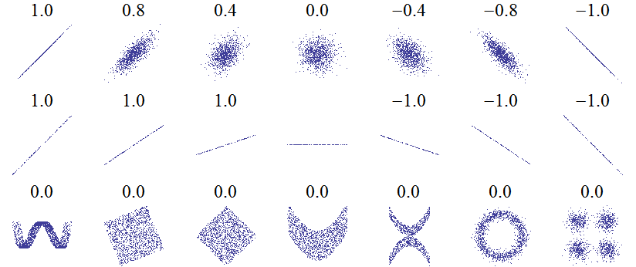
Correlation
Measure of how two (or more) variables vary together
Holds a value from -1 to 1
Pearson Correlation Coefficient
from wikipedia.org

Slide 51
Inferential Statistics
Allows us to make inferences about populations of data
Allows estimations of populations from samples
Hypothesis testing
Uses descriptive statistics to do all of this

Slide 52
Central Theorem of Statistics
Central Limit Theorem
By randomly measuring a subset of a population, we can make estimates about the population
Law of Large Numbers
The mean of the results obtained from a large number of samples should be close to the expected value

Slide 53
Hypothesis Testing
Used to determine if a sample is likely due to randomness in a population
Null Hypothesis (H₀)
Alternative Hypothesis (H_{a})

Slide 54
Hypothesis Testing
Used to determine if a sample is likely due to randomness in a population
Null Hypothesis (H₀)
The sample can occur by chance
Alternative Hypothesis (H_{a})

Slide 55
Hypothesis Testing
Used to determine if a sample is likely due to randomness in a population
Null Hypothesis (H₀)
The sample can occur by chance
Alternative Hypothesis (H_{a})
The sample is not due to chance in this population

Slide 56
Statistical Symbols
Population | Name | Sample
μ | Mean | x
σ | Standard Dev | s
P | Probability | p
N | Number | n

Slide 57
Z-Test (Significance Testing)

Slide 58
Z-Test (Significance Testing)
Determines how many standard deviations the sample is away from the mean in the normal distribution

Slide 59
An Example
The average weight for an American man is 191 lbs and 95% of all men weigh between 171 and 211 lbs. Suppose you want to determine the effect of eating fast food 3 times a week or more on men’s weight.
A sample of 25 men who eat fast food 3 times a week (or more) have an average weight of 195 lbs.

Slide 60
An Example
H₀:

Slide 61
An Example
H₀: μ = 191

Slide 62
An Example
H₀: μ = 191
H_{a}:

Slide 63
An Example
H₀: μ = 191
H_{a}: μ > 191

Slide 64
An Example
H₀: μ = 191
H_{a}: μ > 191
σ =

Slide 65
An Example
H₀: μ = 191
H_{a}: μ > 191
σ = 10

Slide 66
An Example
H₀: μ = 191
H_{a}: μ > 191
σ = 10
=

Slide 67
An Example
H₀: μ = 191
H_{a}: μ > 191
σ = 10
= 195

Slide 68
An Example
H₀: μ = 191
H_{a}: μ > 191
σ = 10
= 195
n =

Slide 69
An Example
H₀: μ = 191
H_{a}: μ > 191
σ = 10
= 195
n = 25

Slide 70
An Example
H₀: μ = 191
H_{a}: μ > 191
σ = 10
= 195
n = 25

Slide 71
An Example
H₀: μ = 191
H_{a}: μ > 191
σ = 10
= 195
n = 25

Slide 72
An Example
H₀: μ = 191
H_{a}: μ > 191
σ = 10
= 195
n = 25

Slide 73
An Example
from wikipedia.org

Slide 74
α Values
p = .023
Is this significant?
Dependent on α value
Specified before sampling
Typically, no looser than α = .05
α = .025, .01, .001 are common
Smaller α value lead to greater statistical significance

Slide 75
Back to the Example
H₀: μ = 191
H_{a}: μ > 191
p = .023
We can reject H₀ if α = .05 or α = .025
We cannot reject H₀ if α < .023

Slide 76
Error Types
Type I Error/False Positive
Erroneously rejecting H₀ and accepting H_{a}
Probability = α
Type II Error/False Negative
Erroneously failing to reject H₀
Reducing the odds of one type of error increases the odds of the other

Slide 77
The Problem with Z-Testing

Slide 78
The Problem with Z-Testing
σ is the population standard deviation

Slide 79
The Problem with Z-Testing
σ is the population standard deviation
Standard Error is used instead
Using SE instead of σ results in a Student’s t test

Slide 80
Confidence Interval

Slide 81
Confidence Interval
Allows an estimation of the population mean
z* is the z-value where a given proportion of the data are between z and -z
Student’s T-Test has an equivalent confidence interval

Slide 82
Confidence Interval
Using our earlier example, we are 95% certain that the average weight of someone who eats fast food three times a week or more is in the range:

Slide 83
Confidence Interval
Using our earlier example, we are 95% certain that the average weight of someone who eats fast food three times a week or more is in the range:

Slide 84
Confidence Interval
Using our earlier example, we are 95% certain that the average weight of someone who eats fast food three times a week or more is in the range:

Slide 85
Confidence Interval
Using our earlier example, we are 95% certain that the average weight of someone who eats fast food three times a week or more is in the range:

Slide 86
Confidence Interval
Using our earlier example, we are 99% certain that the average weight of someone who eats fast food three times a week or more is in the range:

Slide 87
Confidence Interval
Using our earlier example, we are 90% certain that the average weight of someone who eats fast food three times a week or more is in the range:

Slide 88
Other Inferential Stats
ANOVA (Analysis of Variance)
Examines 3+ means by comparing variances across and within groups.
Allows detection of interaction of means.
Regression
Examines how well 1+ variables predict other variables.
Generates an equation to allow prediction.

Slide 89
Questions?

