Slide 1
Experimental Design
Negar Hariri

Slide 2
Introduction
The fundamental principle of science, the definition almost, is this:
the sole test of the validity of any idea is experiment.
– Richard P. Feynman
Good experimental design allows you to:
Isolate effects of each input variable
Determine effects due to interactions of input variables
Determine magnitude of experimental error
Obtain maximum info with minimum effort

Slide 3
Organizing Your Experiment
Before you can write the steps of a procedure, you must identify:
Independent variable
Dependent variable
Constant variables (controlled variables)
The control (most of the time)

Slide 4
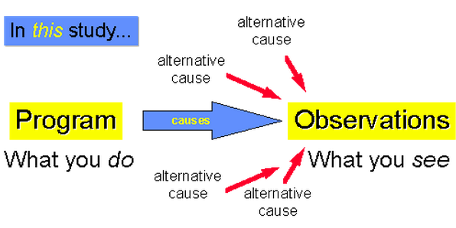
Experimental Design
If X Y & If NOT X NOT Y
Strong internal validity

Slide 5
Two-Group Experimental Designs
Two "equivalent" groups are created
Probabilistically equivalent
Assign people randomly from a common pool of people into the two groups.
One group (the treatment group) gets the program and other group (the comparison or control group) does not.

Slide 6
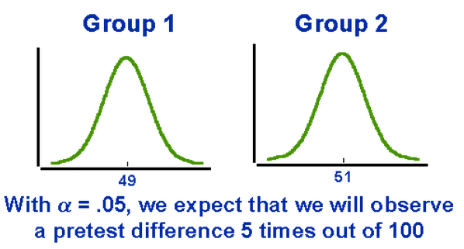
What is Probabilistic Equivalence?

Slide 7
Two-Group Experimental Designs
The groups are compared by testing for the differences between the means using at-test or other methods.
Properties
Pretest is not required.
Strong against the single-group threats to internal validity.
It is susceptible to all of the social interaction threats to internal validity.

Slide 8
Random Selection & Assignment
Random selection is how you draw the sample of people for your study from a population.
Random selection is related to sampling. Therefore it is most related to the external validity of your results.
Random assignment is how you assign the sample that you draw to different groups or treatments in your study.
Random assignment is most related to internal validity.

Slide 9
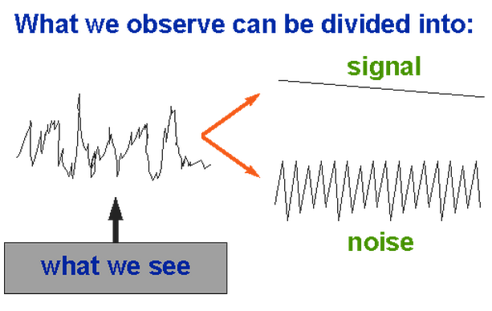
Classifying Experimental Designs

Slide 10
Classifying Experimental Designs
Signal enhancers
Factorial designs
Experimental designs
Covariance designs
Noise-reducing experimental designs
Blocking designs

Slide 11
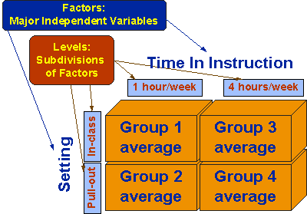
Factorial Design
11
Notes:
05/04/09
11

Slide 12
The Null Case
12
Notes:
05/04/09
12

Slide 13
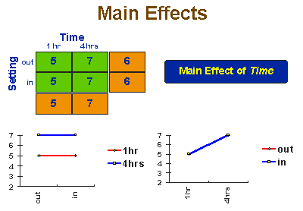
The Main Effect Of Time
13

Slide 14
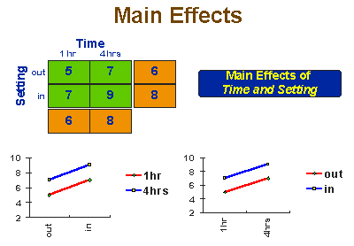
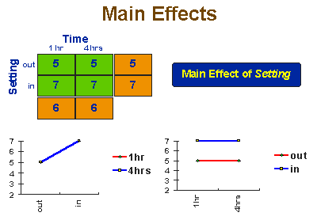
The Main Effect
Notes:
05/04/09
14

Slide 15
Interaction Effects
15
Notes:
05/04/09
15

Slide 16
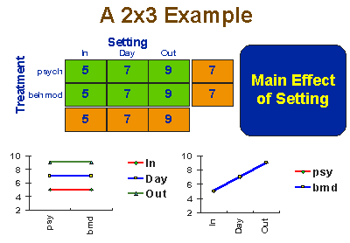
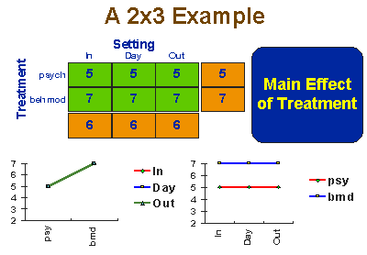
Factorial Design Variations
Dependent measure: severity of illness rating done by the treatment staff..
Factor 1: Treatment
psychotherapy
behavior modification
Factor 2: Setting
inpatient
day treatment
outpatient

Slide 17
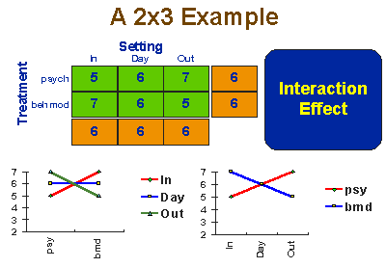
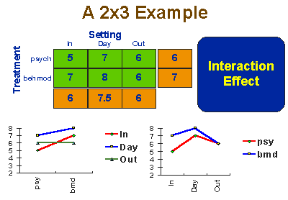
Factorial Design Variations

Slide 18
Randomized Block Designs
Goal
Reducing noise in the data
What are the steps?
Divide the sample into relatively homogeneous subgroups or blocks
The experimental design you want to implement is implemented within each block or homogeneous subgroup
The variability within each block should be less than the variability of the entire sample.
What if the subgroups are not homogeneous?

Slide 19
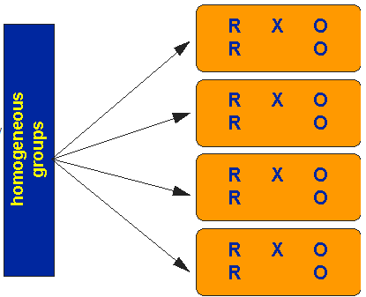
Randomized Block Designs

Slide 20
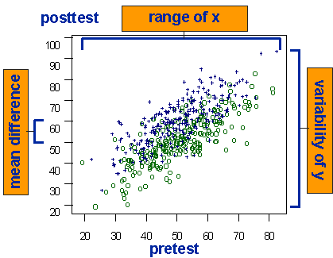
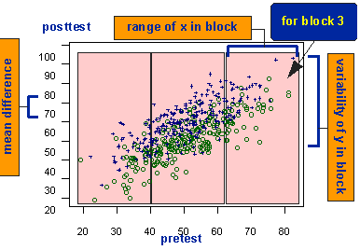
How Blocking Reduces Noise

Slide 21
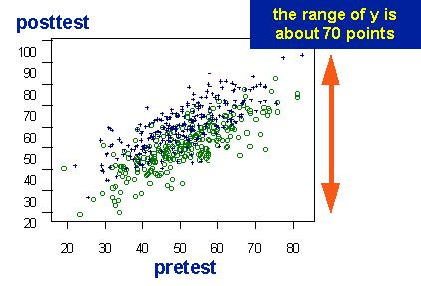
Covariance Designs
Another method for reducing noise

Slide 22
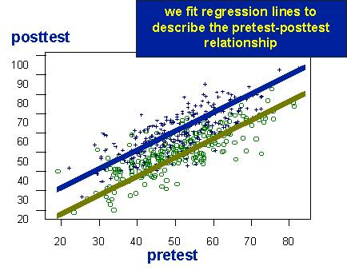
Covariance Designs

Slide 23
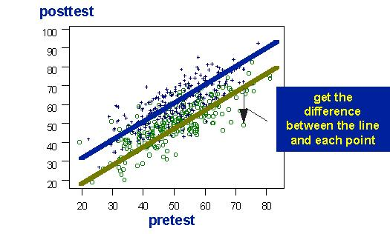
Covariance Designs

Slide 24
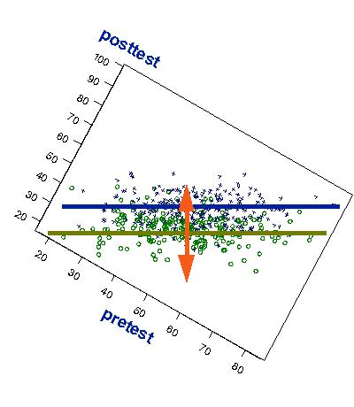
Covariance Designs

Slide 25
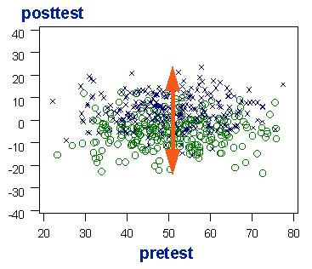
Covariance Designs

Slide 26
Hybrid Experimental Designs
Mitigate specific threats to internal validity
Combine advantages of different standard designs
Example?
Switching Replications Design

Slide 27
Switching Replications Design
Two Groups
The two groups switch roles so all participants have received the treatment

Slide 28
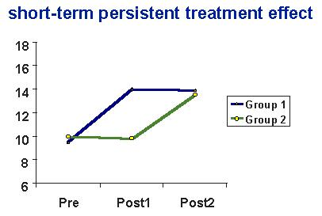
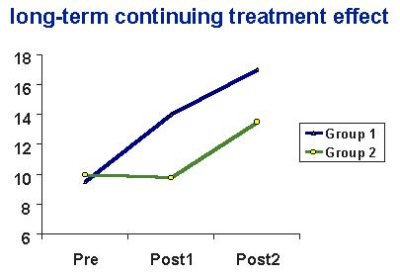
Switching Replications Design

