Slide 1
Secure Personalization
Building Trustworthy recommender systems in the Presence of Adversaries?
Bamshad Mobasher
Center for Web Intelligence
School of Computing, DePaul University, Chicago, Illinois, USA

Slide 2
Personalization / Recommendation Problem
Dynamically serve customized content (pages, products, recommendations, etc.) to users based on their profiles, preferences, or expected interests
Formulated as a prediction problem
  Given a profile P_{u} for a user u, and a target item I_{t}, predict the preference score of user u on item I_{t}
Typically, the profile P_{u} contains preference scores by u on other items, {I₁, …, I_{k}} different from I_{t}
  preference scores may have been obtained explicitly (e.g., movie ratings) or implicitly (e.g., purchasing a product or time spent on a Web page)

Slide 3
Knowledge sources
Personalization systems can be characterized by their knowledge sources:
  Social
    knowledge about individuals other than the user
  Individual
    knowledge about the user
  Content
    knowledge about the items being recommended

Slide 4
Vulnerabilities
Any knowledge source can be attacked
Content
  false item data, if data gathered from public sources
    an item is not what its features indicate
    Example: web-page keyword spam
  biased domain knowledge
    recommendations slanted by system owner
    Example: Amazon “Gold Box”
Social
  bogus profiles
  our subject today

Slide 5
Collaborative / Social Recommendation
Identify peers
Generate recommendation

Slide 6
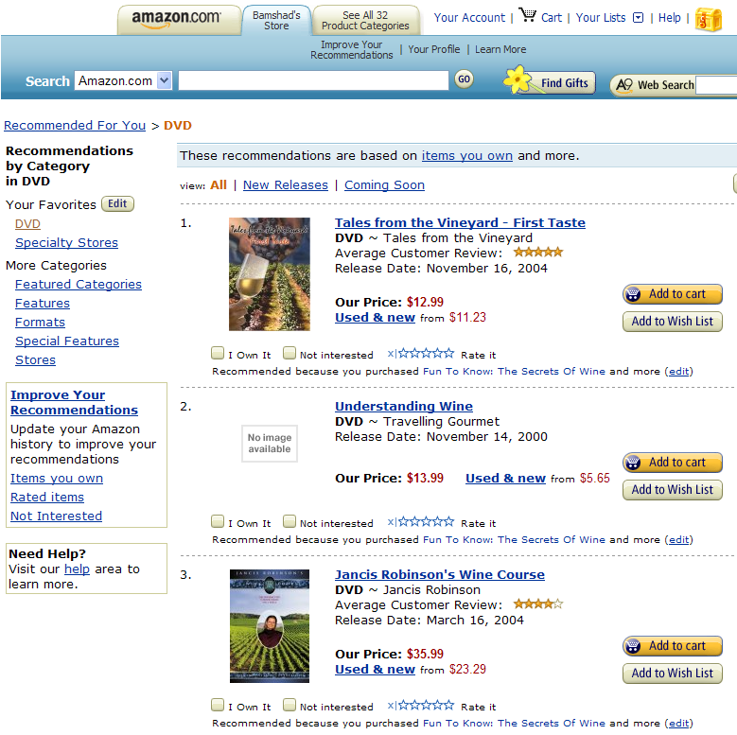
Collaborative Recommender Systems

Slide 7
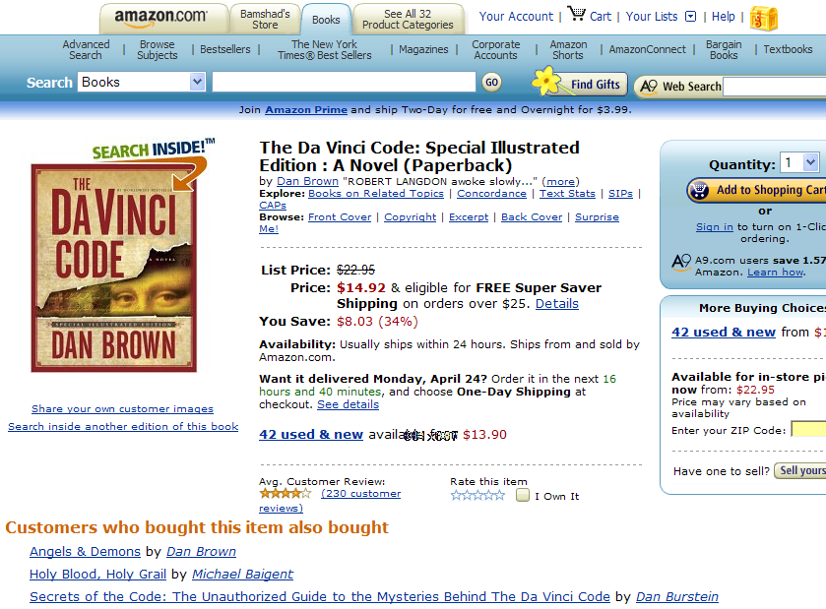

Slide 8
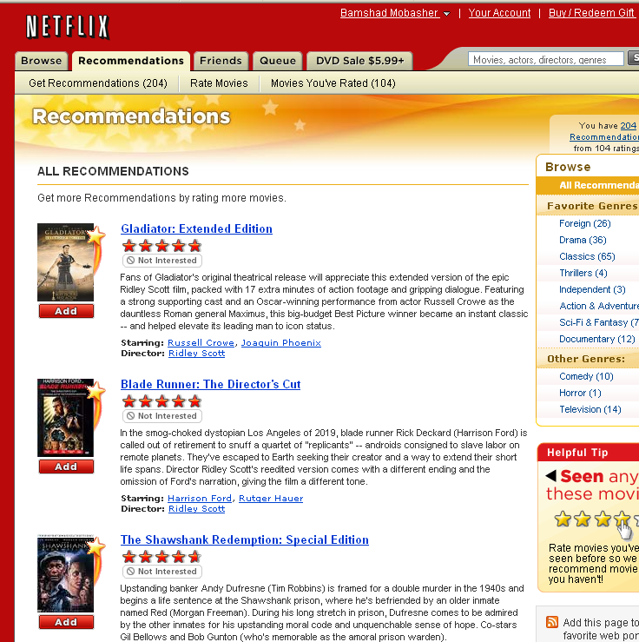

Slide 9


How Vulnerable?

Slide 10
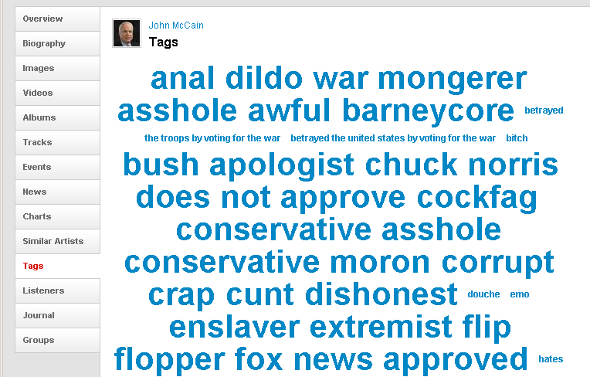
How Vulnerable?
John McCain on last.fm

Slide 11
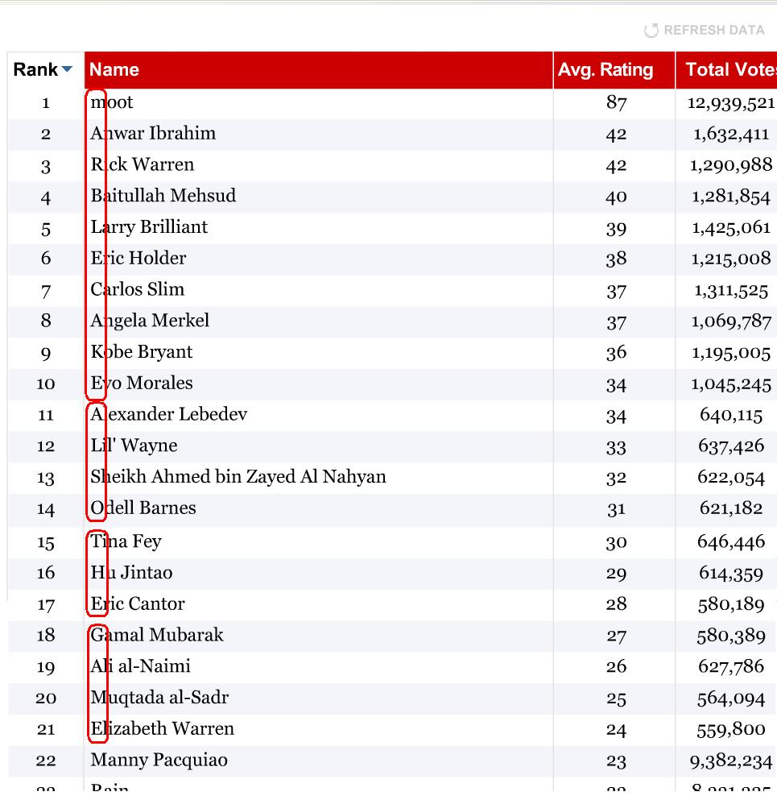
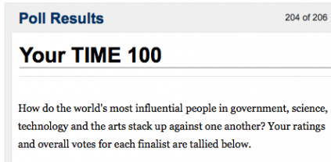
How Vulnerable?
A precision hack of a TIME Magazine Poll
For details of the attack see Paul Lamere’s blog: “Music Machinery”
http://musicmachinery.com/2009/04/15/inside-the-precision-hack/

Slide 12
In other words
Collaborative applications are vulnerable
  a user can bias their output
  by biasing the input
Because these are public utilities
  open access
  pseudonymous users
  large numbers of sybils (fake copies) can be constructed

Slide 13
Research question
Is collaborative recommendation doomed?
That is,
  Users must come to trust the output of collaborative systems
  They will not do so if the systems can be easily biased by attackers
So,
  Can we protect collaborative recommender systems from (the most severe forms of) attack?

Slide 14
Research question
Not a standard security research problem
  not trying to prevent unauthorized intrusions
Need robust (trustworthy) systems
The Data Mining Challenges
  Finding the right combination of modeling approaches that allow systems to withstand attacks
  Detecting attack profiles

Slide 15
What is an attack?
An attack is
  a set of user profiles added to the system
  crafted to obtain excessive influence over the recommendations given to others
In particular
  to make the purchase of a particular product more likely (push attack; aka “shilling”)
  or less likely (nuke attack)
There are other kinds
  but this is the place to concentrate – profit motive

Slide 16
Example Collaborative System
 | Item1 | Item 2 | Item 3 | Item 4 | Item 5 | Item 6 | Correlation with Alice
Alice | 5 | 2 | 3 | 3 |  | ?
User 1 | 2 |  | 4 |  | 4 | 1 | -1.00
User 2 | 2 | 1 | 3 |  | 1 | 2 | 0.33
User 3 | 4 | 2 | 3 | 2 |  | 1 | .90
User 4 | 3 | 3 | 2 |  | 3 | 1 | 0.19
User 5 |  | 3 |  | 2 | 2 | 2 | -1.00
User 6 | 5 | 3 |  | 1 | 3 | 2 | 0.65
User 7 |  | 5 |  | 1 | 5 | 1 | -1.00
Prediction

Best
match

Slide 17
A Successful Push Attack
 | Item1 | Item 2 | Item 3 | Item 4 | Item 5 | Item 6 | Correlation with Alice
Alice | 5 | 2 | 3 | 3 |  | ?
User 1 | 2 |  | 4 |  | 4 | 1 | -1.00
User 2 | 2 | 1 | 3 |  | 1 | 2 | 0.33
User 3 | 4 | 2 | 3 | 2 |  | 1 | .90
User 4 | 3 | 3 | 2 |  | 3 | 1 | 0.19
User 5 |  | 3 |  | 2 | 2 | 2 | -1.00
User 6 | 5 | 3 |  | 1 | 3 | 2 | 0.65
User 7 |  | 5 |  | 1 | 5 | 1 | -1.00
Attack 1 | 2 |  | 3 |  | 2 | 5 | -1.00
Attack 2 | 3 | 2 | 3 |  | 2 | 5 | 0.76
Attack 3 | 3 | 2 | 2 | 2 |  | 5 | 0.93
Prediction

Best
Match

Slide 18
Definitions
An attack is a set of user profiles A and an item t
  such that |A|>1
  t is the “target” of the attack
Object of the attack
  let ρ_{t} be the rate at which t is recommended to users
  Goal of the attacker
    either ρ'_{t} >> ρ_{t} (push attack)
    or ρ'_{t} << ρ_{t} (nuke attack)
    Δ_{ρ} = "Hit rate increase“
    (usually ρ_{t} is ≈ 0)
Or alternatively
  let r_{t} be the average rating that the system gives to item t
  Goal of the attacker
    r'_{t} >> r_{t} (push attack)
    r'_{t} << r_{t}(nuke attack)
    Δ_{r} = “Prediction shift”

Slide 19
Approach
Assume attacker is interested in maximum impact
  for any given attack size k = |A|
  want the largest Δ_{ρ} or Δ_{r} possible
Assume the attacker knows the algorithm
  no “security through obscurity”
What is the most effective attack an informed attacker could make?
  reverse engineer the algorithm
  create profiles that will “move” the algorithm as much as possible

Slide 20
But
What if the attacker deviates from the “optimal attack”?
If the attack deviates a lot
  it will have to be larger to achieve the same impact
Really large attacks can be detected and defeated relatively easily
  more like denial of service

Slide 21
“Box out” the attacker
Detectable
Detectable

Slide 22
Characterizing attacks
I_{S}
I_{F}
I₀
I_{t} | i_{S1} | ... | i_{Sj} | i_{F1} | ... | i_{Fk} | i₀₁ | ... | i_{0l}
R_{max} or R_{min} | f_{S}(i_{S1}) | ... |  | f_{F}(i_{F1}) | ... |  | ∅ | ∅ | ∅
Notes:
22

Slide 23
Characterizing attacks
To describe an attack
  indicate push or nuke
  describe how I_{S}, I_{F} are selected
  Specify how f_{S} and f_{F} are computed
But usually
  I_{F} is chosen randomly
  only interesting question is |I_{F}|
  “filler size”
  expressed as a percentage of profile size
Also
  we need multiple profiles
  |A|
  “attack size”
  expressed as a percentage of database size
Notes:
23

Slide 24
Basic Attacks Types
Random attack
  Simplest way to create profiles
  No “special” items (|I_{S}| = 0)
  I_{F} chosen randomly for each profile
  f_{F} is a random value with mean and standard deviation drawn from the existing profiles P
  Simple, but not particularly effective
Average attack
  No “special” items (|I_{S}| = 0)
  I_{F} chosen randomly for each profile
  f_{F} (i) = a random value different for each item
    drawn from a distribution with the same mean and standard deviation as the real ratings of i
  Quite effective -- more likely to correlate with existing users
  But: knowledge-intensive attack - could be defeated by hiding data distribution
Notes:
24

Slide 25
Bandwagon attack
Build profiles using popular items with lots of raters
  frequently-rated items are usually highly-rated items
  getting at the “average user” without knowing the data
Special items are highly popular items
  “best sellers” / “blockbuster movies”
  can be determined outside of the system
  f_{S} = R_{max}
Filler items as in Random Attack
Almost as effective as Average Attack
  But requiring little system-specific knowledge
Notes:
25

Slide 26
A Methodological Note
Using MovieLens 100K data set
50 different "pushed" movies
  selected randomly but mirroring overall distribution
50 users randomly pre-selected
  Results were averages over all runs for each movie-user pair
K = 20 in all experiments
Evaluating results
  prediction shift
    how much the rating of the pushed movie differs before and after the attack
  hit ratio
    how often the pushed movie appears in a recommendation list before and after the attack

Slide 27
Example Results
Only a small profile needed (3%-7%)
Only a few (< 10) popular movies needed
As effective as the more data-intensive average attack (but still not effective against item-based algorithms)

Slide 28
Targeted Attacks
Not all users are equally “valuable” targets
Attacker may not want to give recommendations to the “average” user
  but rather to a specific subset of users

Slide 29
Segment attack
Idea
  differentially attack users with a preference for certain classes of items
  people who have rated the popular items in particular categories
Can be determined outside of the system
  the attacker would know his market
    “Horror films”, “Children’s fantasy novels”, etc.

Slide 30
Segment attack
Identify items closely related to target item
  select most salient (likely to be rated) examples
    “Top Ten of X” list
  Let I_{S} be these items
  f_{S} = R_{max}
These items define the user segment
  V = users who have high ratings for I_{S} items
  evaluate Δ_{ρ}(v) on V, rather than U

Slide 31
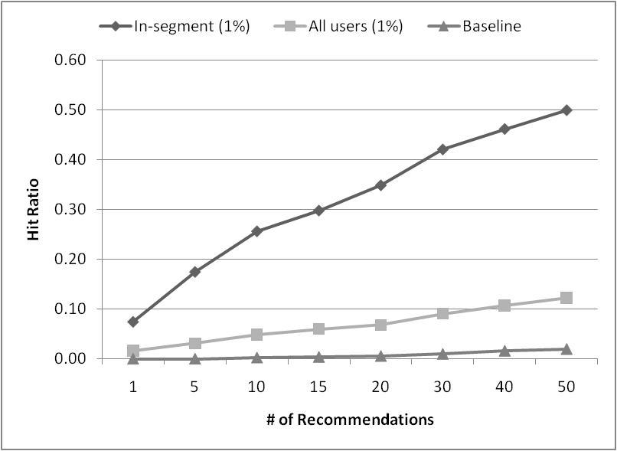
Results (segment attack)

Slide 32
Nuke attacks
Interesting result
  asymmetry between push and nuke
  especially with respect to Δ_{ρ}
  it is easy to make something rarely recommended
Some attacks don’t work
  Reverse Bandwagon
Some very simple attacks work well
  Love / Hate Attack
    love everything, hate the target item

Slide 33
Summary of Findings
Possible to craft effective attacks regardless of algorithm
Possible to craft an effective attack even in the absence of system-specific knowledge
Attacks focused on specific user segments or interest groups are most effective
Relatively small attacks are effective
  1% for some attacks with few filler items
  smaller if item is rated sparsely

Slide 34
Possible Solutions?
We can try to keep attackers (and all users) from creating lots of profiles
  pragmatic solution
  but the sparsity trade-off?
We can build better algorithms
  if we can achieve lower Δ_{ρ}
  without lower accuracy
  algorithmic solution
We can try to weed out the attack profiles from the database
  reactive solution

Slide 35
Larger question
Machine learning techniques widespread
  Recommender systems
  Social networks
  Data mining
  Adaptive sensors
  Personalized search
Systems learning from open, public input
  How do these systems function in an adversarial environment?
  Will similar approaches work for these algorithms?

