Slide 1
Evaluation Methodologies in Computer Science
Mehdi Mirakhorli

Slide 2
Introduction
Evaluation Methodologies:
Basic Definitions
Key Characteristics
Feature Recommendation for Domain Analysis – An Evaluative Case Study
Notes:
weak methodology leads to incorrect findings. Equally

Slide 3
Evaluation Methodologies
Basic Definition:
“Professional evaluation is defined as the systematic determination of quality or value of something (Scriven 1991)
What are the main purpose of evaluation:
Determine overall quality and areas for improvement
Notes:
The Goals of Evaluation: to provide "useful feedback" which aids decision making
Things that we should evaluate systematically include:
Projects, programs, or organizations
Personnel or performance
Policies or strategies
Products or services
Processes or systems
Proposals, contract bids, or job applications

Slide 4
Evaluation Methodologies: Purpose
What are big picture questions for which we need the answers:
Absolute merit or worth (e.g. how effective/valuable/meritorious is this? Is this worth resources [time. money] put into in?
E.g. Architecture degradation
Relative merit or worth (e.g, How does it compare with other options or candidates)
E.g. traceability schemas
Notes:
Davidson, Jane (2004). Evaluation Methodology Basics: The Nuts and Bolts of Sound Evaluation. Sage Publications, Inc. 1st Edition.
Merit is the “intrinsic” value of something; the term is used interchangeably with quality.
Worth is the value of something to an individual, an organization, an institution, or a collective; the term is used interchangeably with value.

Slide 5
Evaluation Methodologies: Key Characteristics
Relevant workloads which determine what to test
Appropriate experimental design
We are concerned with the analysis of data generated from an experiment. It is wise to take time and effort to organize the experiment properly to ensure that the right type of data, and enough of it, is available to answer the questions of interest as clearly and efficiently as possible. This process is called experimental design.
Rigorous analysis
Identify and articulate the significance of experimental results
Notes:
Sound experimental design requires a meaningful baseline and comparisons that control key parameters. Most researchers choose and justify a baseline well, but identifying which parameters to control and how to control them is challenging.

Slide 6
Evaluation Methodologies: 1. Workload
It should be relevant and diverse
No workload is definitive: but does it meet the test objective?
Each candidate should be evaluated quantitatively and qualitatively (e.g. specific platform, domain, application)
Widely used (e.g. open source applications)
Nontrivial (e.g. toy systems)
Suitable for research
Tractable: Can be easily used, manageable
Repeatable
Standardized
Workload selection: it should reflect a range of behaviors and not just what we are looking for
Notes:
quantitatively and qualitatively evaluated each candidate. Table 1 lists the static and dynamic metrics we used to ensure that the benchmarks were relevant and diverse.
Researchers need tractable workloads because they often run thousands of executions for a single experiment

Slide 7
Evaluation Methodologies: 2. Sound experimental design
Meaningful Baseline
Comparing against the state of the art
Widely used workloads
Not always practical (e.g. unavailable implementation for public)
Comparisons that control key parameters
Understanding what to control and how to control it in an experimental system is clearly important.
Comparing two garbage collection schemas while controlling the Heap size
Bound and free parameters
Degree of freedom
Notes:
Experimental Design
Sound experimental design requires a meaningful baseline and comparisons that control key parameters. Most researchers choose and justify a baseline well, but identifying which parameters to control and how to control them is challenging
The complexity and degrees of freedom inherent in these systems make it easy to produce misleading results through errors, omissions, or mischief.
In each experimental setting, the relative influence of the degrees of freedom, and how to control them, will vary. For example, when evaluating a new compiler optimization, researchers should hold the garbage collection activity constant to keep it from obscuring the effect of the optimization. Comparing on multiple architectures is best, but is limited by the compiler back-end. When evaluatinga new architecture, vary the garbage collection load and JIT compiler activity, since both have distinctive execution profiles. Since architecture evaluation often involves very expensive simulation, eliminating nondeterminism is particularly important

Slide 8
Evaluation Methodologies: 2. Sound experimental design
Control Changing Environment and Unintended Variance
E.g. Host platform, OS, Arrival rate
Scheduling schemas, workloads
Network latency & traffic
Differences in environment

Slide 9
Evaluation Methodologies: 2. Sound experimental design
Controlling nondeterminism
Understand key variance points
Due to nondeterminism quality of the results usually does not reach the same steady state on a deterministic workload
Take multiple measurements and generate sufficient data points
Statistically analyze results for differences in remaining nondeterminism
Notes:
Degrees of freedom
# of freely variable values in the final calculation of a statistic

Slide 10
Evaluation Methodologies: 3. Rigorous analysis
Researchers use data analysis to identify and articulate the significance of experimental results
Challenging in complex systems with sheer volume of results
Aggregating data across repeated experiments is a standard technique for increasing confidence in a noisy environment
Since noise cannot be eliminated altogether, multiple trials are inevitably necessary.

Slide 11
Evaluation Methodologies: 3. Rigorous analysis
Reducing nondeterminism
Researchers have only finite resources, Reducing sources of nondeterminism with sound experimental design improves tractability.
Statistical confidence intervals and significance
Show best and worst cases

Slide 12
Conclusion
Evaluation methodology underpins all innovation in experimental computer science.
Needs keeping pace with the changes in our field
Need to be adaptable and customizable

Slide 13
Feature Recommendation for Domain Analysis – An Evaluative Case Study
Problem Statement:
Domain analysis is a labor intensive task
Existing works rely upon analysts manually reviewing existing requirements documentation or competitors’ product brochures, and are therefore relatively labor intensive.
Furthermore, the success of these approaches is dependent upon the availability of relevant documents or access to existing project repositories.
Proposed Approach
A recommender system that is designed to reduce the human effort of performing a domain analysis. This approach uses data mining techniques to extract features from online product descriptions and machine learning methods to make feature recommendations during the domain analysis process.
Evaluation:
We explore and evaluate the use of our recommender system in a larger scale software engineering project. The performance of the recommender system is illustrated and evaluated within the context of a case study for an enterprise level collaborative software suite.

Slide 14
Feature Recommendation for Domain Analysis – An Evaluative Case Study
Evaluative Case Study: Collaborative Software Suite

Slide 15
Feature Recommendation for Domain Analysis – An Evaluative Case Study
Case Study Creation Methodology:
Selection Reason:
This domain contains a relatively large number of interrelated features.
Several researchers on our team were familiar with using enterprise level collaborative tools.
The case study was developed by a member of our research team:
Followed the FODA method
Domain model developed based on a combination of expert knowledge and through reviewing of 100 related commercial products publicly available.
To avoid introducing bias to the experiment, the analyst did not use Softpedia.com, which was the website from which we later mined features to train the recommender system.

Slide 16
Feature Recommendation for Domain Analysis – An Evaluative Case Study
Feature Recommendation Process:
Model Creation:
Product descriptors are mined from online resources, processed using standard information retrieval techniques, and then clustered into features.
Model Usage:
An analyst provides an initial textual description of the product to be developed, and information retrieval methods are used to transform this into a partial product profile. Then A hybrid recommender approach is used to generate feature recommendations

Slide 17
Feature Recommendation for Domain Analysis – An Evaluative Case Study
Experiments:
Quantitative Analysis:
Using the case study profile as the ground truth, and then systematically removing parts of the profile, and assessing if the recommender would find them.
Standard leave-one-out
Growing profile size
Four different profile sizes were evaluated: 3, 6, 9, and 12 features
Notes:
in which at each run of the experiment, one of the 15 entries of the profile was removed, the recommender algorithms were executed on the remaining
14 features, and the results analyzed to see if the recommender was able to find the removed feature
The second experiment consisted of iteratively increasing the profile size of the case study to determine the effect that the profile size has on the predictability of the recommender system. Since the case study profile has 15 entries,.
At each level, that number of random entries was selected, and the algorithms executed to determine if the remaining features were found.

Slide 18
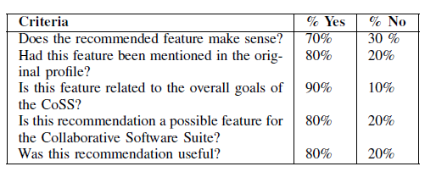
Feature Recommendation for Domain Analysis – An Evaluative Case Study
Experiments:
Qualitative Analysis:
Notes:
in which at each run of the experiment, one of the 15 entries of the profile was removed, the recommender algorithms were executed on the remaining
14 features, and the results analyzed to see if the recommender was able to find the removed feature
The second experiment consisted of iteratively increasing the profile size of the case study to determine the effect that the profile size has on the predictability of the recommender system. Since the case study profile has 15 entries, four different profile sizes were evaluated: 3, 6, 9, and 12 features.
At each level, that number of random entries was selected, and the algorithms executed to determine if the remaining features were found.

Slide 19
Experimental standards
Yuet Ling Wong

Slide 20
Why do we need experiment standards
Researchers are expected to be ethical
A key element of ethical behavior is the standards for conduct and recording of experiments
In computer science, there are no widely accepted standards for recording experiments or for making such records available

Slide 21
Standards for experimentation
Some communities such as Commission on Research Integrity have developed some standards and guidelines
Some of the detail will not apply to all disciplines
The need for good records has been highlighted by recent cases of academic fraud
Two cases of medical drug
Experiment records are not only constraint to observed values, but also record a considerable mass of material

Slide 22
Motivations for record-keeping
evidence of precedent
Newton’s note: optics effects—the advent of quantum mechanics
Rigor: some kind of predetermined template require a certain degree of care
Elucidation: forces the researchers to state thoughts clearly and to clarify vague ideas
Reproduction: sometimes difficult to reproduce the same result, but should provide similar conclusion—psychology experiment
Verification: never exact, for detecting misconduct

Slide 23
Experiment in computer science
Computer science is a broad discipline and the kinds of records depend on the kind of research
The outcome of experiments is researcher-dependent: test algorithm
Results are hard to replicate especially small improvement between one algorithm and another
Another problem relying on code as record is the evaluation of algorithm involves other factors such as data set and parameter values.

Slide 24
Practice in computer science
Hard to maintain the version of code
Automatic mechanisms store information indiscriminately
Three separate, mutually supporting elements:
Notebooks: record dates, daily notes, names and locations and so on
Code: major versions could be kept
Logs: the data as reduced by some process for human consumption – a summary table, list of averaged values

Slide 25
Reliability and construct validity

Slide 26
Reliability
Reliability is the consistency or repeatability of your measures
The foundation of reliability: the true score theory of measurement
Different types of measure error
Theory of reliability
Different types of reliability
The relationships between reliability and validity in measurement

Slide 27
True score theory
Observed score = true ability + random error
It is a simple yet powerful model for measurement
It is the foundation of reliability theory
No random error is perfectly reliable
No true score has zero reliability
It can be used in computer simulation as the basis for generating “observed” scores with certain known properties

Slide 28
Different types of measure error
X = T + er + es
Random error
Cause by any factors that randomly affect measurement of the variable
Sum to 0 and does not affect the average
Systematic error
Cause by any factors that systematically affect measurement
Consistently either positive or negative
Reducing measurement error
Pilot study
Training
Double check the data thoroughly
Use statistical procedure
Use multiple measures

Slide 29
Theory of reliability
In research, reliability means “repeatability” or “consistency”
Reliability is a ratio or fraction:
true level/the entire measure—var(T)/var(X)
Covariance(X1,X2)/sd(X1)*sd(X2)
We can not calculate reliability because we can not measure the true score but we can estimate (between 0 and 1)

Slide 30
Different types of reliability
Inter-rater or inter-observer reliability
Raters for categories
Calculate the correlation
Test-retest reliability
The shorter the time gar, the higher correlation
Parallel-forms reliability
Create a large set of questions that address the same construct, divide into two set and administer the same sample
Internal consistency reliability
Average inter-item correlation
Average total-item correlation
Split-half reliability
Cronbach’s alpha (a)

Slide 31
Construct validity
Construct validity refers to the degree to which inferences can legitimately be made from the operationalizations to the theoretical constructs
Involve generalizing from you program or measures to the concept of your program or measures
Idea of construct validity
Construct validity threats

Slide 32
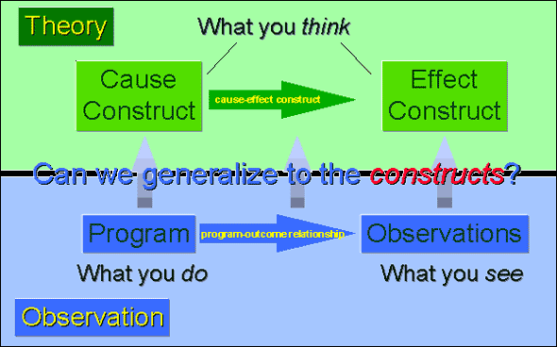
Idea of construct validity

Slide 33
Construct validity threats
Inadequate preoperational explication of constructs
Mono-operation bias
Mono-method bias
Interaction of different treatments
Interaction of testing and treatment
Restricted generalizability across constructs
Confounding constructs and levels of constructs
“Social” threats
Hypothesis guessing
Evaluation apprenhension
Experiment expectancy

Slide 34
Measurement validity types
Translation validity
Face validity
Content validity
Criterion-related validity
Predictive validity
Concurrent validity
Convergent validity
Discriminant validity

Slide 35
Three approaches to assess validity
Nomological network: a theoretical basis
Multitrait-multimethod matrix: to demonstrate both convergent and discriminant validity
Pattern matching

Slide 36
Nomological network

Slide 37
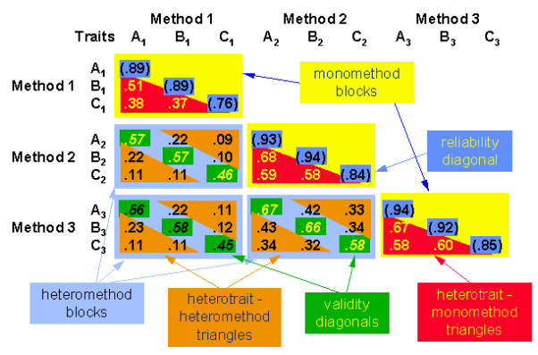
Multitrait-multimethod matrix

Slide 38
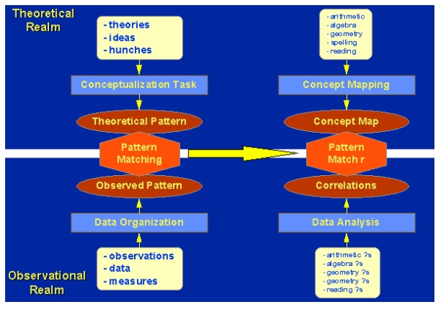
Pattern matching

Slide 39
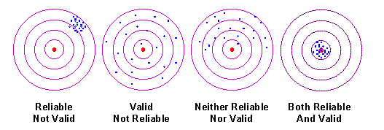
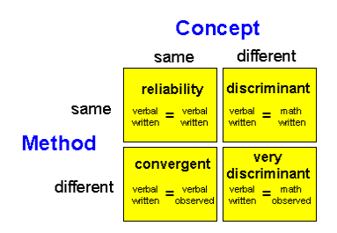
The relationship between reliability and validity

Slide 40
Thank you!

